Slide 1
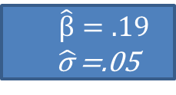
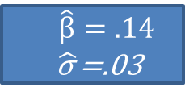
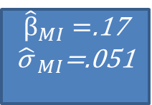
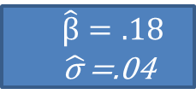
M=3 MI datasets
Regress Age on Weight
Analysis
Age | Weight | Height
24 | 170 | 70
28 | 160 | 68
20 | 155 | 65
⁞ | ⁞ | ⁞
$\hat{β}=.14$
$\hat{\text{σ} }$=.03
Pooled Result
Original data
Age | Weight | Height
24 | ? | 70
28 | 160 | ?
20 | 155 | 65
⁞ | ⁞ | ⁞
Age | Weight | Height
24 | 150 | 70
28 | 160 | 64
20 | 155 | 65
⁞ | ⁞ | ⁞
${\hat{β}}_{MI}=$.17
${\hat{\text{σ} }}_{MI}$=.051
$\hat{β}=.19$
$\hat{\text{σ} }$=.05
Age | Weight | Height
24 | 163 | 70
28 | 160 | 66
20 | 155 | 65
⁞ | ⁞ | ⁞
$\hat{β}=.18$
$\hat{\text{σ} }$=.04

Slide 2
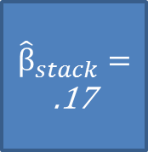
M=3 MI datasets
Age | Weight | Height
24 | 170 | 70
28 | 160 | 68
20 | 155 | 65
⁞ | ⁞ | ⁞
24 | 150 | 70
28 | 160 | 64
20 | 155 | 65
⁞ | ⁞ | ⁞
24 | 163 | 70
28 | 160 | 66
20 | 155 | 65
⁞ | ⁞ | ⁞
Age | Weight | Height
24 | 170 | 70
28 | 160 | 68
20 | 155 | 65
⁞ | ⁞ | ⁞
Regress Age on Weight
Pooled Result
Original data
Age | Weight | Height
24 | 150 | 70
28 | 160 | 64
20 | 155 | 65
⁞ | ⁞ | ⁞
$${\hat{β}}_{stack}=$$
.17
Age | Weight | Height
24 | ? | 70
28 | 160 | ?
20 | 155 | 65
⁞ | ⁞ | ⁞
Age | Weight | Height
24 | 163 | 70
28 | 160 | 66
20 | 155 | 65
⁞ | ⁞ | ⁞

Slide 3
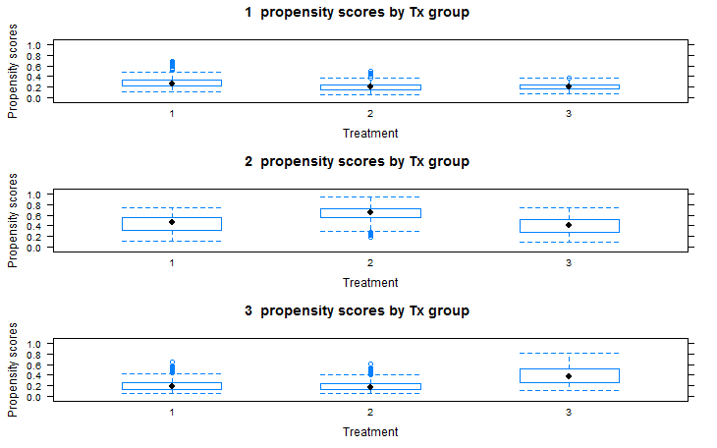
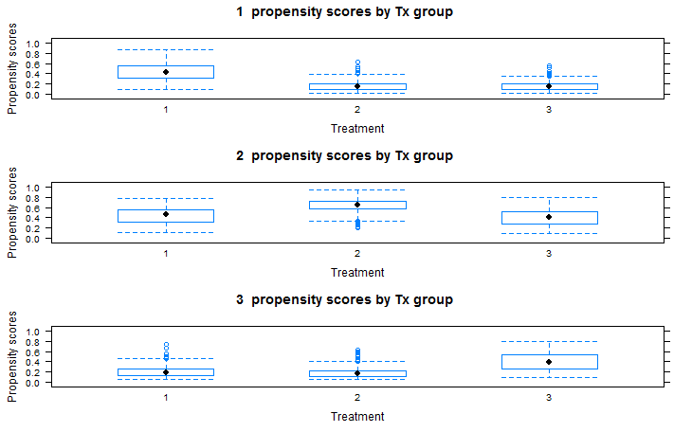

Slide 4
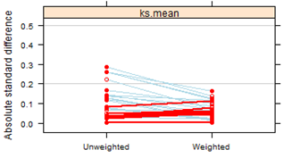
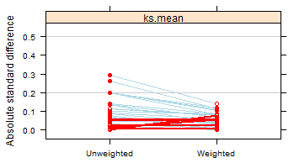
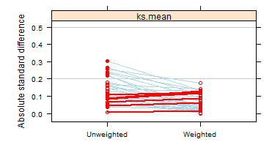
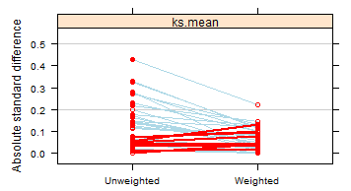
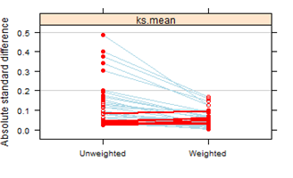
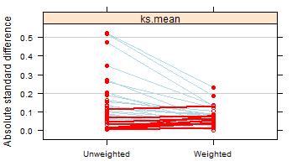
Cape. Vs. Other
Cape. Vs. Other
Cape. Vs. none
Cape. Vs. none
Other Vs. None
Other Vs. None

Slide 5
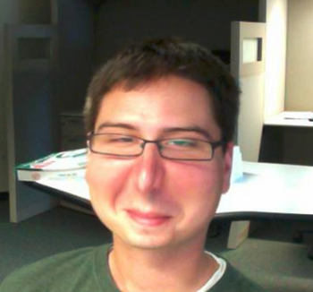


Placebo: Counterfactual (unobserved)
Weight
Drug: Observed
Pretreatment
Post treatment

Slide 6
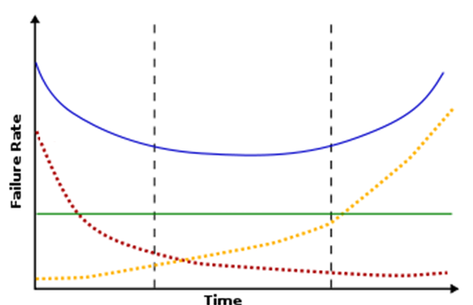
Bathtub
Hazard
Early
Late
Constant
Time

Slide 7
