Slide 1
Mercedes Warranty V1
25.09.2019

Slide 2
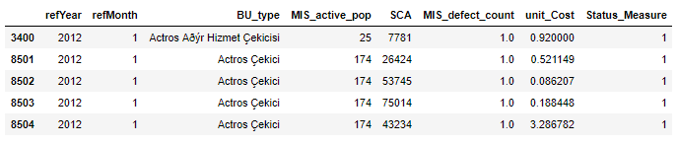
Dataset
Total number of Status_Measure = 5
1: Stable, 2: Issue_New, 3: Issue_Decerase, 4:Issue_Stable, 5: Issue_Increase
Total number of data : ~ 33.000

Slide 3
Properties of Features
refYear : 2012, 2013, 2014, 2015, 2016, 2017
refMonth : 1, 2, 3, 4, 5, 6, 7, 8, 9, 10, 11, 12
Bu_Type : Vehicle type (Actros Ağır Hizmet Çekicisi (actros heavy service attractive), Actros Çekici (Actros attractive), Atego/LKT, Axor TE vs.) (total nine type available)
SCA : Vehicle Part Code Number
MIS_active_pop : Number of vehicles in the period
MIS_defect_count : the number of vehicles that go to warranty within the period
unit_Cost : MIS_active_pop / Warranty_Cost Status_Measure : Status (Issue_Decerase, Issue_Increase, Issue_New, Issue_Stable, Stable)

Slide 4
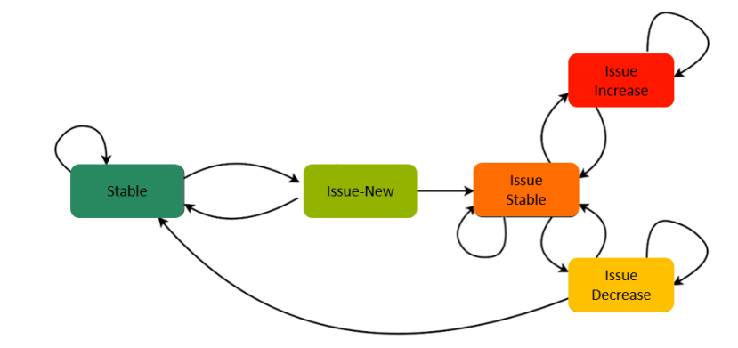
Determination of Data Case

Slide 5
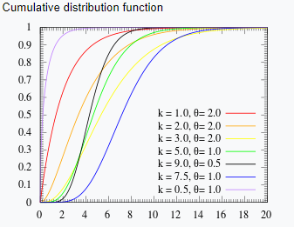
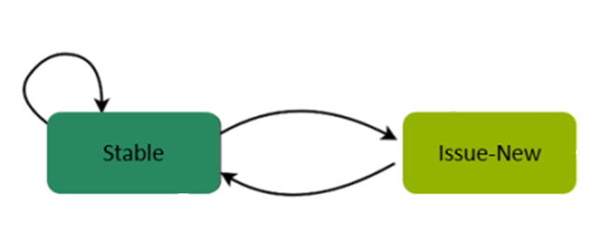
Gamma Distribution
Thresold : 0.03

Slide 6
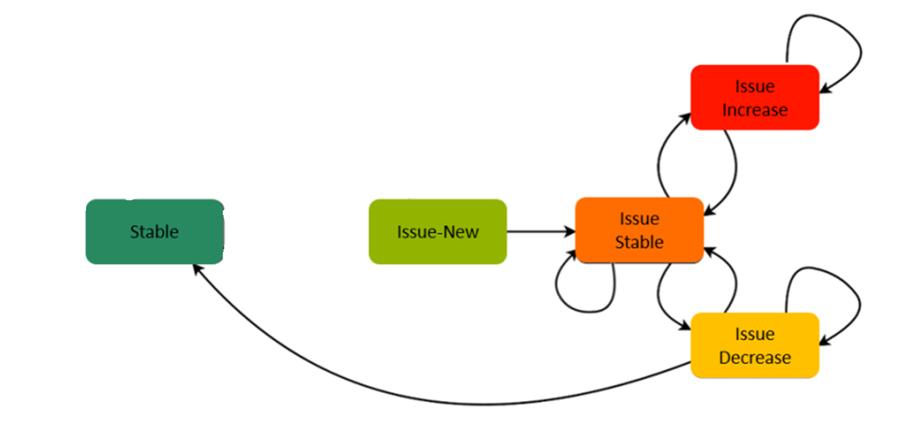
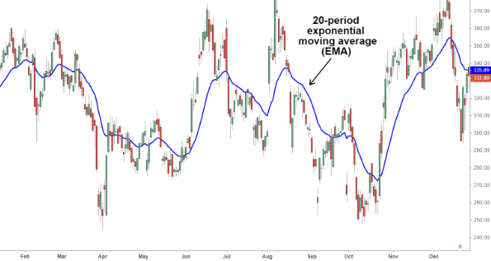
Moving Average Methods
Thresold : 0.02

Slide 7
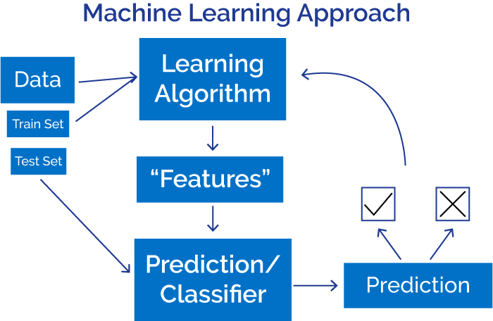
https://www.xenonstack.com/blog/data-science/overview-of-artificial-intelligence-and-role-of-natural-language-processing-in-big-data

Slide 8
Classification
Stable and Issue_New Features are used
The total number of data for classification : ~ 23.000
Stable : ~ 15.000 and Issue_New: ~ 7.000

Slide 9
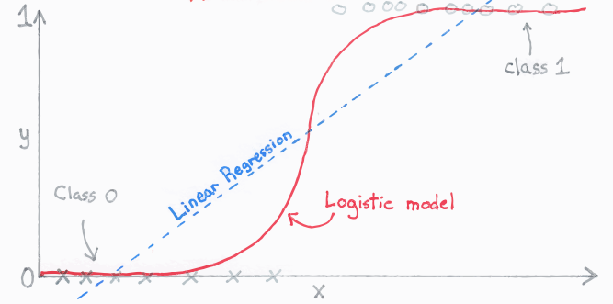
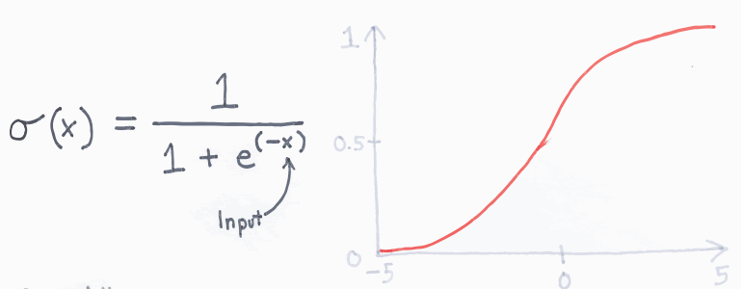
Logistic Regression

Slide 10
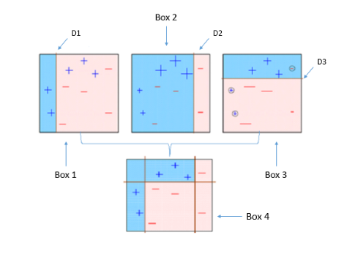
XGBOOST
https://www.xenonstack.com/blog/data-science/overview-of-artificial-intelligence-and-role-of-natural-language-processing-in-big-data

Slide 11
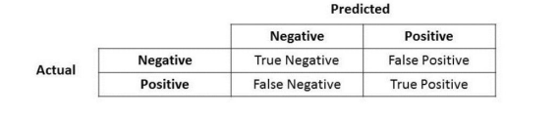
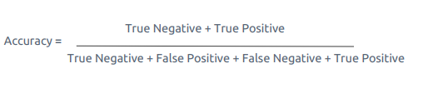
Evaluation

Slide 12
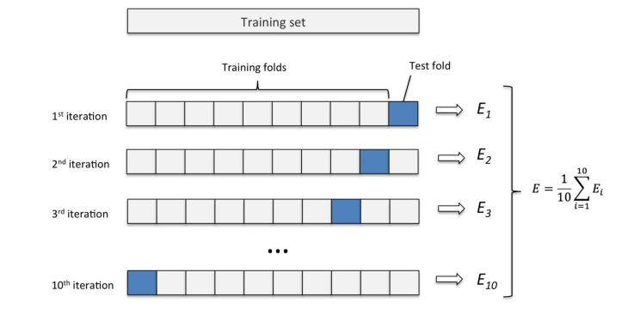
Cross Validation

Slide 13
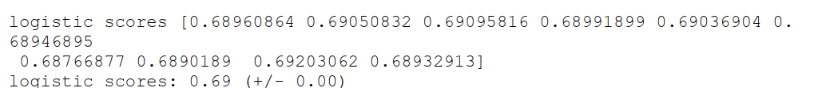
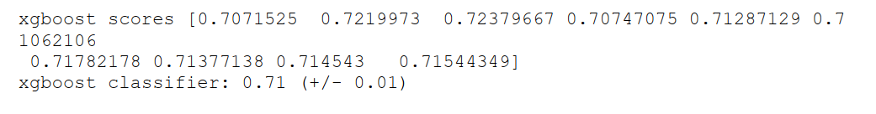
Result

