Slide 1

CS668A: Practical Cyber Security for Cyber Practitioners
Software in loop Testing
:
A Review of Open-Source Cyber Threat Detection Tools
Presented By:
Team Name: Hawkeye
Team members : Rohit Negi and Nitesh Kumar

Slide 2
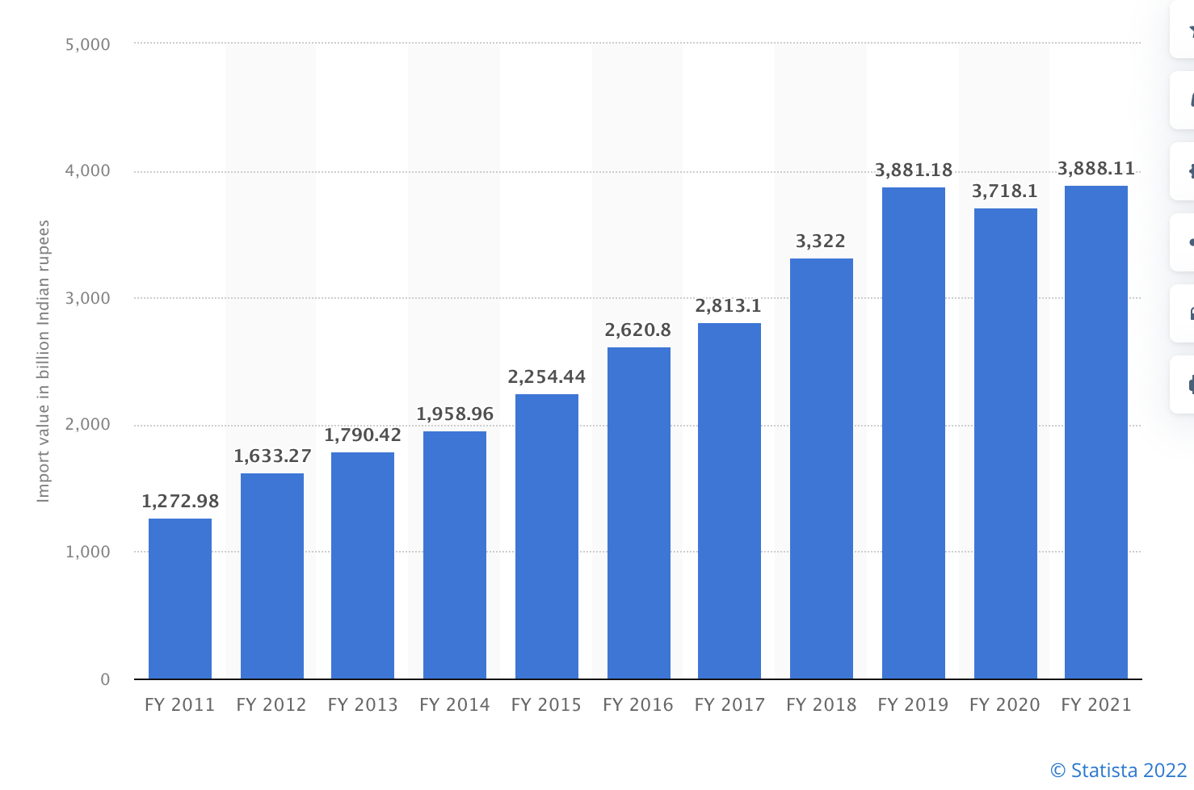
Value of electronic product imported into India from financial year 2011 to 2019, with estimates until 2021
INR
3.8K
Billion

Slide 3


















Slide 4


Slide 5


Slide 6
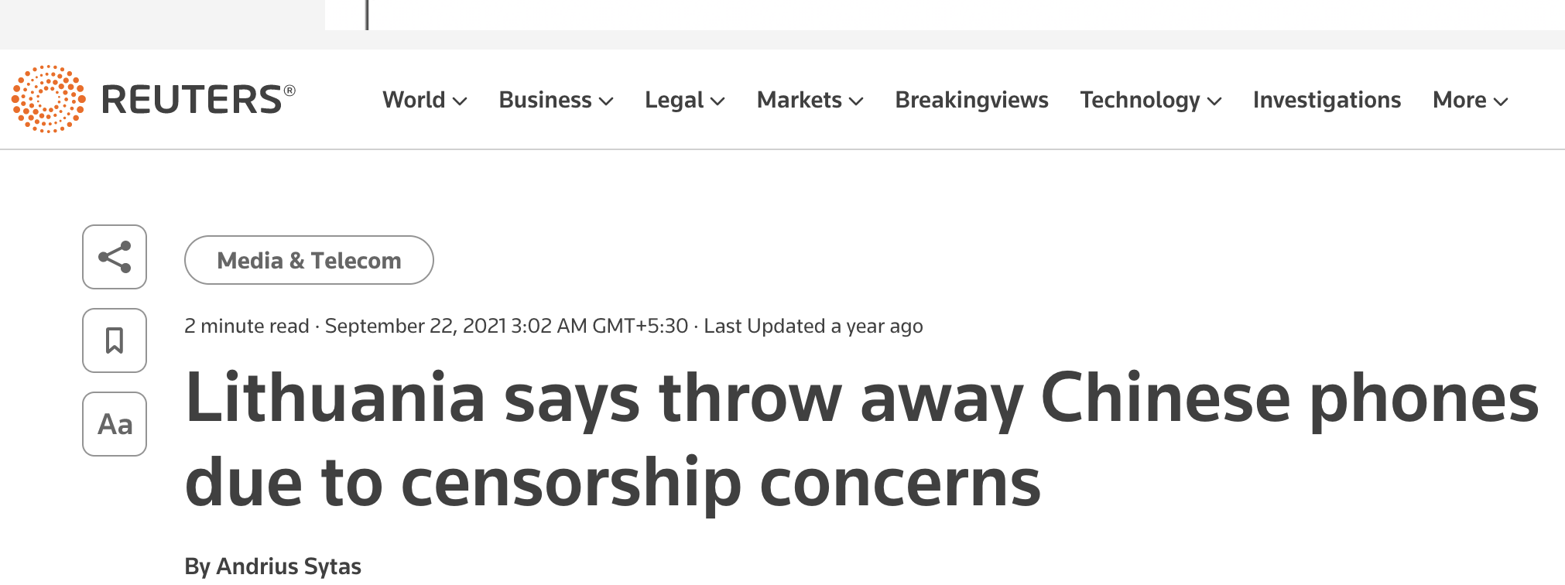

Slide 7

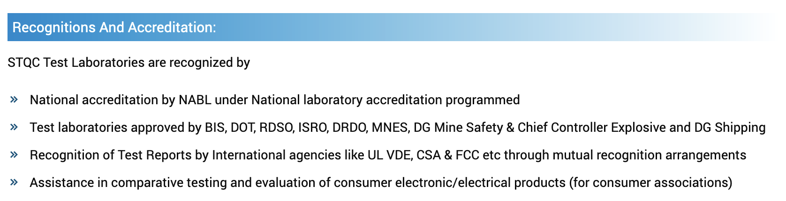
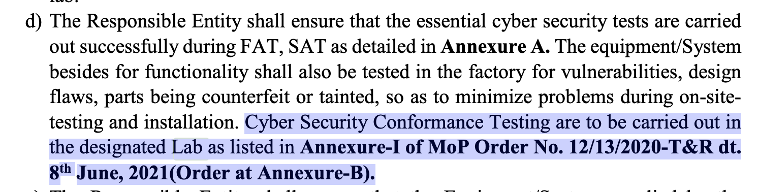
Problem Statement:
Software in loop Testing

Slide 8
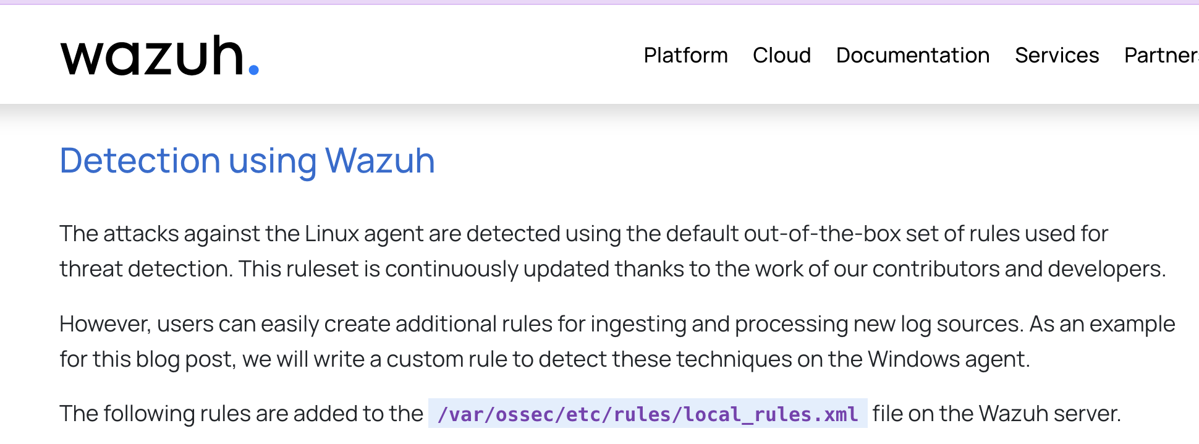
Solutions available
Ref:- https://wazuh.com/blog/adversary-emulation-with-caldera-and-wazuh/

Slide 9



Narrative
Internet
Security Device
Security Device
Network Device
Network Device

Slide 10
DEMO

Slide 11
Major Logs understanding
/var/log/syslog | Stores all global system activity data, including startup messages | External Remote Services
/var/log/auth.log | Security-related events such as user logins, root user activity and PAM output | Valid Accounts: Default Accounts
/var/log/kern.log | Contains errors, events and warning logs | Create or Modify System Process
/var/log/cron | Scheduled tasks (optimal for identifying persistence) | Scheduled Task
/var/log/faillog | Failed logon attempts | Brute Force Password Guessing
/var/log/wtmp | Contains all login and logout events | Valid Accounts: Default Accounts for initial access
/var/log/audit/audit.log | System logs designed to record security events for incident investigation | Systemd Service: Create or Modify System Process

Slide 12
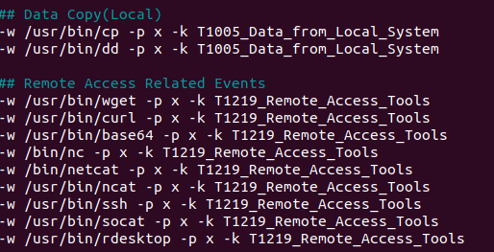
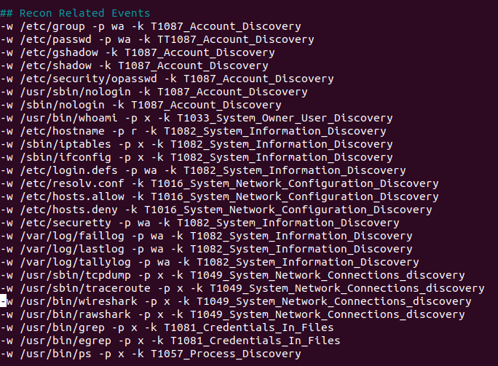


Rules to map with mitre

Slide 13
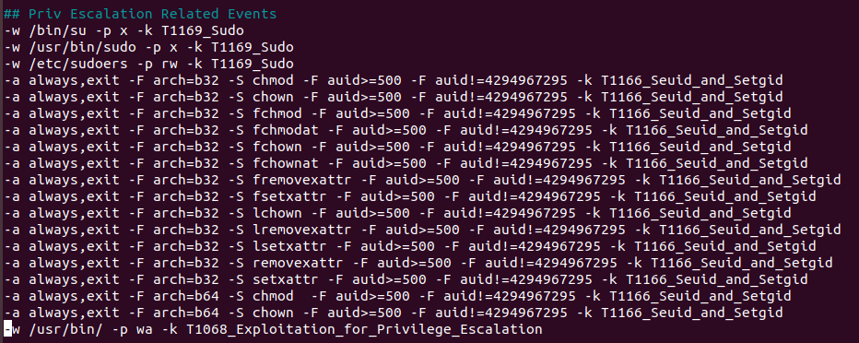
Rules to map with mitre

Slide 14
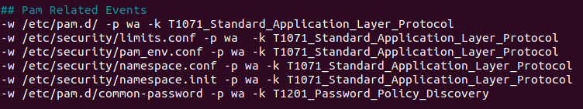
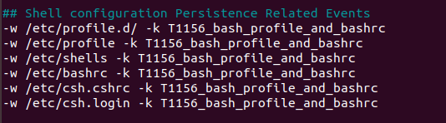
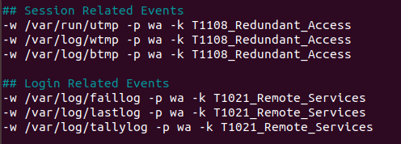
Rules to map with mitre

Slide 15
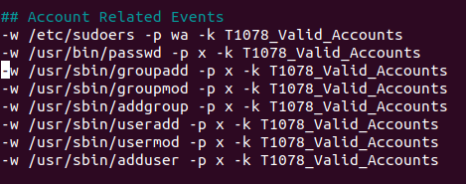
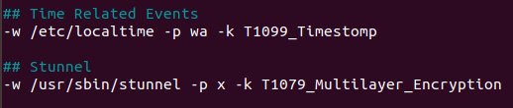

Rules to map with mitre

Slide 16
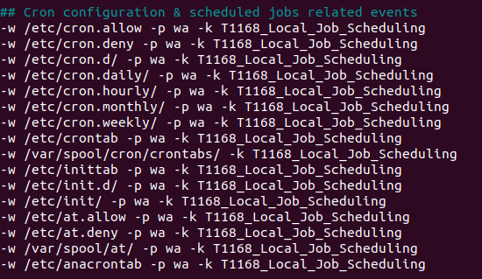
Rules to map with mitre

Slide 17
Observations
To check for the persistence of any malware at startup
Init.d directory
Rc.local
Systemd directory
Mapping attacks based on the cyber kill chain
Login session by remote user (may be attacker)
Malicious documents download from external source and execute a malware

Slide 18
Future Scope
Map more Mitre Att&CK TTP to the existing tools like auditd, sysmon
Enhance the mapping of attack based on the cyber kill chain
In future also add the mitigation against the attacks mapped for better understanding of SOC analyst.
Explore more platform like Windows and Android

Slide 19
References
https://stackify.com/linux-logs/
https://chronicle.security/blog/posts/your-security-operations-cheat-sheet-for-windows-and-linux-logs-and-how-to-tie-them-to-the-mitre-attck-framework/
https://sematext.com/blog/auditd-logs-auditbeat-elasticsearch-logsene/
https://documentation.wazuh.com/current/installation-guide/wazuh-agent/wazuh-agent-package-linux.html
https://documentation.wazuh.com/current/user-manual/ruleset/mitre.html
https://izyknows.medium.com/linux-auditd-for-threat-detection-d06c8b941505
https://github.com/bfuzzy/auditd-attack

Slide 20
Thank you

