Slide 1
Team 1
Final presentation

Slide 2
Project overview & background
Mastermind Game
Lab Mastermind
Goal of this final project: UI & UX with JavaFX
Team Member
Lily Parker - Product Owner
Minh Anh Phan - Scrum Master
Anurag Vaidya - Developer
Cuong Nguyen - Developer
Notes:
If possible, establish a motivation for your problem domain.

Slide 3
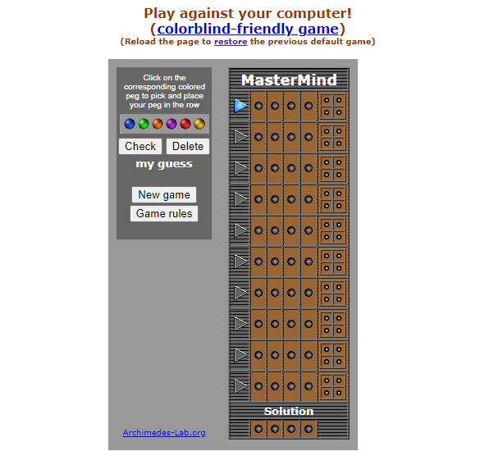
An online version of Mastermind

Slide 4
Design & implementation
1
CRC, UML, user stories

Slide 5
Some critical user stories
As a user, I want to …
Start the game and see the board
Submit and be able to see the feedback of my guess
Determine if I have won or lost
Be able to restart the game
Have visually and audibly pleasing experience
Winning and losing messages
Button click sounds
Themes

Slide 6
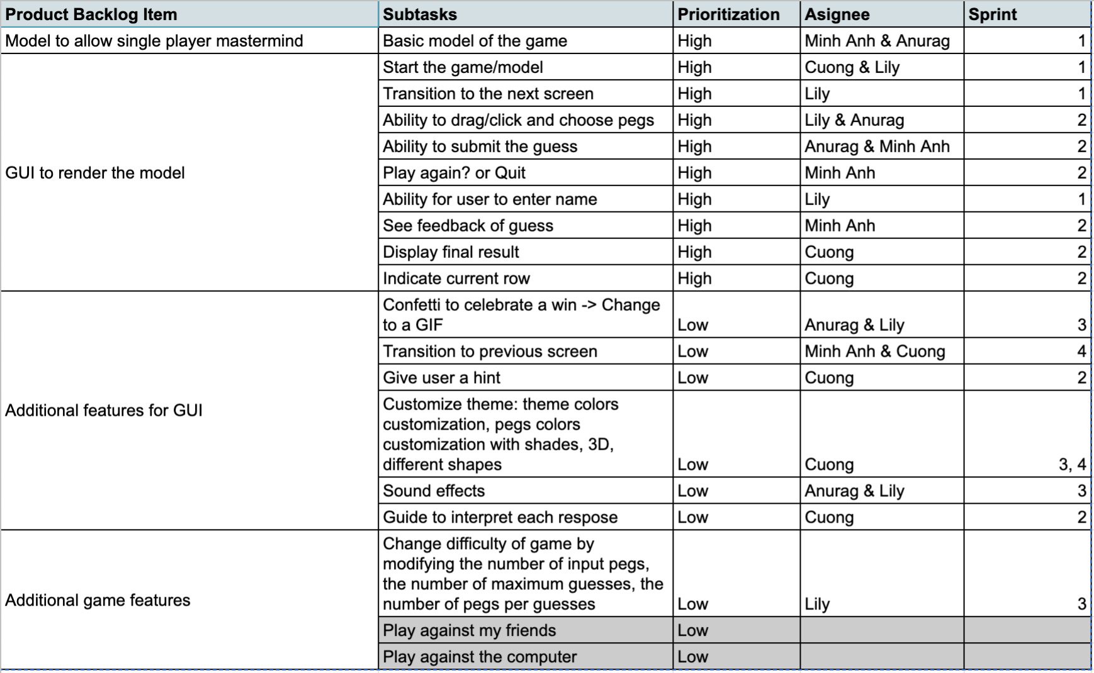
Product backlog

Slide 7
Some important design choices
We implemented the Code and Response as PegSequence (ArrayList of Pegs)
Peg is implemented as an enum
Each Peg has a color and number value associated
Utilized the MVC design pattern extensively
Extensive measures taken to not let user break the code!

Slide 8
Some important design choices
We chose to use CSS sheets to decouple GUI logic and design styles (colors, fonts, etc)
Allowed us to create multiple themes without duplicating code
Multiple controllers and view classes for different screens
Decrease coupling and increase cohesion between different classes

Slide 9
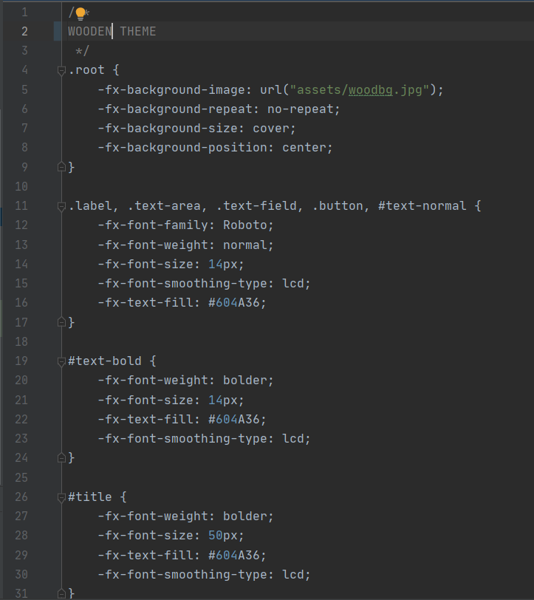
CSS sheets allowed us to reuse code while creating themes

Slide 10
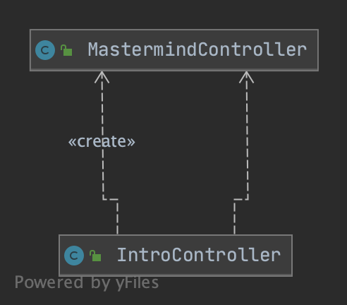
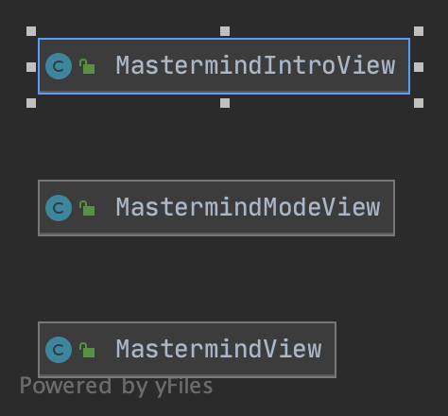
Minimize Coupling and maximize cohesion

Slide 11
User interface
2
Figma, sounds, confetti
Notes:
Screenshots of figma

Slide 12
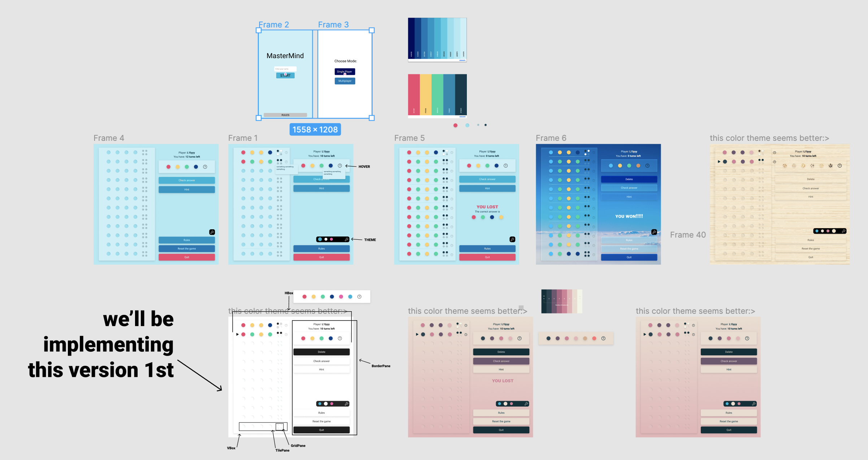
Notes:
Lily -
Adding name in
Sound first
EasyMind (click)
Medium Mind (10 guesses and 5 peg)
MasterMind ( 8 guesses and 6 peg)
CustomMode (click into)
Rules
Line indicator
Question mark by pegs
Peg choice
Check answer and results
Hint
Delete
Edge cases
Explain peg choice (click)

Slide 13
Git & Scrum
3
Sprint planning, Git, burndown charts

Slide 14
Sprint process
Sprint 1
sprint 2
sprint 3
sprint 4
Wireframe version, GUI board created with no logic, initial design implementation
Basic gameplay with all buttons working
Add features: sounds, feedback texts, themes, difficulty modes, GIF for win/ lose
Refine the features, refactor, continue adding features

Slide 15
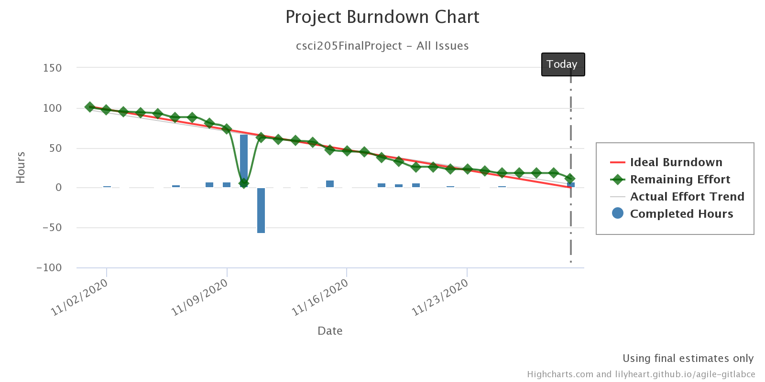
Scrum Process
Strengths
Individual’s work
Team help
Time estimate
Successes
Tasks finished ~100%
User interviews
Challenges
Time difference
Burndown chart
Keep track of the issues & subtasks
Git
Help with the process
Merge hell?

Slide 16
Final thoughts
What we learned
Teamwork
Dividing tasks based on the members’ strengths and weaknesses
Divide into small work
What would change
Project in-person
See other teams’ work
Next version
Networking
User feedbacks
Drag the pegs
Notes:
Teamwork (communication between members, working with time zone difference)
Divide into small work (time estimation, frequently divide small tasks to members rather than divide big tasks and set the deadline too far away?)
Project in-person and see other teams’ work (remote learning is undoubtedly a difficulty, but we felt like we should still reach out and see our other classmates’ works during those last few weeks, so that we can learn, if anything, from them and then improve our project
Networking (against other players and against bot)
User feedbacks ()

Slide 17
thank you!

