Slide 1
Investigation of Nfe2l1 in muscle metabolism using mouse multi-omics data in gastrocnemius and soleus
Nick Diercksen, supervised by Phong Nguyen
November 2, 2022

Slide 2
Agenda
Aim of the project
Data
Workflow of the project
Preliminary analysis

Slide 3
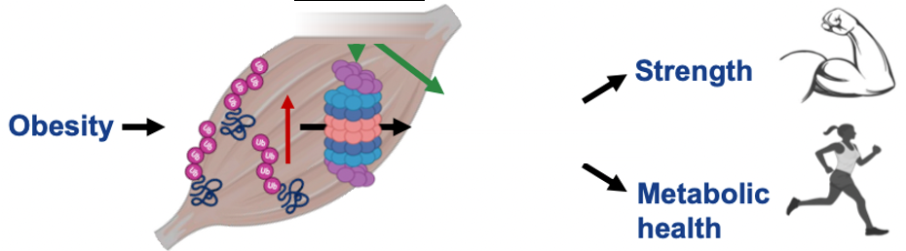
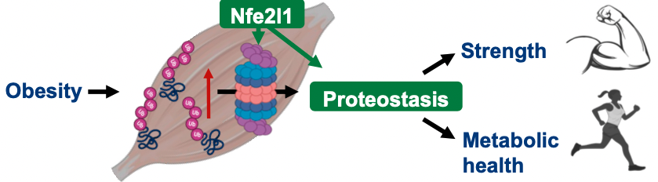
Aim of the project
Exercise /
Scientific questions:
general role of Nfe2l1 in muscles
possible metabolic induced changes reflected in multi-omics data
possible inferences to slow- and fast-twitch muscle development
Credit: Imke Lemmer
Nfe2l1:
transcription factor (gene switch)
and regulator of the UPS
functions varies on tissue types (heart, liver, BAT)
whole body knockout is lethal
Notes:
UPS: ubiquitin-proteasome system
nuclear-factor erythroid-2, like-1
Understand different types of muscle adaptation
Nfe2l1 in different tissues has different roles
heat regulation
binds cholesterol in liver
helps recover heart tissue (afert surgery)

Slide 4
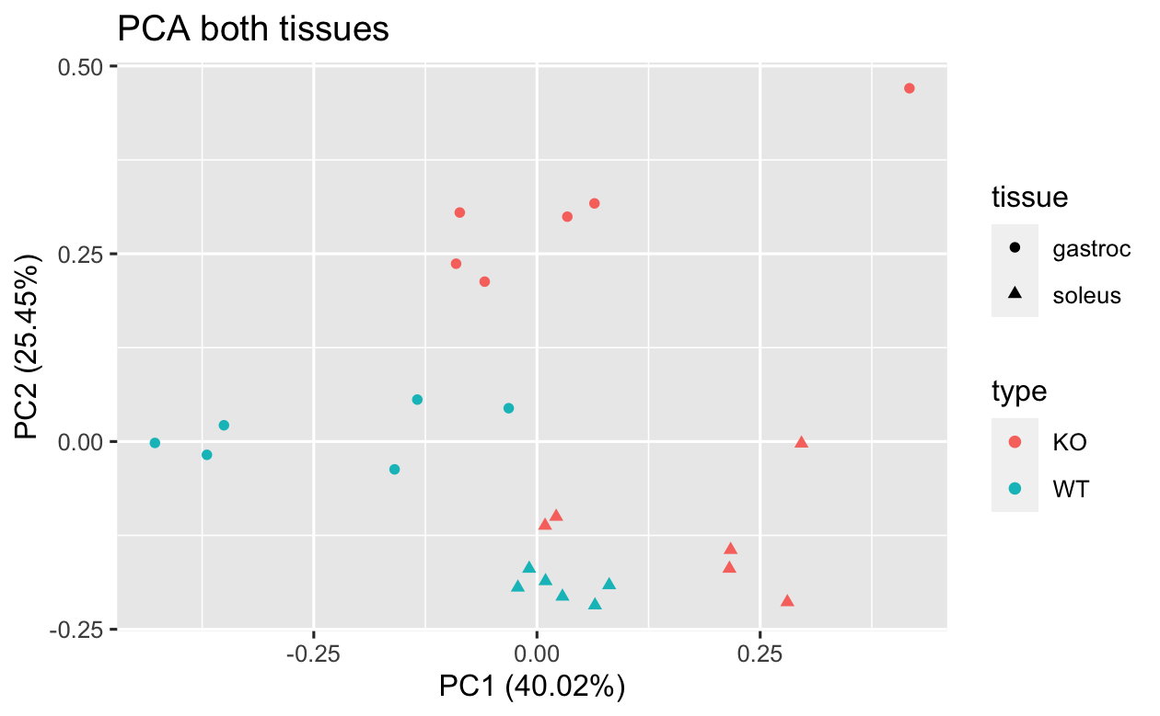
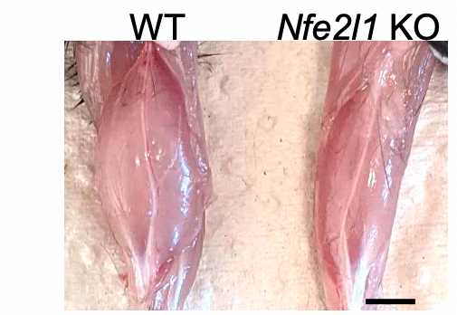
Data
Experimental Design
tissue specific knockout
(Cre-Lox recombination)
Levels of mRNA from gastrocnemius muscle from wild-type (WT) and skeletal muscle (Acta1-Cre) Nfe2l1 knock-out (KO) mice.
Credit: Imke Lemmer
cohort: 12 mice (f.)
RNAseq
Raw data
read counts
all genes (~50,000) were analyzed
Further analysis (separate cohorts):
Proteome hits (3 WT, 3 KO)
Metabolomics (6 WT, 6 KO)
Ubiquitomics (3 WT, 3 KO)
6 WT
6 KO
(m.)
Notes:
Each single omics data is from a different cohort
every cohort was male except RNASeq

Slide 5
Workflow of the project
Differential Expression Analysis
Gene Set Enrichment Analysis
Multi-omics Analysis
R Shiny app for diff. gene expr. Analysis “on the fly” [optional]
with custom selectable DB
Notes:
Some analysis already done
Incorporate other datatypes in the future

Slide 6
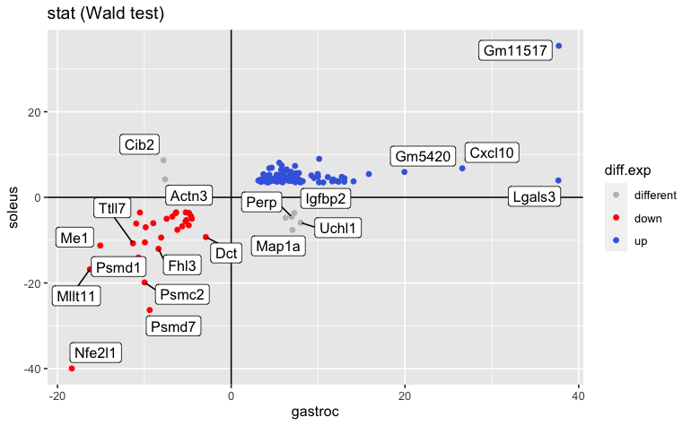
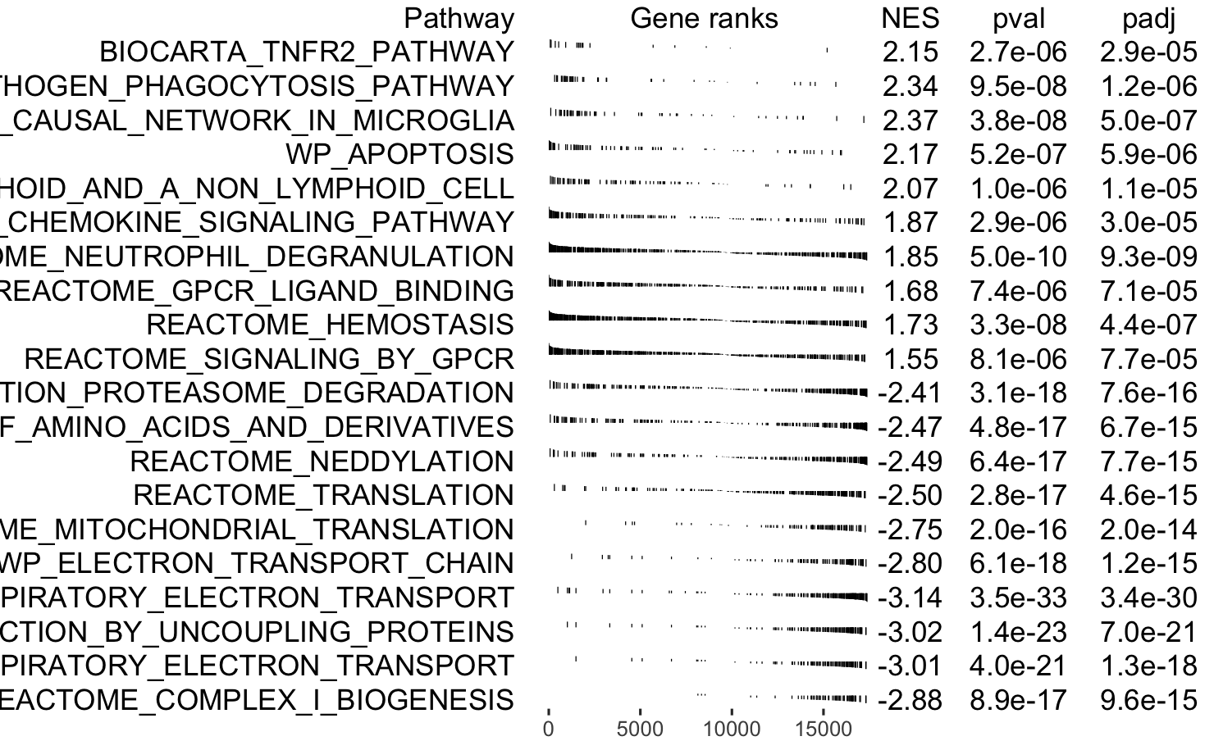
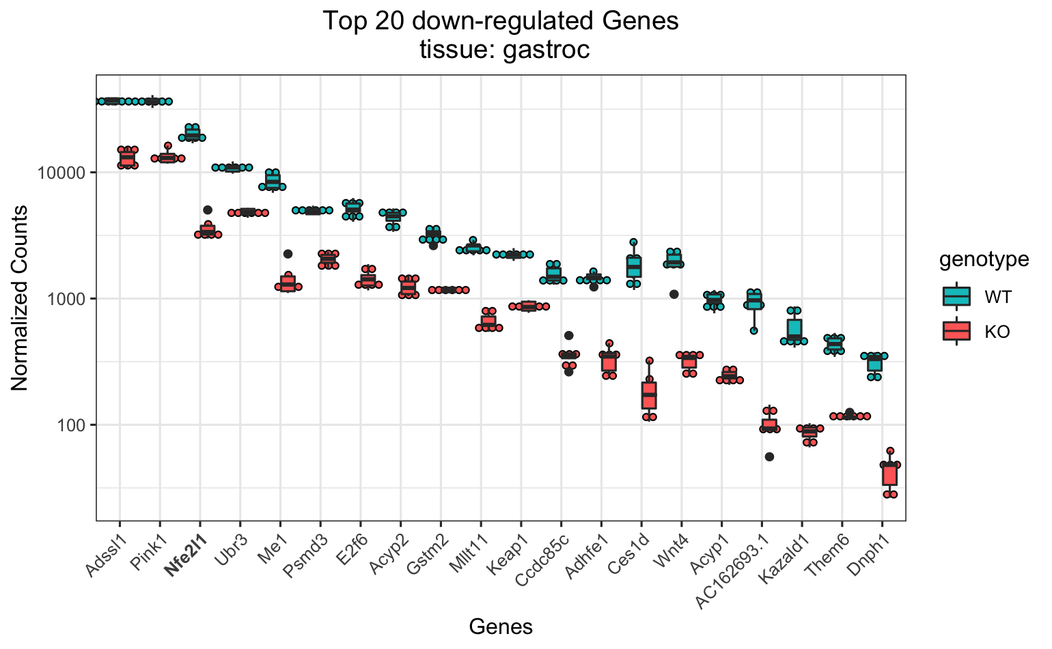
Preliminary analysis
(canonical pathways)
Notes:
Each single omics data is from a different cohort
every cohort was male except RNASeq

Slide 7
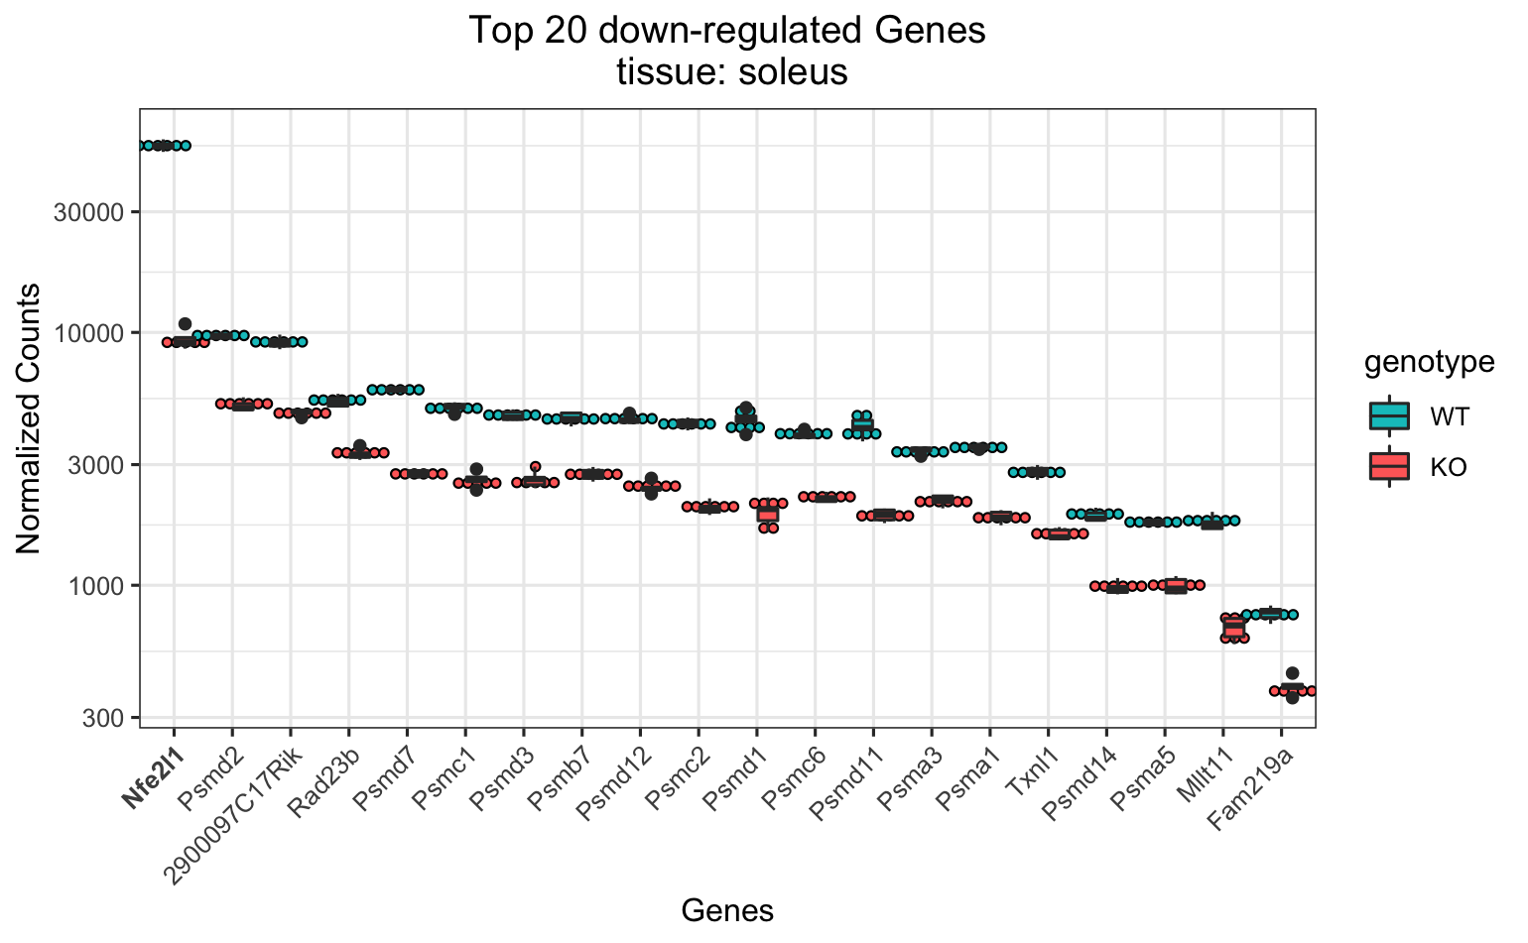
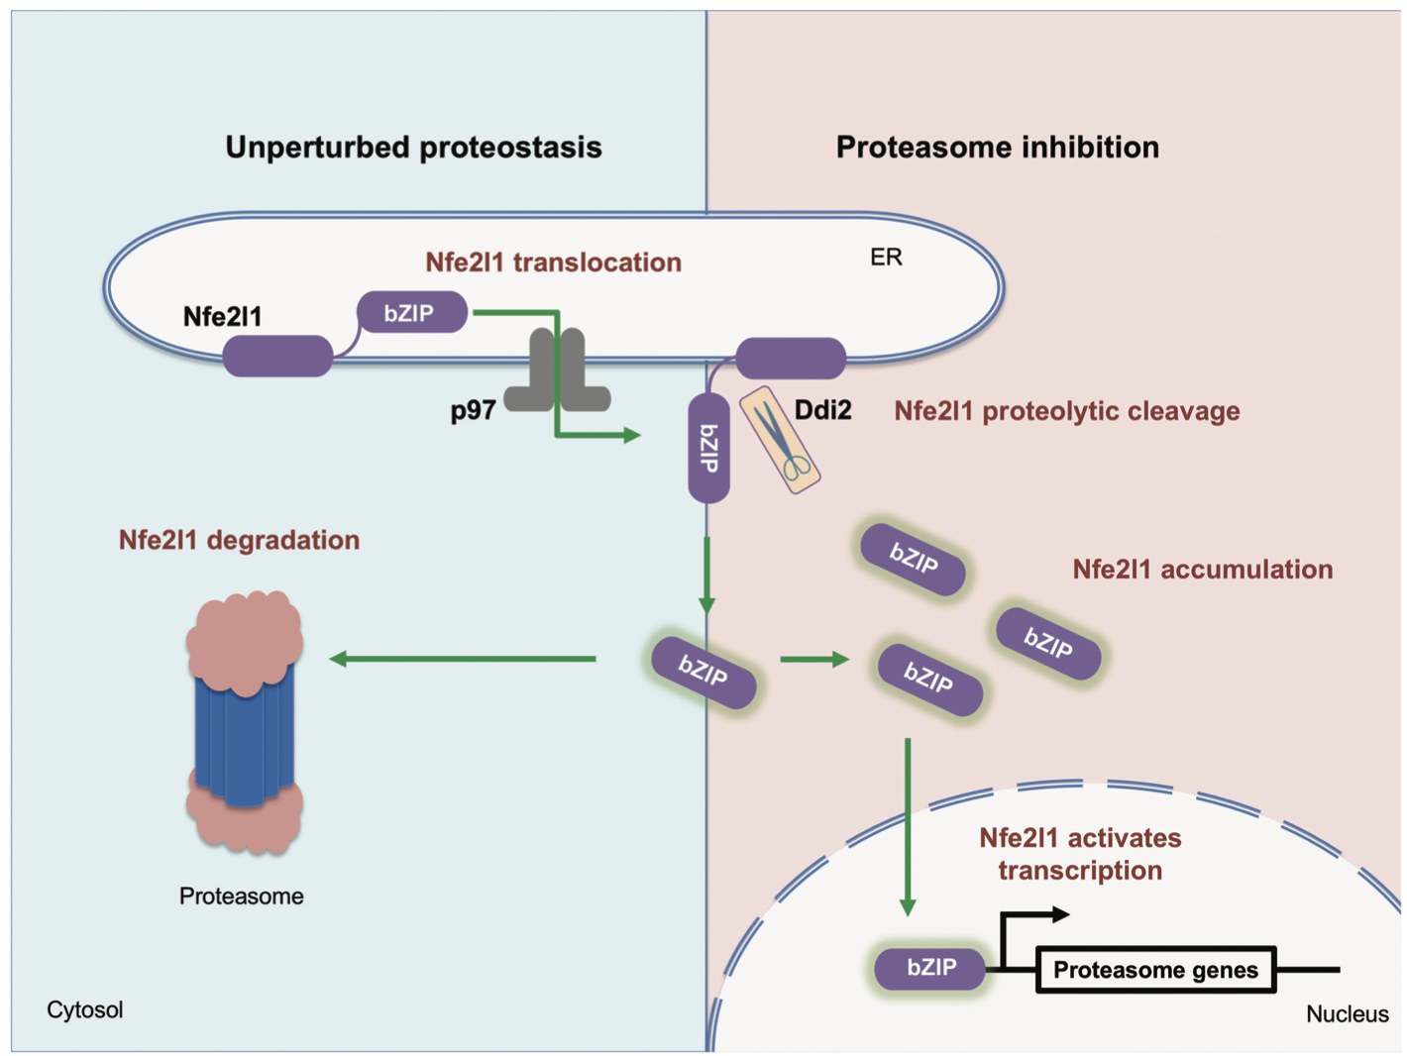
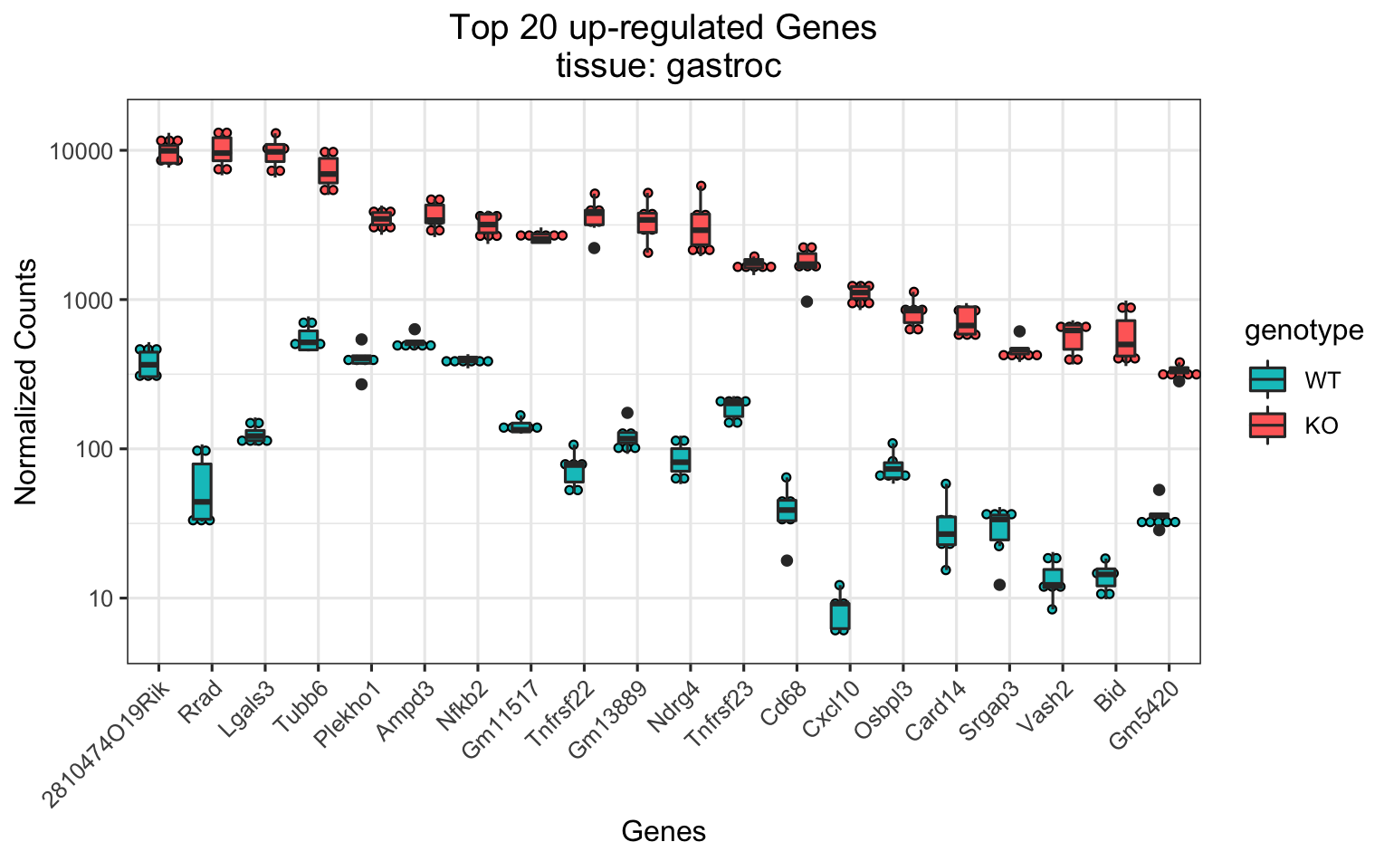
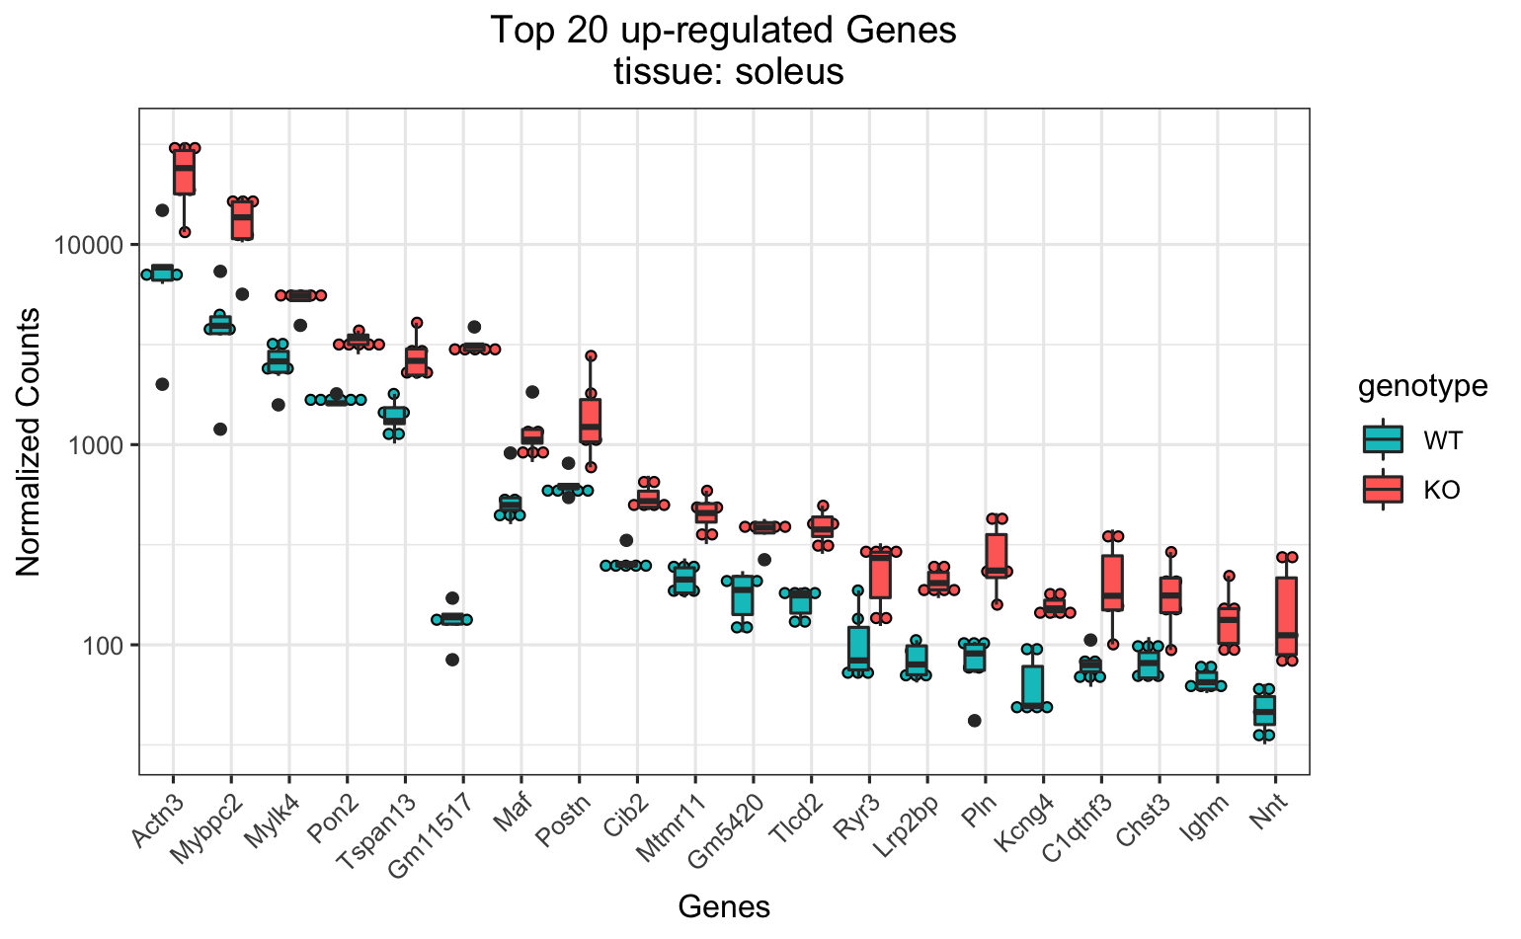
appendix
Notes:
Each single omics data is from a different cohort
every cohort was male except RNASeq

