Slide 1
Proteofit – RNAseq Bachelor thesis project outline
Nick Diercksen, supervised by Phong Nguyen
November 2, 2022

Slide 2
Agenda
About Proteofit
Data
Preliminary analysis
Outline
Notes:
already

Slide 3

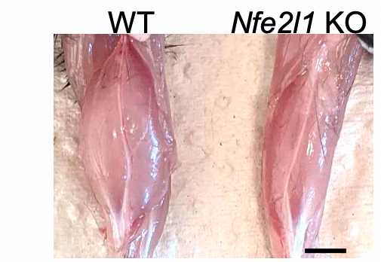
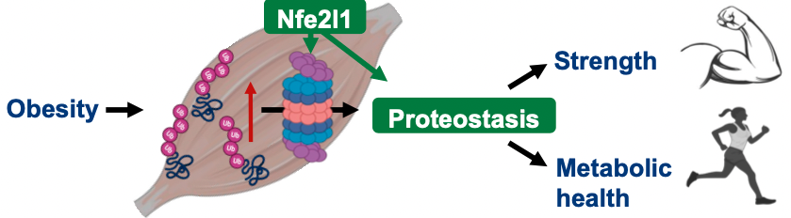
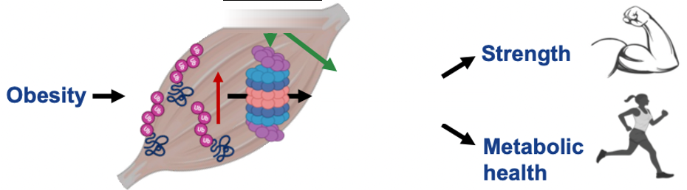
Nfe2l1:
transcription factor (gene switch)
and regulator of the UPS
functions varies on tissue types (heart, liver, BAT)
whole body knockout is lethal
About
Bartelt Lab
Proteofit:
“ECR project to investigate the role of Nfe2l1 in muscle specific adaptation to exercise and obesity.”
⇒ understand molecular processes of the muscle cell
⇒ find novel mechanisms of protein homeostasis
tissue specific knockout
(Cre-Lox recombination)
Levels of mRNA from gastrocnemius muscle from wild-type (WT) and skeletal muscle (Acta1-Cre) Nfe2l1 knock-out (KO) mice.
Exercise /
points of interest:
general role of Nfe2l1 in muscles
possible metabolic induced changes
possible inferences to slow- and fast-twitch muscle development
Credit: Imke Lemmer
Notes:
UPS: ubiquitin-proteasome system
nuclear-factor erythroid-2, like-1
Understand different types of muscle adaptation
Nfe2l1 in different tissues has different roles
heat regulation
binds cholesterol in liver
helps recover heart tissue (afert surgery)

Slide 4
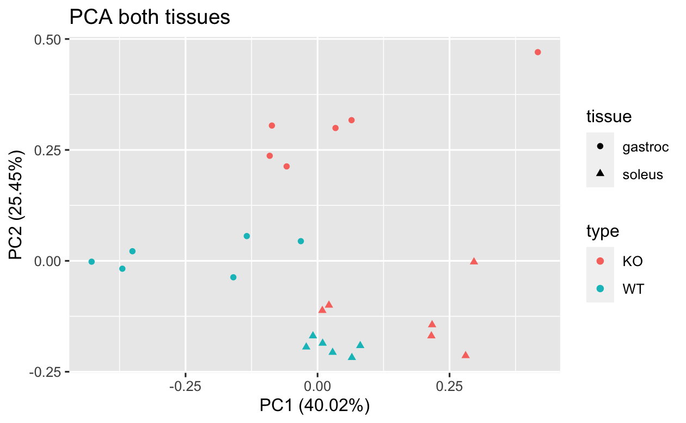
Available data
cohort: 12 mice (f.)
RNAseq
read counts
raw data
all genes (~50,000) were analyzed
6 WT
6 KO
For later QC (separate cohorts):
Proteome hits (3 WT, 3 KO)
Metabolomics (6 WT, 6 KO)
Ubiquitomics (3 WT, 3 KO)
(m.)
Notes:
Each single omics data is from a different cohort
every cohort was male except RNASeq

Slide 5
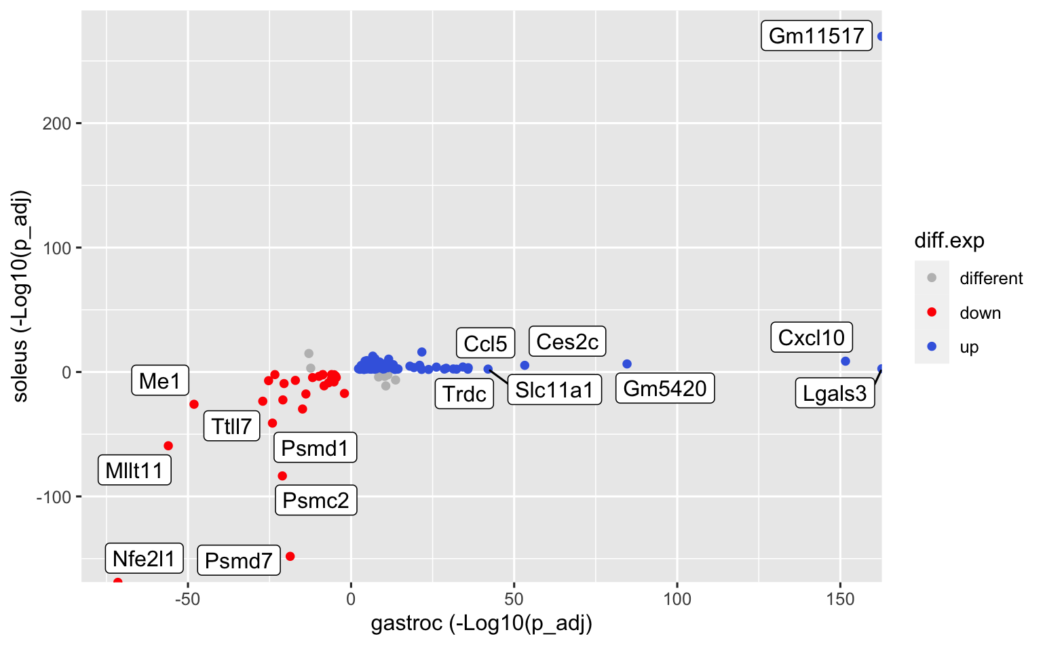
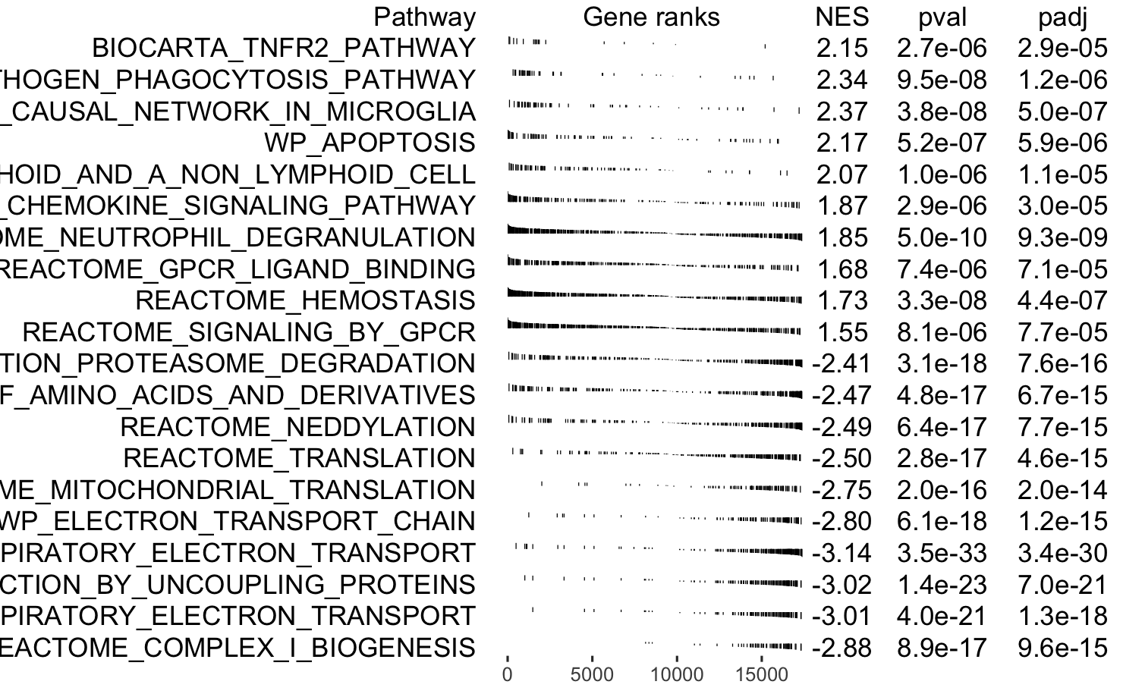
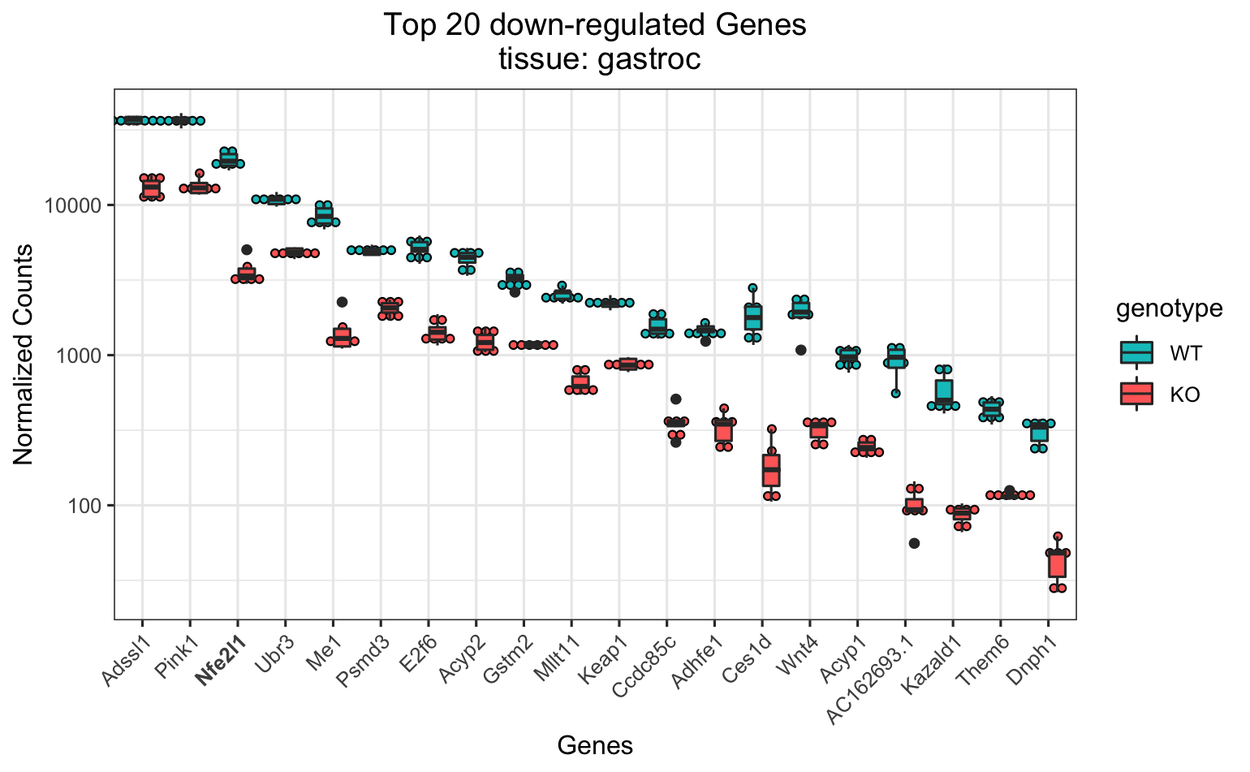
Preliminary analysis
(canonical pathways)
Notes:
Each single omics data is from a different cohort
every cohort was male except RNASeq

Slide 6
Outline
Processing pipeline with GSEA
GO Analysis / KEGG Analysis
top regulated genes
Producing R markdown report for analysis
R Shiny app for diff. gene expr. Analysis “on the fly”
with custom selectable DB
Notes:
Some analysis already done
Incorporate other datatypes in the future

Slide 7
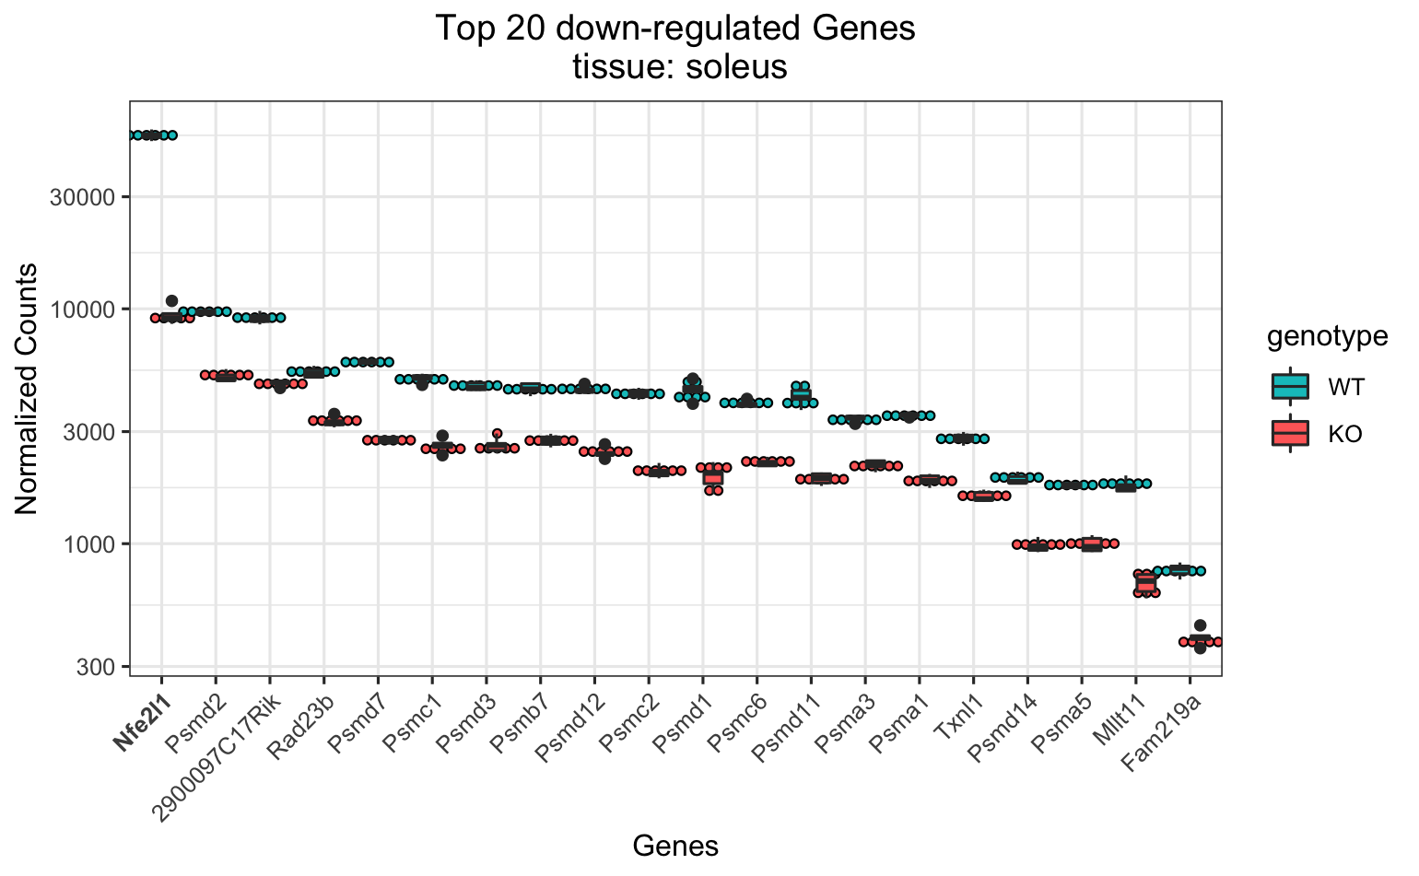
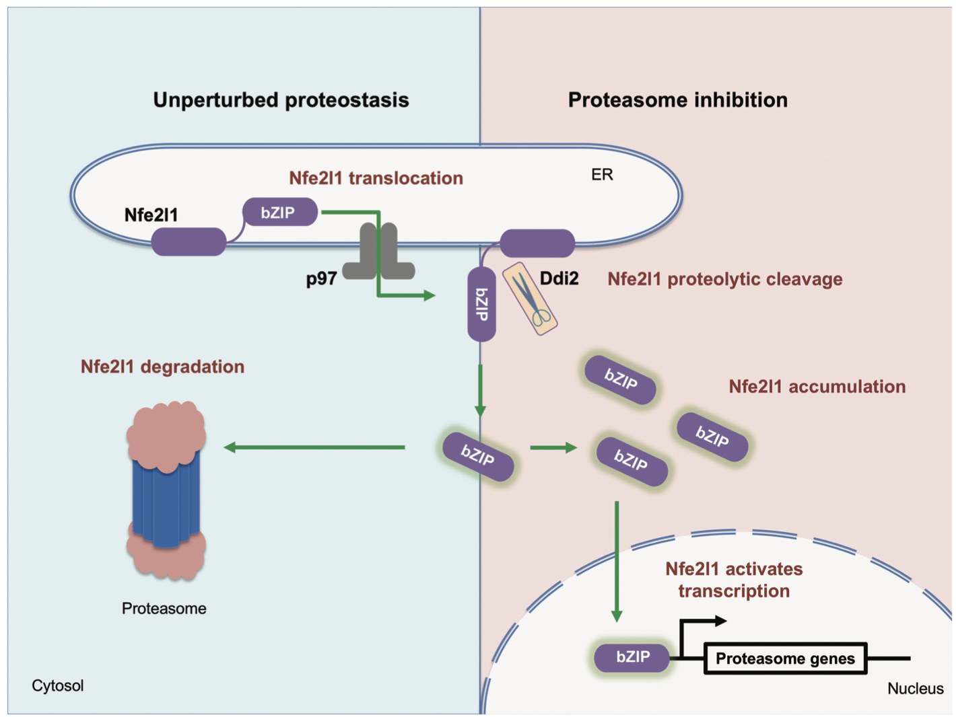
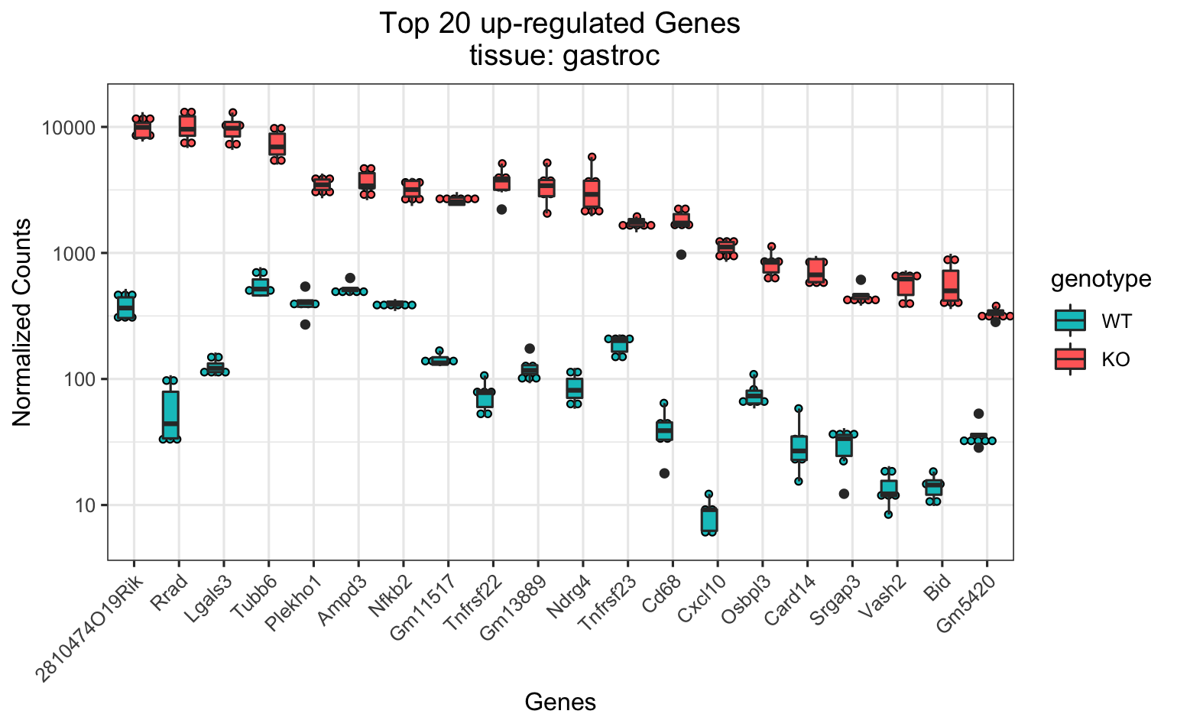
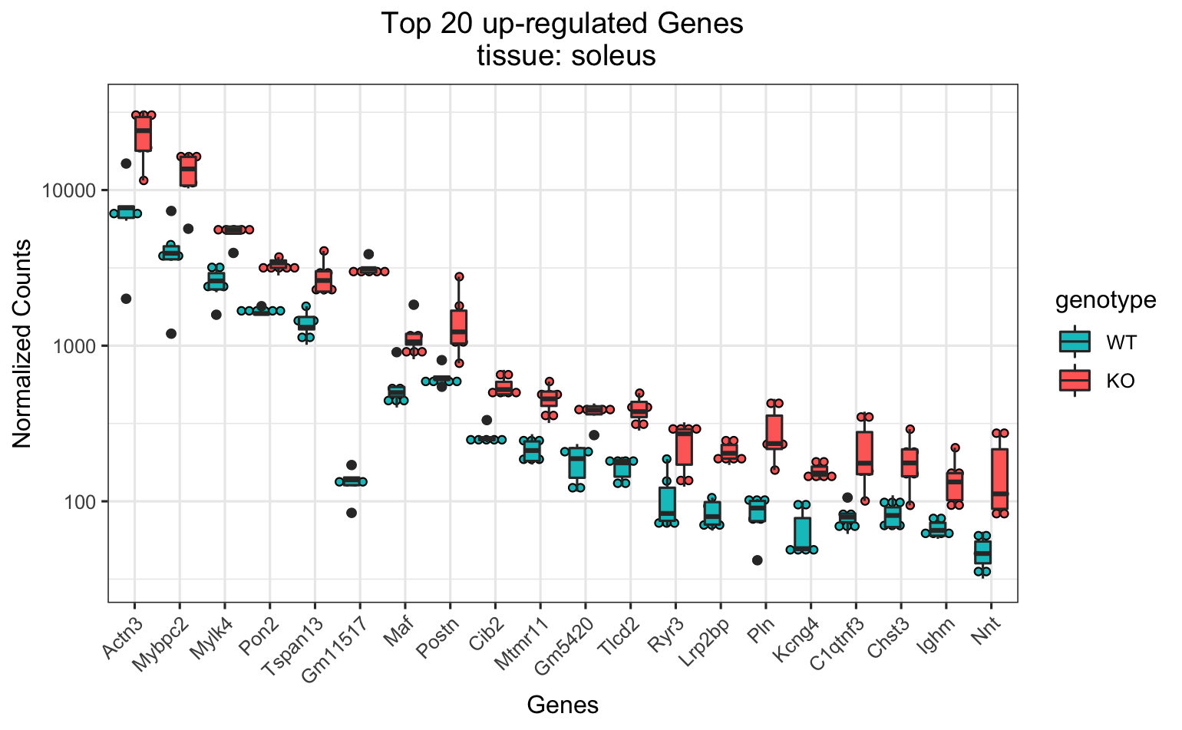
appendix
Notes:
Each single omics data is from a different cohort
every cohort was male except RNASeq

