Slide 1
An Introduction to COS Data Analysis
Nat Kerman
Thursday – March 10, 2022
Notes:
Introduction
Hi all! In case we have anyone who doesn't yet know me, my name's Nat Kerman, I'm a ISSB hire matrixed to the COS.
I'm glad to be kicking off the first of these presentations on "how to use an instrument's data" - and I hope that these miight be useful to at least someone in the audience who has to start worjking with COS data now, or in the future. (make sure recorded)

Slide 2
COS Meeting Code-of-Conduct
ATTENDEES
Raise hand before speaking unless in active discussion
Be present in the meetings by actively listening
Ask questions as everyone will benefit from more clarity
Allow the presenter time to deliver their content
PRESENTERS
Always acknowledge the work and ideas of others
Assign a co-host/meeting facilitator to help moderate
Ensure sufficient time and opportunity for questions
Provide time and opportunity for discussion
ALL
Do not interrupt when someone is speaking
Be mindful & give everyone a chance to contribute
Be constructive and kind with your feedback
If you don’t feel comfortable with the meeting dynamic, provide feedback (during or afterwards in private)
Notes:
on the cos team, we recently implemented a meeting code of conduct and I wanted to practice good meeting etiquette and displayed here
I’ll ask the meeting moderator if they can keep an eye on the chat for queastions, etc.

Slide 3
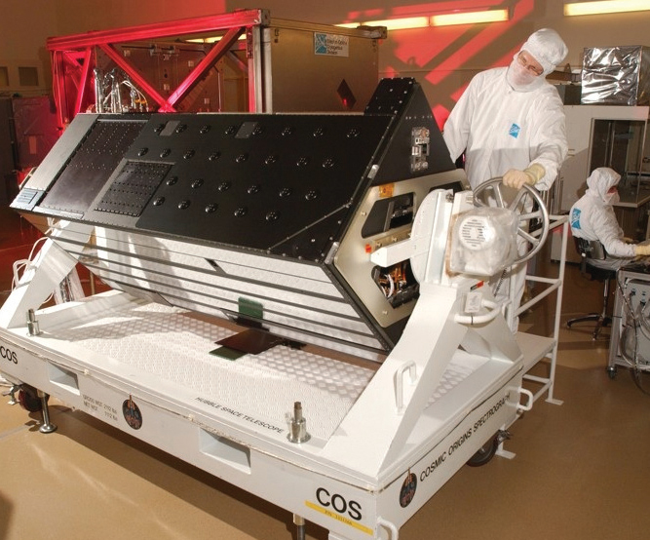
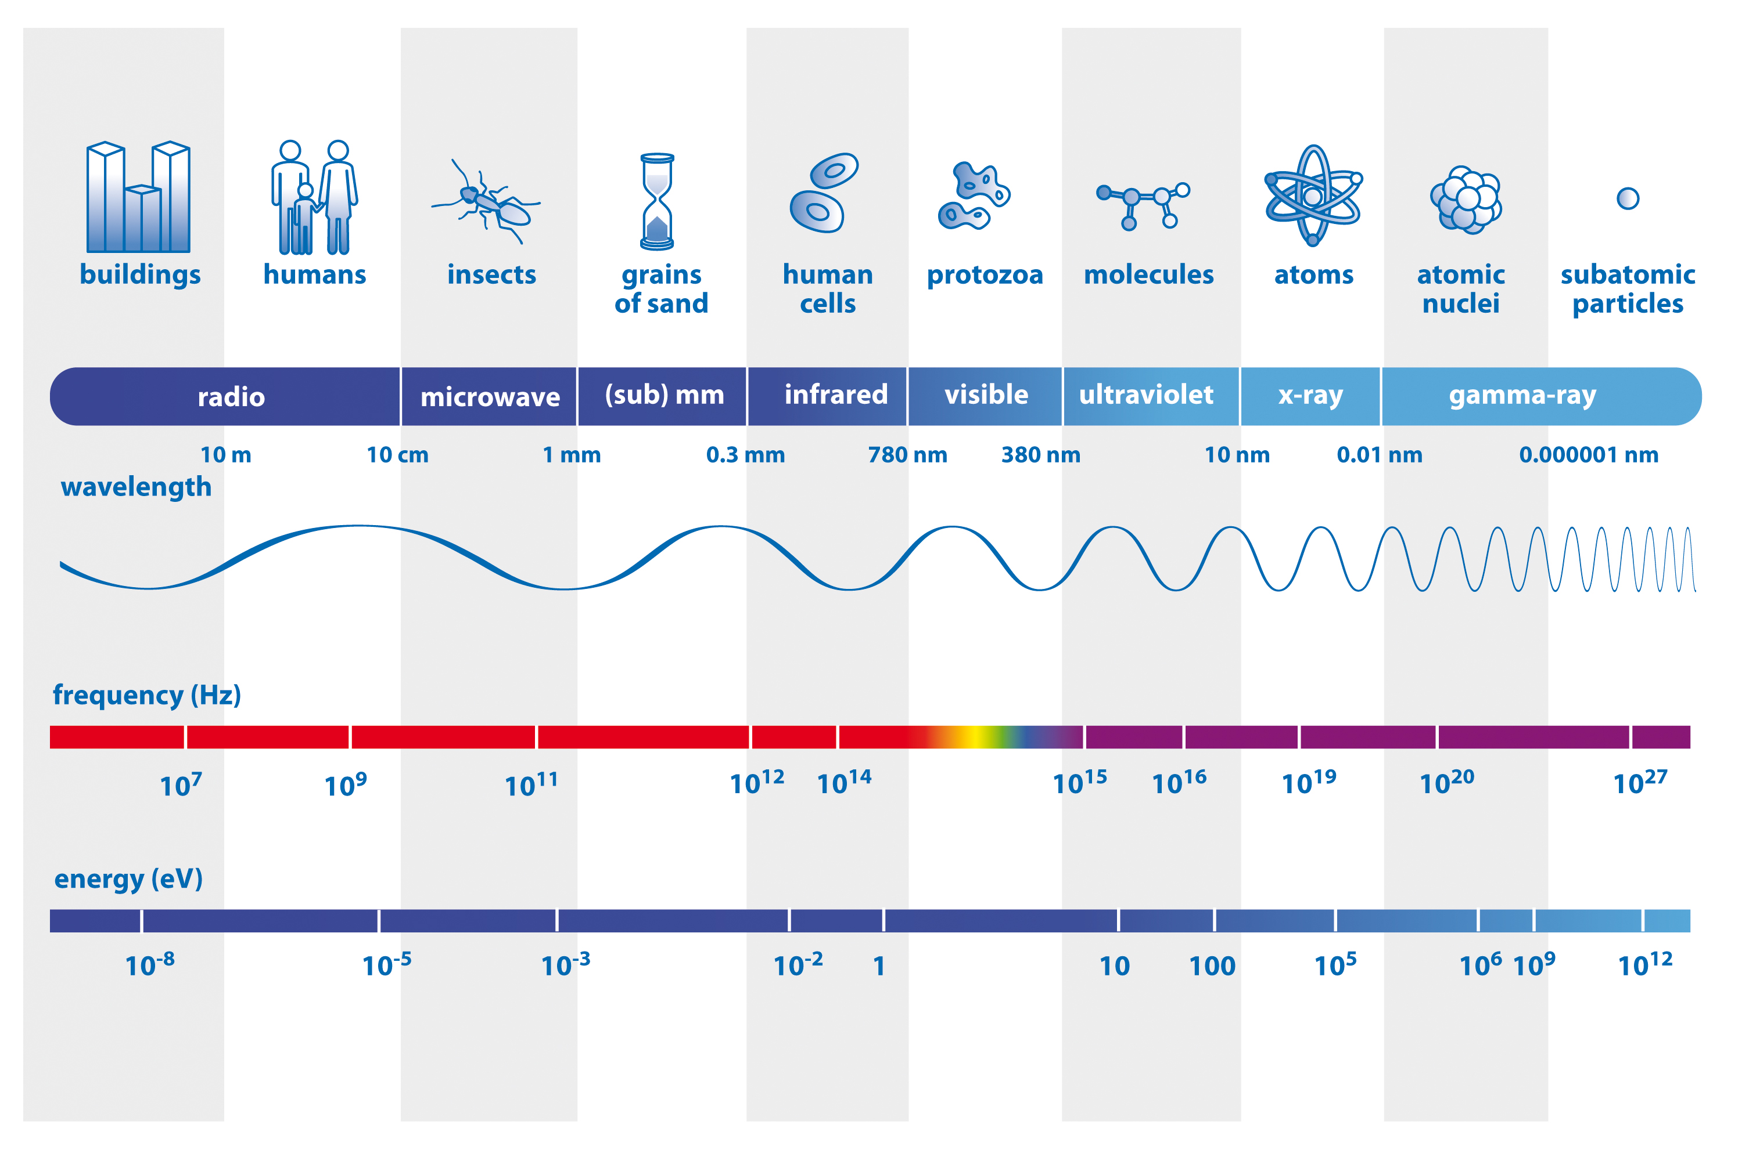
COS: The Cosmic Origins Spectrograph
COS Wavelength Range
COS/FUV: 800 – 2800 Å
COS/NUV: 1700 – 3200 Å
Notes:
Well if I expect you to care about the nuts/bolts of COS data, I should at least lead w what IS COS?
Spectrograph for UV light
FUV/NUV at low-medium resolutions
Generally lower spec res than STIS, but a very sensitive instrument – great for point sources
It has two channels, and 2 (or sorta 3 detectors)
FUV detector - FUV Channel get’s used a lot more – has two constituent segments pretty much identical detectors. They’re Cross Delay line detector, the same detectors flown with FUSE.
As far as differences from STIS, it's very very sensitive (relatively speaking) in the FUV
NUV uses a somewhat more traditional NUV MAMA detector – II think this is more similar to STIS’ UV detectors
Not going to really get into the science done with COS, but some of the main themes are:
large scale structure of the universe
young and hot stars behavior (like with ULLYSES)
planet, star formation

Slide 4
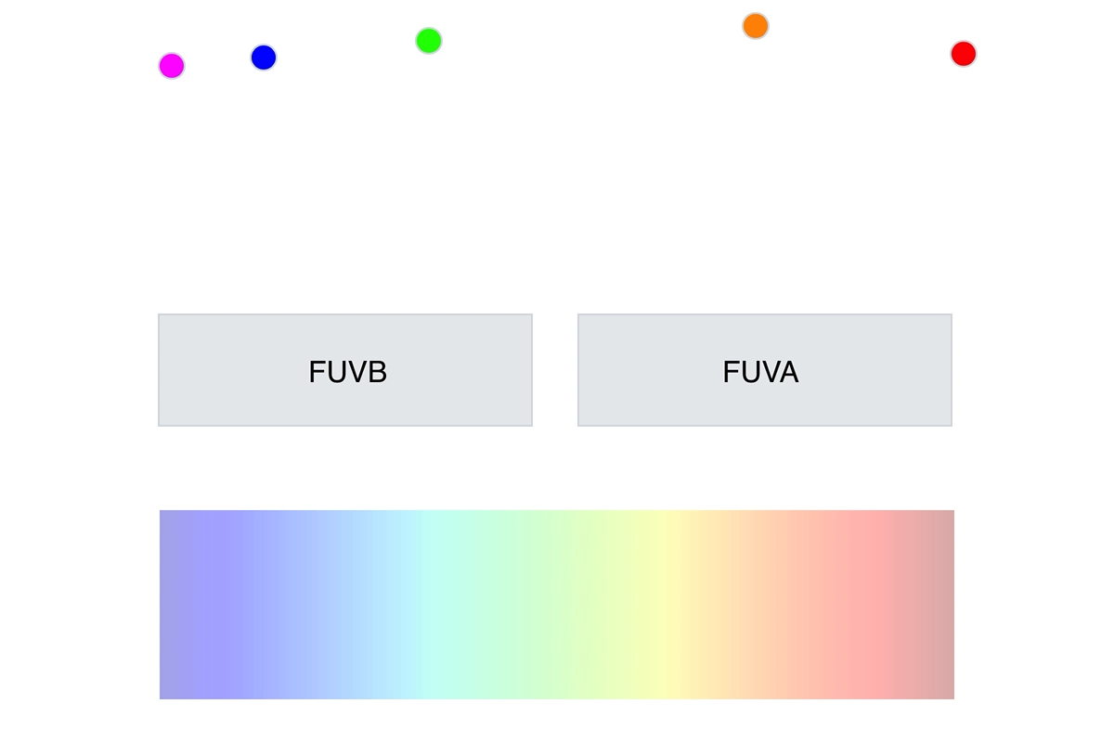
The COS Detector
COS is a UV spectrograph on Hubble
FUV/NUV at low-medium resolutions
Two possible exposure modes:
ACCUM:
All photon events integrated over exposure
Less common, but used for bright sources
TIME-TAG:
Measures each photon interaction discretely
List of all photon interactions with:
time [±32 ms], location, pulse height
Notes:
More relevant to this presentation about the data is the detectors, and where that data comes from
As mentioned, COS has two channels, and we'll focus on the primarily used, FUV detector
* The FUV detector is actually comprised of 2 sub-detectors we call segments (FUVA, FUVB)
When taking data w FUV channel, 2 possible exp modes
ACCUM
[X] TIME-TAG
each indiv photon hitting detector
Not only time, location in X, Y but also the pulse height
what’s the pulse height? measurement of energy NOT of the incoming photon, but helps distinguish background counts, dark noise etc from our real photons from the source
- We’ll focus on T-T data (rawtag and corrtag files), as that’s what most COS data is taken as, and is generally the “cool” data ☺

Slide 5
Questions?

Slide 6
Let’s look at the data!
git clone https://github.com/nkerman/cos_data_presentation_ISSB.git

Slide 7
Extra Slides

Slide 8
Image Credits
https://www.nasa.gov/sites/default/files/thumbnails/image/cos_fact_sheet_img_lg.jpg
https://sci.esa.int/web/education/-/50368-the-electromagnetic-spectrum

