Slide 1
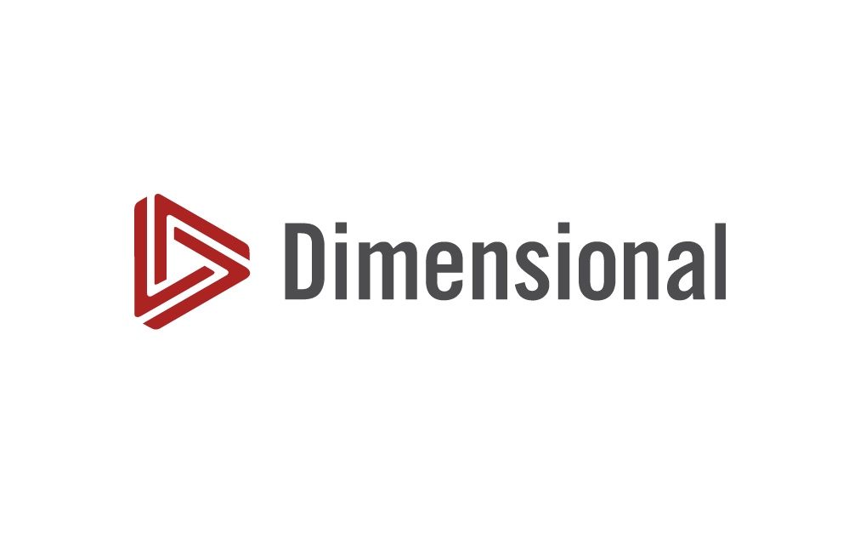

Dimensional Fund Advisors
Akif GOKTUK, Chris McQUEEN, Niranjan MUKUND KESKAR,
Noyan DELIBASI, Yashart Singh RAKESH
April-2026
Champaign, IL

Slide 2




TEAM MEMBERS-GROUP 6
Chris McQUEEN
Yashart Singh
RAKESH
Akif
GOKTURK
Niranjan MUKUND KESKAR
Noyan DELIBASI

Slide 3
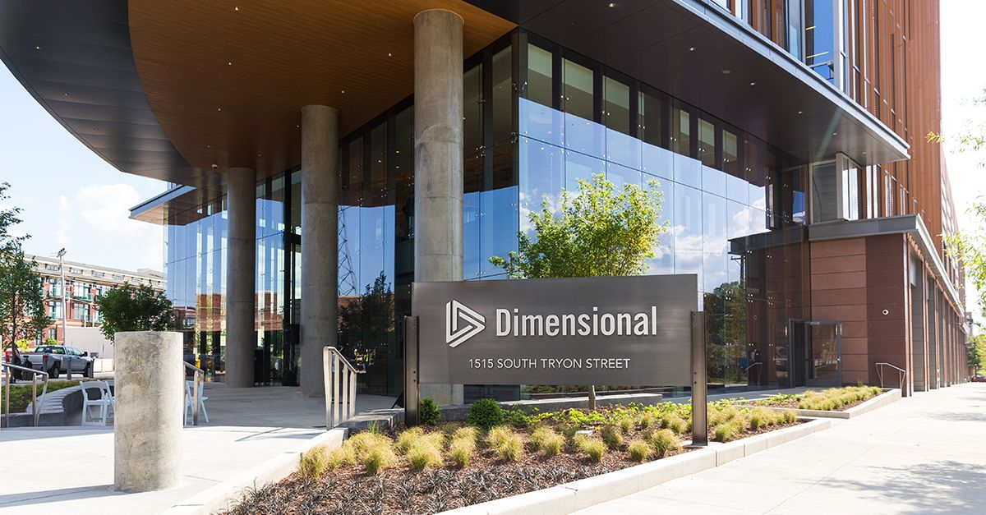
Agenda
01
BUSINESS MODEL, VALUE CREATION
& STRATEGIC DILEMMA
02
ANALYSIS A: FAMA–FRENCH DRIVERS
03
ANALYSIS B: PERFORMANCE & ADVANTAGE
04
ANALYSİS C: TAX-MANAGED NİCHE
05
CONCLUSİON: STRATEGY GOİNG FORWARD

Slide 4
DFA at a Glance
1
2
3
4
Founded in 1981
Built on efficient market philosophy
Hybrid model: not purely passive, not active
Ranked 96th globally
Dimensional Fund Advisors, or DFA, was founded in 1981.It is built on the idea that markets are largely efficient.
At that time, DFA ranked 96th globally in terms of assets under management, which shows it was successful, but still far from dominant.
Unlike traditional active managers, DFA does not try to pick winning stocks.But it is also not a pure index fund.
It operates in a hybrid model, combining factor-based investing with disciplined execution.

Slide 5




HOW DFA CREATES VALUE
Factor investing
(size & value)
Academic
foundation:
Fama–French
Trading
advantage:
discount capture
01
02
03
it targets factor premiums, especially size and value, instead of individual stock selection.
its strategy is grounded in academic research, particularly the Fama–French framework.
DFA acts as a liquidity provider, buying large blocks of less liquid stocks at a discount, which directly improves returns.

Slide 6
The key point is this: DFA’s advantage is not what it buys… but how it trades. So alpha does not come from prediction…it comes from execution.
It provides liquidity when others want to sell, and captures price discounts..
It depends on very specific market conditions, especially illiquid small-cap stocks.
Depends on illiquid small caps
Liquidity provider
On average, this creates about a 0.8% trading advantage.
Block trading discounts(0.8%)
Needs block trading opportunities
It also relies on access to large block trades and trusted counterparties.
At the same time, it keeps turnover low and maintains broad diversification.
Low turnover & diversification
Requires trusted counterparties
THE REAL EDGE
LIMITATION

Slide 7
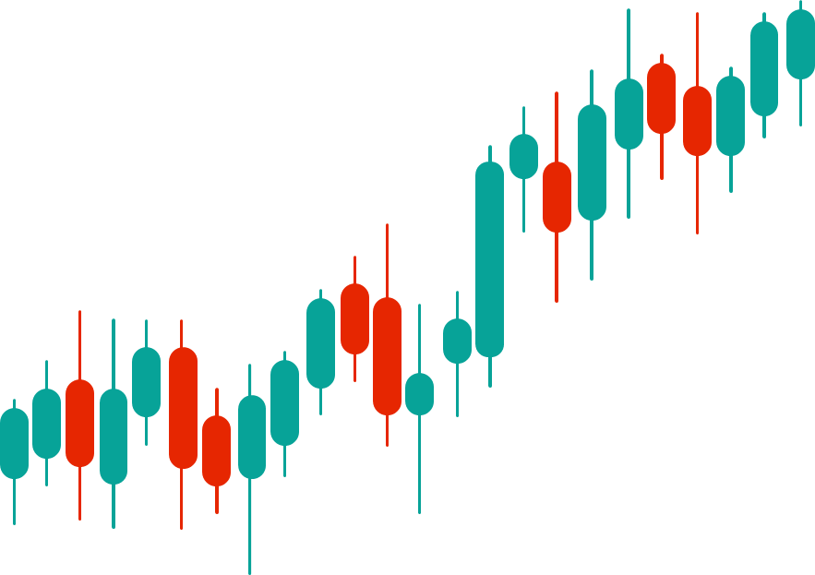
MAIN ISSUE
Scale ↑ → opportunities ↓
AUM ↑ → price impact ↑
Growth → execution risk ↑

Slide 8
Why has DFA’s small stock fund performed so well?
Block trading discounts
DFA was able to extract a significant discount on the stock purchase. (average discount of %3.33 in 2001 and %2 in 20 years)
Screening the securities
DFA employed strict screening rules.
They avoided;
closing transactions right before earnings announcements,
stocks with recent insider sales.
Penalty Box
If a broker is not completely honest,
DFA will refuse to do business with him for months.

Slide 9
Can DFA keep this competitive advantage in the future?
In the short run, YES
In the long run, NO
It is built on a foundation of established market power, institutional trust, and strict discipline.
DFA has earned a reputation for secrecy, which makes sellers feel safe revealing the full size of their holdings and planned sales.
Flexibility to wait for the best block trade discounts to come to them
In the stock market, there are 3,620 "Micro Cap" companies and 563 "Small Cap« companies. Together, these 4,183 companies represent roughly 83% of the 5,020 total companies listed in the U.S.
Small companies’ market value is quite small (%10 of overall market’s value), which could eventually limit DFA's strategy.
Regulatory ownership thresholds:
The 5% Beneficial Ownership Rule
Once an investor or a fund acquires 5% or more of a company's outstanding voting stock, they are legally required to report this to the SEC. This rule causes loss of secrecy. (their position becomes public knowledge, however secrecay is crucial for DFA)
The 10% Ownership Limit
A diversified fund cannot own more than 10% of the outstanding voting securities of any single issuer. When dealing with micro-cap stocks, a fund with billions of dollars can hit these percentage limits very quickly.
.

Slide 10
Why don’t competitors emulate DFA’s approach?
Different investment philosophy
Since it believes that the market is efficient, DFA does not do fundamental analysis on individual companies. However, most competing mutual funds rely on active management, meaning they conduct fundamental analysis to bet on particular firms.
It is practically and mathematically impossible for every fund—especially the massive ones—to meaningfully invest in small firms. (Even the 50th largest firm (General Motors Asset Mgmt.) managed over $111 billion.) If a trillion-dollar mega-fund wanted to allocate just 1% of its portfolio ($10 billion) to micro-cap stocks, it would have to absorb the entirety of roughly 26 average-sized micro-cap companies.
Even if a large fund attempted to buy smaller portions of these tiny companies, the illiquid nature of small stocks would destroy their returns. When funds have to buy these stocks in the open market (listed as a "working order"), the sheer demand pushes the price up, resulting in a positive cost (a penalty) to the fund.
Massive Funds vs Small Companies
Increased Costs
.

Slide 11
ANALYSIS C: TAX-MANAGED NICHE
Will DFA’s tax-managed fund family succeed? Our view: YES - but it will remain a niche, not a dominant business.
Arguments for Success
Early Performance Evidence
Regulatory Catalyst
SEC’s April 2001 rule requiring after-tax return disclosure permanently raised investor awareness of tax drag, channeling more capital to tax-managed products
Natural Client Fit
DFA’s RIA channel already serves high-net-worth taxable investors which are the exact clients for whom after-tax returns matter most. Advisors are financially sophisticated enough to explain the value
Operational Synergy
Tax management requires low transaction costs which is a core DFA strength. Block-trading discounts reduce both cost and taxable events simultaneously
Disappearing Dividends
Fama & French: dividend-paying stocks fell from 66.5% (1978) to 20.8% (1999), expanding the universe of tax-efficient growth stocks
16.89%
Pretax return — Tax-Managed U.S. Small Cap Value
vs. benchmark 13.55%
After-tax drag: only 23 basis points
Why it works specifically for DFA
DFA’s patient block-trading discipline that earns purchase discounts also defers capital gains. Turning an existing execution edge into a tax advantage at near-zero additional cost. The same moat that drives alpha also drives tax efficiency

Slide 12
ANALYSIS C: OVERALL ASSESSMENT
Why It Will Remain a Niche
Overall Assessment
Limited Addressable Market
A large share of investment capital sits in tax-exempt accounts (pension funds, endowments, 401(k)s). For these investors, tax management adds no value and introduces unnecessary complexity
Complexity & Investor Education Barrier
Optimal use depends heavily on the investor’s tax rate, holding period, state of residence, and portfolio composition. This limits the product to a narrow, sophisticated audience
Value Proposition Tension
Tax-managed value funds must exclude or underweight dividend-paying stocks, which are disproportionately represented in value indices. This creates tracking error and complicates the factor story for clients
DFA’s tax-managed funds are well-positioned to grow meaningfully within the taxable high-net-worth segment, but are unlikely to become a dominant part of DFA’s overall AUM due to structural constraints on the addressable market.
The product is a natural fit for DFA’s existing capabilities and client base, but its appeal will remain bounded by the subset of investors for whom tax management genuinely adds value.
“Successful niche, not a dominant franchise.
the right product, for the right client,
delivered by the right firm.”

Slide 13
THANK YOU...

