Slide 1
Analytical Process Overview

Slide 2
4 Types of Analytics
Descriptive – “What happened?”
Diagnostic – “Why did it happen?”
Predictive – “What might happen in the future?”
Prescriptive – “What should we do about it?”

Slide 3
CRISP-DM
Cross-Industry Standard Process for Data Mining
Conceived in 1996 and became a European Union project under the ESPRIT funding initiative in 1997.
Project was led by five companies: Integral Solutions Ltd (ISL), Teradata, Daimler AG, NCR Corporation and OHRA, an insurance company.

Slide 4
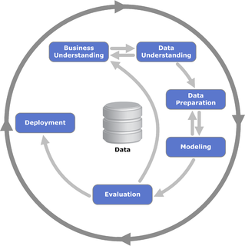
CRISP-DM

Slide 5
Business Understanding
Determine business objectives: You should first “thoroughly understand, from a business perspective, what the customer really wants to accomplish” and then define business success criteria.
Assess situation: Determine resources availability, project requirements, assess risks and contingencies, and conduct a cost-benefit analysis.
Determine data mining goals: In addition to defining the business objectives, you should also define what success looks like from a technical data mining perspective.
Produce project plan: Select technologies and tools and define detailed plans for each project phase.

Slide 6
Data Understanding
Collect initial data: Acquire the necessary data and (if necessary) load it into your analysis tool.
Describe data: Examine the data and document its surface properties like data format, number of records, or field identities.
Explore data: Dig deeper into the data. Query it, visualize it, and identify relationships among the data.
Verify data quality: How clean/dirty is the data? Document any quality issues.

Slide 7
Data Preparation
Select data: Determine which data sets will be used and document reasons for inclusion/exclusion.
Clean data: Often this is the lengthiest task. Without it, you’ll likely fall victim to garbage-in, garbage-out. A common practice during this task is to correct, impute, or remove erroneous values.
Construct data: Derive new attributes that will be helpful. For example, derive someone’s body mass index from height and weight fields.
Integrate data: Create new data sets by combining data from multiple sources.
Format data: Re-format data as necessary. For example, you might convert string values that store numbers to numeric values so that you can perform mathematical operations.

Slide 8
Modeling
Select modeling techniques: Determine which algorithms to try (e.g. regression, neural net).
Generate test design: Pending your modeling approach, you might need to split the data into training, test, and validation sets.
Build model: As glamorous as this might sound, this might just be executing a few lines of code like “reg = LinearRegression().fit(X, y)”.
Assess model: Generally, multiple models are competing against each other, and the data scientist needs to interpret the model results based on domain knowledge, the pre-defined success criteria, and the test design.

Slide 9
Evaluation
Evaluate results: Do the models meet the business success criteria? Which one(s) should we approve for the business?
Review process: Review the work accomplished. Was anything overlooked? Were all steps properly executed? Summarize findings and correct anything if needed.
Determine next steps: Based on the previous tasks, determine whether to proceed to deployment, iterate further, or initiate new projects.

Slide 10
Deployment
Plan deployment: Develop and document a plan for deploying the model.
Plan monitoring and maintenance: Develop a thorough monitoring and maintenance plan to avoid issues during the operational phase (or post-project phase) of a model.
Produce final report: The project team documents a summary of the project which might include a final presentation of data mining results.
Review project: Conduct a project retrospective about what went well, what could have been better, and how to improve in the future.

Slide 11
Data Preparation

Slide 12
Data Cleaning Challenges
Data Volume
Misspellings/Abbreviations
Misfielded Values – values entered in wrong fields
Irregularities – different units/formats in same field
Missing Values
Duplication
Embedded Values – name and age in same field

Slide 13
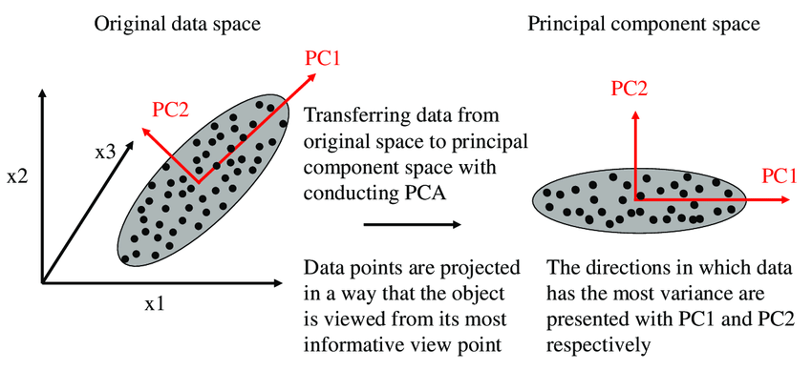
Dimensionality Reduction

Slide 14
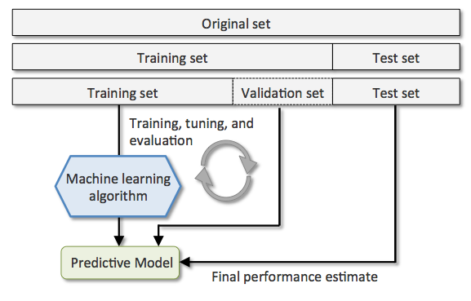
Training/Testing/Validation

Slide 15
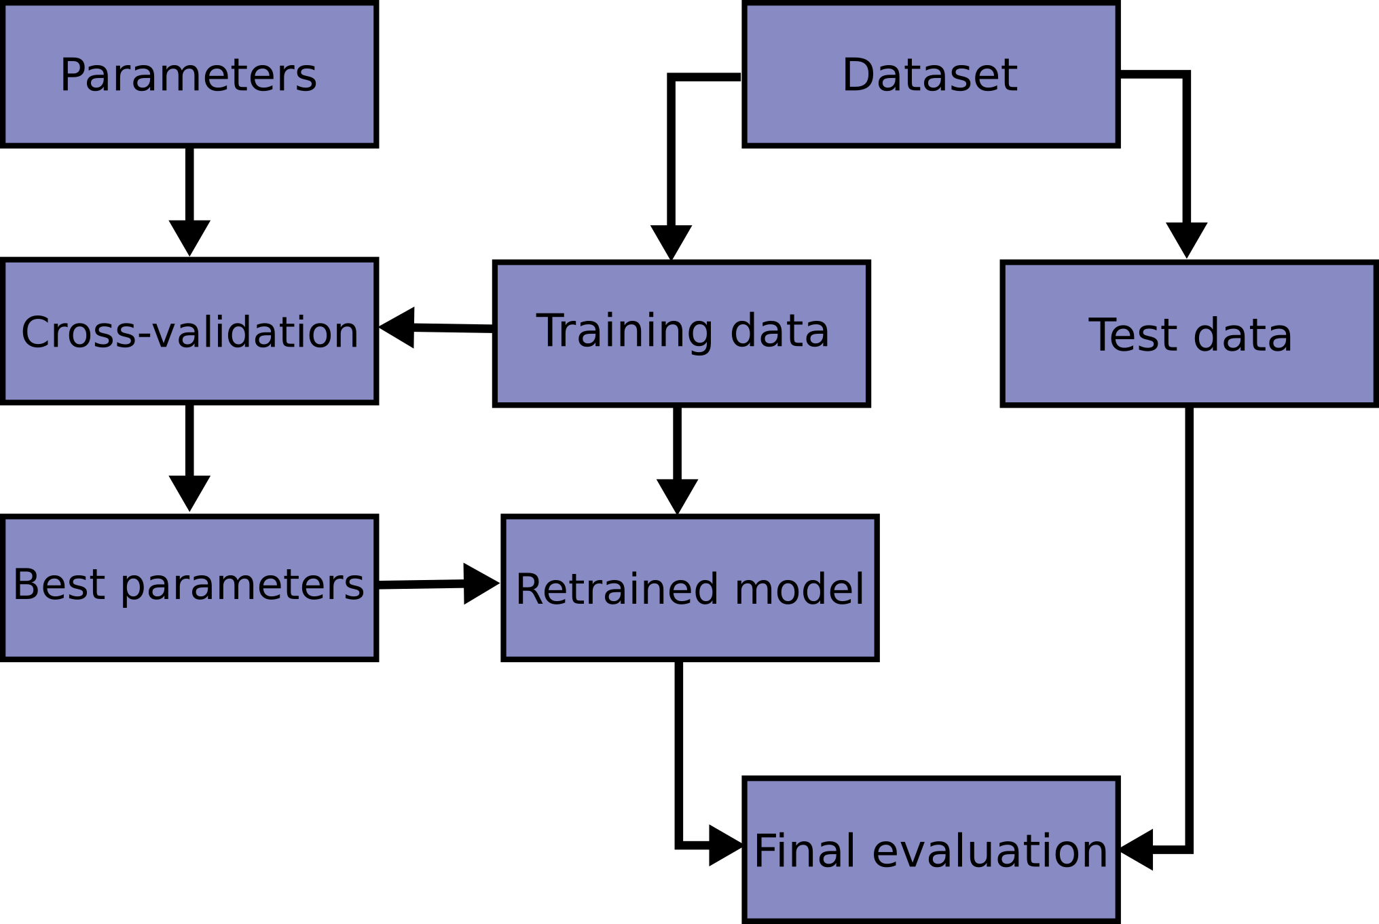
Training/Testing/Validation

Slide 16

Training/Testing/Validation

Slide 17
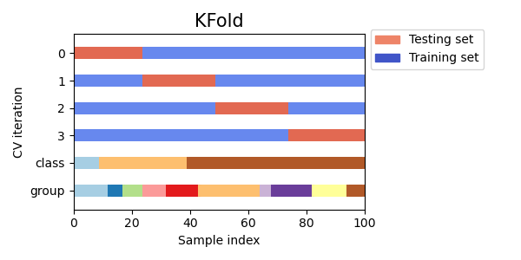
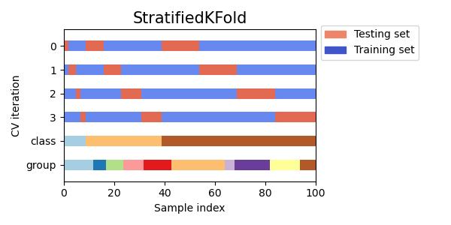
Stratified Crossvalidation

Slide 18
Modeling
Diagnostic
Correlation Analysis
Changepoint Detection
Predictive
Supervised Learning
Unsupervised Learning
Semi-supervised Learning (Reinforcement Learning)
Prescriptive
Math Programming
Heuristics
Simulation-Optimization

Slide 19
Diagnostic Analytics

Slide 20
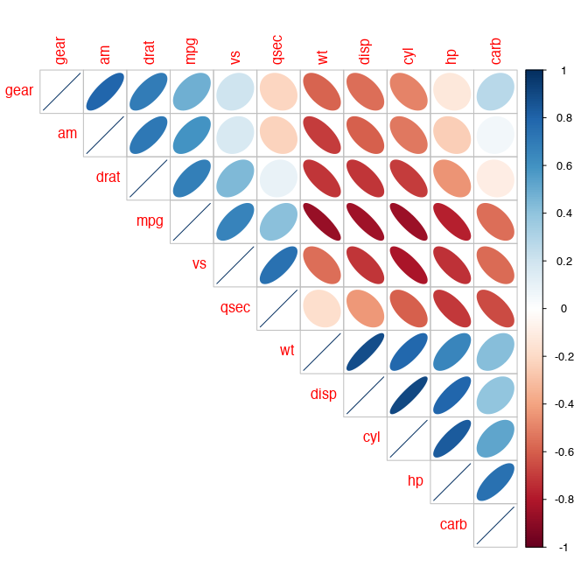
Correlation Analysis

Slide 21
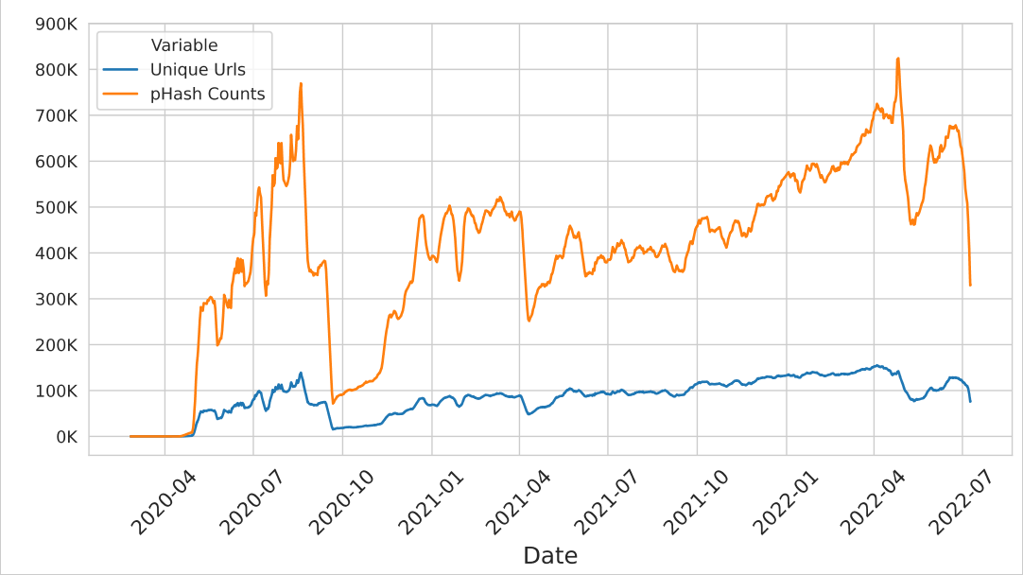
Changepoint Detection

Slide 22
Predictive Analytics

Slide 23
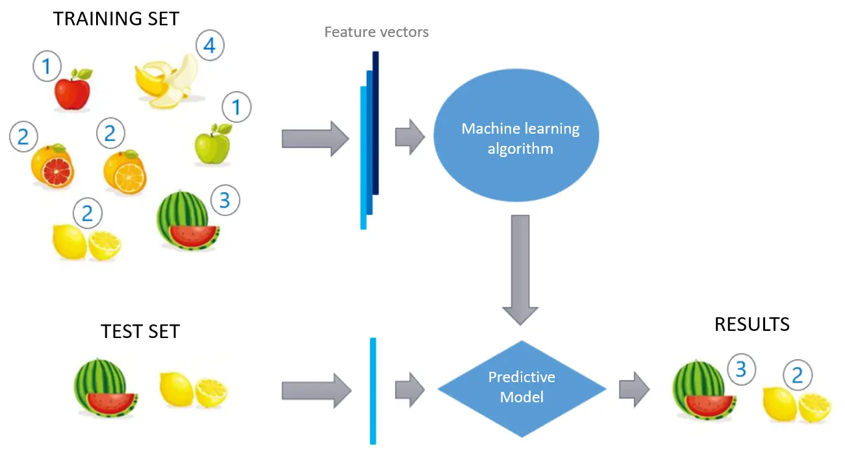
Supervised Learning

Slide 24
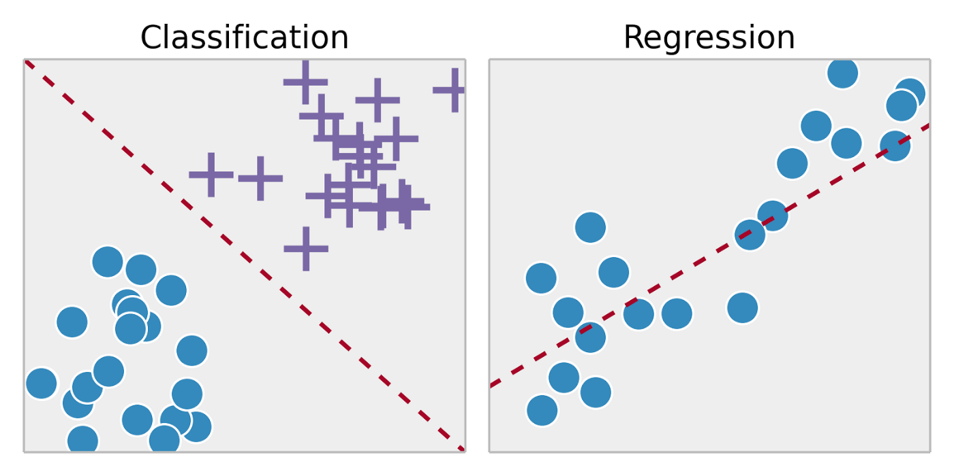
Supervised Learning

Slide 25
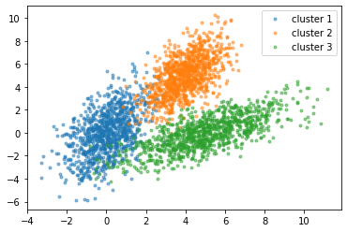
Unsupervised Learning

Slide 26
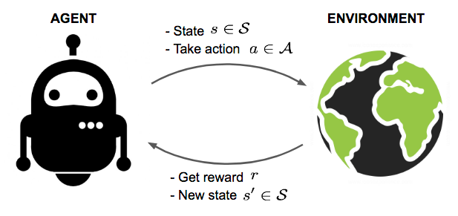
Reinforcement Learning

Slide 27
Prescriptive Analytics

Slide 28
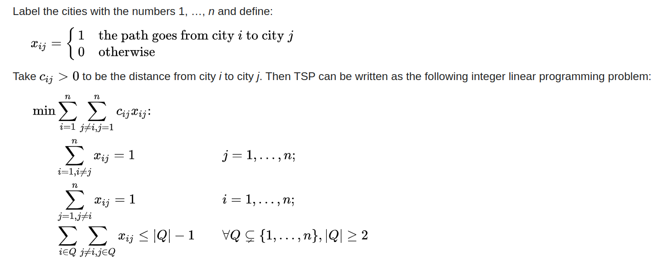
Math Programming
Mathematical representations of problems that focusing on finding “optimal” solutions.

Slide 29
Heuristics
“Rule of Thumb” procedures for constructing “good” but not necessarily “optimal” solutions.
https://stemlounge.com/animated-algorithms-for-the-traveling-salesman-problem/

Slide 30
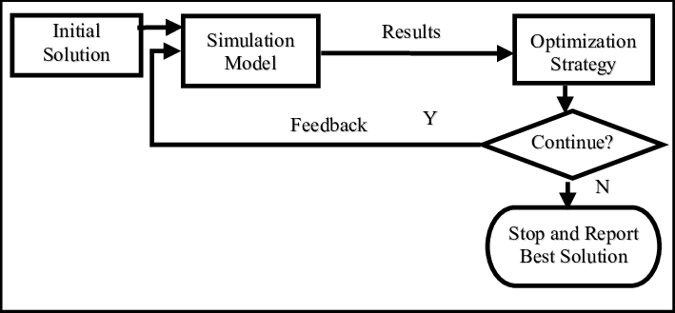
Simulation-Optimization

