Slide 1
Extracted 10-K filings (Items 1A, 7 and 7A)
List of FLS
FLS classifier
FLS + metrics
Sentences with assigned metric(s)
Potential FLS
Data integration
Rule-based
Rule-based
True values of financial metrics
Keyword lists
Legend:
Predicting model
Method used
End result
Company performance prediction
External data
Intermediary result
XAI
Dataset
Important textual features

Slide 2
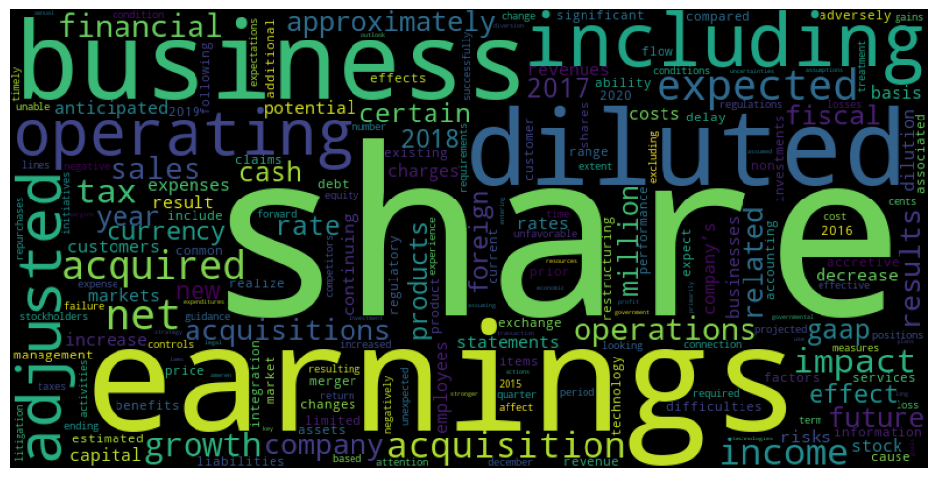
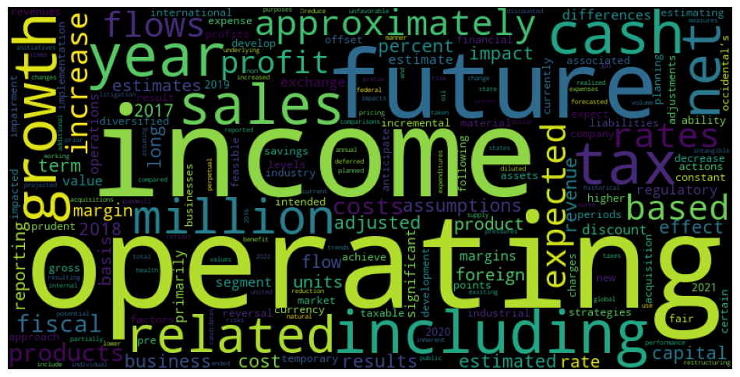
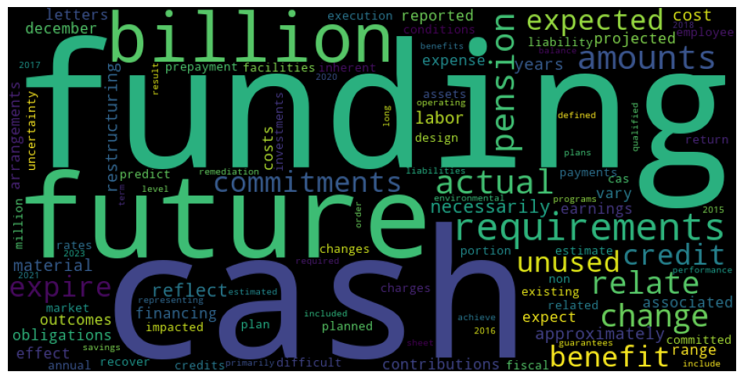
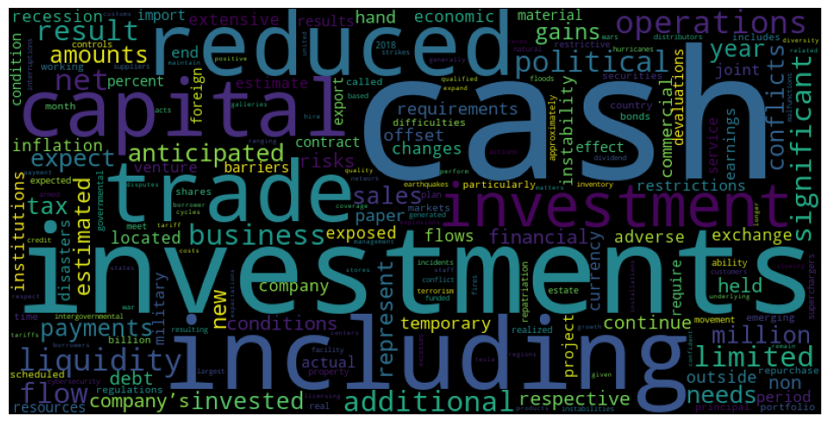
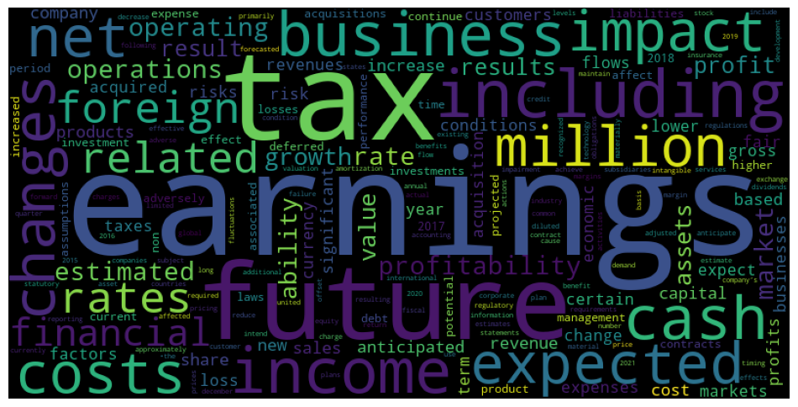
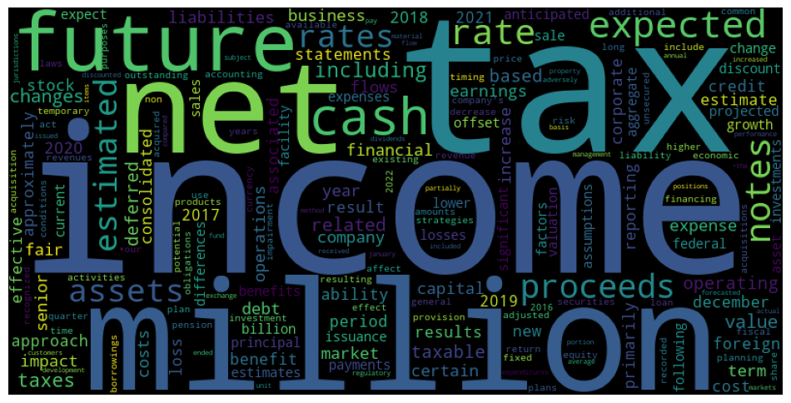

Slide 3
