Slide 1
Extracted 10-K filings (Items 1A, 7 and 7A)
List of FLS
FLS classifier
FLS + metrics
Sentences with assigned metric(s)
Potential FLS
Data integration
Rule-based
Rule-based
True values of financial metrics
Keyword lists
Legend:
Predicting model
Method used
End result
Company performance prediction
External data
Intermediary result
XAI
Dataset
Important textual features

Slide 2
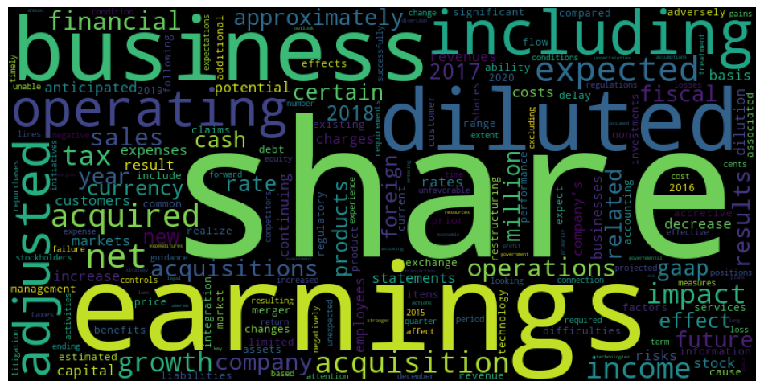
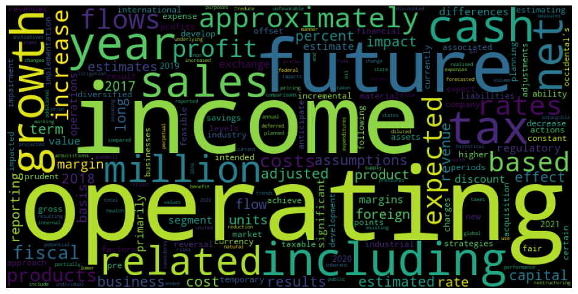
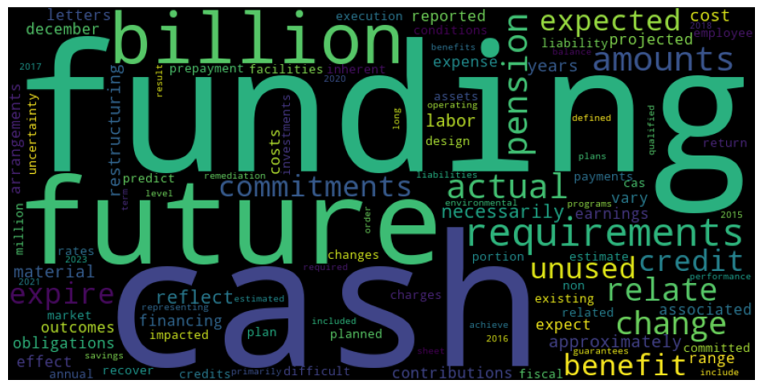
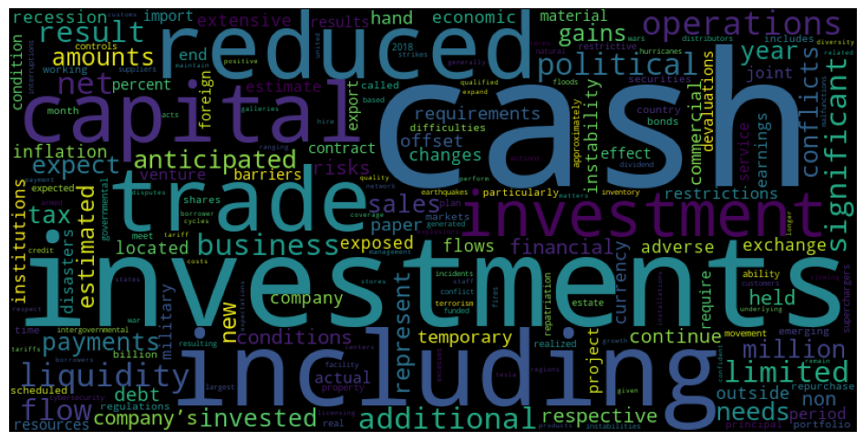
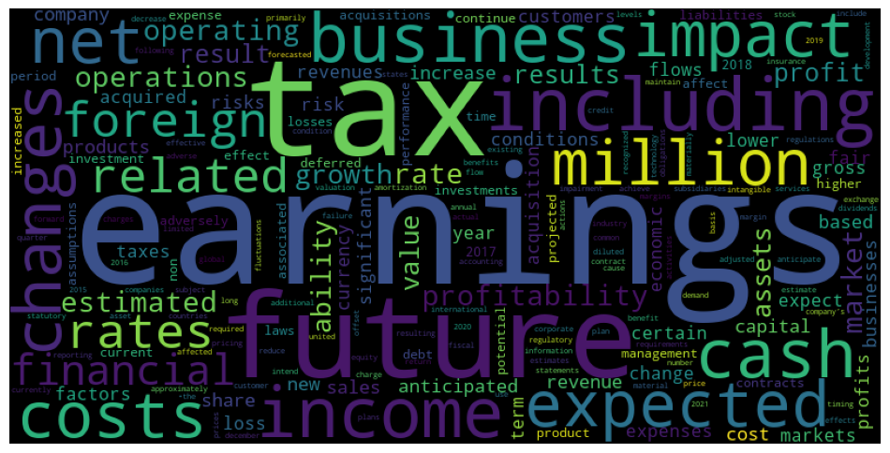
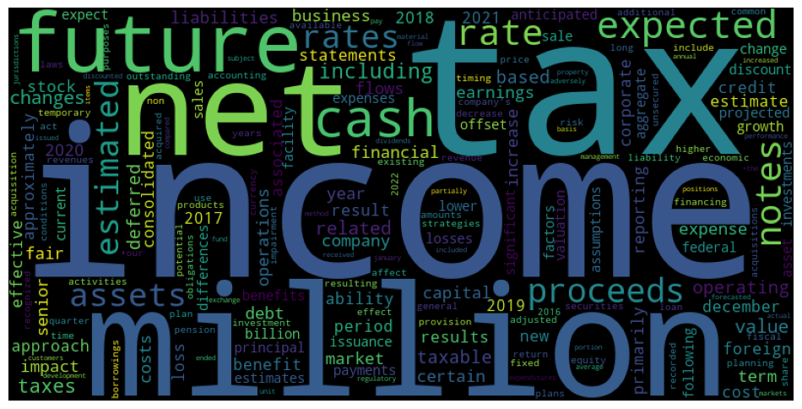

Slide 3
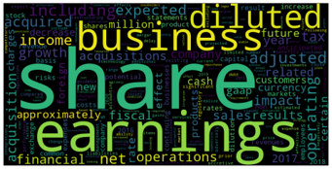
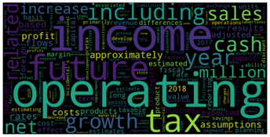
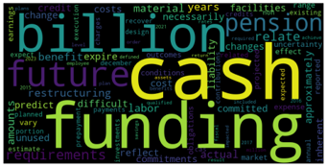
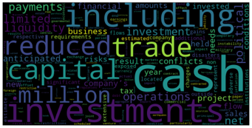
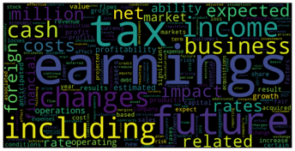
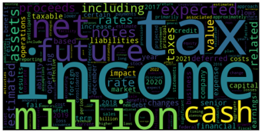

Slide 4
Extracted 10-K filings (Items 1A, 7 and 7A)
List of FLS
DistilBERT-FLS
RFR & FBR
Sentences with assigned metric(s)
Potential FLS
Company performance prediction
Rule-based
Rule-based
Keyword lists
SHAP
Review & refine
Legend:
Global feature importance (RFR)
Context analysis (FBR)
Method used
End result
External data
Intermediary result
Dataset

