Slide 1

InsightfulProctor
AI‑POWERED REMOTE INTERVIEW PROCTORING & MONITORING.

Slide 2
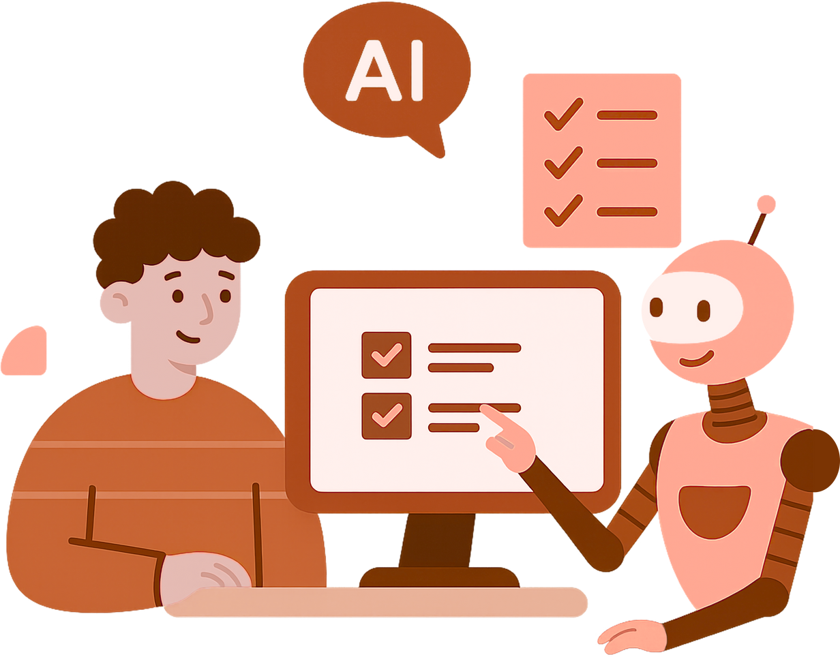
InsightfulProctor
Integrity Layer for AI Interviews
Purpose: Ensure fairness and integrity when an AI conducts interviews by detecting identity, attention, and environment issues.
Approach: Merge signals from computer vision + GPT‑4o Vision; pick whichever is clearer and non‑vague.
Outcome: Clear Green/Amber/Red decisions with concise reasons and on‑screen overlays.

Slide 3

PROBLEM IN AI‑FIRST INTERVIEWS
Missed signals: AI interviewers focus only on Q&A but cannot reliably notice if someone else is present, if the candidate is using another device, looking away from the screen, or reading from hidden notes.
Scaling issue: Human proctors can catch these issues, but they are expensive, inconsistent, and cannot support thousands of interviews at once.
Business need: Companies require an automated integrity layer that is transparent, respects privacy, and plugs directly into AI interview workflows.

Slide 4

WHAT InsightfulProctor CHECKS
Identity: Confirms the same person is present throughout the interview by comparing their face with a reference photo or ID.
Attention: Verifies that the candidate is looking at the screen and engaged, not distracted or turned away.
Environment: Flags extra devices like phones, second screens, or printed notes that could help the candidate unfairly.
Hands & actions: Detects whether the candidate is holding or using objects that suggest external assistance.

Slide 5
HOW IT WORKS
Computer Vision pipeline:
Built with MediaPipe (Face & Hands), YOLOv8m (object detection), DeepFace (ArcFace + RetinaFace for identity). These give measurable outputs: faces, gaze direction, objects, and match scores.
GPT-4o Vision (Azure OpenAI):
Reads the same frames and produces a short, factual description of what it sees (e.g., “person looking left, phone in hand”).
Smart Selector logic:
If GPT-4o Vision gives a clear, concise summary → we use it.
If it’s vague or uncertain → we rely on the deterministic CV results.
Outcome: The system always delivers non-vague, auditable decisions — blending the precision of CV tools with the readability of GPT-4o Vision.

Slide 6

✅ Decision Categories
🎯 Scoring Model
Green - No issues detected.
Amber - Minor concerns
— Brief off-gaze
— 1–2 low-risk objects (e.g., notebook)
Red - Critical Violations
— Wrong person
— Prohibited object detected
— Face not visible
→ Triggers immediate stop
Start Score: 100
Amber: −20 points each
→ Up to 3 allowed
Red: −50 points
→ Early stop on Red or score reaching 40

Slide 7
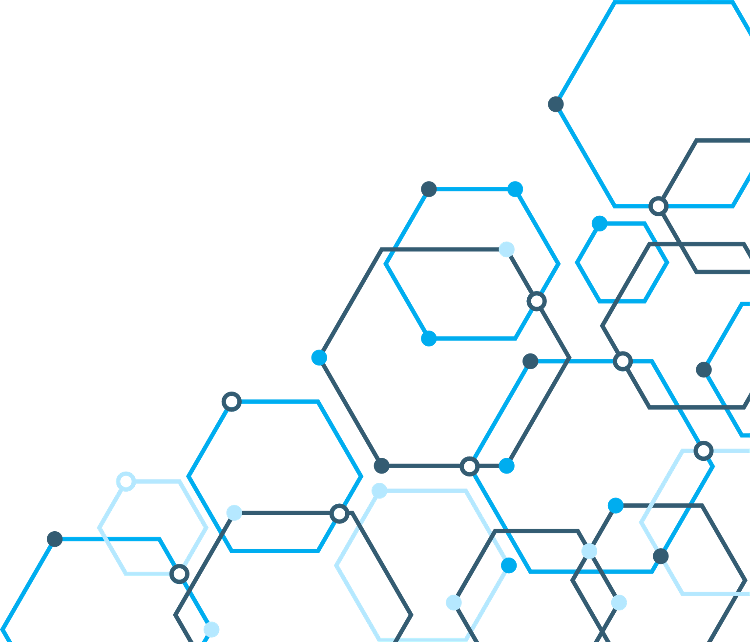
TECH STACK AND INTEGRATIONS
CV: OpenCV, MediaPipe (Face/Hands/Mesh), YOLOv8m.
Identity: DeepFace (ArcFace + RetinaFace).
AI summaries: GPT-4o Vision (Azure OpenAI).
Backend: Python, PyTorch.
Frontend: Streamlit for demo UI.
Integration: JSON results.
Privacy: Processes session media only; no storage, no training.

Slide 8

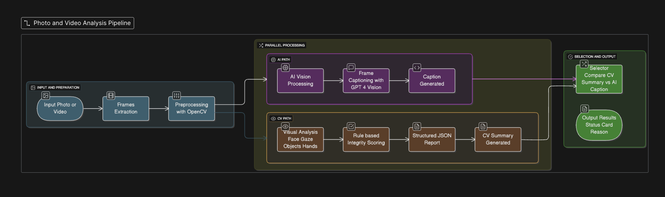
ARCHITECTURE & FLOW

Slide 9
DEMO

Slide 10
Thank you very much!

