Slide 1
Checkpoint 1
By: Neil Khapre and Ian Pagador

Slide 2
Synopsis
Our project is to make looking up Playoff stats in the NBA easier
Our database will store NBA playoffs data which can be displayed for customers to navigate.

Slide 3
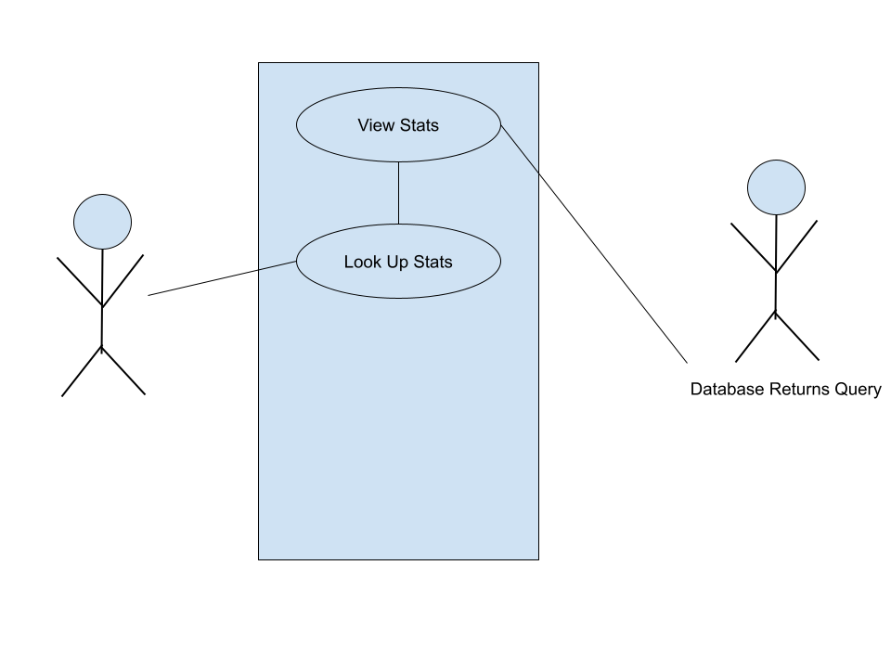
UML Use Case Diagram
Customers can navigate through playoff rounds, their series, and their results.
Each series consists of teams which are composed of players and coaches.
Customers can also find individual player statistics such as points per game, assists per game, and rebounds per game

Slide 4
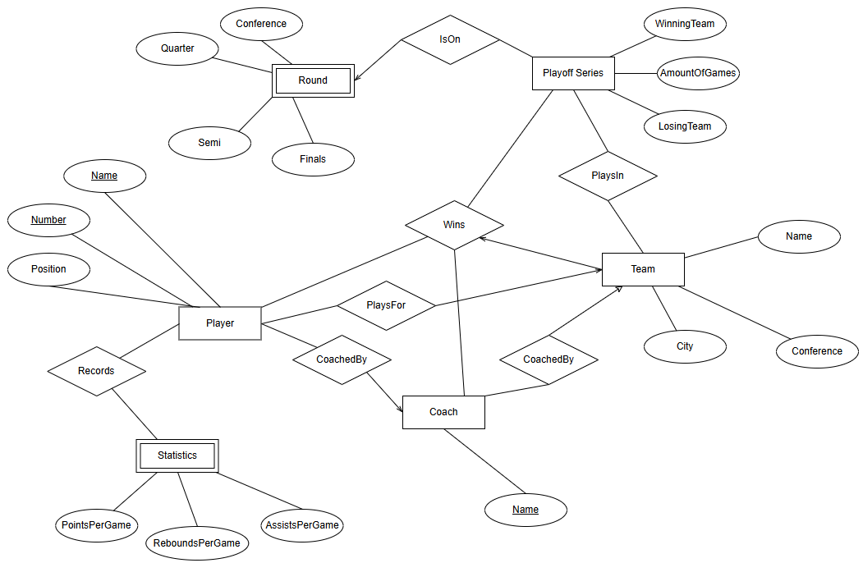
ER Diagram

Slide 5
Relational Schema
Entities
Player(Name, Number, Team, Position, Statistics, Coach)
Coach(Name, Team, Players)
Team(Name, City, Conference)
Round(Semi,Quarter,Conference,Finals)
Statistics(PointsPerGame, ReboundsPerGame, AssistsPerGame)
PlayoffSeries(WinningTeam,LosingTeam, Round)
Relations
Records(Player, Statistics)
IsOn(Round,PlayoffSeries)
PlaysIn(Team, PlayoffSeries)
PlaysFor(Player, Team)
CoachedBy(Coach,Player,Team)
Wins(Player, Coach, Team, PlayoffSeries)

Slide 6
QnA?

