Slide 1
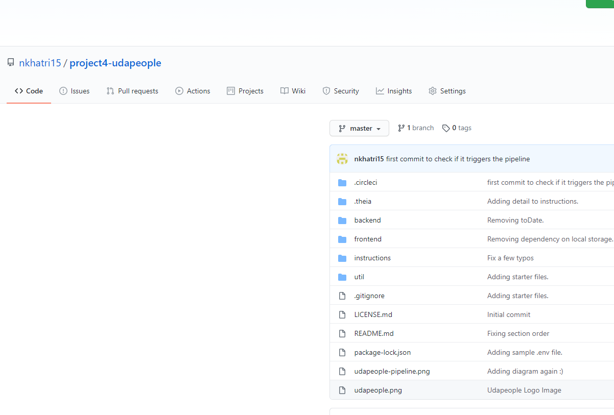
Git setup cloned repo for CircleCI

Slide 2
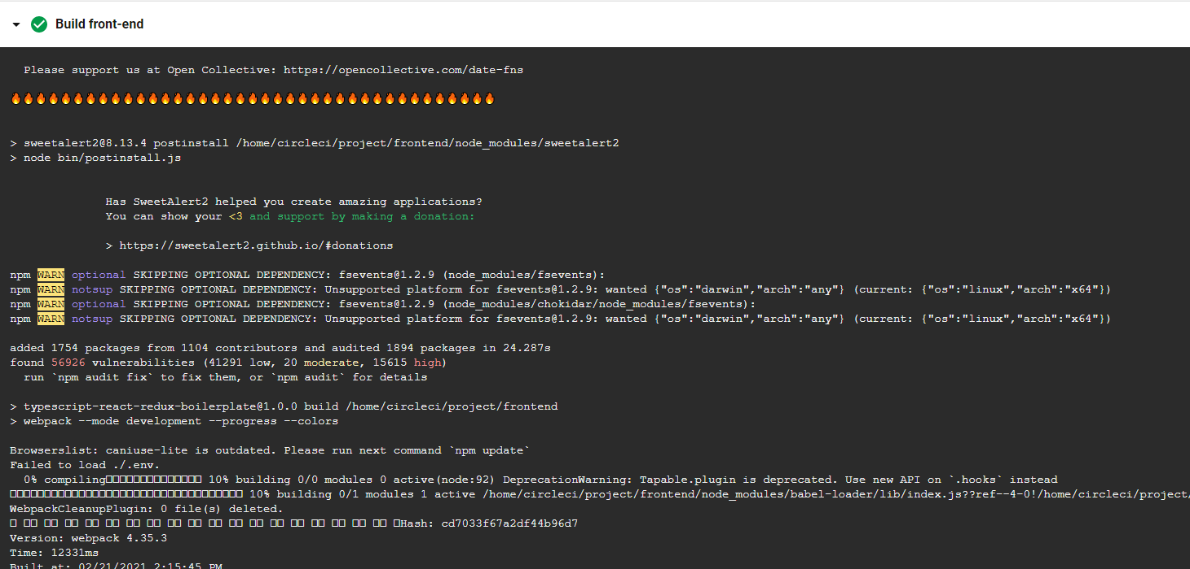
1. Build phase : Building front-end

Slide 3
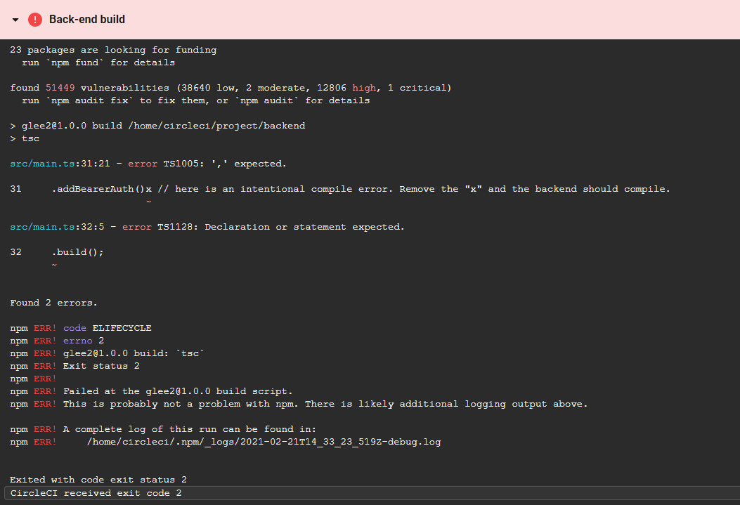
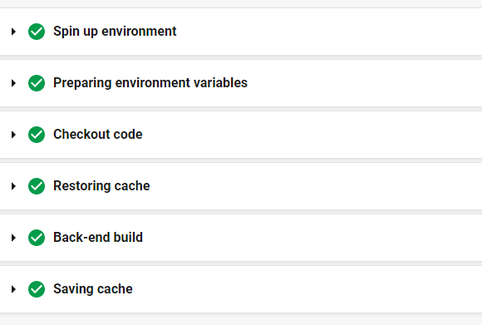
Build fail
Build passed after fixing compile error

Slide 4
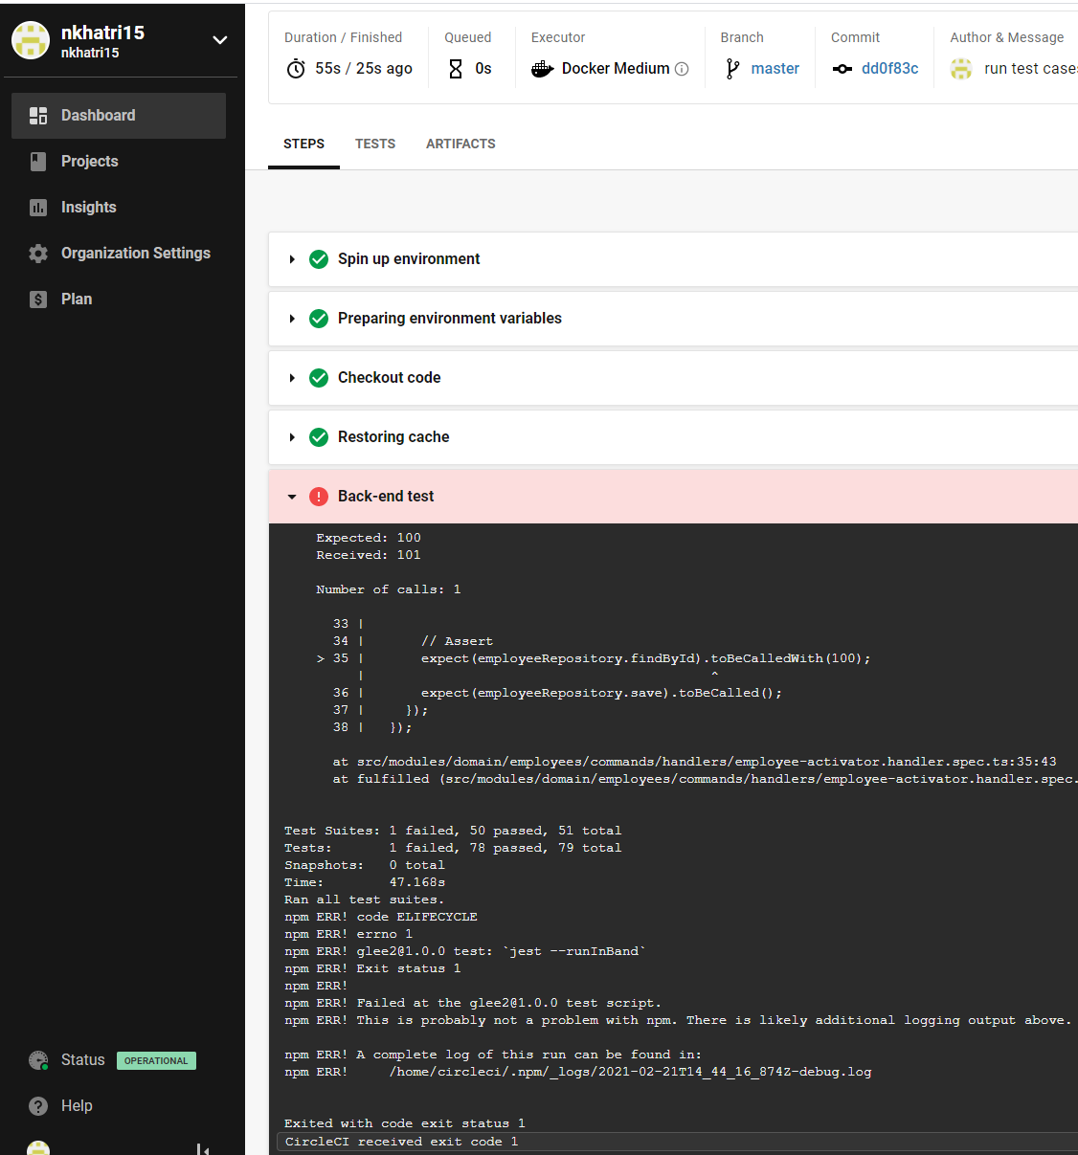
Test case failed

Slide 5
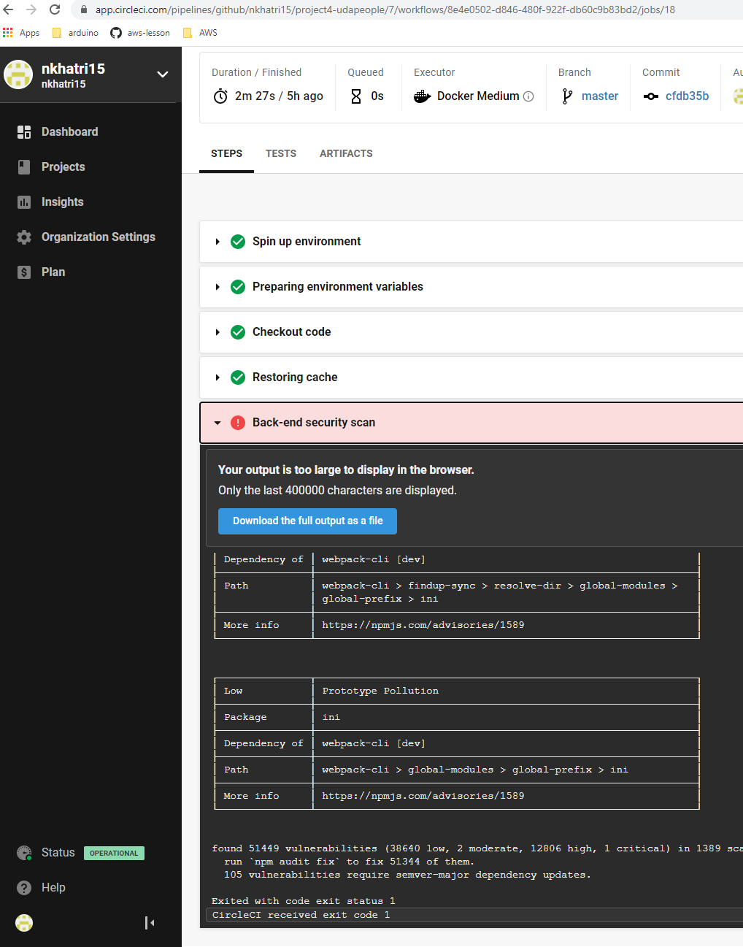
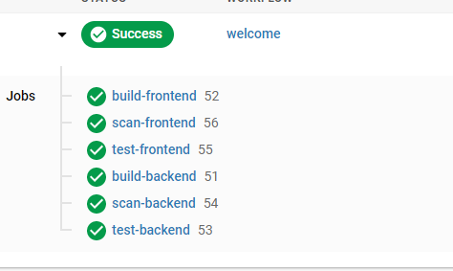
Scan failed
And fixed

Slide 6
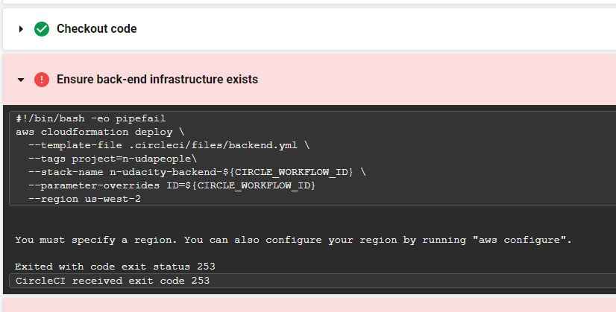
Fixed by adding environment variables aws key ,secret key and region

Slide 7
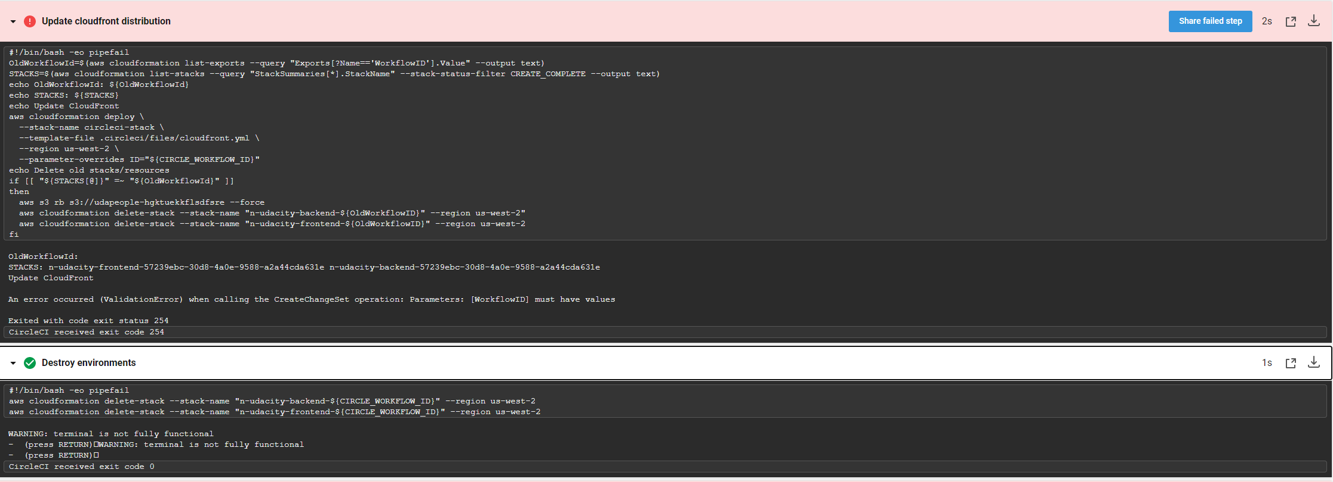
Environment is destroyed if job fails

Slide 8
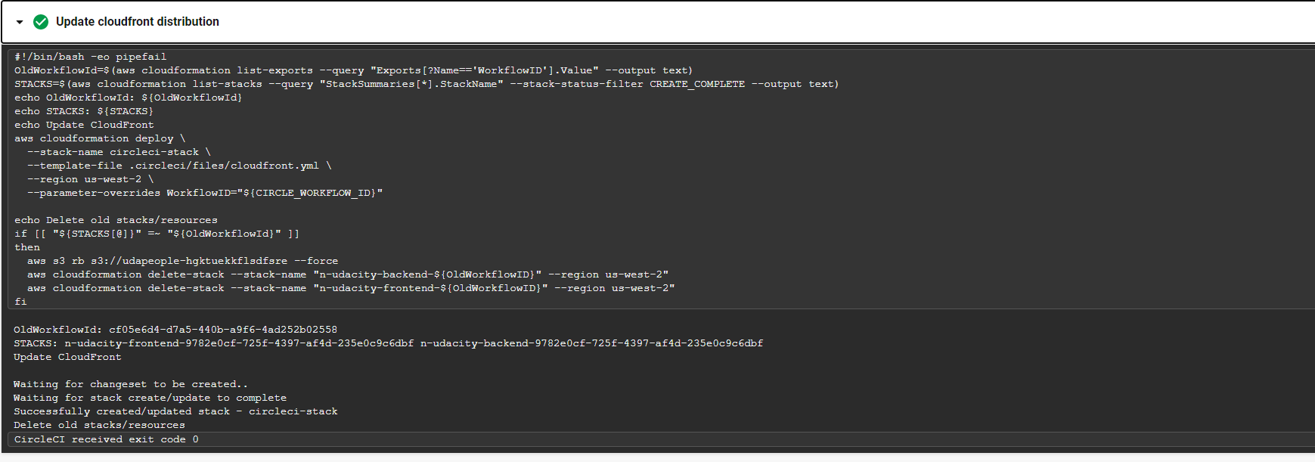
Successful job

Slide 9
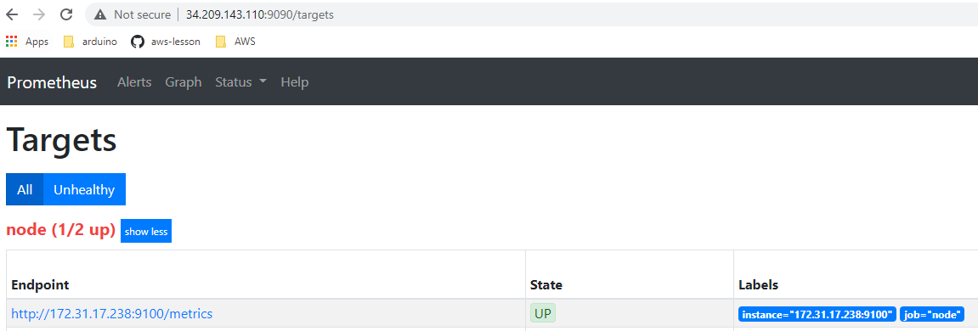
Prometheus can discover target

Slide 10
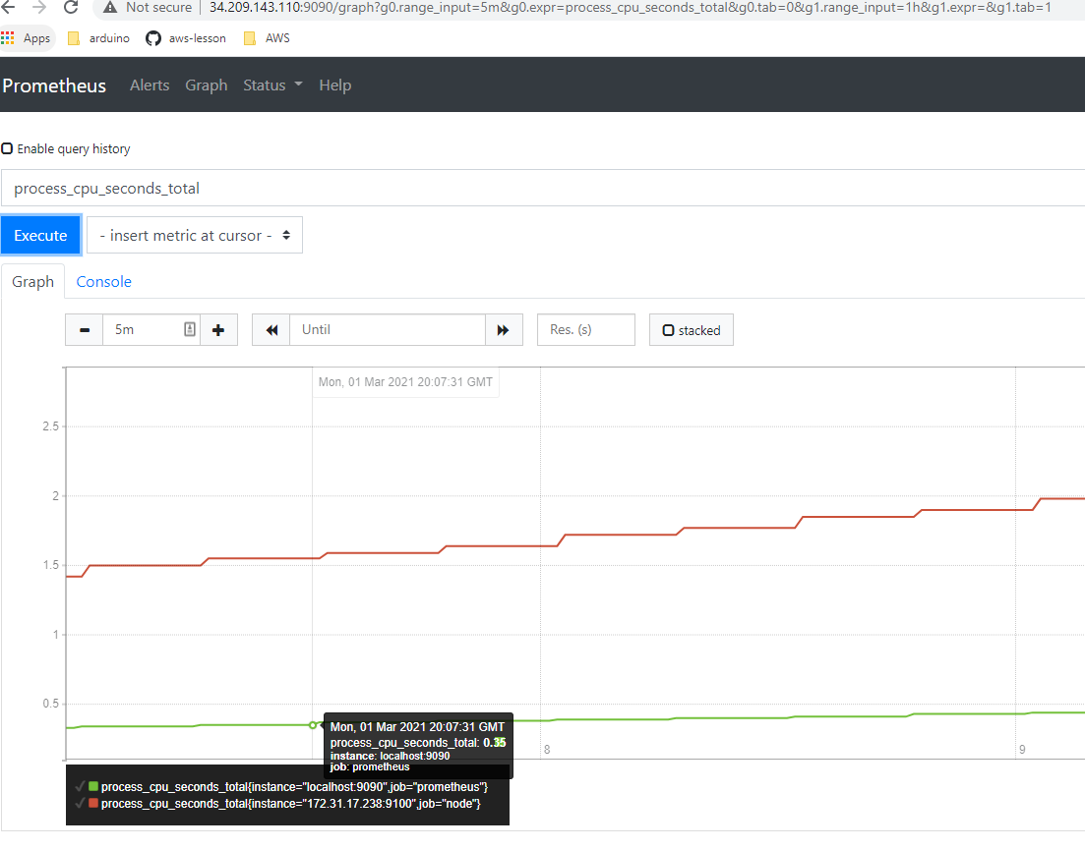
Prometheus CPU graph

Slide 11
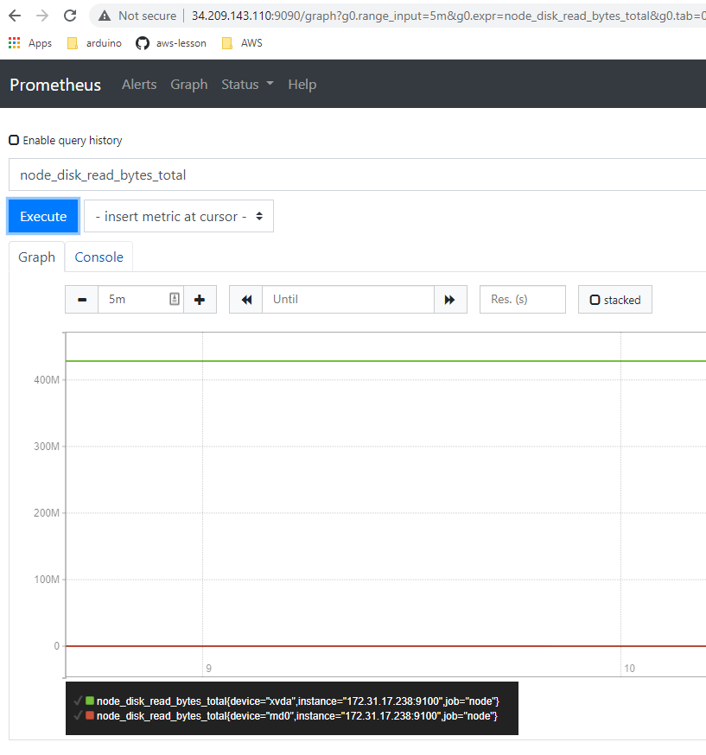
Prometheus disk usage graph

Slide 12
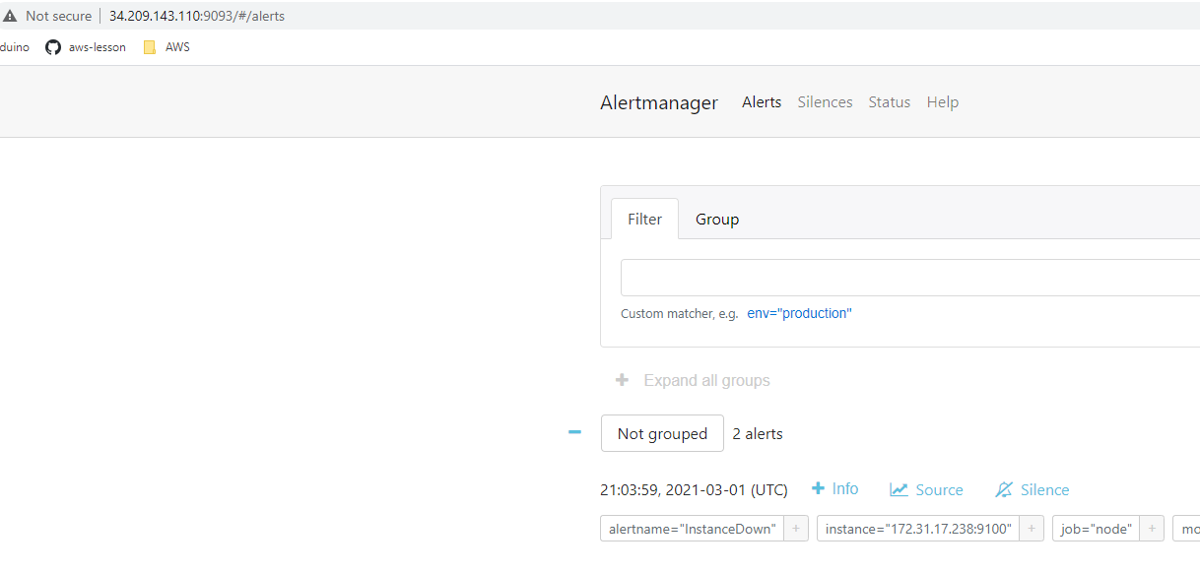
Down alert

