Slide 1
TANLP PROJECT PRESENTATION
Sentiment Analysis of
Restaurant Reviews
Majhitar, Sikkim
Presented by:
NIKHIL PATNAIK
Registration No.: 202300488

Slide 2
Table of Contents
01
Introduction to Sentiment Analysis
09
Dish-Based Recommendation System
02
What is VADER?
10
Model Evaluation — Metrics
03
Dataset Overview — Manual CSV Collection
11
Confusion Matrix
04
NLP Pipeline / Block Diagram
12
Key Findings & Observations
05
Preprocessing & Scoring
13
Future Scope
06
Sentiment Distribution Results
14
GitHub Repository
07
Restaurant Ranking Table
15
Conclusion
08
Visualizations — Bar & Breakdown Charts

Slide 3
Introduction to Sentiment Analysis
Definition: Sentiment Analysis (Opinion Mining) is an NLP technique that identifies and extracts subjective information from text — classifying it as Positive, Negative, or Neutral.
Opinion
Mining
Polarity
Detection
Use Cases
Extracting opinions, feelings, and attitudes from written text
Determining if the tone is Positive, Negative or Neutral
Product reviews, social media, customer feedback, restaurant ratings
Example: "The momos here are absolutely delicious!" → POSITIVE ✔

Slide 4
What is VADER?
VADER — Valence Aware Dictionary and sEntiment Reasoner
Rule-based NLP
Uses a pre-built lexicon of words with sentiment scores — no training needed.
Compound Score
Returns a score from –1.0 (most negative) to +1.0 (most positive) per text.
Thresholds Used
≥ 0.05 → Positive | ≤ –0.05 → Negative | Between → Neutral
Handles Informality
Works well with abbreviations, slang, punctuation (!!!), and CAPS emphasis.
Why VADER for Reviews?
Google reviews are short, informal, and opinionated — ideal for VADER's design.

Slide 5
Dataset Overview
21
205
173
26
6
Restaurants
& Cafes
Total
Reviews
Positive
Reviews
Negative
Reviews
Neutral
Reviews
How the Dataset Was Built
1
Visited Google Maps and searched for restaurants and cafes in Majhitar, Sikkim.
2
Manually opened each restaurant's profile and read through the customer reviews.
3
Copied each review text along with the restaurant name into a CSV file.
4
Covered 21 establishments — from popular spots like Coffee Break & Punjabi Kitchen to smaller cafes.
5
CSV columns: restaurant_name, review (no star ratings — sentiment derived purely from text).

Slide 6
NLP Pipeline
1
Data
Collection
2
Load &
Preprocess
3
VADER
Scoring
4
Classify
Sentiment
5
Aggregate
by Restaurant
→
→
→
→
Google Reviews
CSV (21 Restaurants)
pandas read_csv
Drop nulls / clean
compound_score
per review
Pos / Neg / Neutral
using thresholds
avg_score
per restaurant
6
Visualization
7
Dish-Based
Recommender
8
Model
Evaluation
9
Output &
Report
→
→
→
Bar, Pie, Stacked
matplotlib charts
Keyword match
in reviews
Accuracy, F1
Confusion Matrix
Top restaurant
recommendations
Pipeline flows from raw data collection → VADER scoring → classification → visualization → evaluation

Slide 7
Preprocessing & Sentiment Scoring
Preprocessing Steps
VADER Scoring Logic
1. Load CSV with pandas (latin-1 encoding)
def get_sentiment(text):
scores = analyzer.polarity_scores(text)
compound = scores['compound']
if compound >= 0.05:
return 'Positive'
elif compound <= -0.05:
return 'Negative'
else: return 'Neutral'
2. Select only restaurant_name & review columns
3. Drop rows with missing/null reviews
4. Convert all review text to string type
5. Pass each review to VADER analyzer
6. Extract compound score per review
≤ –0.05
→ NEGATIVE
7. Apply threshold rules to label sentiment
–0.05 to +0.05
→ NEUTRAL
8. Group by restaurant → compute avg score
≥ +0.05
→ POSITIVE

Slide 8
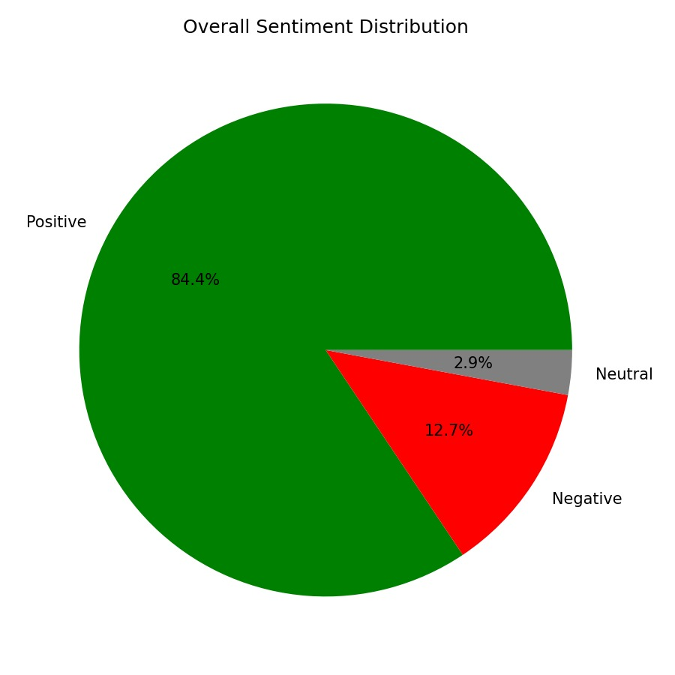
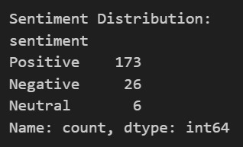
Sentiment Distribution Results
Sentiment count output from VADER classifier
Key Insight: 84.4% of all 205 reviews across 21 Majhitar restaurants are Positive. Only 12.7% are Negative and 2.9% Neutral — indicating a predominantly satisfying dining experience in the region.

Slide 9
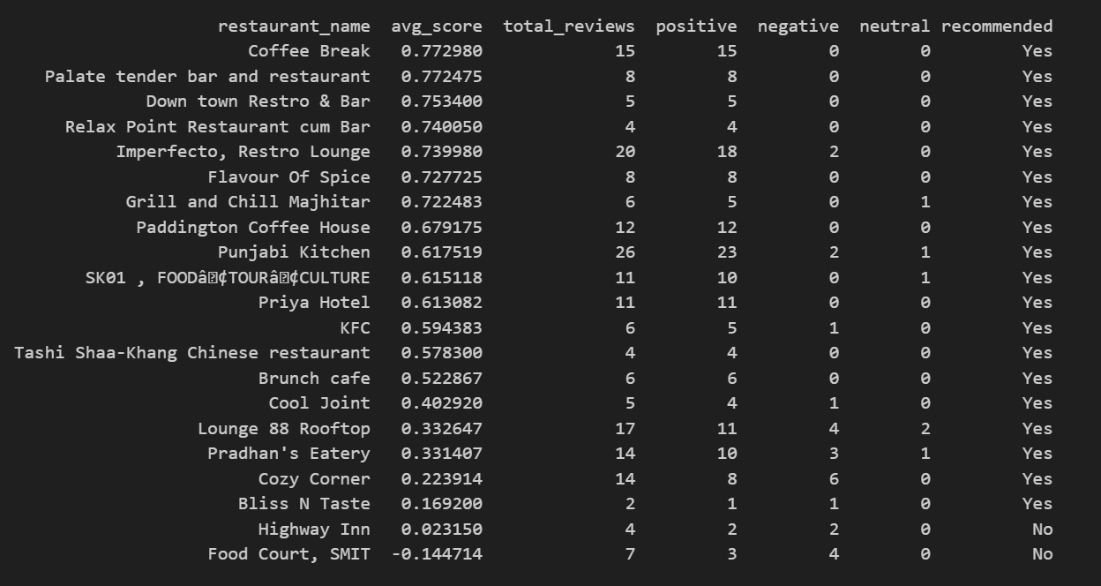
Restaurant Ranking by Sentiment Score
Top performers: Coffee Break (0.77), Palate Tender Bar (0.77), Downtown Restro (0.75) | Not Recommended: Highway Inn (0.02), Food Court SMIT (–0.14)

Slide 10
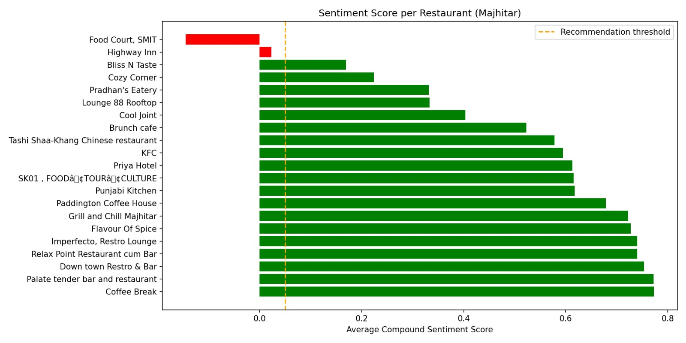
Visualization — Sentiment Score per Restaurant
Chart Details: Horizontal bar chart sorted by average VADER compound score. Green bars = recommended (score ≥ 0.05). Red bars = not recommended. The dashed orange line marks the recommendation threshold at 0.05.

Slide 11
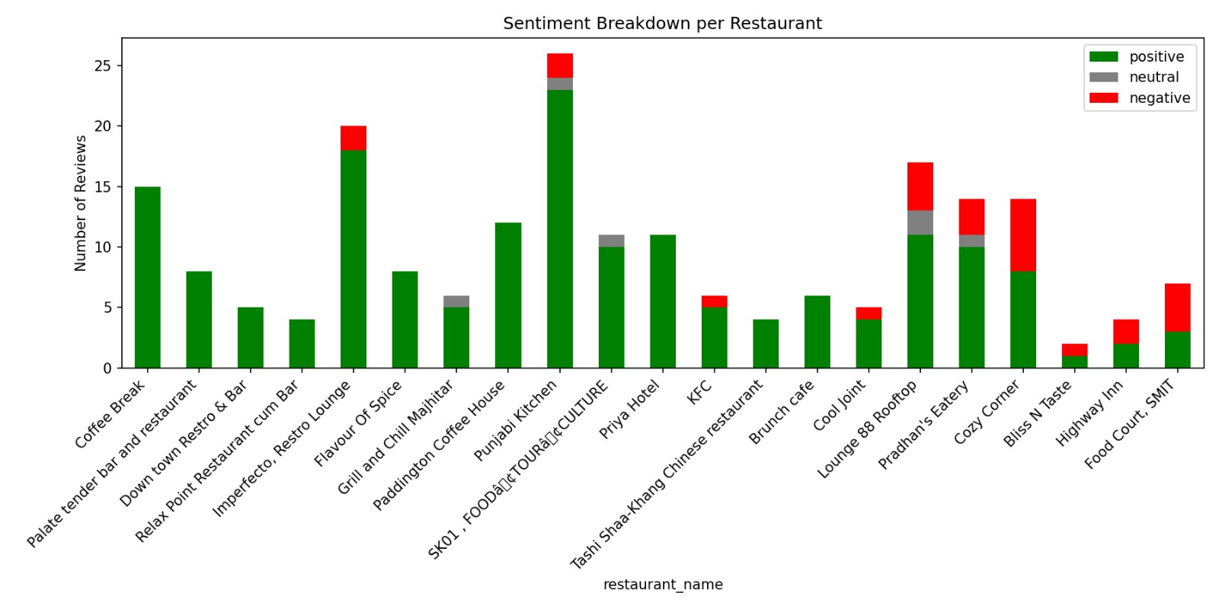
Visualization — Sentiment Breakdown per Restaurant
Chart Details: Stacked bar chart showing the count of Positive (green), Neutral (gray), and Negative (red) reviews per restaurant. Punjabi Kitchen has the highest total review count (26). Restaurants like Coffee Break and Palate Tender have entirely positive reviews.

Slide 12
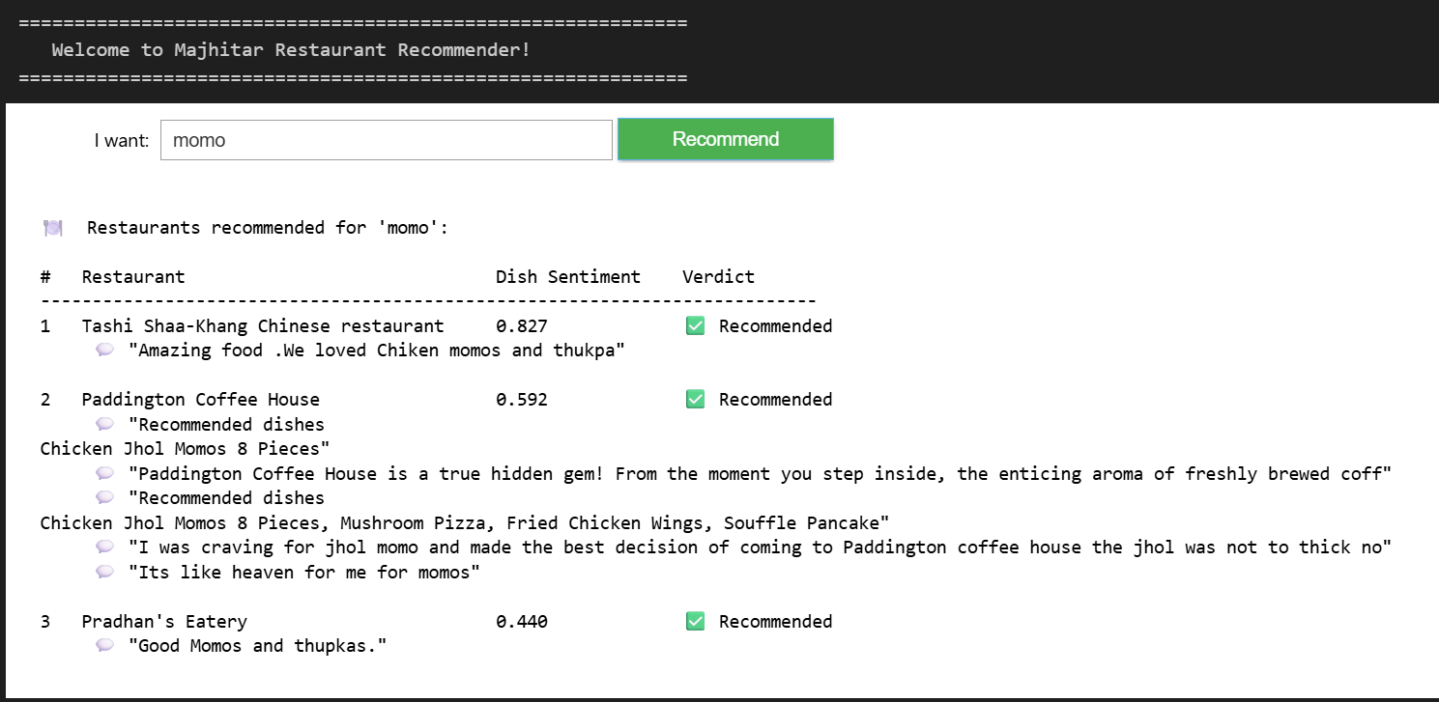
Dish-Based Restaurant Recommendation System
How It Works
1
User types a dish name (e.g. momo, biryani, coffee)
2
System filters all reviews that mention the dish keyword
3
VADER compound score of matched reviews is averaged per restaurant
4
Restaurants are ranked by their dish-specific sentiment score
5
Top 3 restaurants with score ≥ 0.05 are recommended with review snippets
Example: Searching 'momo' returns Tashi Shaa-Khang, Paddington Coffee House & Pradhan's Eatery with review snippets

Slide 13
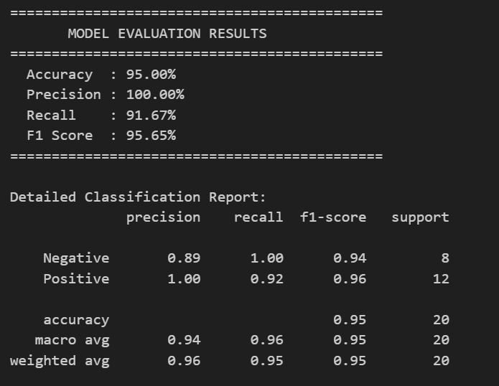
Model Evaluation
Accuracy
95.00%
95 out of 100 predictions are correct
Precision
100%
Every positive prediction was truly positive
Recall
91.67%
92% of actual positives were correctly found
F1 Score
95.65%
Harmonic mean of precision and recall
Evaluation Method: A sample of 20 reviews (8 negative, 12 positive) was manually labelled as ground truth. VADER predictions were compared against these labels using sklearn metrics. The model achieved excellent results with 0 false positives.

Slide 14
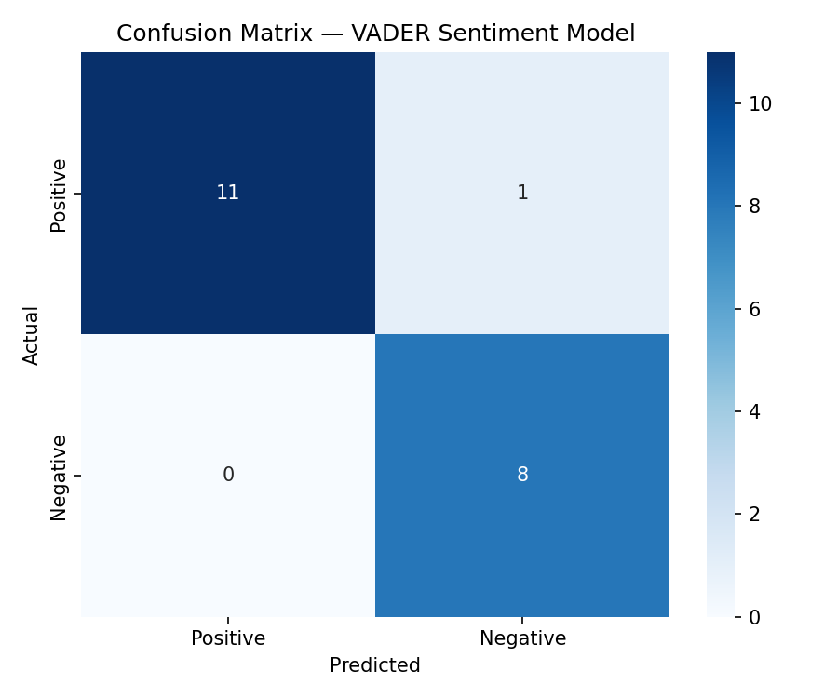
Confusion Matrix
Interpretation
11
True Positive
Correctly predicted positive
8
True Negative
Correctly predicted negative
0
False Positive
No false positive alarms
1
False Negative
1 positive missed as negative

Slide 15
Key Findings & Observations
🏆 Top Restaurants
⚠️ Underperformers
Coffee Break & Palate Tender Bar and Restaurant both scored 0.77 — the highest avg compound scores with entirely positive reviews.
Food Court SMIT (–0.14) and Highway Inn (0.02) scored below threshold. Most of their reviews reflect service and food quality issues.
📊 Dataset Skew
🍜 Dish Insight
84.4% positive reviews indicate Majhitar eateries are generally well-received. The small negative sample (26) slightly limits evaluation diversity.
Momos were the most mentioned dish across reviews, with Tashi Shaa-Khang Chinese Restaurant earning the highest dish-level sentiment score (0.827).
✅ VADER Performance
🔍 Neutral Reviews
VADER achieved 95% accuracy on a 20-sample ground-truth test, with 100% precision — meaning zero false positives in positive classification.
Only 6 reviews (2.9%) were classified as neutral — most reviewers had strong positive or negative opinions about Majhitar restaurants.

Slide 16
Future Scope
01
Deep Learning Models
02
Multilingual Support
Replace VADER with transformer-based models (BERT, RoBERTa) for context-aware sentiment — especially for sarcastic or mixed-language reviews.
Incorporate Nepali and Hindi reviews which are common in Sikkim. Use multilingual NLP models to cover non-English feedback.
03
Aspect-Based Sentiment
04
Real-Time Data Pipeline
Identify sentiment for specific aspects: food quality, service, ambience, pricing — rather than a single overall sentiment score.
Automate data collection via Google Places API or web scraping to refresh reviews periodically without manual CSV entry.
05
Web Application
06
Larger Dataset
Build a user-facing web app (Flask/Streamlit) where locals and tourists can search for dishes and get real-time restaurant recommendations.
Expand coverage to more restaurants, nearby towns (Rangpo, Singtam), and include star ratings to improve model evaluation accuracy.

Slide 17
GitHub Repository
Sentiment Analysis on Restaurant Reviews
https://github.com/nkhllptnk/sentiment-analysis-of-restaurant-reviews.git⁠
Repository Contents
📄 restaurant_reviews_majhitar.csv
— Manually collected dataset — 205 reviews, 21 restaurants
📄 sentiment_analysis.ipynb
— Main Jupyter notebook with full pipeline & visualizations
📄 requirements.txt
— Python dependencies (vaderSentiment, sklearn, pandas, etc.)
📄 README.md
— Project overview, setup instructions, and results summary

Slide 18
Conclusion
✔
Successfully applied VADER sentiment analysis to 205 manually collected Google Reviews from 21 Majhitar restaurants.
✔
Built a complete NLP pipeline: data collection → preprocessing → scoring → classification → visualization → evaluation.
✔
Achieved 95% accuracy, 100% precision and 95.65% F1 score on a labelled test set — demonstrating VADER's suitability for informal review text.
✔
Developed a dish-based recommendation engine that identifies the best restaurant for a specific dish using sentiment of relevant reviews.
✔
Majhitar's food scene is predominantly positive (84.4%) — Coffee Break and Palate Tender Bar lead, while Food Court SMIT needs improvement.
✔
This project demonstrates how NLP can be practically applied to real, locally sourced data from smaller communities with limited digital presence.

Slide 19
THANK YOU

