Slide 1

https://prezi.com/view/NIuRLRTW0XSoslEHmrKm/?referral_token=X1CfOjlnB3FN
(Please view on prezi platform for the presentation to be viewed properly.)

Slide 2
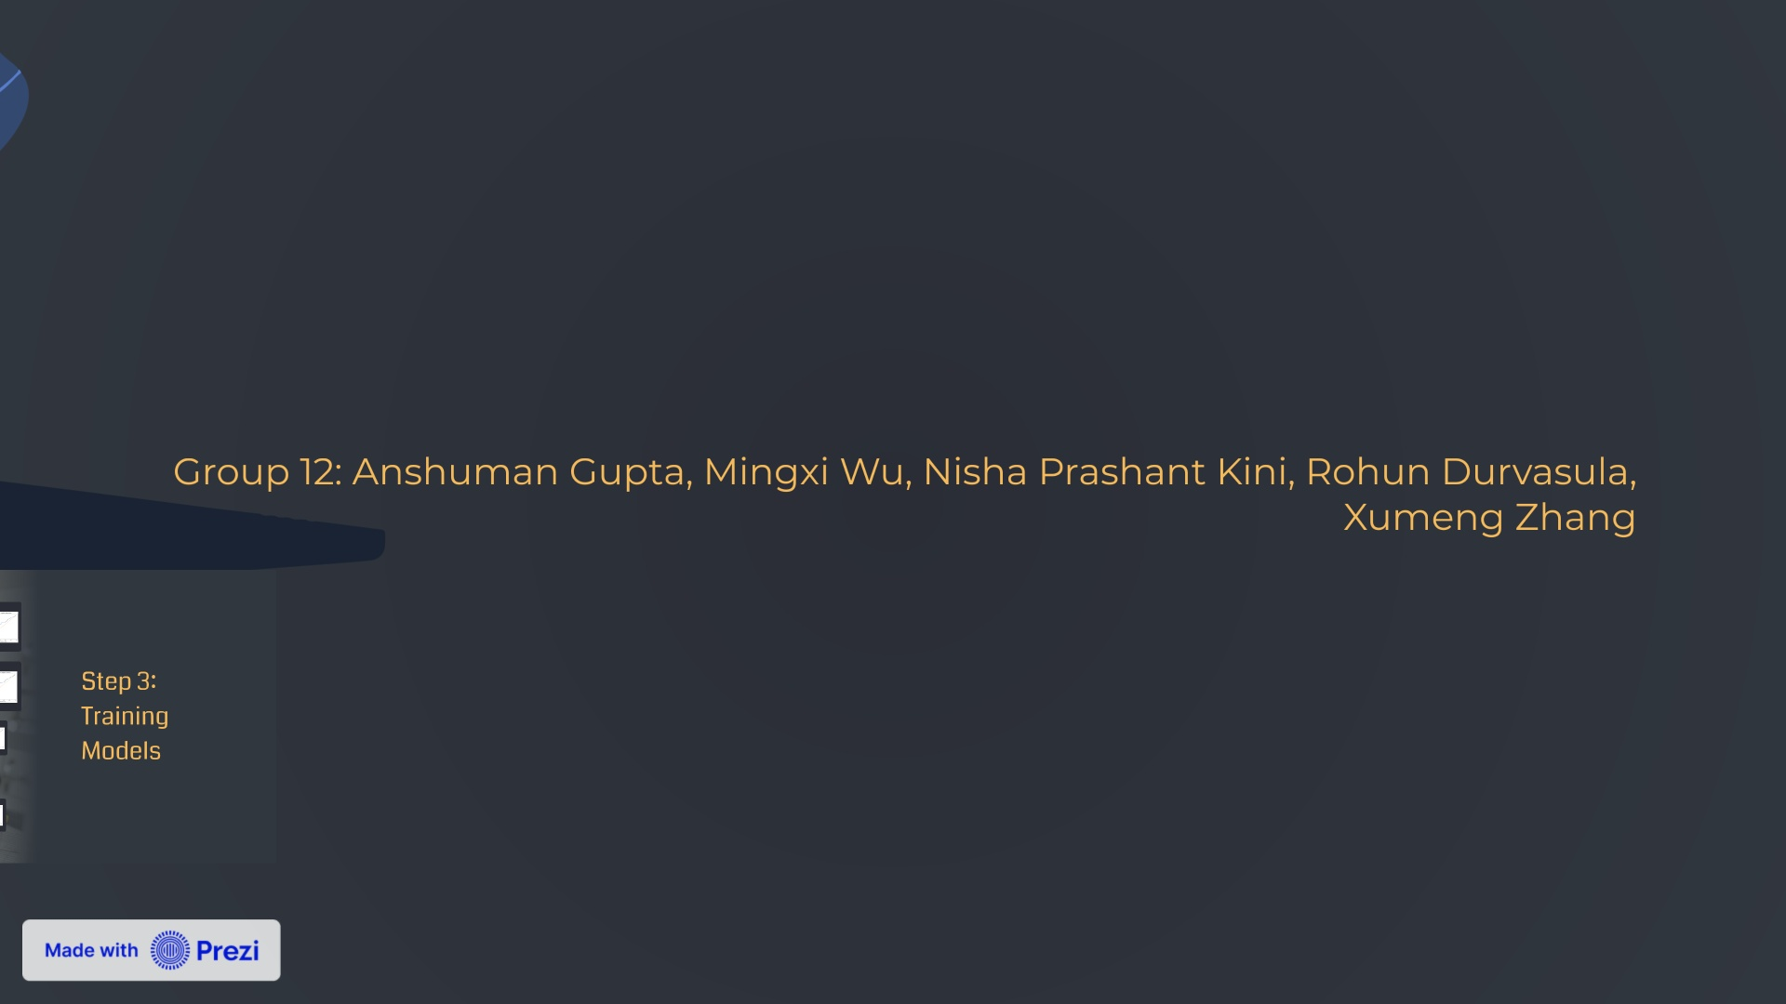

Slide 3
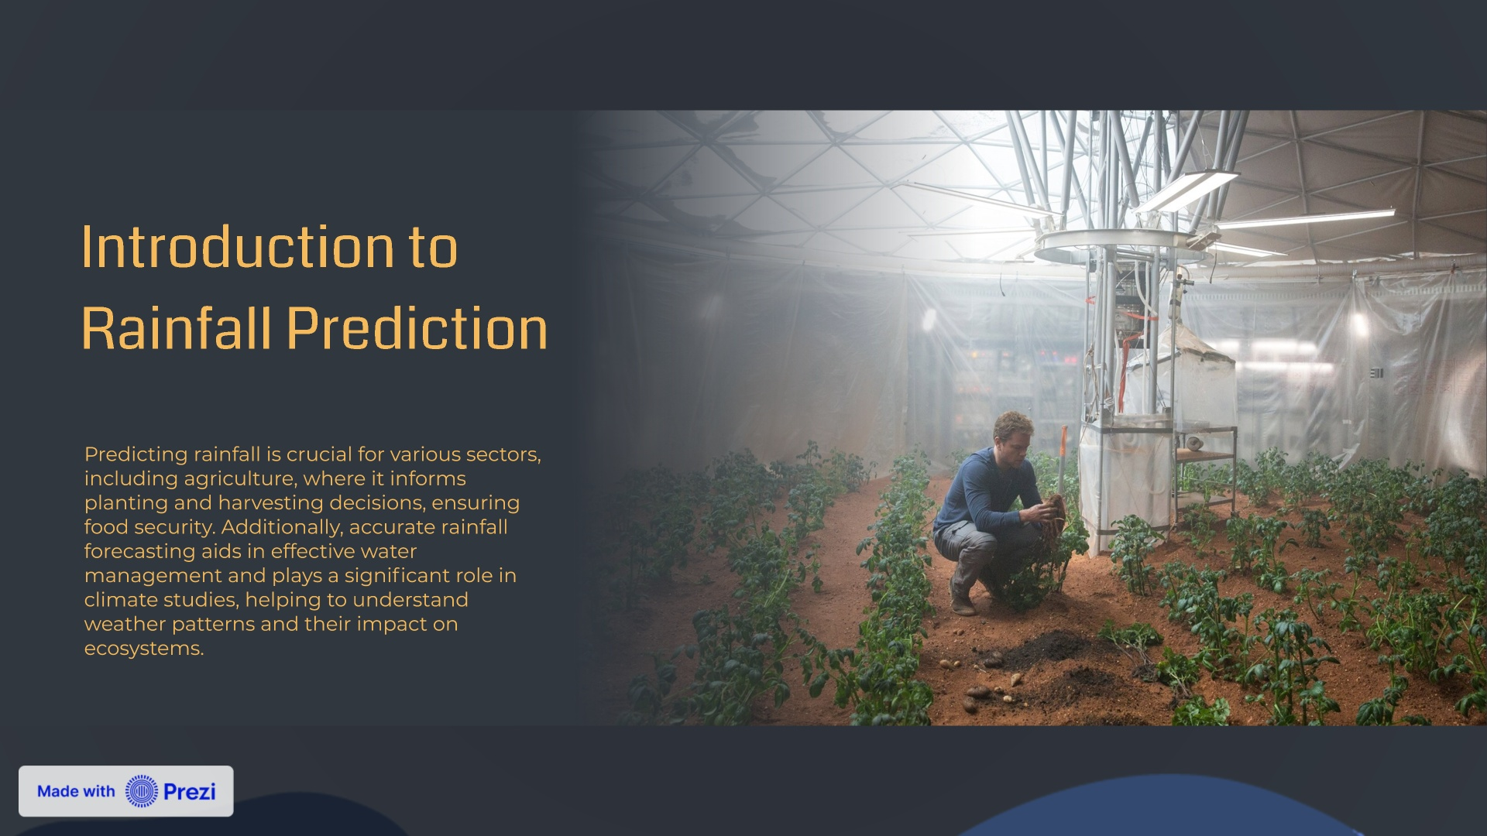

Slide 4
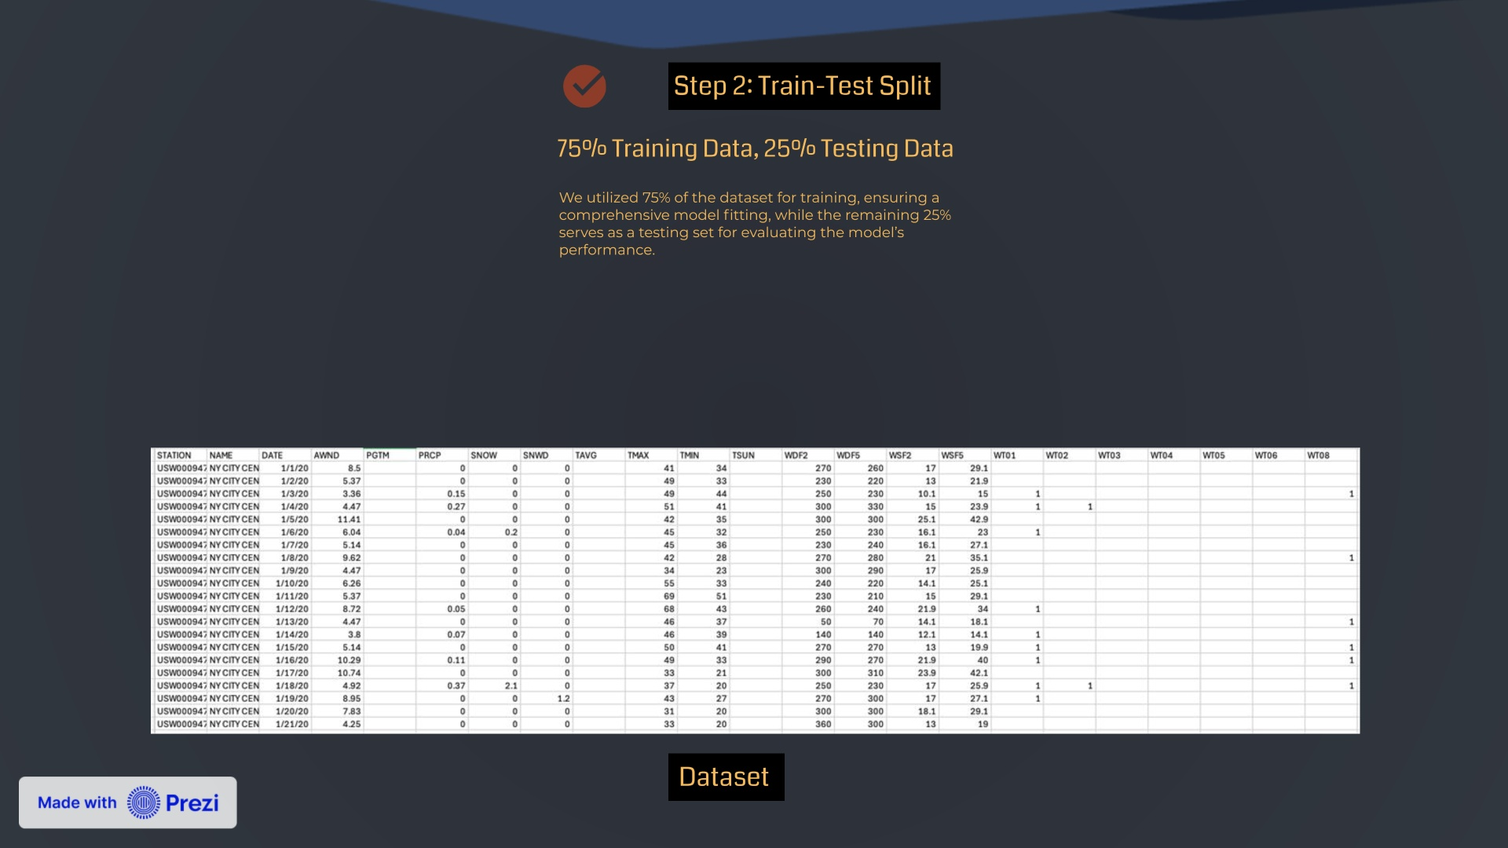

Slide 5


Slide 6
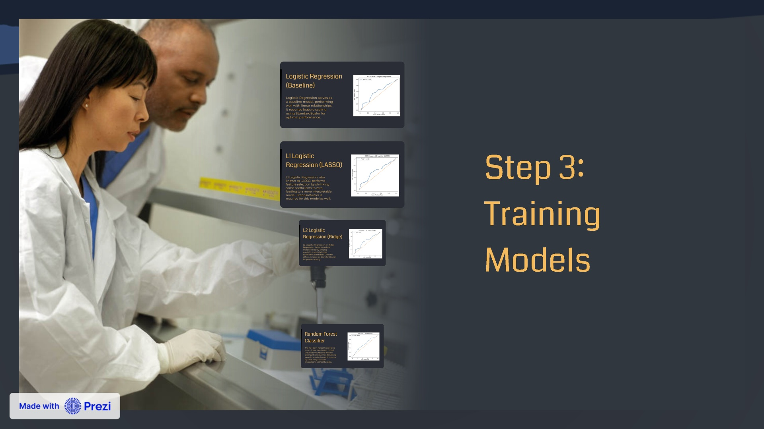

Slide 7
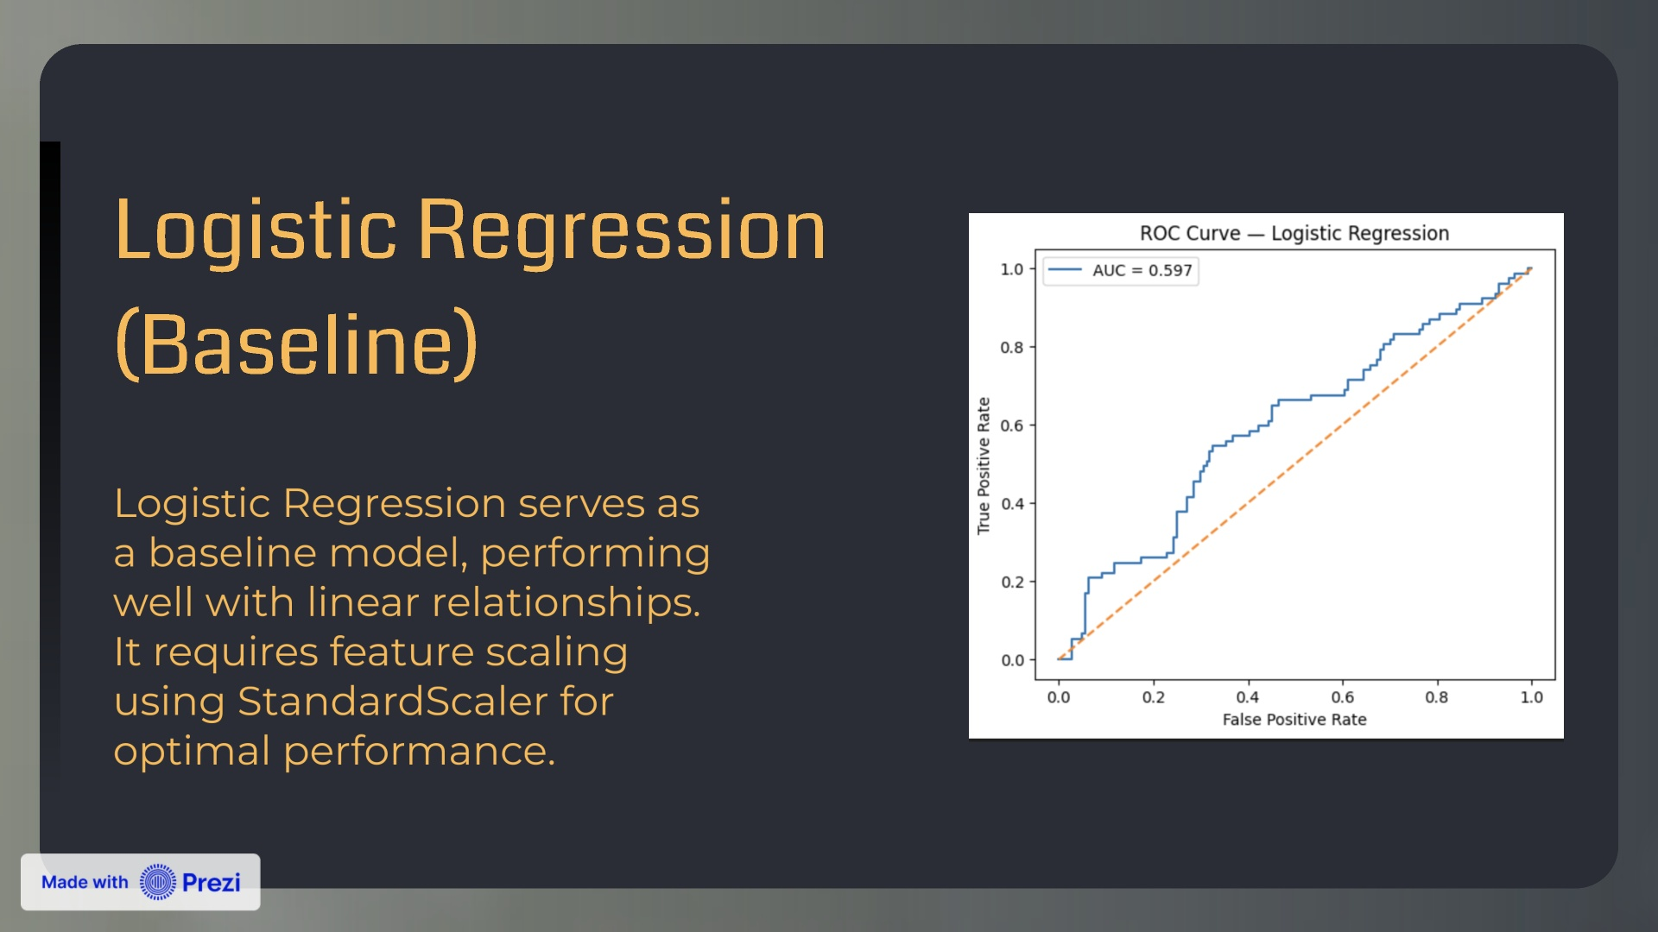

Slide 8
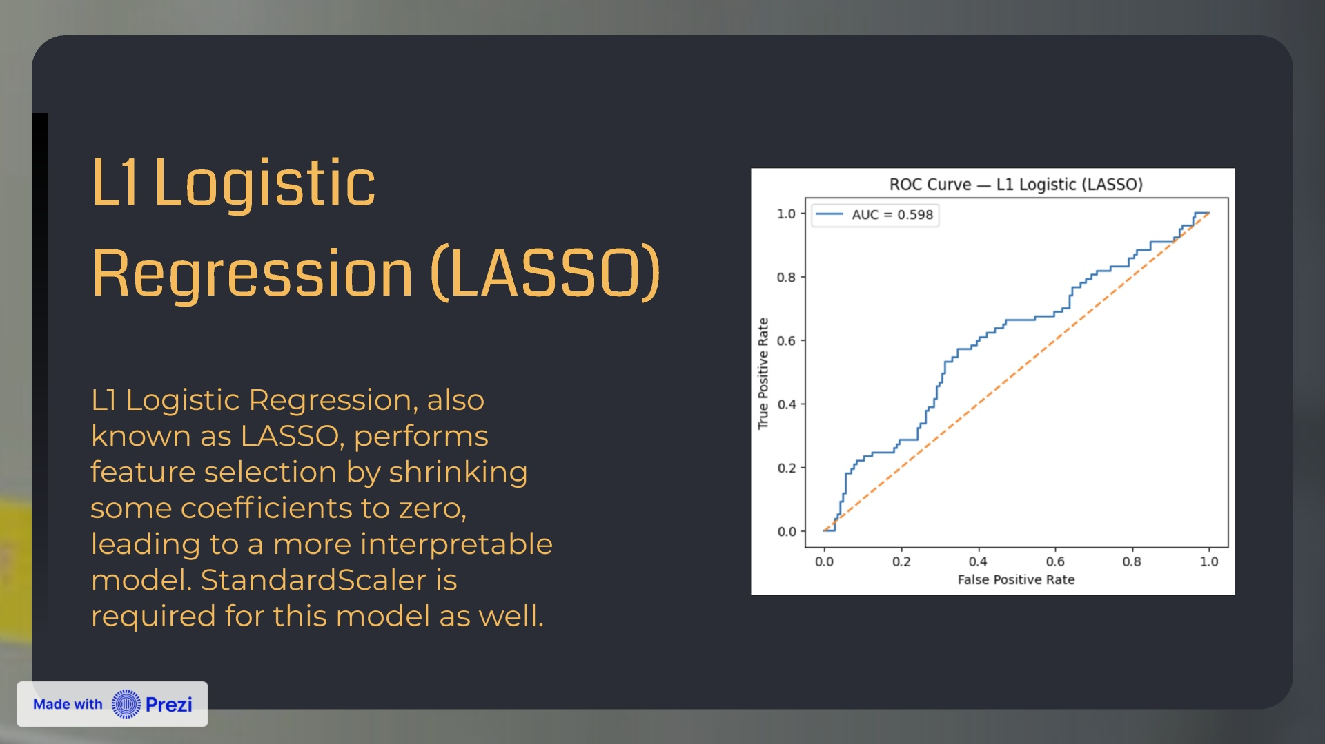

Slide 9
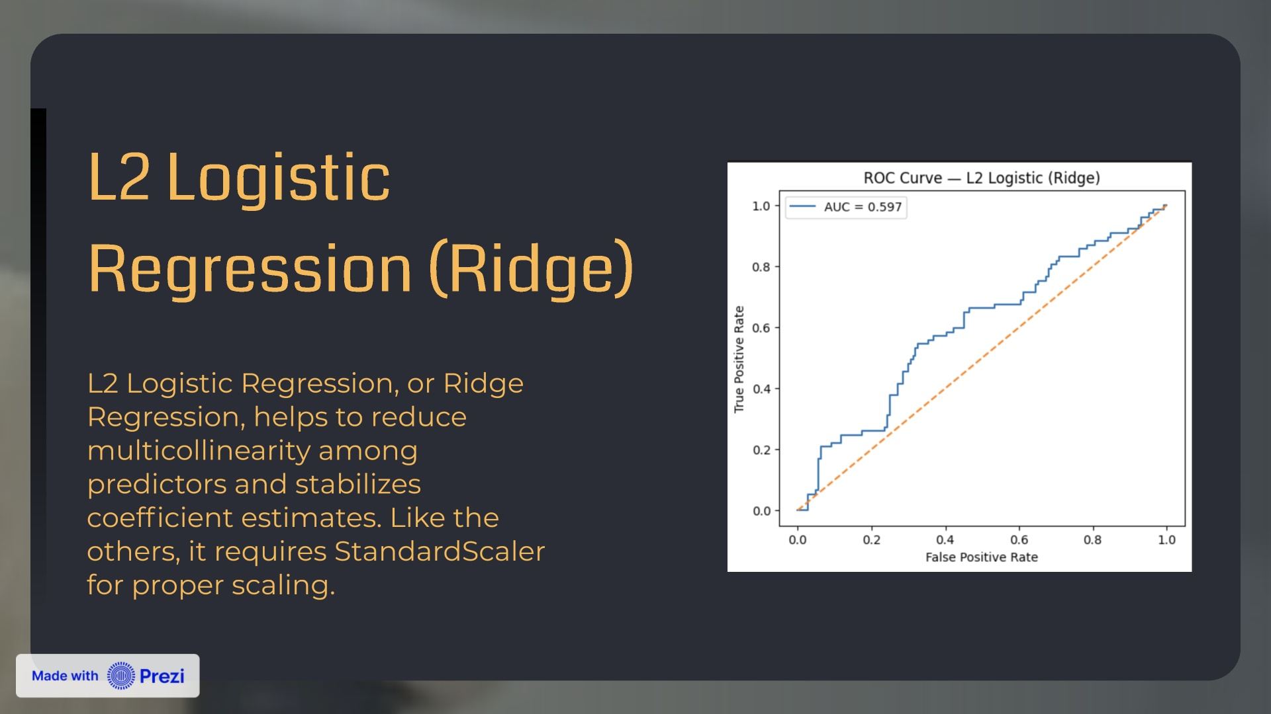

Slide 10
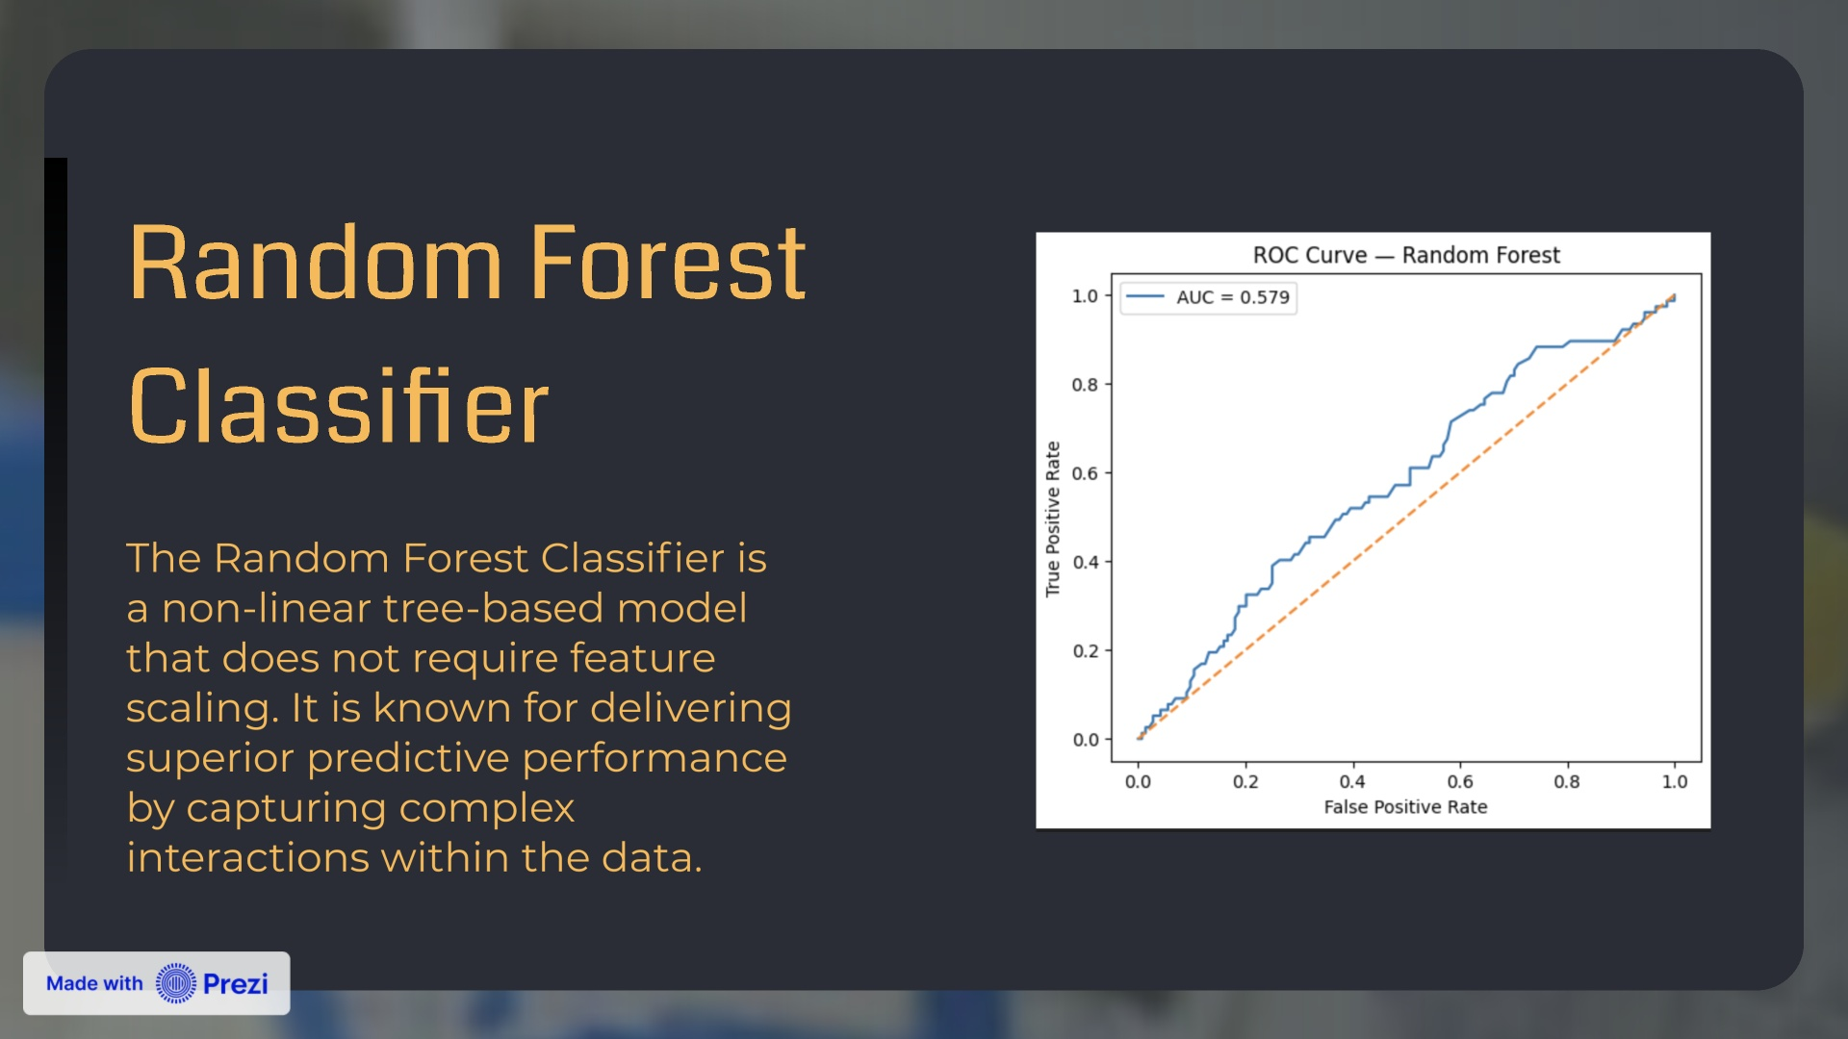

Slide 12
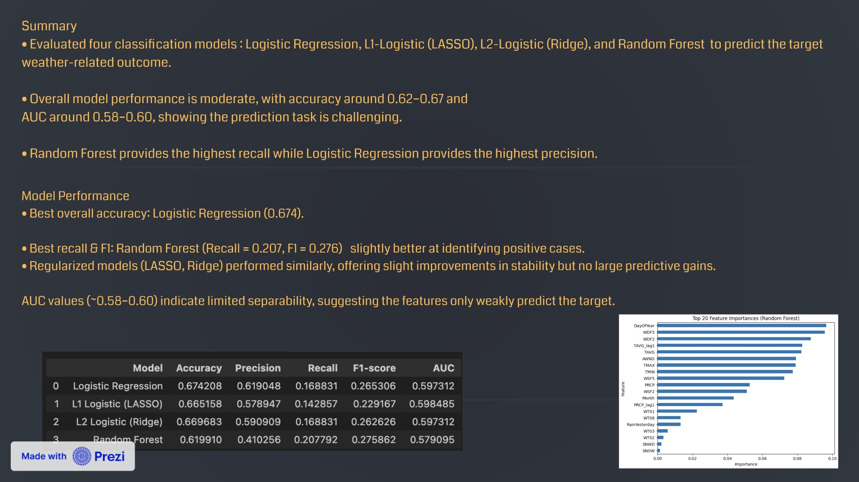

Slide 13
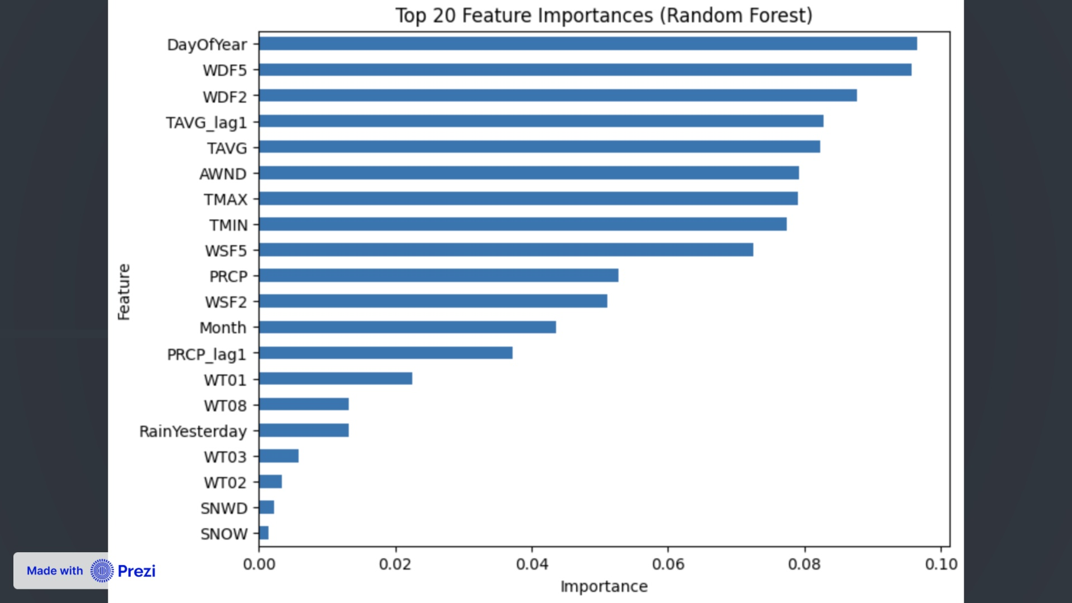

Slide 14
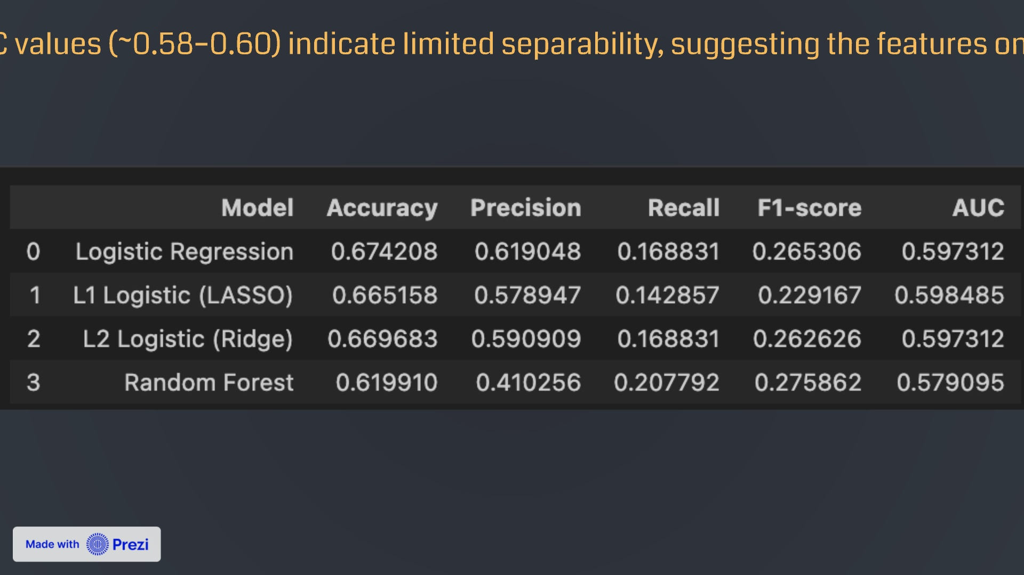

Slide 15


Slide 16


Slide 18

