Slide 1
Paper Reading
主讲人：刘嘉晖
2018.5.18
南开大学智能信息处理实验室

Slide 2
A new method to measure the semantic similarity from query phenotypic abnormalities to diseases based on the human phenotype ontology Hui Lu(SJTU-Yale Joint Center)
Abstract
With the establishment of HPO and the enrichment of phenotype-disease annotations, we pay more attention to the improvement of phenotype-based diagnosis.
Proposed a novel method to measure similarity from the query terms to hereditary disease based on HPO and then rank the candidate diseases.
To evaluate the performance, simulated a set of patients based on 44 complex diseases.

Slide 3
RelativeBestPair
Methods
Human phenotype ontology
RelativeBestPair method
Other semantic similarity methods
Performance evaluation

Slide 4

RelativeBestPair
Methods
Human phenotype ontology (HPO)
Information content (IC) in HPO :
Note : when comparing two sets of phenotypes similarity, other methods just counts the number of same terms, dose not take the semantic inheritance structure of HPO and the different importance of the terms.

Slide 5
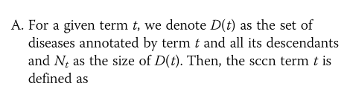
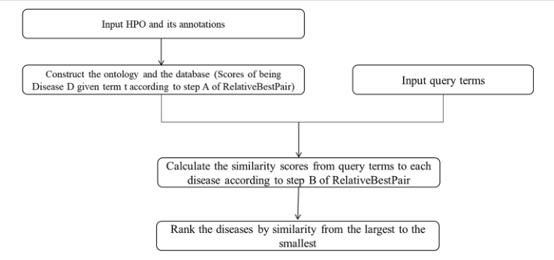
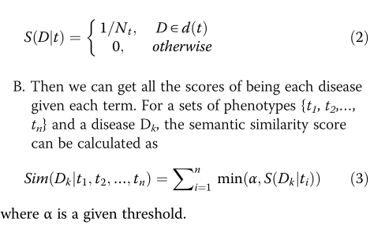
RelativeBestPair
Methods

Slide 6
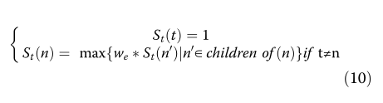
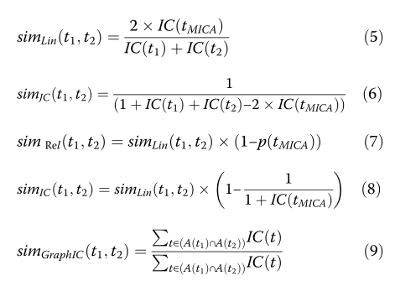


RelativeBestPair
Baselines

Slide 7
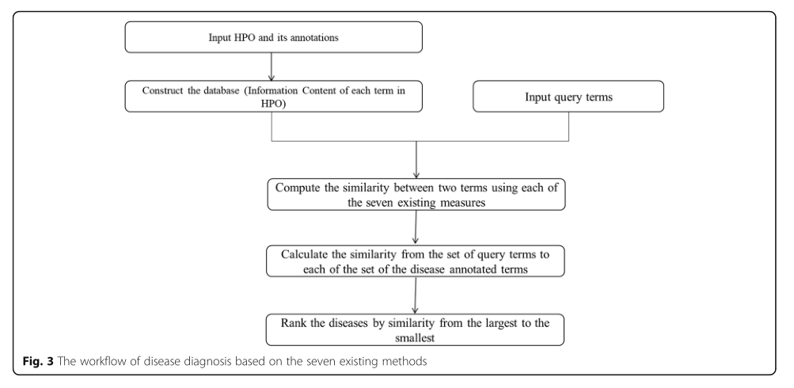
RelativeBestPair
Baselines

Slide 8
RelativeBestPair
Simulate Experiment
First, we assign a disease to each patient.
Second, for each phenotype associated with the assigned disease, a random integer between 0 and 100 was generated to judge if use.
For each of the 44 diseases, we generated 25 patients with at least there phenotypes.
Four datasets(standard, noise, imprecision, noise and imprecision)

Slide 9
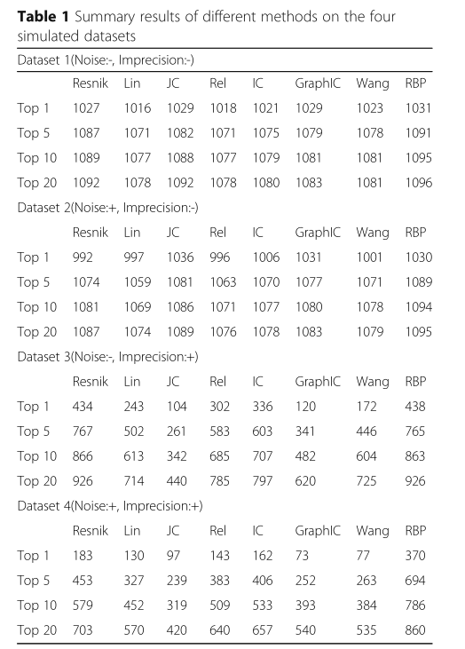
RelativeBestPair
Experiment

Slide 10
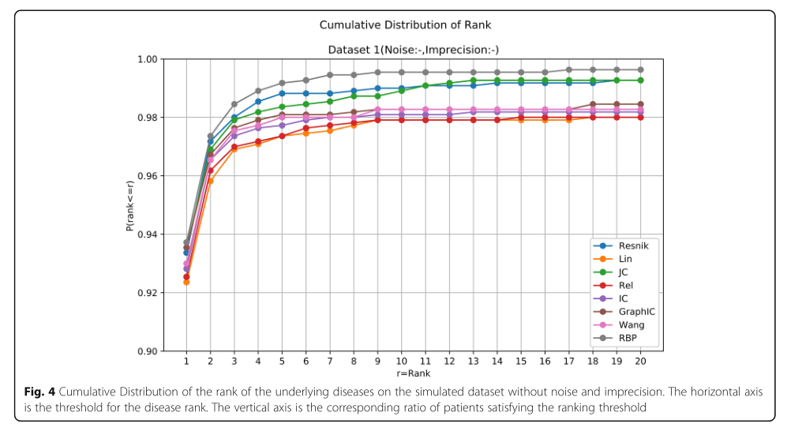
RelativeBestPair
Experiment

Slide 11
RelativeBestPair
Summary
Different from other approaches that calculate the similarity from the query set to a certain disease based on term-term comparison, we directly define the contribution of one phenotype term to the certain disease.
Simulate Patients can be learned.
We can use this method to define disease and phenotype’s relation.

Slide 12
An improved approach to infer protein-protein interaction based on a hierarchical vector space model Ying Qian
Abstract
Comparing and classifying functions of gene products are important in today’s biomedical research.
The semantic similarity derived from the Gene Ontology annotation is the most widely used indicators for protein interactions.
Propose a Hierarchical Vector Space Model(HVSM) for computing semantic similarity between different genes, take GO term’s ancestors and descendants related by “is_a” and “part_of” relations into account.

Slide 13
HVSM
Related Work (3页)
Vector-based : transform a gene product into a vector, then use vectors measure similarity.
Term-based : calculate semantic similarities from term similarities using various combination strategies.
Set-based : view the set of terms as bags of words, then judge if there is a large overlap between two terms.
Graph-based : use graph matching techniques to compute the similarity.

Slide 14


HVSM
Vector-based
Transform a gene term to all GO denoted vector.
Suppose G1 and G2 are annotated by two sets of GO terms.[1]
[1]Intelligo : a new vector-based semantic similarity measure including annotation origin.

Slide 15

HVSM
Term-based
Path-based : shortest path | average path
IC-based :
Hybrid : maximum (MAX)
average(AVG) best-match average(BMA)

Slide 16




HVSM
Set-based
Use the Tversky ratio model of similarity to calculate the similarity between gene products.

Slide 17
HVSM
Graph-based
The similarity is calculated by quantifying the difference between two sub-graphs.
Three disadvantages :
1. a few measures only takes into account the shared terms in the sub-graphs, ignoring the edge type.
2. graph matching have a weak correlation with similarity between terms.
3. graph matching is an NP-complete problem.

Slide 18
HVSM
Hybrid approaches
Machine Learning : SVM 、 random forest 、 Adaboost
Natural Language Processing

Slide 19
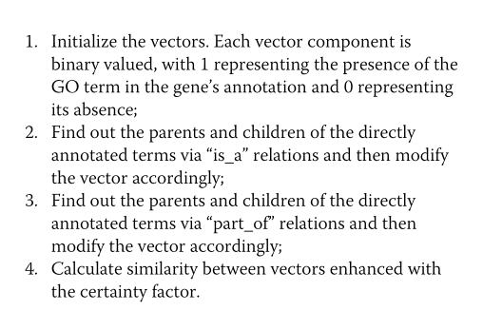
HVSM
Methods

Slide 20
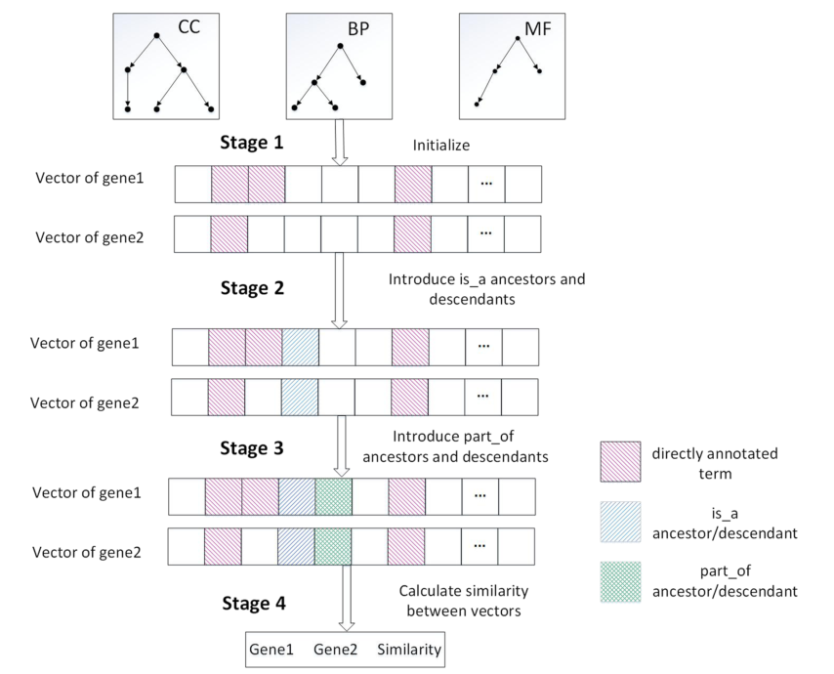
HVSM
Methods

Slide 21








HVSM
Methods
21

Slide 22


HVSM
Methods
Certainty Factor
Note: remove all the common zero dimensions of two vectors.
22

Slide 23
HVSM
Experiment
Datasets: Homo sapiens 、 Saccharomyces cerevisiae PPI datasets and GO annotation file
Measures : ROC, AUC
23

Slide 24
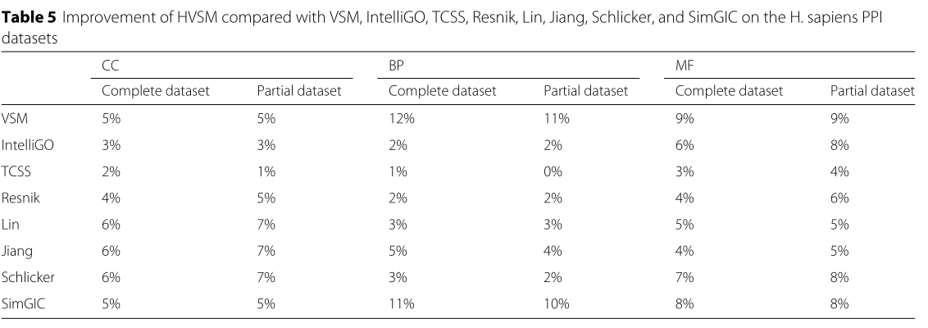
HVSM
PPI tests
24

Slide 25
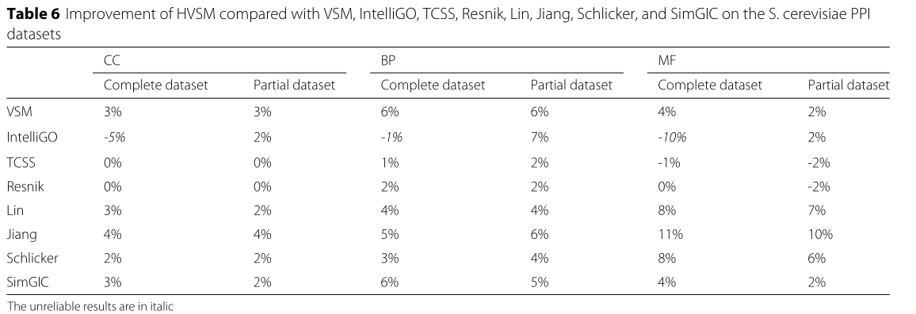
HVSM
PPI tests
25

Slide 26
HVSM
Summary
Related work is specific, but not necessary.
Picture’s location bad.
Method : consider the children, and the rate, and in the vector way, we can easily accept it.

