Slide 1
20180330 Paper Discussion
Finding Cut from the Same Cloth:
Cross Network Link Recommendation via
Joint Matrix Factorization
Junhao Yuan
From AAAI-17

Slide 2
Cross Network Link Recommendation via Joint Matrix Factorization
Authors:
Arizona State University
Arun Reddy Nelakurthi
Jingrui He

Slide 3
Introduction
Cross network link recommendation
Identify similar patients from heterogeneous SNs (Aim)
Jointly decompose the user-keyword matrices
Previous Work: different accounts same user / find complementary
Cross Network Link Recommendation via Joint Matrix Factorization

Slide 4
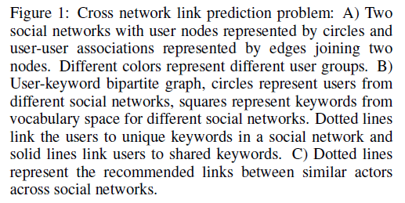
Cross Network Link Recommendation

Slide 5

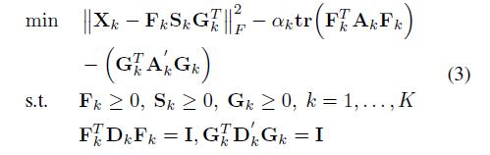
Related NMTF
NMTF
Graph based NMF
IGNMTF Gu, Ding, Han(2011) + Huang et al.(2014)

Slide 6
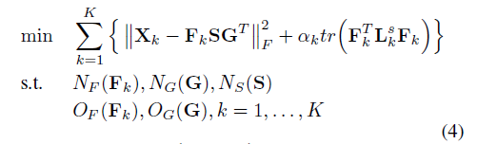
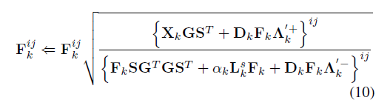
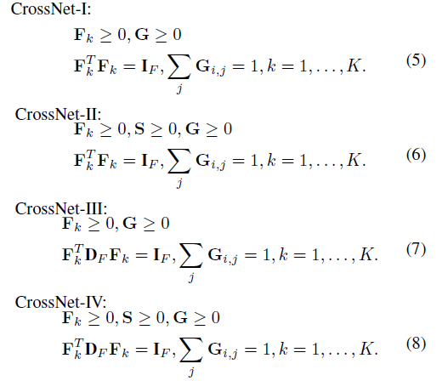
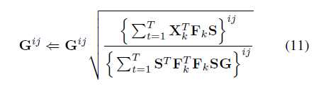
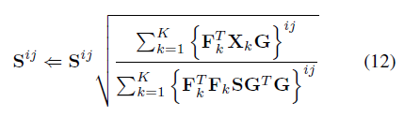
CrossNet Algorithm

Slide 7
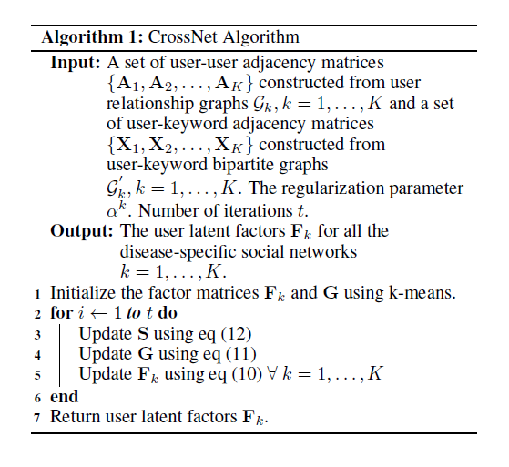
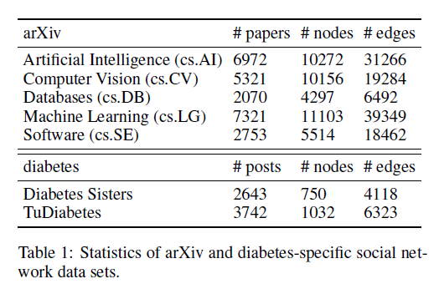
CrossNet Algorithm & Datasets
Link Recommendation -> Random Walk with Restart

Slide 8
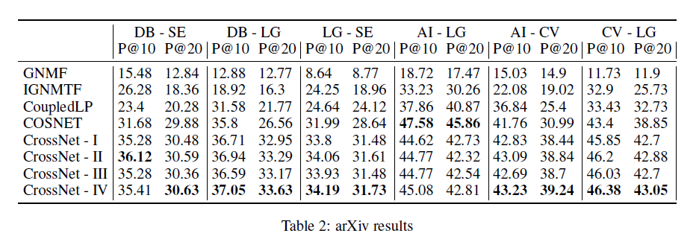
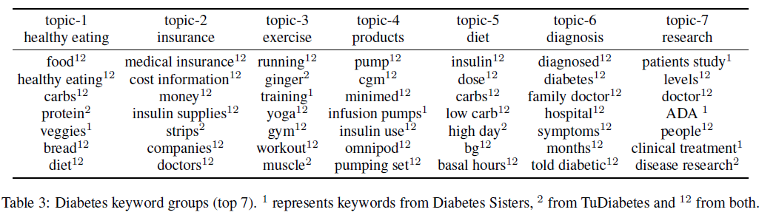
Performance

Slide 9
Conclusion
NMTF
Symmetric Normalized Laplacian
Orthogonal Constraints

Slide 10
THANK YOU

