Slide 1
Paper Reading
主讲人：刘嘉晖
2018.3.23
南开大学智能信息处理实验室

Slide 2
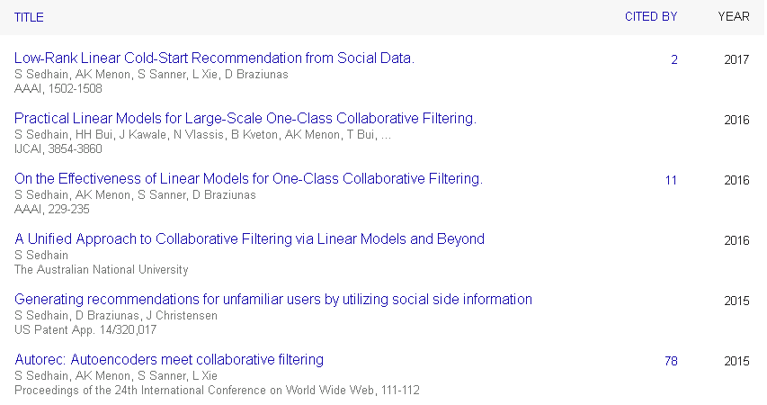
LoCo
Low-Rank Linear Cold-Start Recommendation from Social Data
Author : Suvash Sedhain
Related Work:

Slide 3
LoCo
Abstract
Cold-start problem
Recent work has shown that social metadata can mitigate the problem
But they limit scalability, or require tuning several hyperparameters.
Propose LoCo, new model for this problem based on three ingredients: linear regression, low-rank, scalable learning

Slide 4
LoCo
Introduction
Other’s work.
Our first contribution: Show how three popular cold-start models can be seen as a special case of a linear content-based model, and their drawbacks.
Our second contribution: A new model, LoCo, that overcomes these limitations by employing three ingredients.

Slide 5


LoCo
Background
.
Collaborative and content-based filtering.
The user cold-start problem
。
Approaches to cold-start recommendation

Slide 6



LoCo
Background
Approaches to cold-start recommendation
Neighborhood +metadata similarity
Since we can’t use a neighborhood model with a similarity S computed from Rte.
Matrix factorization with regularization

Slide 7



LoCo
Unified view of methods
Social neighborhood model
CMF model

Slide 8
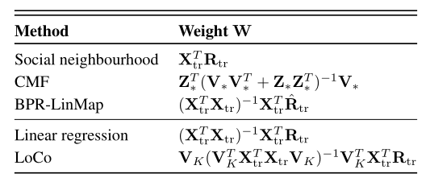






LoCo
Unified view of methods
BPR - LinMap model
Pros and cons of existing approaches

Slide 9



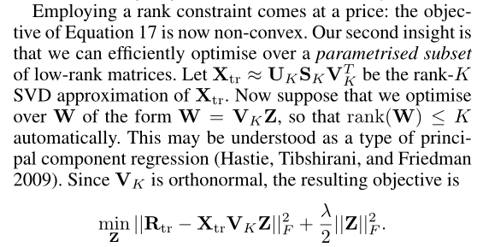

LoCo
Method

Slide 10
LoCo
Experiment
Datasets: Ebook、Flickr、Blogcatalog、Hetrec11-LastFM
Baselines：
CBF-KNN-Low
Cos-Cos
BPR-LinMap-Low
CMF
Measure: precision@k, recall@k, map@100
Comparison、Sensitive、Runtime

