Slide 1
Drug-Target Interaction Prediction with Graph Regularized Matrix Factorization
IEEE/ACM TRANSACTIONS ON COMPUTATIONAL BIOLOGY AND BIOINFORMATICS
Ali Ezzat, Peilin Zhao, Min Wu, Xiao-Li Li, and Chee-Keong Kwoh
School of Computer EngineeringHong Kong Nanyang Technological University
By LiuXiaohu

Slide 2
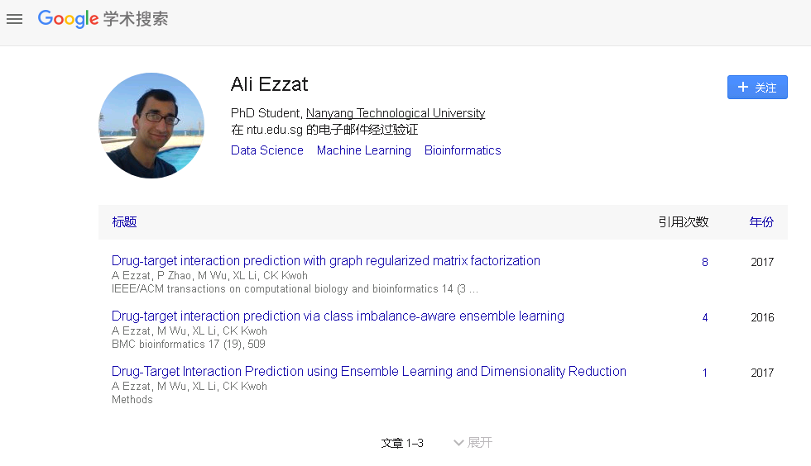
Author： Ali Ezzat

Slide 3
Objective：Drug-Target Interactions Prediction
Motivation：
However, these algorithms had difficulty predicting interactions involving new drugs or targets for which there are no known interactions
Method：we propose two matrix factorization methods that use graph regularization

Slide 4

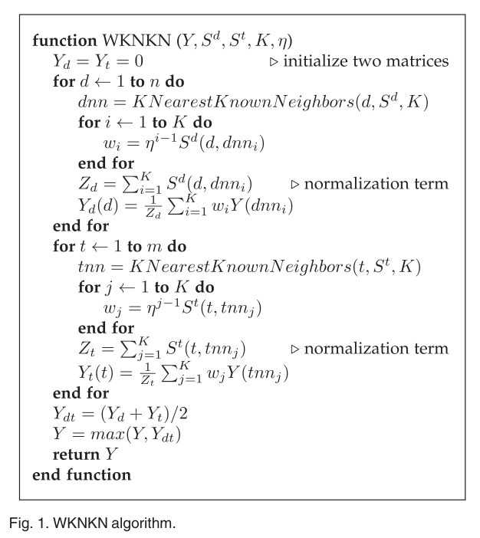
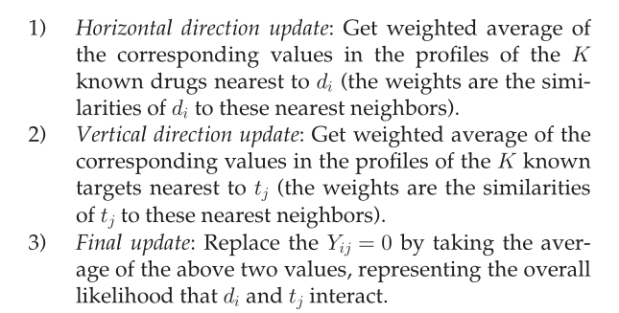
Method：

Slide 5
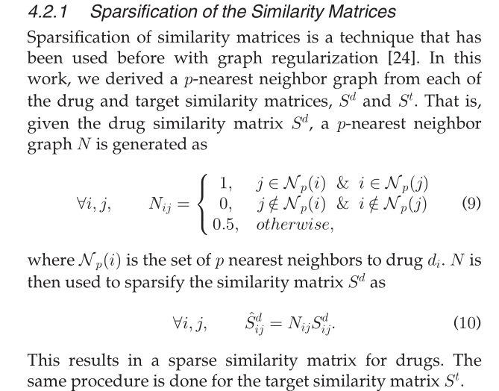
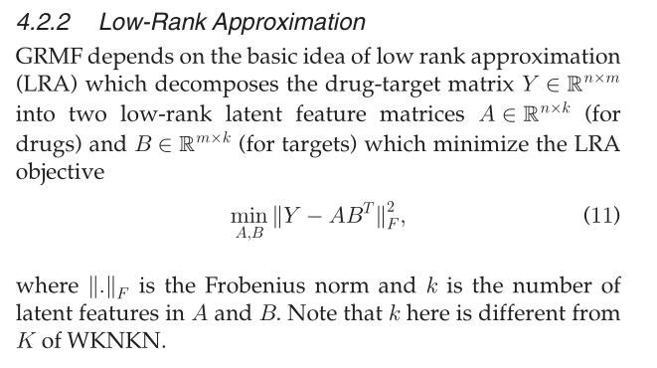
Method：

Slide 6
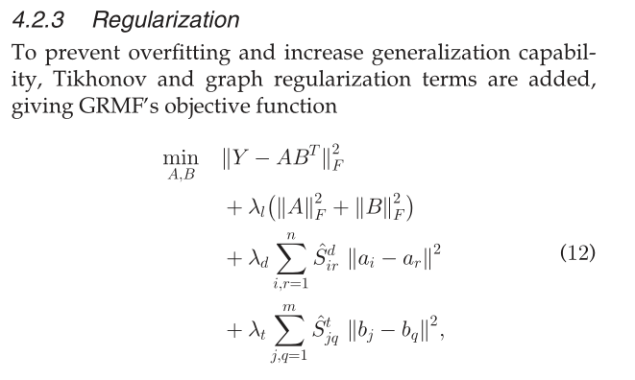
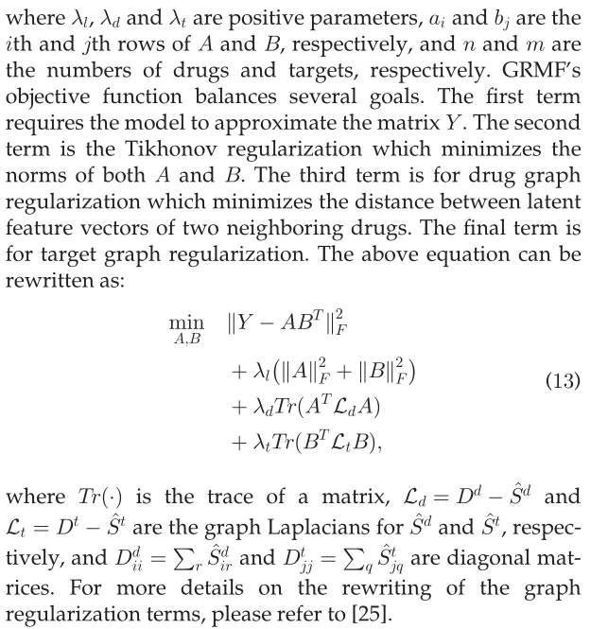
Method：

Slide 7
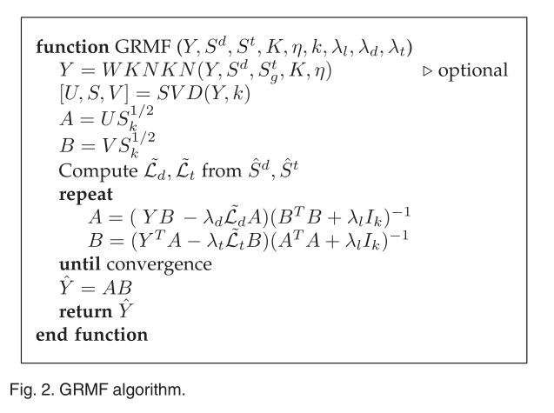
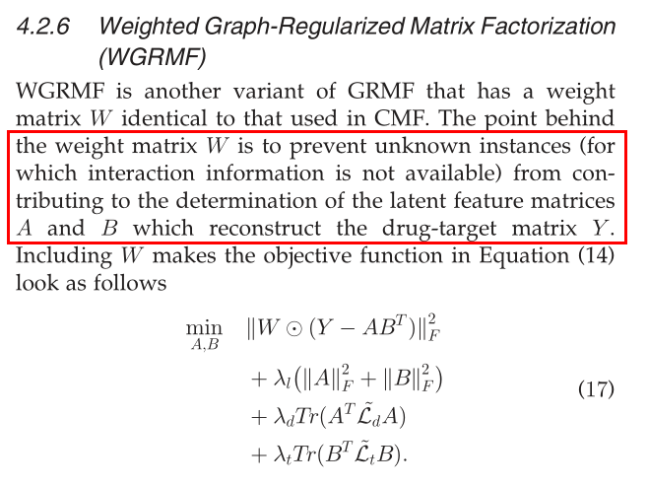
Method：

Slide 8
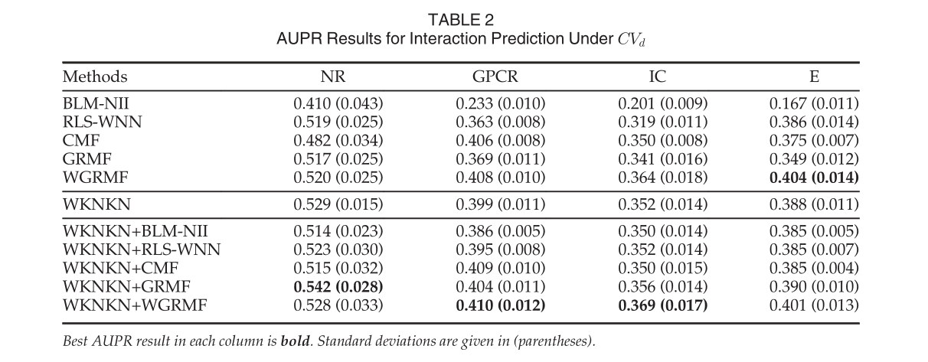
Result：

Slide 9
Predicting Drug–Target Interactions With
Multi-Information Fusion
IEEE JOURNAL OF BIOMEDICAL AND HEALTH INFORMATICS
Lihong Peng, Bo Liao, Wen Zhu, Zejun Li, and Keqin Li
the College of Information Science and Engineering
Hunan University

Slide 10
Objective：Drug-Target Interactions Prediction
Motivation：
Most models only consider chemical structures and protein sequences, and other models are oversimplified
Moreover,datasetsusedforanalysiscontain only true-positive interactions, and experimentally validated negative samples are unavailable
Method： we developed a semi-supervised based learning framework called NormMulInf through collaborative filtering theory by using labeled and unlabeled interaction informa-
tion

Slide 11
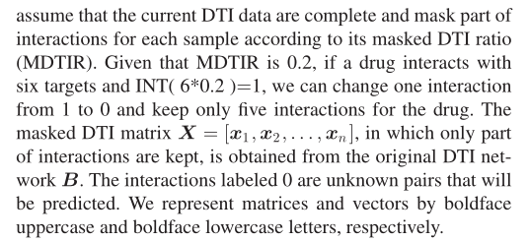
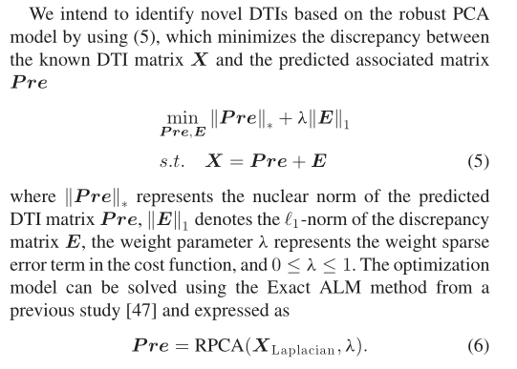
Method：

Slide 12

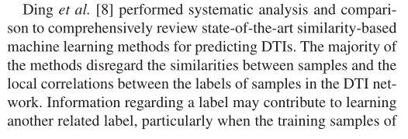
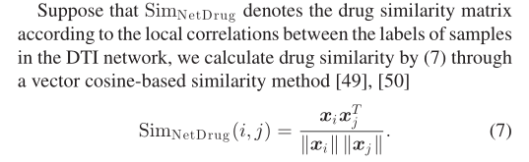


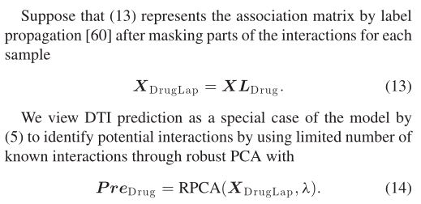

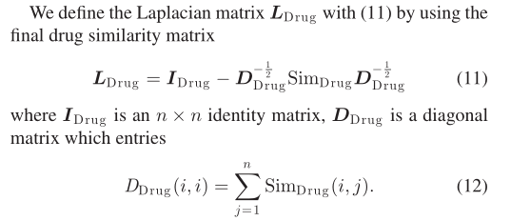
Method：

Slide 13



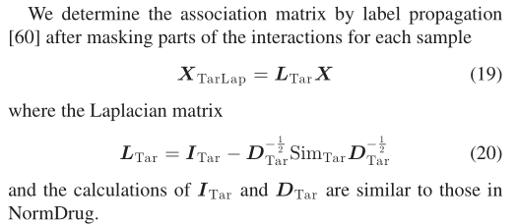


Method：

Slide 14
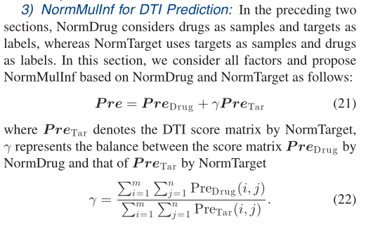
Method：

Slide 15
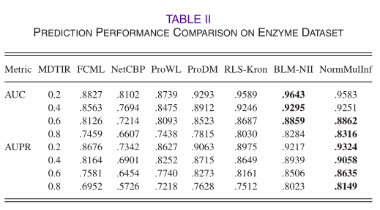
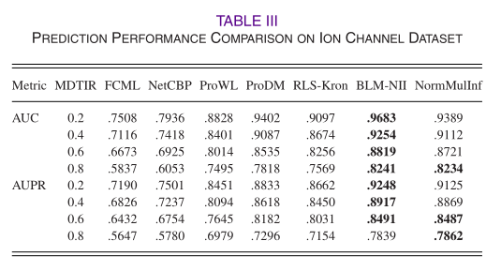
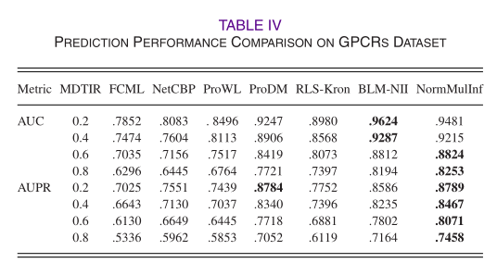
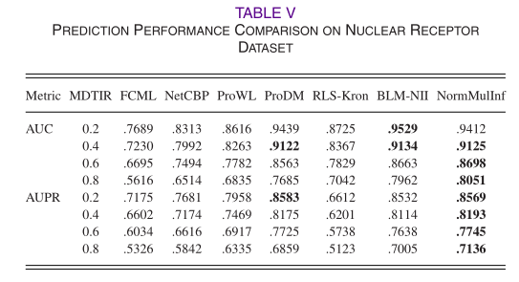
Result：

