Slide 1
NIPS-2017-Paper Introduction
Presented by: fanxin
Time:2017-12-08

Slide 2
Papers
Representation of Graph Data
DeepWalk:Online Learning of Social Representations
Inductive Representation Learning on Large Graphs
Protein Interface Prediction using Graph Convolutional Networks
PU-learning
Positive Unlabeled Learning with Non-negative Risk Estimator
Graph Matching
Graph Matching via Multiplicative Update Algorithm

Slide 3
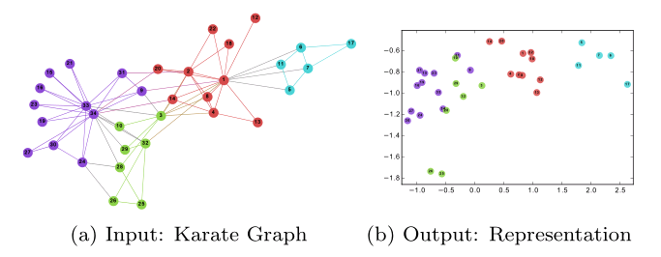
DeepWalk
DeepWalk:Online Learning of Social Representations
A novel approach for learning latent representations of vertices in a network

Slide 4
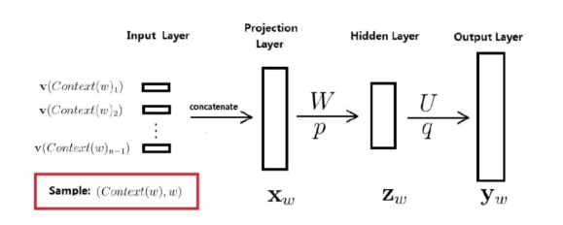
Review of Word2vec
Tianjin is a nice city
Tianjin -> (1, 0, 0, 0, 0) is -> (0, 1, 0, 0, 0) a -> (0, 0, 1, 0, 0) …
(is,Tianjin)，(is,a)，(a,is)，(a,nice)，(nice,a)，(nice,city)

Slide 5
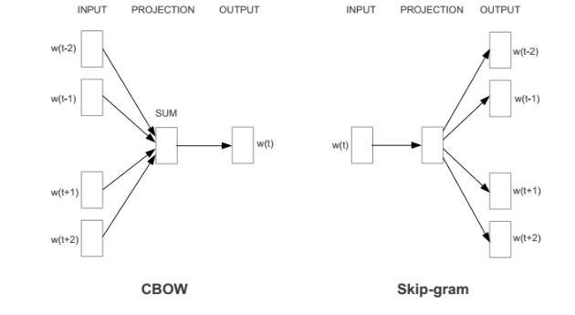
Review of Word2vec
Improved

Slide 6
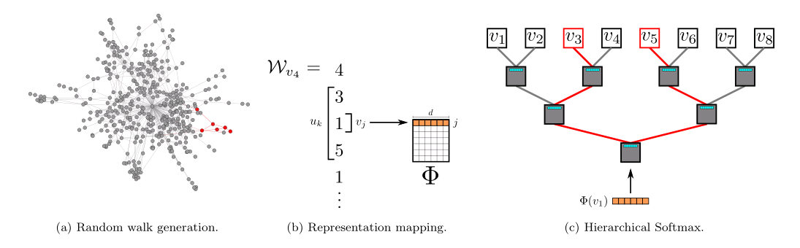
DeepWalk
DeepWalk uses local information obtained from truncated random walks to learn latent representations by treating walks as the equivalent of sentences

Slide 7
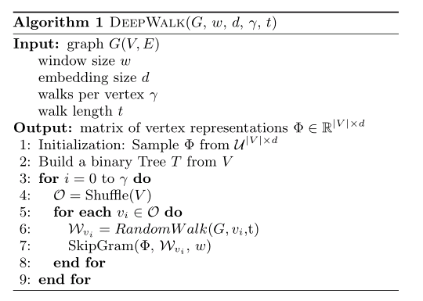
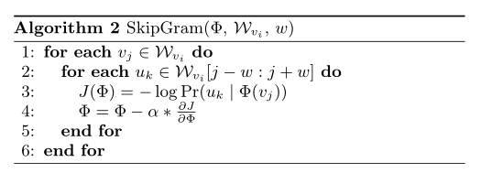
DeepWalk

Slide 8
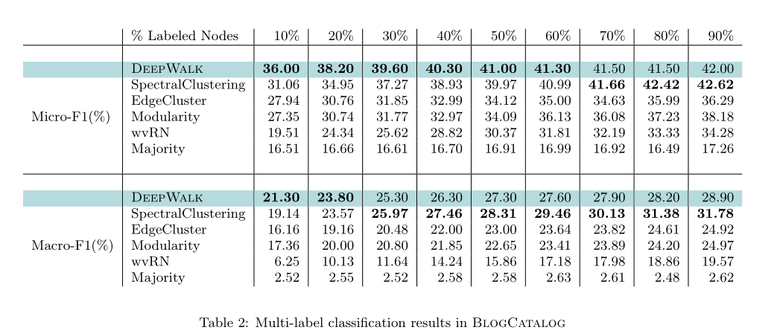
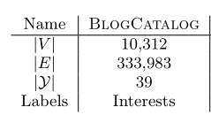
DeepWalk
Evaluation
BlogCatalog is a network of social relationships provided by blogger authors. The labels represent the topic categories provided by the authors.

Slide 9
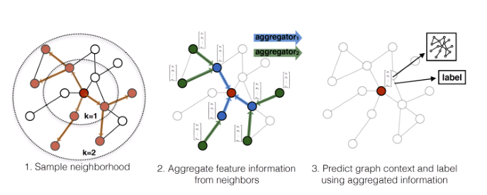
GraphSAGE
Inductive Representation Learning on Large Graphs(GraphSAGE)
A general inductive framework that leverages node feature information (e.g., text attributes) to efficiently generate node embeddings for previously unseen data

Slide 10
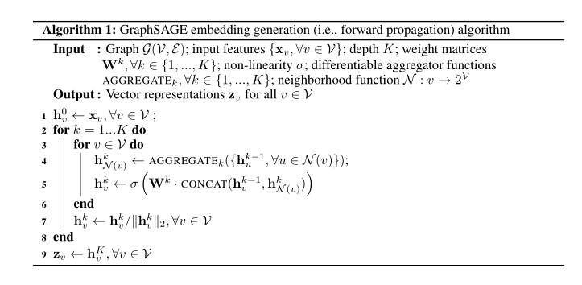
GraphSAGE
Aggregator Architectures
Mean aggregator
LSTM aggregator
Pooling aggregator
Learning the parameters

Slide 11
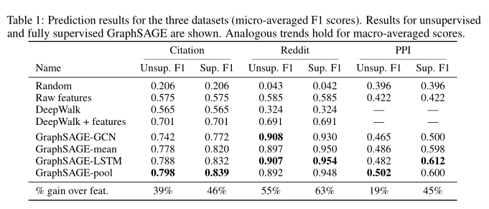
GraphSAGE
Evaluation
protein-protein interaction (PPI) graphs
use positional gene sets, motif gene sets and immunological signatures as features
gene ontology sets as labels (121 in total)

Slide 12
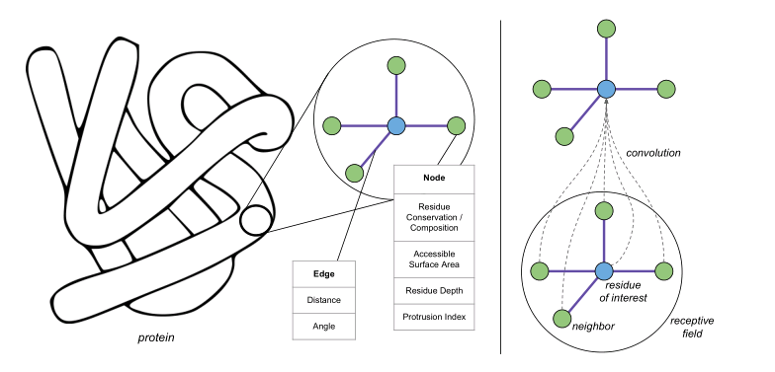
GCN
Protein Interface Prediction using Graph Convolutional Networks

Slide 13
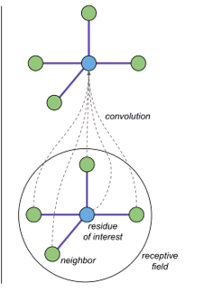

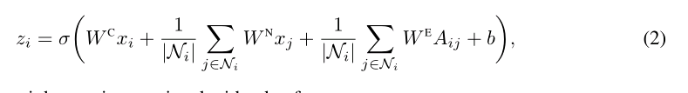

GCN

Slide 14
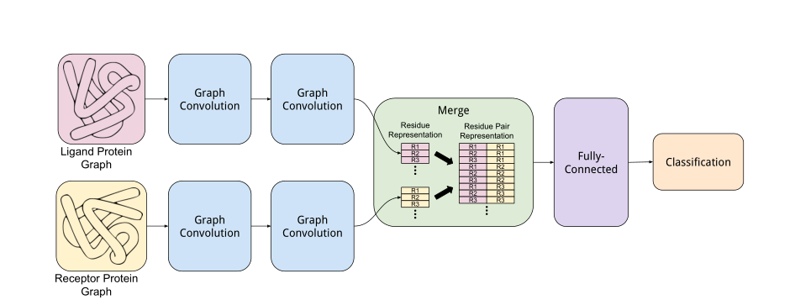
GCN

Slide 15
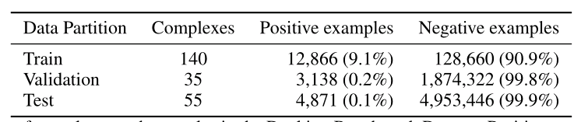
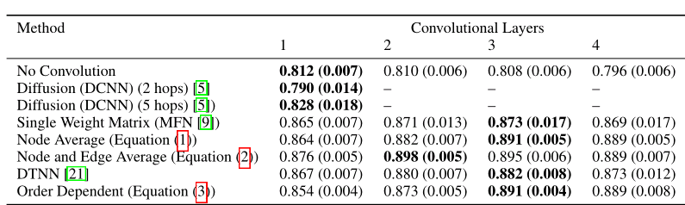
GCN
Experiment

Slide 16
nnPU
Positive-Unlabeled Learning with Non-Negative Risk Estimator
PN-learning
PU-learning

Slide 17
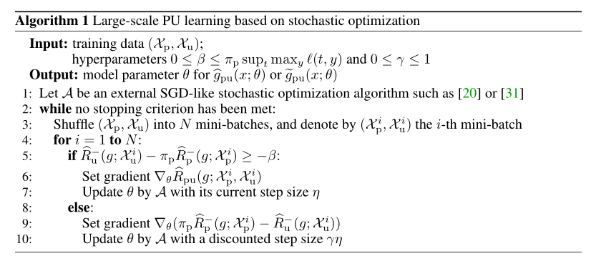
nnPU
Non-negative risk estimator

Slide 18
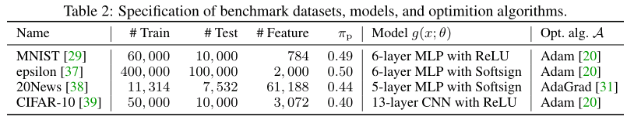
nnPU
Experiment

Slide 19
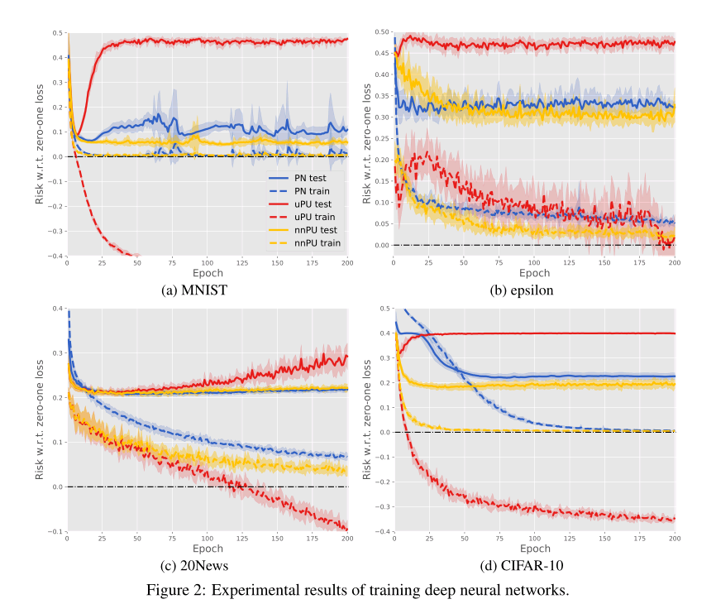
nnPU

Slide 20

MPGM
Graph Matching via Multiplicative Update Algorithm
Problem Formulation
1
2
3

Slide 21
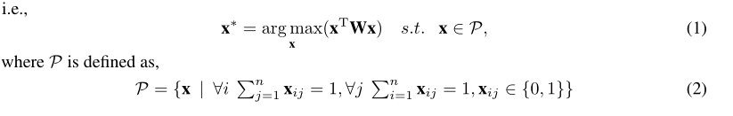

MPGM
Objective

Slide 22
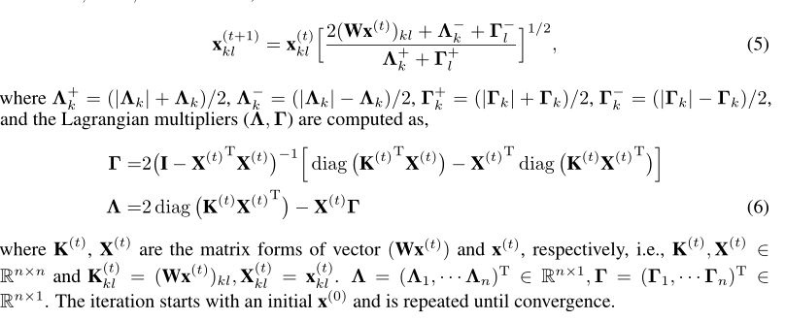
MPGM
Solution

Slide 23
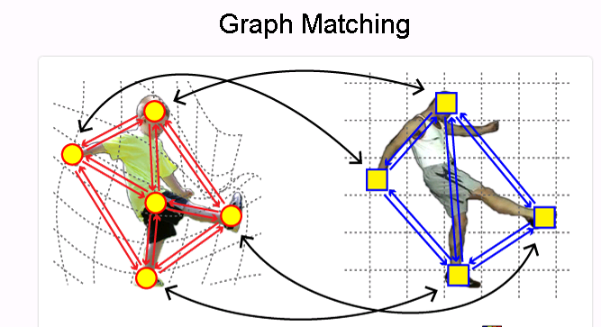
MPGM

Slide 24
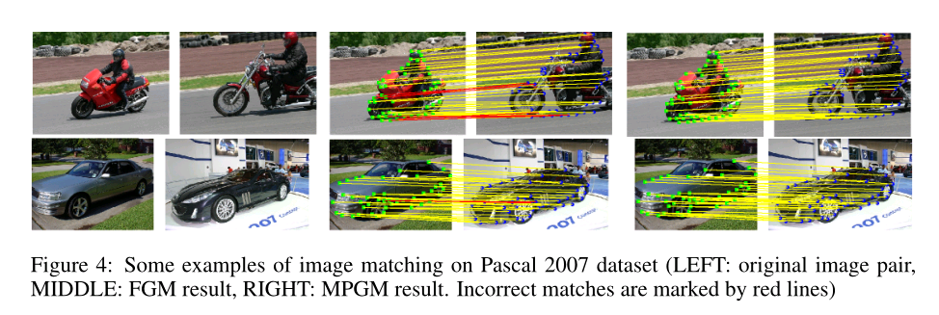
MPGM

Slide 25
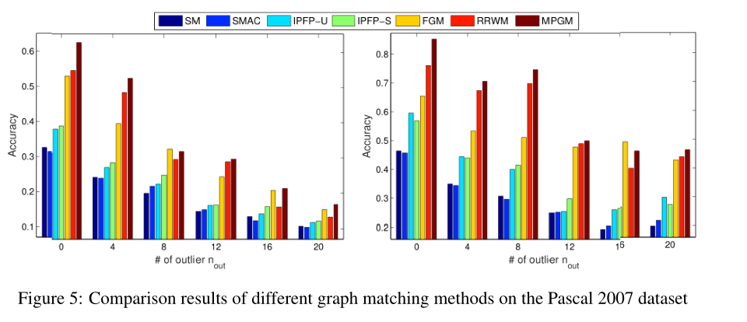
MPGM

Slide 26
Q&A

