Slide 1
Paper Introduction
Presented by: Hong Yuxiang
Time:2017-12-10

Slide 2
Papers
Adaptive Manifold Regularized Matrix Factorization for Data Clustering-IJCAI-2017
On Mixed Memberships and Symmetric Nonnegative Matrix Factorizations-ICML2017
Joint Capped Norms Minimization for Robust Matrix Recovery-IJCAI-2017
Improved Bounded Matrix Completion for Large-Scale Recommender Systems-IJCAI2017
Multi-Component Nonnegative Matrix Factorization-IJCAI-2017
Privileged Matrix Factorization for Collaborative Filtering-IJCAI-2017
Tensor Decompositions and Applications-2007
metric_learning_tutorial_CIL-2013

Slide 3
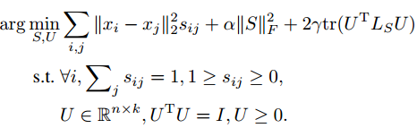
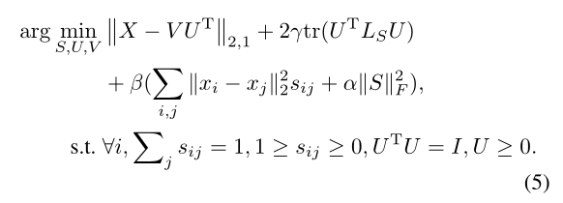
AMRMF
Adaptive Manifold Regularized Matrix Factorization for Data Clustering-IJCAI-2017
Abstract
Spectral clustering is not optimal
Jointly learn an affinity matrix and matrix factorization
Employ l-2,1 norm to relieve effect of outlier
ALM to get the optimal
Loss Function

Slide 4
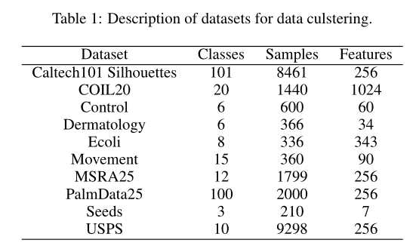


AMRMF
Experiment
ACC
NMI

Slide 5
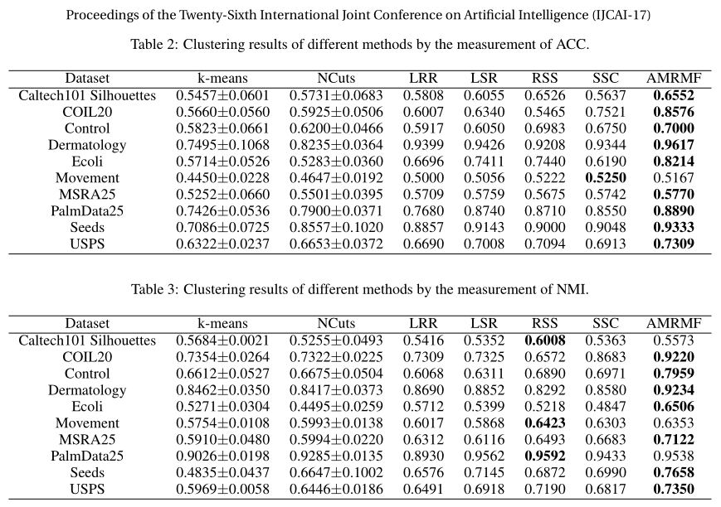

Slide 6
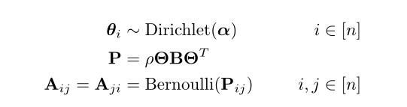

GeoNMF
On Mixed Memberships and Symmetric Nonnegative Matrix Factorizations-ICML2017
Abstract:
Combine two kind of approaches MMSB and NMF and propose a computationally efficient approach
MMSB can’t get the unique solution
NMF can’t get the global optimal
Model: GeoNMF
MMSB is defined as

Slide 7
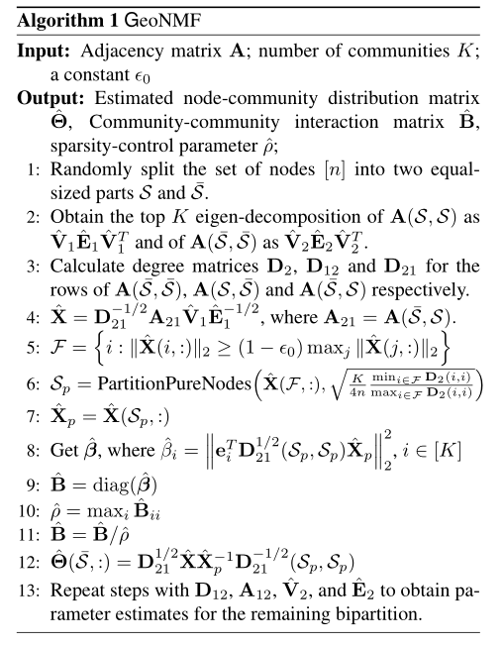
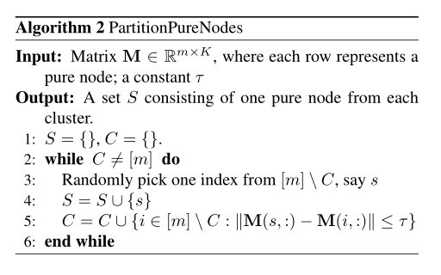
GeoNMF

Slide 8

GeoNMF
Experiment
Correlation coefficients (RC)
Dataset
Facebook
Dblp
mag

Slide 9
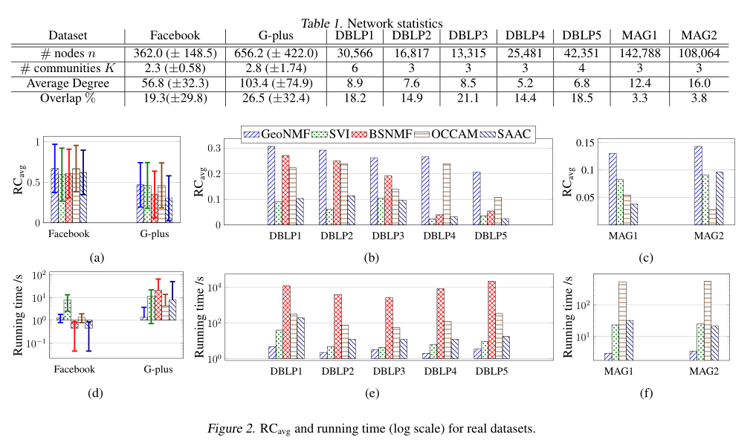

Slide 10
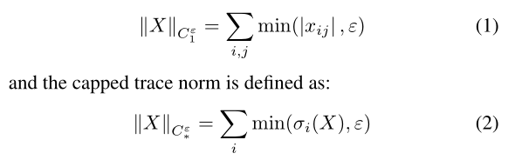
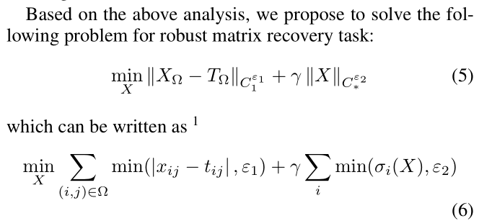
cRMC
Joint Capped Norms Minimization for Robust Matrix Recovery-IJCAI-2017
Abstract
Most MC methods are sensitive to outliers, so it propose a capped norm, which is robust to outlier
Propose a simple computational algorithm to get the optimal
Loss Function is

Slide 11
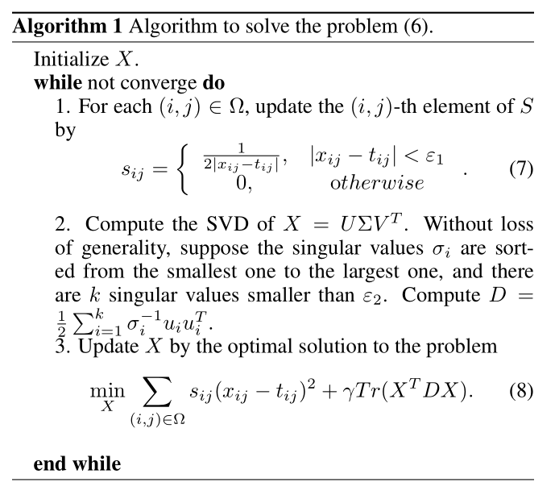
cRMC
Experiment
Dataset
Jester Jokes data
social network linking data
Sweetrs data set
MAE
RMSE

Slide 12
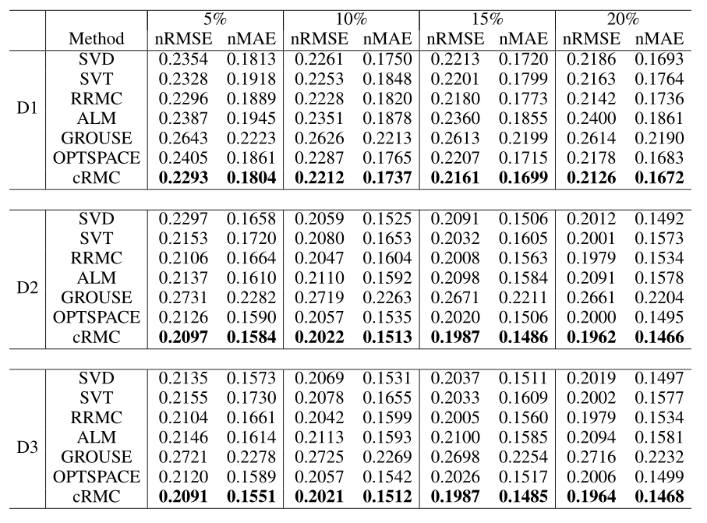

Slide 13
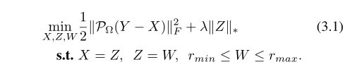
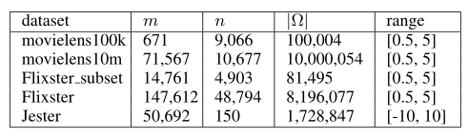
BMC-ADMM
Improved Bounded Matrix Completion for Large-Scale Recommender Systems-IJCAI2017
Abstract
It is based on the BMC (Bound Matrix completion) problem
The matrix factorization can’t converge to the stationary pointes
Employ ADMM frame work to get the optimal instead of factorization form
Loss Function
Experiment
RMSE

Slide 14
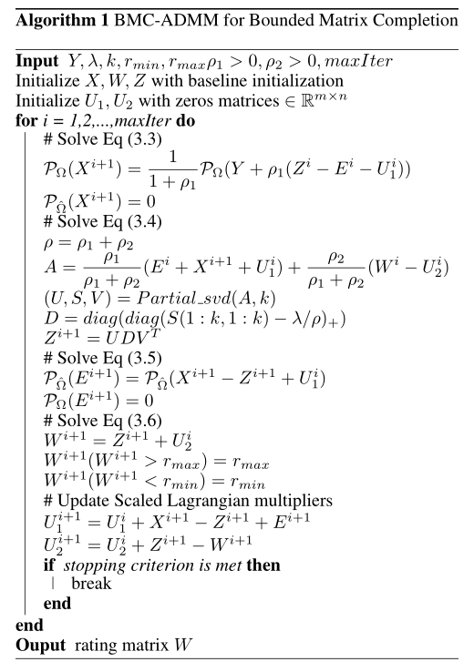
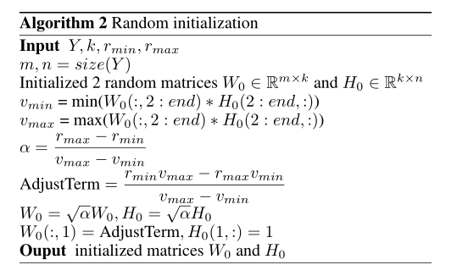
BMC-ADMM

Slide 15
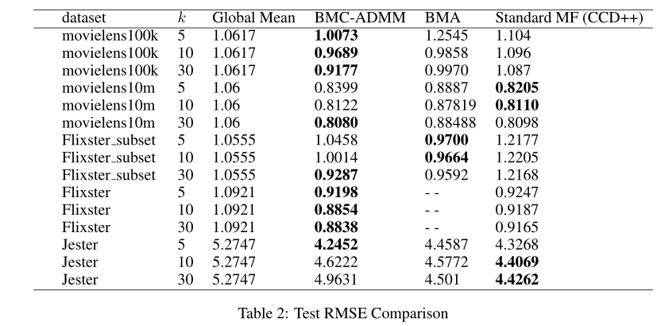

Slide 16



MCNMF
Multi-Component Nonnegative Matrix Factorization-IJCAI-2017
Abstract
Multiple components of nonnegative matrix factorization, good to understand the data comprehensively
Propose a fesible method to get the solution of the model (not global optimal)
Loss Function
Hilbert-Schmidt Independence Criterion (HSIC)

Slide 17
MCNMF
Experiment
ACC
NMI
Purity
Dataset
Yale
ORL
NothingHill,
COIL20

Slide 18
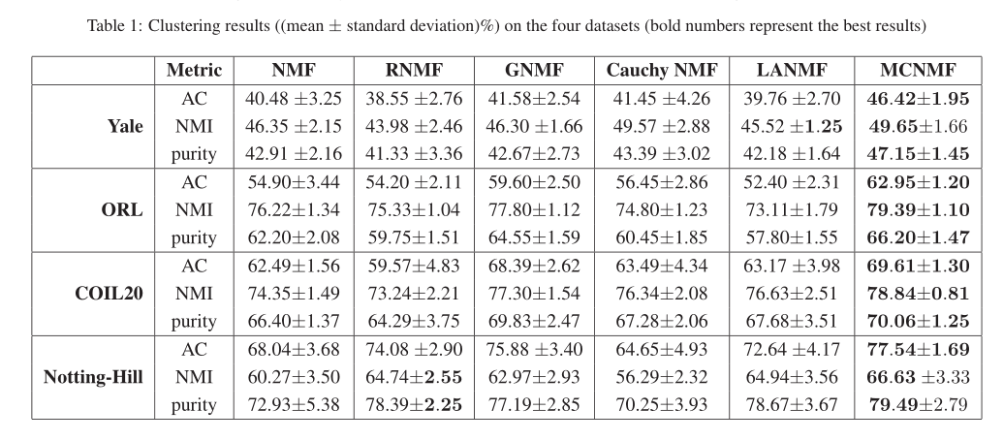

Slide 19

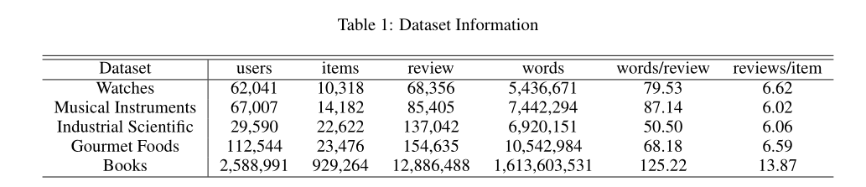
PriMF
Privileged Matrix Factorization for Collaborative Filtering-IJCAI-2017
Abstract
Combine user, item, review simultaneously, and propose a high effective algorithm to recommend
Propose a fesible solution for the optimization
Experiment (amazon)
MSE

Slide 20
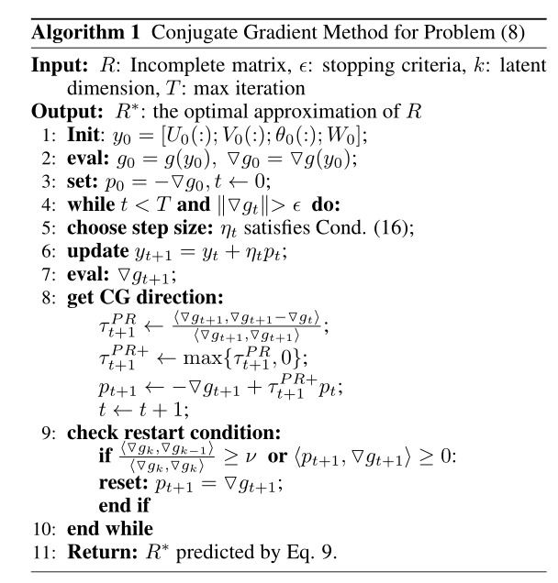
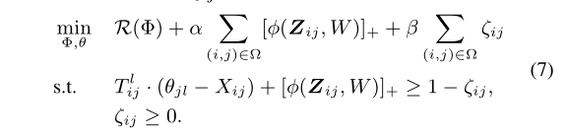





PriMF

Slide 21
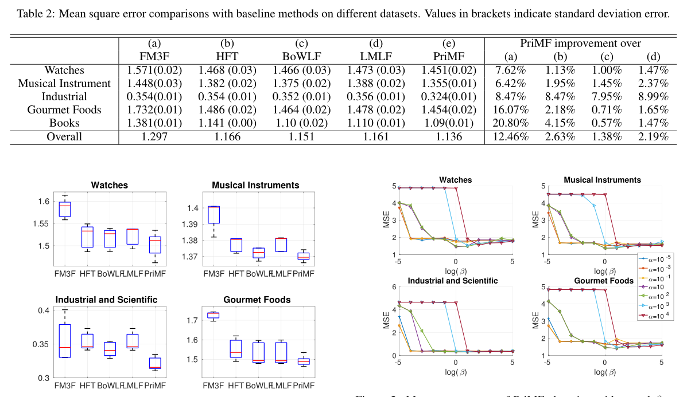

Slide 22
Survey and Review
Tensor Decompositions and Applications-2007
metric_learning_tutorial_CIL-2013

Slide 23
Tensor Decomposition
This survey provides an overview of higher-order tensor decompositions, their applications, and available software. A tensor is a multidimensional or N-way array. Decompositions of higher-order tensors (i.e., N-way arrays with N ≥ 3) have applications in psychometrics, chemometrics, signal processing, numerical linear algebra, computer vision, numerical analysis, data mining, neuroscience, graph analysis, etc. Two particular tensor decompositions can be considered to be higher-order extensions of the matrix singular value decomposition: CANDECOMP/PARAFAC (CP) decomposes a tensor as a sum of rankone tensors, and the Tucker decomposition is a higher-order form of principal components analysis. There are many other tensor decompositions, including INDSCAL, PARAFAC2, CANDELINC, DEDICOM, and PARATUCK2 as well as nonnegative variants of all of the above. The N-way Toolbox and Tensor Toolbox, both for MATLAB, and the Multilinear Engine are examples of software packages for working with tensors.

Slide 24
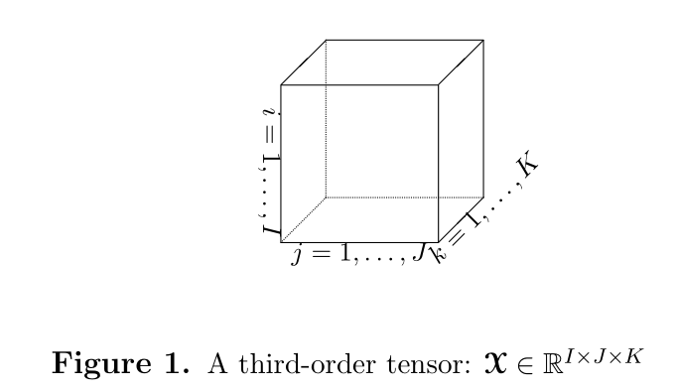
3-way Tensor

Slide 25
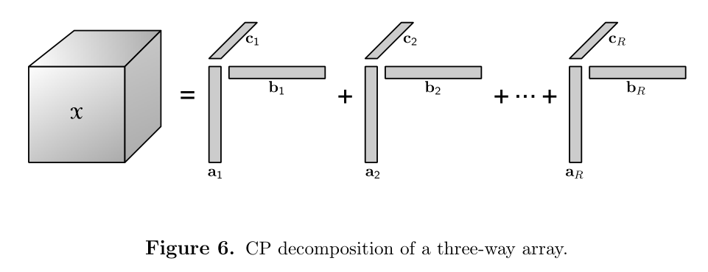
CP-decomposition

Slide 26
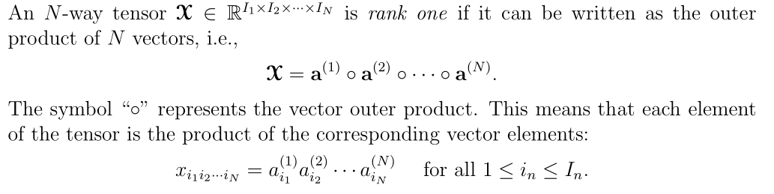
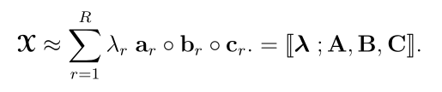
CP-decomposition

Slide 27
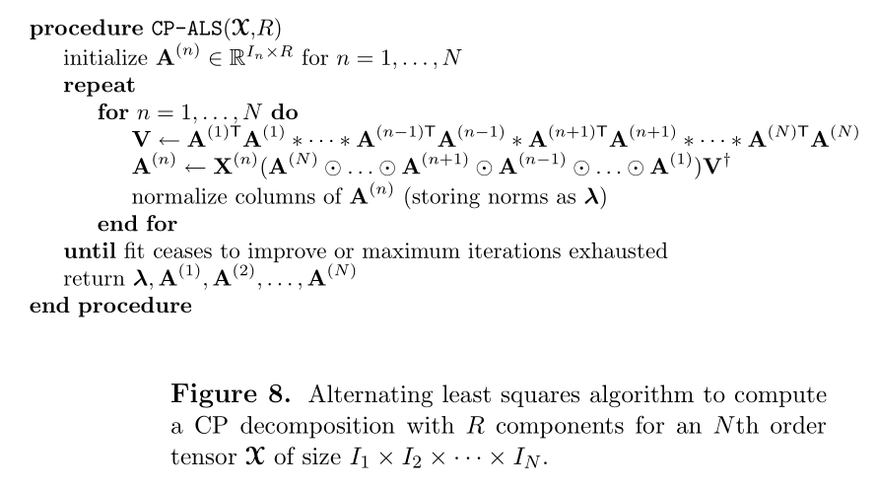
CP-decomposition

Slide 28
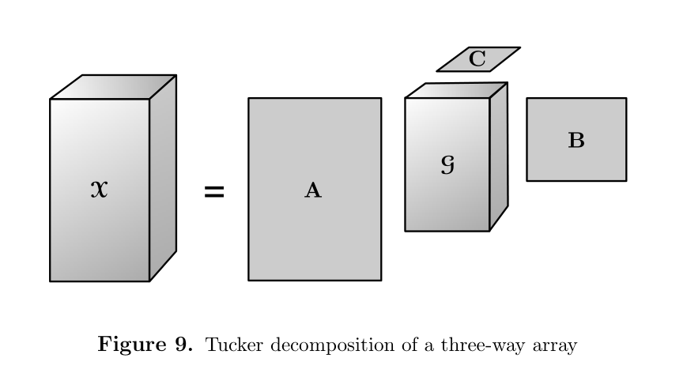
Tucker decomposition

Slide 29
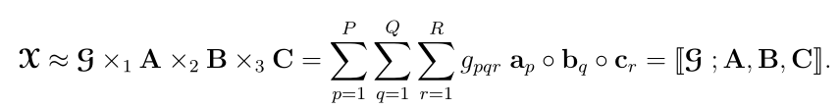
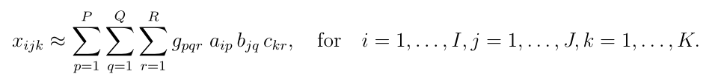
Tucker decomposition

Slide 30
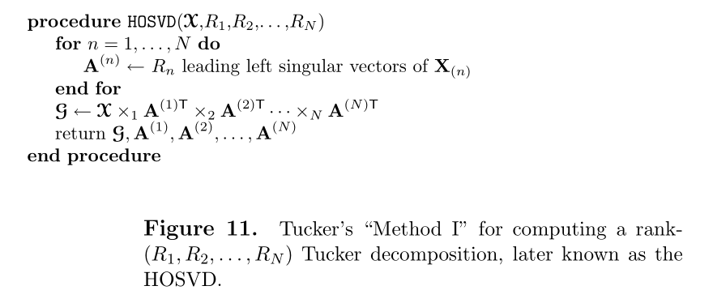
Tucker decomposition

Slide 31
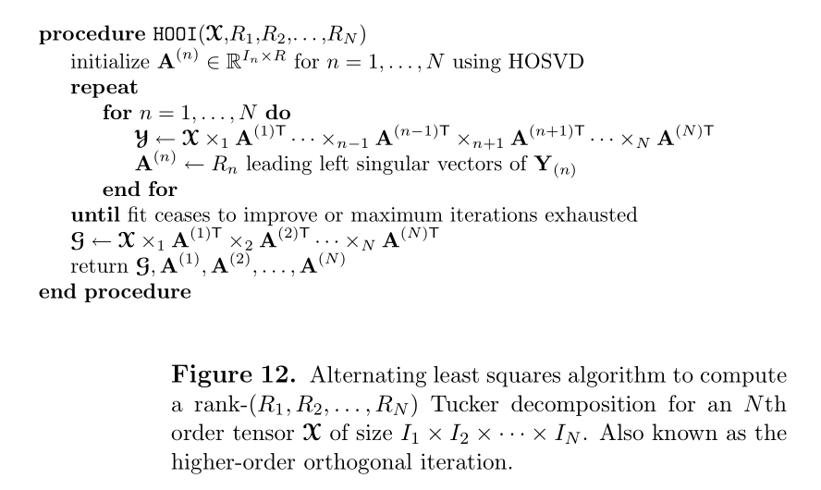
Tucker decomposition

Slide 32
Thanks

