Slide 1
Paper Reading
Presented by: Fan Xin
Time:2018-4-27

Slide 2
Papers
Convex Co-Embedding for Matrix Completion with Predictive Side Information-AAAI-2017
Yuhong Guo（Carleton University, Ottawa, Canada）
Positive-Unlabeled Learning with Non-Negative Risk Estimator-NIPS-2017
Ryuichi Kiryo（The University of Tokyo，Japan）、 Gang Niu、
Marthinus C. du Plessis、Masashi Sugiyama

Slide 3
Convex Co-Embedding for Matrix Completion with Predictive Side Information
Main purpose
Matrix Completion
Contribution
Propose a novel matrix completion approach to exploit side information within a principled co-embedding framework.
Formulate the framework as a convex minimization problem with nuclear norm regularization, provide a bound analysis, and develop a fast proximal gradient descent algorithm to solve the problem efficiently.
conduct experiments on two types of applications, transductive incomplete multi-label learning and matrix completion for recommendation systems

Slide 4








Convex Co-Embedding
Co-Embedding Perspective of Matrix Completion
Co-Embedding Perspective of Linear Predictions
×
×
$$W$$
$$B^{T}$$
$$\hat{Y}$$
$$X$$
=

Slide 5







Convex Co-Embedding
Convex Co-Embedding Framework
Definition

Slide 6

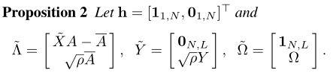


Convex Co-Embedding
Transform

Slide 7

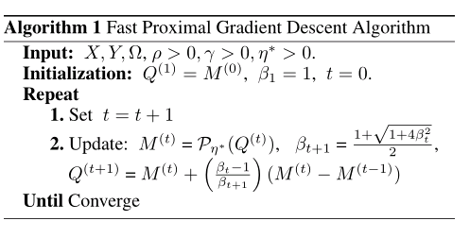
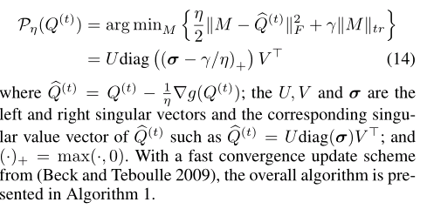
Optimization Algorithm

Slide 8
Experiment
Transductive Incomplete Multi-label Learning
ten standard multi-label datasets for web page classification from “yahoo.com” (Ueda and Saito 2002). Each dataset has around 5,000 instances with the number of labels varies from 21 to 40.
Recommendation Matrix Completion
Beauty (2,275 product items, 1,965 users, 11,051 transactions), Office (2,107 product items, 1,888 users, 8,307 transactions), and Sports (1,789 product items, 1,324 users, 7,947 transactions).

Slide 9
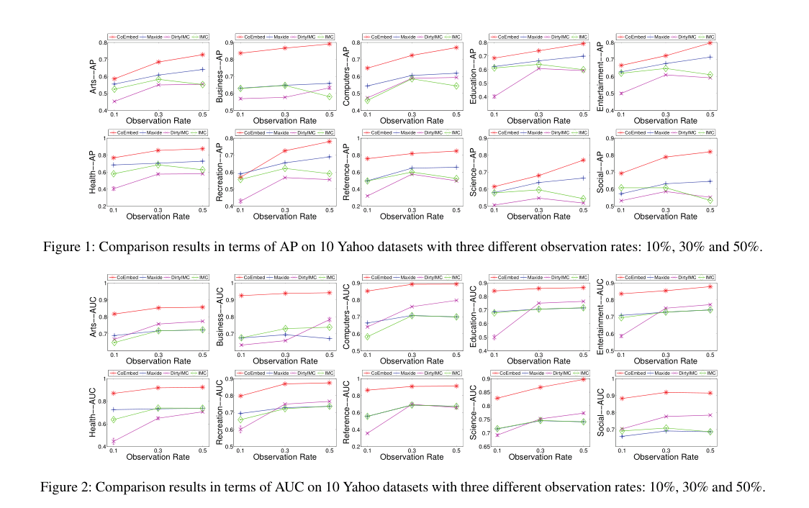
Experiment

Slide 10
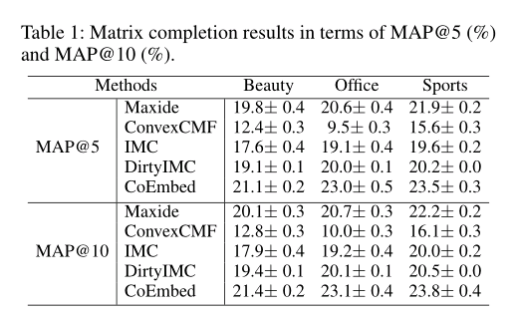
Experiment

Slide 11
Positive-Unlabeled Learning with Non-Negative Risk Estimator
Main purpose
Objective function construction
Contribution
Propose a novel non-negative risk estimator that follows and improves on the state-of-the-art risk estimators mentioned above.
Propose a large-scale PU learning algorithm for minimizing the non-negative risk estimators.

Slide 12
nnPU
PN-learning
PU-learning

Slide 13
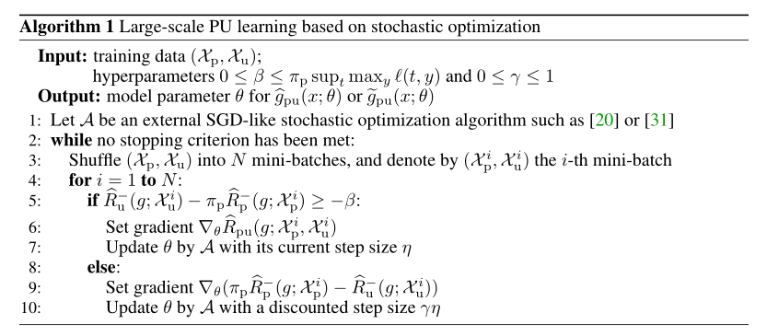
nnPU
Non-negative risk estimator

Slide 14
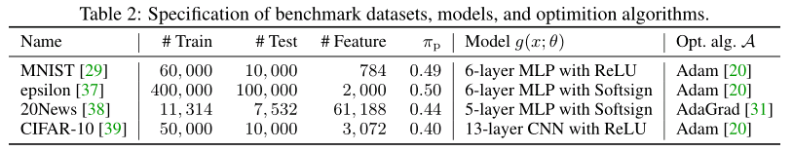
nnPU
Experiment

Slide 15
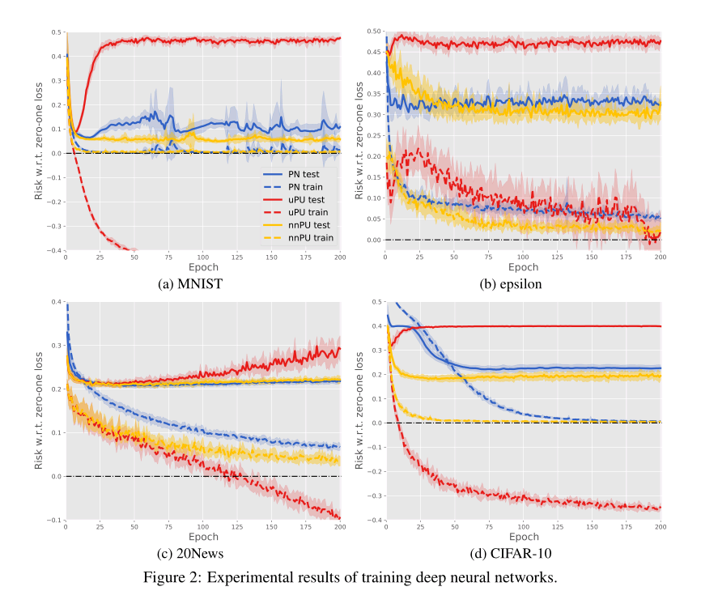
nnPU

Slide 16

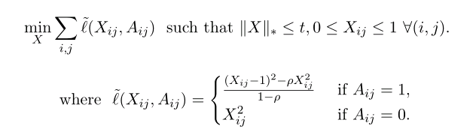
PU Learning for Matrix Completion
Shifted Matrix Completion for Non-deterministic Setting (ShiftMC)

Slide 17
Thanks

