Slide 1
Paper Reading
Presented by: Hong Yuxiang
Time:2018-4-13

Slide 2
Papers
Robust Manifold Matrix Factorization for Joint Clustering and Feature Extraction-AAAI-2017
Lefei Zhang（wuhan）、Qian Zhang（Alibaba）、Bo Du（wuhan）
Joint Capped Norms Minimization for Robust Matrix Recovery-IJCAI-2017
Feiping Nie（Northwestern）、 Zhouyuan Huo 、 Heng Huang

Slide 3
Robust Manifold Matrix Factorization for Joint Clustering and Feature Extraction
Main purpose
clustering & feature extraction
Contribution
A unified low-rank matrix factorization framework that combines clustering and feature extraction in a novel way.
suggest the l2,1 -norm based matrix factorization in our framework to obtain the robust solution against the noises and outliers.
incorporate the manifold regularization terms on both the low-dimensional feature representation and the cluster labels.

Slide 4



RMMF
Original form of feature extraction and clustering
A unified framework

Slide 5

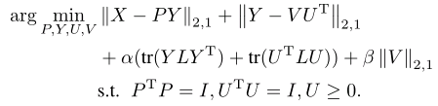

RMMF
Add a l_{2,1} –norm
Incorporate the manifold regularization terms

Slide 6
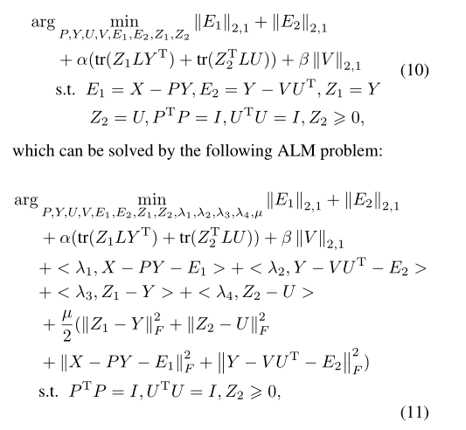
Optimization
ALM

Slide 7
Experiment
Clustering
ACC，U，6 kind benchmark datasets
Feature Extracting
OA，P，6 kind public datasets

Slide 8
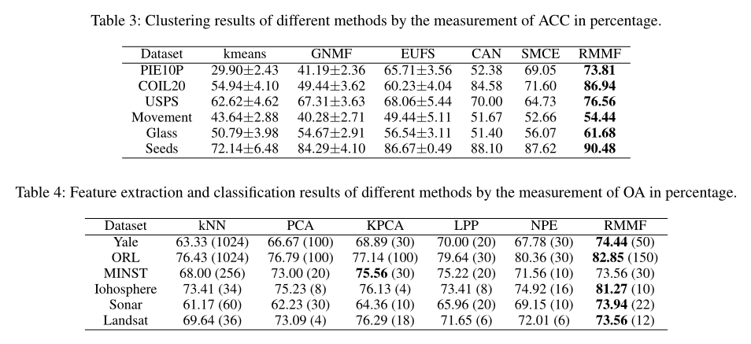
Experiment

Slide 9
Joint Capped Norms Minimization for Robust Matrix Recovery
Main purpose
Matrix completion
Contribution
using the joint capped trace norm and capped l₁-norm for the robust matrix recovery task
derive a new optimization algorithm to solve the objective fuction

Slide 10


cRMC
Capped l₁-norm and capped trace norm
Advantages
Outliers usually make the input values largely deviate from zero, thus the bounded property in the capped norm will make it very robust to outliers.
When the largest singular values have large changes, the rank of the matrix could keep the same value but the trace norm will definitely change largely.

Slide 11



cRMC
Basic matrix completion
Capped Robust Matrix completion
Better approximation to low rank minimization
Robust to the outliers

Slide 12
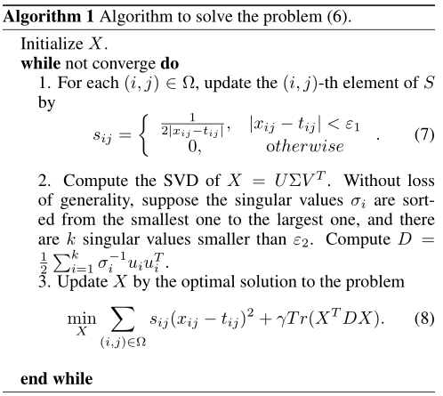
Optimization

Slide 13
Experiment
3 kind public datasets
Jester Jokes Rating
Social Network (wikipedia and Epinions)
Sweetrs Rating
Synthetic noise data (add outliers in Jester jokes and sweetrs)
Evaluation
nRMSE & nMAE

Slide 14
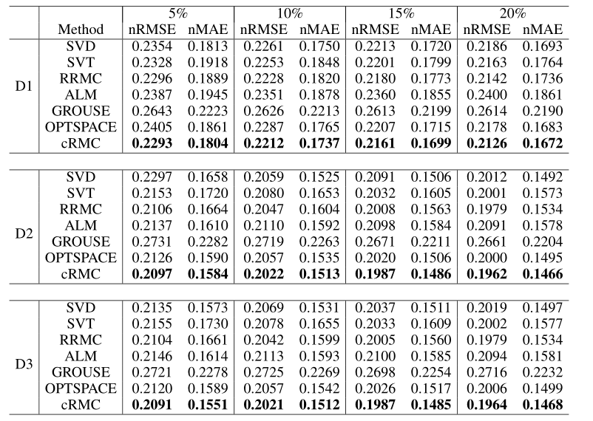
Experiment

Slide 15
Thanks

