Slide 1
Flowable KT part 1
By Nik

Slide 2
Flowable
Flowable = Process Engine capable of handling business processes notated in BPMN 2.0 (https://www.omg.org/)
Forked from Activiti
Open Source
Alternatives: Camunda, Activiti and several others

Slide 3
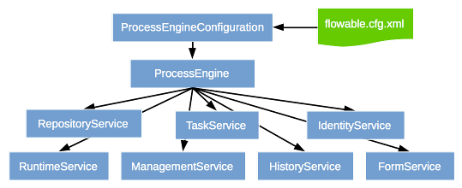
Flowable API Overview (1/2)
https://www.flowable.com/open-source/docs/javadocs/org/flowable/engine/package-summary.html

Slide 4
Flowable API Overview (2/2)
RuntimeService
Start processes
Query and define/modify process variables
TaskService
Complete User Tasks
Claim/Assign User Tasks

Slide 5
Process terms (1/3)
Process Definition = Process Structure/Model
Process Instance = One (of many) executions of a process
Process Key = Equivalent to the process id of latest deployed process definition
Process Id = Different versions of a process definition can be stored in the DB. Hence, a specific version of a process definition can be started by its id.

Slide 6
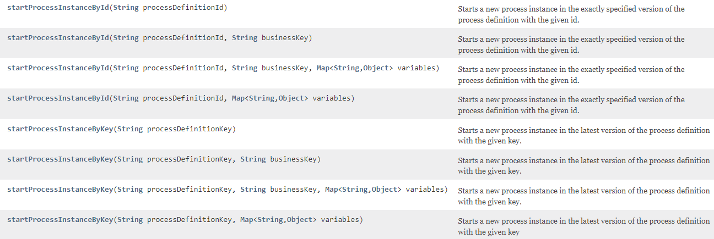
Process terms (2/3)
https://www.flowable.com/open-source/docs/javadocs/org/flowable/engine/RuntimeService.html
Notes:
businessKey – a key that identifies the process instance and can be used to retrieve the process instance later via the query API.
A business key can be provided to associate the process instance with a certain identifier that has a clear business meaning. For example in an order process, the business key could be an order id. This business key can then be used to easily look up that process instance , see ProcessInstanceQuery.processInstanceBusinessKey(String). Providing such a business key is definitely a best practice.

Slide 7
Process terms (3/3)
ID | KEY | VERSION | ...
Adfasdl32daf-adfiuew239 | pizza_ordering_process | 1 | ...
Fidjl5439-rg9043jfj-1wefi | pizza_ordering_process | 2 | ...
Cxdsf3we-q3wsd-hfdg5 | pizza_ordering_process | 3 | ...
startProcessInstanceById(Adfasdl32daf-adfiuew239) starts which version?
startProcessInstanceById(Fidjl5439-rg9043jfj-1wefi) starts which version?
startProcessInstanceByKey(pizza_ordering_process) starts which version?
Notes:
The processDefinitionKey refers to the “id” attribute in the model xml. By starting a process via the processDefinitionKey the latest version of that model (process definition) will be started → recommended!
The processDefinitionId refers to the DB id of a deployed model (process definition). In case there is a history of the process definitions the DB identifies them by a unique id! Using that a specific version of the model can be started → not really recommended

Slide 8
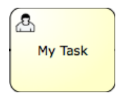
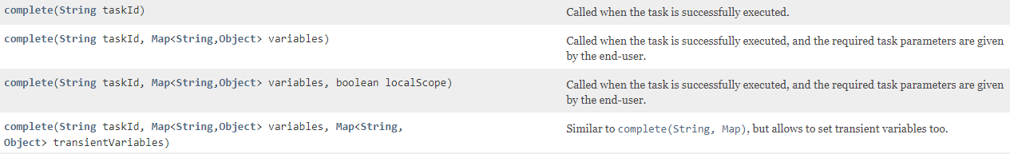
User Task
User has to “do” something and trigger the completion
Process Engine is in wait state until the User Task is completed (external trigger)
Variables can be passed when completing a User Task
Syntax:
<userTask id="theTask" name="Important task" />
https://www.flowable.com/open-source/docs/javadocs/org/flowable/engine/TaskService.html

Slide 9
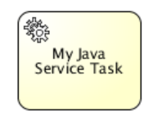
Service Task
No user interaction
Process Engine is NOT in a wait state
Syntax:
<serviceTask id="javaService" name="My Java Service Task" flowable:class="org.flowable.MyJavaDelegate" />
<serviceTask id="serviceTask" flowable:delegateExpression="${delegateExpressionBean}" />
<serviceTask id="javaService" name="My Java Service Task" flowable:expression=“${printer.printMessage()}" />

Slide 10
Variables
Can be set by:
Starting a Process
Completing a User Task
Anywhere in the code via the RuntimeService

Slide 11


Gateways (parallel / exclusive)
Parallel (AND)
Parallel execution of flows
fork and join (join waits for incoming sequence flows)
Exclusive (OR)
Conditional execution of a sequence flow
One sequence flow needs to be defined as the default flow and thus, must not have an underlying condition

Slide 12
Flowable KT part 2
By Nik

Slide 13
Cardinality (1/3)
Executing a specific activity multiple times without complex modelling
Loop a fixed number of times
Variable number of times (determined by process variables)
Loop over a list
Define a “completion condition”
https://www.flowable.com/open-source/docs/bpmn/ch07b-BPMN-Constructs#multi-instance-for-each

Slide 14
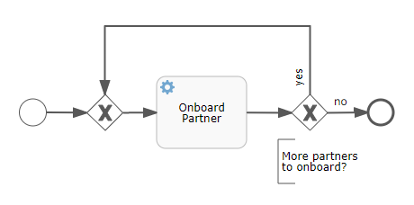
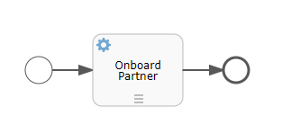


Cardinality (2/3)

Slide 15
Cardinality (3/3)
Syntax
<multiInstanceLoopCharacteristics isSequential="false|true"> <loopCardinality>5</loopCardinality> </multiInstanceLoopCharacteristics>
<multiInstanceLoopCharacteristics isSequential="false|true"> <loopCardinality>${nrOfOrders-nrOfCancellations}</loopCardinality> </multiInstanceLoopCharacteristics>
<multiInstanceLoopCharacteristics isSequential="false" flowable:collection=«loopList" flowable:elementVariable=«listItem" > </multiInstanceLoopCharacteristics>

Slide 16
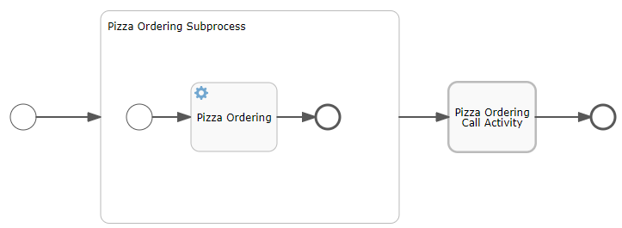
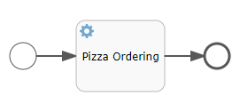
Call Activities / Subprocesses (1/5)
Reference to external process

Slide 17
Call Activities / Subprocesses (2/5)
(Embedded) Subprocess:
Like a “Model in a Model”
Can be “collapsed” for better overview
Not reusable
<subProcess id="subProcess"> <startEvent id="subProcessStart" /> ... other Sub-Process elements ... <endEvent id="subProcessEnd" /> </subProcess>
Call Activity
Calls an externally defined model
Reusable across processes
<callActivity id="callCheckCreditProcess" name="Check credit" calledElement="checkCreditProcess" />

Slide 18
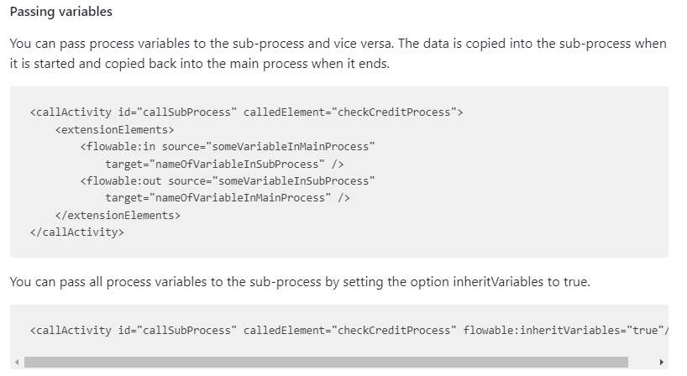
Call Activities / Subprocesses (3/5)

Slide 19
Call Activities / Subprocesses (4/5)
Starting a mainProcess process
mainProcess: {mainProcessVariable=Guten Abend}
passedVariablesSubprocess: {subprocessVariable=Guten Abend}
passedVariablesSubprocess: Setting process variable 'subprocessVariable' to: Magandang Gabi
passedVariablesSubprocess: {subprocessVariable=Magandang Gabi}
mainProcess: {mainProcessVariable=Magandang Gabi}
inheritedVariablesSubprocess: {mainProcessVariable=Magandang Gabi}
inheritedVariablesSubprocess: Setting process variable 'mainProcessVariable' to: Good Evening
inheritedVariablesSubprocess: {mainProcessVariable=Good Evening}
mainProcess: {mainProcessVariable=Magandang Gabi}

Slide 20
Call Activities / Subprocesses (5/5)
mainProcess
mainProcessVariable (Guten Abend) → subprocessVariable (Guten Abend)
SET subprocessVariable TO Magandang Gabi
passedVariablesSubprocess
mainProcess
mainProcessVariable (Magandang Gabi) ← subprocessVariable (Magandang Gabi)
mainProcessVariable = Magandang Gabi
mainProcess
inherit mainProcessVariable (Magandang Gabi)
SET mainProcessVariable TO Good Evening
inheritedVariablesSubprocess
mainProcess
NOTHING HAPPENS HERE!
mainProcessVariable = Magandang Gabi

