Slide 1
Flowable KT (part 1)
By Nik

Slide 2
Contents
Introduction to Flowable
General
General Setup (Code)
Generic process start
Generic task query
Generic task completion
Modelling
xml
Flowable Modeler
Eclipse Flowable Plugin
Core BPMN Constructs
User Tasks / Service Tasks
Gateways (parallel (and), exclusive (or))

Slide 3
Introduction to Flowable
Flowable = Process Engine
Alternatives: Camunda, Activiti, …

Slide 4
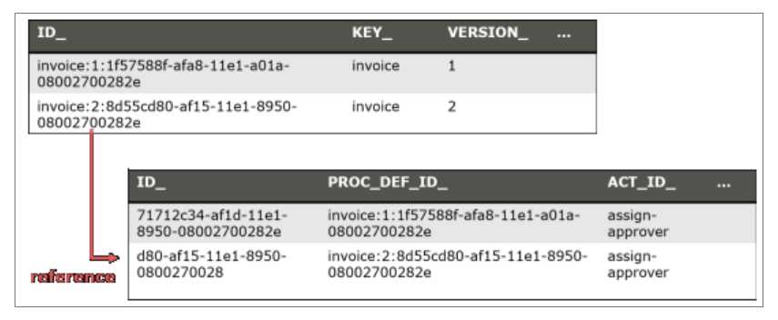
Process terms
Process Definition = Process Structure/Model
Process Instance = One execution of a process (basically when a process is initiated → we will cover that)
Process Key: Equivalent to the process id of latest deployed process definition
Process Id: Different versions of a process definition can be stored in the DB. Hence, a specific version of a process definition can be started from its id.

Slide 5
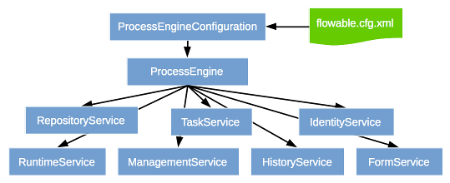
Flowable API (1/2)
https://www.flowable.com/open-source/docs/javadocs/org/flowable/engine/package-summary.html

Slide 6
Flowable API (2/3)
RuntimeService (https://www.flowable.com/open-source/docs/javadocs/org/flowable/engine/TaskService.html)
Start processes
Query and set process variables
startProcessInstanceByKey(String processDefinitionKey) - Starts a new process instance in the latest version of the process definition with the given key.
startProcessInstanceById(String processDefinitionId) - Starts a new process instance in the exactly specified version of the process definition with the given id.
Notes:
The processDefinitionKey referes to the “id” attribute in the model xml. By starting a process via the processDefinitionKey the latest version of that model (process definition) will be started → recommended!
The processDefinitionId refers to the DB id of a deployed model (process definition). In case there is a history of the process definitions the DB identifies them by a unique id! Using that a specific version of the model can be started → not really recommended

Slide 7
Flowable API (3/3)
TaskService (https://www.flowable.com/open-source/docs/javadocs/org/flowable/engine/TaskService.html)
Complete active User Tasks
Claim/Assign User Tasks
complete(String taskId, Map<String,Object> variables)
Notes:
The processDefinitionKey referes to the “id” attribute in the model xml. By starting a process via the processDefinitionKey the latest version of that model (process definition) will be started → recommended!
The processDefinitionId refers to the DB id of a deployed model (process definition). In case there is a history of the process definitions the DB identifies them by a unique id! Using that a specific version of the model can be started → not really recommended

Slide 8
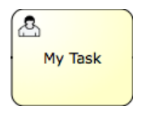
User Task / Service Tasks (1/2)
User Task
User has “do” something and trigger the completion
Process Engine is in wait state until the User Task is completed (external trigger)
Variables can be passed upon completion of a User Task
<userTask id="theTask" name="Important task" />

Slide 9
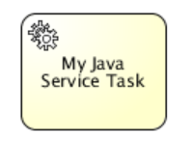
User Task / Service Tasks (2/2)
Service Task
No user interaction
Process Engine is NOT in a wait state
<serviceTask id="javaService" name="My Java Service Task" flowable:class="org.flowable.MyJavaDelegate" />
<serviceTask id="serviceTask" flowable:delegateExpression="${delegateExpressionBean}" />
<serviceTask id="javaService" name="My Java Service Task" flowable:expression="#{printer.printMessage()}" />

Slide 10


Gateways (parallel / exclusive)
Parallel (AND)
Parallel execution of flows
fork and join (join waits for incoming sequence flows)
<parallelGateway id="fork" />
Exclusive (OR)
Conditional execution of a sequence flow
One sequence flow needs to be defined as the default flow and thus, must not have an underlying condition

Slide 11
Outlook for next session
Basic Error Handling
Call Activities / Subprocesses

