Slide 1
OAuth 2.0
Noah Kilders
Notes:
asdasd

Slide 2
Agenda
OAuth
Roles
Workflow

Slide 3

OAuth
„Open Authorization“
2007: 1.0
2012: 2.0
IETF: RFC 6749; RFC 6750
©️Chris Messina
CC BY-SA

Slide 4

Roles
Application
„Bob“

Slide 5

Roles
Third Party Application
Authorization Server
Resource Server

Slide 6

Roles
User / Resource Owner
„Alice“

Slide 7
Workflow
Application
Authorization
Server
Name
Permissions
Callback URL
Client ID
Client Secret

Slide 8
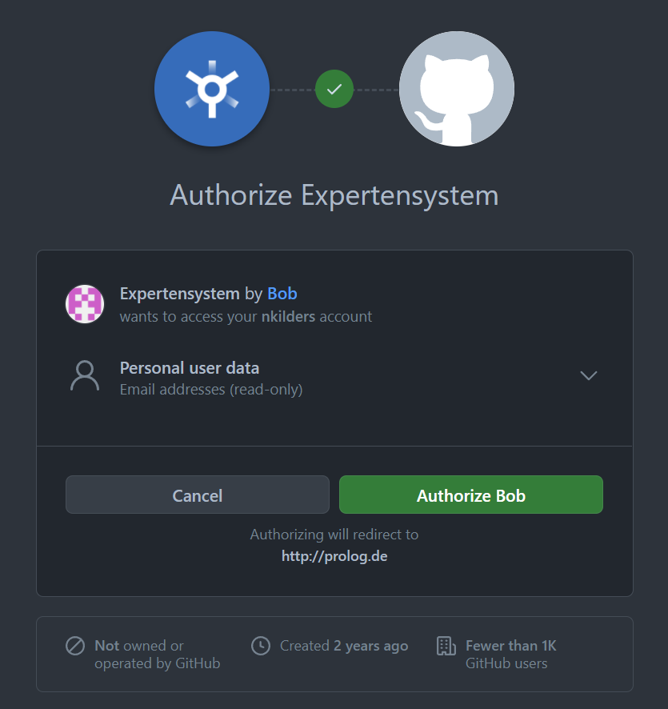

Workflow
Application
Authorization
Server
Authorization Request
Authorization Grant
Authorization Grant
Access Token
Resource
Server
Access Token
Protected Resource

Slide 9
Literature
https://datatracker.ietf.org/doc/html/rfc6749
https://datatracker.ietf.org/doc/html/rfc6750
https://en.wikipedia.org/wiki/OAuth

