Slide 1





Butemwe Nkinke · 2022082613
Keila Ketlan Ngandu · 2022009908
Supervisor: Mrs. Monde Kabemba
MediVault
A Role-Based Patient Portal for the University of Zambia Clinic
Final Year Project Presentation · 2026
University of Zambia · School of Natural and Applied Sciences · Department of Computing and Informatics

Slide 2

Team Roles and Responsibilities
Member | Computer No. | Primary Role / Responsibilities
Butemwe Nkinke | 2022082613 | Application development, database design and management, REST API development, JWT authentication, RBAC, input validation, healthcare business logic, role-based dashboards, notifications, care timeline, unit testing, code quality, and application-level audit logging.
Keila Ketlan Ngandu | 2022009908 | Infrastructure setup and deployment, Linux server administration, PostgreSQL hosting, reverse proxy configuration, TLS/HTTPS security, firewall and network hardening, clinic LAN/Wi-Fi and VLAN design, Docker, CI/CD, backups and recovery, monitoring, security and load testing, SMS/email integrations, and NHIMA/MOH connectivity.
Supervisor: Mrs. Monde Kabemba

Slide 3








Presentation Overview
Background and Context
The problem at the UNZA Clinic and who it affects
System Analysis and Design
Architecture, data model and technical design
Implementation / Development
Environment, modules and key implementation details
Testing, Results and Evaluation
353 automated tests, all passing, and the problems we solved
Discussion
What the results mean and where they fall short
Conclusion
What we built and what comes next
System Demonstration
A walkthrough of the seven role dashboards

Slide 4





Background and Context · A visit today
Show your ID
A student queues at reception and shows a physical ID card. No card, no care.
Vitals on paper
A nurse writes vitals on paper, and nothing links this visit to earlier ones.
A doctor working blind
Doctors often cannot see past diagnoses, medications or allergies at the point of care.
Carry the prescription
The patient carries a paper prescription to be filled and only then learns whether the drug is in stock.
No emergency plan, no trail
There is no formal way to get consent when a patient cannot give it, and no record of who views or changes data.
Notes:
Open with your own story, in this order: I show my ID card at reception. A nurse writes my vitals on paper. I sign in to the visit. The doctor writes a prescription on paper. I carry it to the lab to collect drugs, and only there do I find out whether the drug exists. The doctor was never sure it was in stock. Then ask the room: has anyone here had the same experience? Pause for a show of hands.

Slide 5


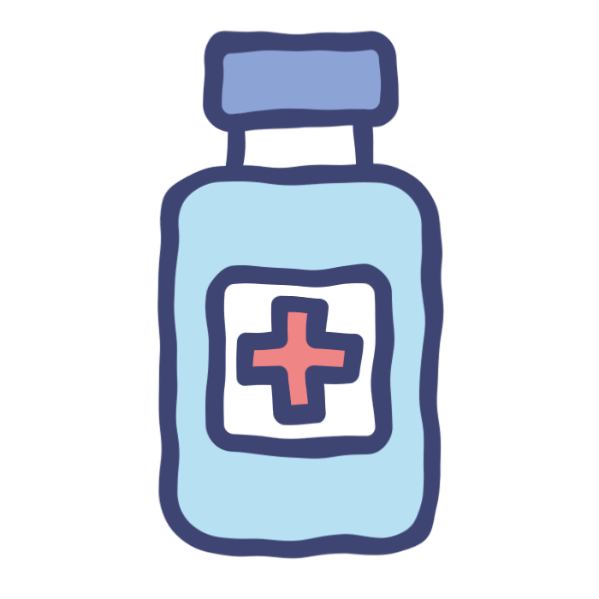
Background and Context · Who it is for
Patient
Receptionist
Doctor
Pharmacist
A UNZA student who books visits, sees results and names a next of kin.
Verifies students by student number and registers each visit.
Reviews profiles, orders labs, prescribes and releases results.
Dispenses prescriptions and keeps drug stock accurate.
Lab technician
Next of kin
Admin
Records results from the work queue; flags are automatic.
Gives emergency consent when a patient cannot.
Manages users and reviews the access logs.

Slide 6

Background and Context · Existing systems
Big EMRs
MediVault
OpenMRS, Bahmni, DHIS2, SmartCare and commercial hospital systems
Powerful, but heavy to set up, license and train for
Often focused on national reporting or whole hospitals
Not shaped around one campus clinic's daily workflow
Lightweight and right-sized for a university clinic
Built around the clinic's real visit workflow
Patient in the loop: appointments, messaging, results and consent
Could integrate later through standards such as HL7 FHIR
We do not claim to beat them. The aim is the right fit for this clinic.

Slide 7
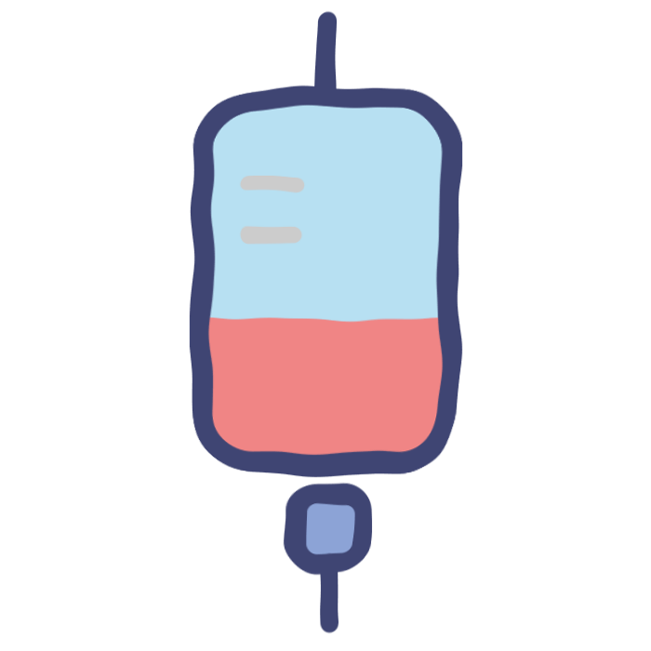
Background and Context · Project objectives
Role-based access
Every user sees and does only what their role allows.
Student-number verification
Receptionists confirm eligibility in seconds, with no physical ID card.
Electronic medical profiles
Doctors view and update diagnoses, medications, allergies and visit history.
Next of kin consent
Patients pre-assign someone who can give consent in an emergency.
Access logging
Every view or edit of a patient record is written to the audit trail.

Slide 8



System Analysis and Design · Architecture
Browser: React dashboards
Seven role dashboards built with Next.js pages and Tailwind CSS
Middleware: the first gate
Verifies the JWT signature and expiry, then keeps each role on its own dashboard
API route handlers
Every route re-checks the caller with getRoleAndActor and validates input with Zod
Prisma and PostgreSQL
Parameterised queries, with transactions for dispensing and appointments
Audit and notifications
Each patient-data access is logged; the bell alerts the right role

Slide 9
System Analysis and Design · Request flow
1. Browser
2. Middleware
3. API route
Role dashboards send the request with the JWT cookie.
Verifies the JWT and checks the role against the route.
Verifies again, then validates the input with Zod.
4. Business logic
5. Prisma + PostgreSQL
6. Access log
Rules in src/lib, such as dispensing and lab flagging.
Parameterised queries and transactions.
Patient-data access is recorded, then the response returns.
Notes:
One sentence: a visit is a chain of handoffs, and each person only sees and does what their role allows. Concrete trace to say aloud: the pharmacist clicks Dispense. The browser sends POST /api/prescriptions/:id/dispense with the cookie. The middleware verifies the JWT and lets it through. The route calls getRoleAndActor, confirms PHARMACIST or ADMIN, runs one transaction in src/lib/pharmacy.ts logic, writes an AccessLog row, and notifies the patient 'Your prescription is ready'.

Slide 10


System Analysis and Design · Project structure
prisma/
src/app/api/
src/app/dashboard/
Schema, migrations and the seed script.
The REST backend, one folder per domain such as auth, pharmacy and lab.
One dashboard per role, all sharing one layout.
src/lib/
src/middleware.ts
tests/unit/
Business logic kept out of route files so it can be unit tested.
The first security gate for every request.
Vitest tests for logic, authentication and route safety.
Notes:
Why this structure: one codebase and one deployment keeps it simple for a clinic with limited IT staff. Business rules live in lib/ so they can be unit tested without a database. Example: computeFlag() in src/lib/lab.ts takes a reference range and a result and returns a flag. The test calls it with Hb 10.4 and expects LOW, no database needed.

Slide 11
Database · 18 tables in 7 groups
People
Clinical care
Inpatient
Pharmacy
User, PatientProfile
MedicalRecord, Visit
Admission, AdmissionNote, VitalsReading, AdmissionCounter
Prescription, DrugInventory
18 tables
Laboratory
Engagement
Consent and audit
LabTest, LabOrder, LabOrderItem
AppointmentRequest, Notification, Message
NextOfKinAssignment, AccessLog
The ERD is on the next slide; domain model views are in the repo's doc folder.

Slide 12
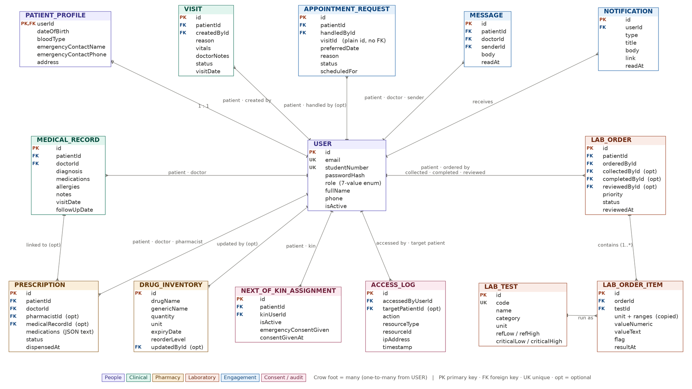
Database · Entity relationship diagram

Slide 13
Database · Design decisions
One user table
A single User table with a 7-value Role enum keeps login and access control in one place.
One-to-one patient profile
Patient details sit in PatientProfile, which is deleted together with its user.
Ranges copied onto orders
Lab reference ranges are copied onto each order, so old results never change meaning.
Deactivate, never delete
Users are deactivated rather than deleted, so clinical history and audit trails survive.

Slide 14
Technical Design · Authentication
Passwords
Hashed with bcrypt at 12 rounds, which makes brute-forcing stolen hashes slow.
Token in an httpOnly cookie
A signed JWT (HS256) that JavaScript cannot read, so XSS cannot steal it.
Verified twice
Signature and expiry are checked in the middleware and again in every API route.
Defence in depth
If the middleware is ever bypassed, the API still refuses the request.
Rate limiting
5 login attempts per 15 minutes, plus security headers on responses.
Notes:
Walk through this confidently. bcrypt with 12 rounds, a JWT (HS256) in an httpOnly cookie, and verification in two places: the middleware and again inside every API route via getRoleAndActor(). Example if asked 'what if someone forges the cookie': they write a token that says role ADMIN with a made-up signature. jwtVerify fails, verifyToken returns null, and the API answers 401. Also note getRoleAndActor looks the user up in the database, so a deactivated account is refused on API calls straight away. Open src/lib/jwt.ts and src/lib/auth.ts before presenting.

Slide 15
Technical Design · Dispensing
One database transaction
Claiming the prescription and deducting stock happen together or not at all.
Earliest expiry first (FEFO)
Stock comes from the batch that expires soonest, so older stock is used first.
Never below zero
If stock is short, the whole dispense rolls back.
Records and stock always agree
A failure leaves nothing half-done, so prescription status and inventory cannot disagree.
Notes:
Example to say aloud: the seed has ORS at 8 sachets with a reorder level of 20. If a doctor prescribes 10 sachets, dispensing fails with 'Not enough ORS: need 10, only 8 in stock.' and nothing changes: the prescription stays PENDING and the stock stays at 8. FEFO example: if Paracetamol is held in two batches, the batch expiring first is emptied first, and expired batches are never used. Known gap: the doctor's prescription screen does not show live stock yet; say so if asked.

Slide 16
Technical Design · Lab result flagging
The server decides the flag
Each result is compared with its reference range and labelled normal, low, high or critical.
Critical limits first
The server checks critical limits first, then the normal range.
Special cases
Yes/no tests match a normal answer, and no range means no flag.
Doctor releases results
Patients see results only after a doctor releases them, so a critical value never arrives without explanation.
Notes:
Example to say aloud: Fasting Blood Glucose has a normal range of 3.9 to 5.6 mmol/L and a critical high of 22. The seeded result for Patient 3, Chanda Mutale, is 24.3, so the server flags CRITICAL_HIGH. Patient 1's Haemoglobin of 10.4 g/dL is below the 12 floor, so it is LOW. A malaria RDT of Positive against a normal answer of Negative is ABNORMAL. A test with no range on file returns no flag, which is better than a wrong Normal. Open src/lib/lab.ts before presenting.

Slide 17
Technical Design · Rules and safeguards
Care team rule
Zod validation
Prisma queries
Access log
A doctor can message a patient only after a record, prescription, lab order or admission. It is derived, not stored.
Every endpoint validates its input with a Zod schema before any logic runs.
Parameterised queries guard against SQL injection.
Every patient-data access is written to the AccessLog.

Slide 18




Development Environment
Operating system
Developed on Windows; also runs on Linux and macOS
Languages
TypeScript, SQL (Prisma migrations) and CSS (Tailwind)
Frameworks
Next.js 14, React 18, Tailwind 3, Prisma 5, Zod, jose
Database
PostgreSQL 15+, 18 tables and 5 migrations
IDE and tools
VS Code, Prisma Studio, Vitest, ts-node, npm
Version control
Git and GitHub; run locally for the demo, no Docker

Slide 19
System Components / Modules
Access control
Clinical care
Pharmacy
JWT login, RBAC middleware, rate limiting and admin user management.
Medical records, visits, student verification, profiles and inpatient admissions.
Prescriptions, drug inventory and transactional dispensing.
Laboratory
Patient engagement
Consent and audit
Test catalogue, orders, results, flags and doctor release.
Appointments, notifications, care timeline and secure messaging.
Next of kin consent, access logs and CSV export.

Slide 20


Key Implementation Details
One source of truth
roles.ts maps each role to its dashboard; jwt.ts is the only place tokens are read
Logic you can test
Result flagging and stock plans are pure functions with their own unit tests
Guarded transactions
Dispensing, appointments and discharge are guarded, so nothing happens twice
SIS integration
A mock UNZA SIS lookup accepts registered students only; the real API plugs in later
Security and performance
bcrypt with 12 rounds, httpOnly cookies, 5 logins per 15 minutes, security headers

Slide 21
Implementation · Supporting systems
Notifications
Messaging
Care timeline
Next of kin consent
A bell on every role's dashboard, checked every 30 seconds.
Limited to doctors on that patient's care team (care-team.ts).
Merges records, visits, prescriptions, released labs and appointments into one view.
The patient pre-assigns someone who can grant emergency consent.

Slide 22

Challenges and Solutions
Challenge: anyone could forge an admin cookie
Solution: verifyToken now checks signature and expiry in the middleware and in every protected API route.
Challenge: the route-protection middleware never ran
Solution: moved it into src/ and matched "/" exactly, so only truly public paths pass.
Challenge: dispensing never reduced the stock
Solution: one transaction claims the prescription, deducts earliest-expiry stock and rolls back if short.

Slide 23

Test Results
Test suite | Tests | Result
Middleware and forged tokens | 15 | Pass
Authentication and rate limiting | 17 | Pass
Pharmacy and lab logic | 34 | Pass
Inpatient admissions | 123 | Pass
Appointments, timeline, messaging | 45 | Pass
Input validators | 15 | Pass
Visits and student verification | 29 | Pass
Roles, dates, SIS mock, icons | 62 | Pass
Route safety | 13 | Pass
353 / 353
tests passing across 18 Vitest files
The earlier 3 route-safety failures (a leftover [Id] folder name and the /api/debug route) are fixed, and the suite now has 13 checks.

Slide 24
Testing · What the tests protect
Forged tokens
15 middleware tests prove that a forged or expired cookie is rejected.
Login and rate limits
17 tests cover authentication and the 5-per-15-minutes limit.
Clinical logic
34 tests cover lab flagging and stock deduction, and 123 cover inpatient admissions.
Route safety
13 checks stop leftover folders and debug routes from reaching production.
Notes:
Example to say aloud: the middleware test builds a token that looks like an admin token but has a made-up signature, sends it to /api/admin/users and expects 401. It sends the same token to /dashboard/admin and expects a redirect to /login. Further tests cover a token signed with a different secret, an expired token and an unsigned alg:none token. Each one is a real attack the first version of the middleware would have accepted.

Slide 25

Discussion of Findings
All five objectives met
Role-based access, student-number checks, medical profiles, next of kin consent and access logging work end to end in the demo.
More than we promised
Pharmacy, laboratory, appointments, messaging, notifications and admissions grew the system from five roles to seven.
The key finding
A security review showed login cookies could be forged. Signed-token checks and 15 middleware tests now close that gap.
Against existing portals
Epic MyChart, OpenEMR and Bahmni inspired the patient features. MediVault fits a university clinic: student numbers and a pre-set next of kin.

Slide 26
Discussion · How MediVault answers each problem
Problem today | MediVault
Paper ID check at the door | Student-number verification in seconds
Paper records, no history across visits | Electronic profile and care timeline
Patient carries the prescription | Doctor sends it straight to the pharmacy
Doctor prescribes without knowing stock | Stock tracked and deducted at dispensing; a live view at prescribing is next
Waiting and uncertainty about results | Lab orders, results and notifications flow through the system
No record of who viewed a file | Every access is audit-logged
Emergencies with no consent route | Pre-assigned next of kin

Slide 27

Limitations
Mock student system
Verification uses a hard-coded stand-in for the UNZA SIS. A real connection is needed before live use.
Missing security extras
There is no two-factor login or field encryption, and a deactivated user’s session lasts up to 8 hours.
Polling, not push
The notification bell checks every 30 seconds. There is no WebSocket, SMS or email delivery yet.
Looser data rules
Duplicate next-of-kin links are not blocked and completed lab results cannot be corrected. Admissions have no wards, beds or nurse role yet.
Notes:
Say what is done first, then what is planned. Be ready with one sentence per limit: the SIS lookup is a stand-in with 7 hard-coded students (including one suspended and one alumnus); there is no 2FA or field encryption; notifications are polled every 30 seconds.

Slide 28
Limitations · What we would fix first
Rate limiter
Deactivated users
Encryption
It is in memory, so it resets on restart and does not work across servers. The fix is Redis.
A token stays valid for up to 8 hours. The fix is a token version or revocation check.
Passwords are hashed and production traffic would use HTTPS. AES-256 field encryption at rest is planned.
Notes:
These limits are also listed in the README, which shows you know them. Say what is done first, then what is planned. Rate limiter example: the 6th wrong password from the same IP inside 15 minutes is refused, but restarting the server clears the counter, and two servers would each keep their own count. That is why Redis is the fix. Before presenting, check the deactivated-user line against src/lib/auth.ts: getRoleAndActor already refuses a deactivated user on API calls, so the remaining gap is the page shell and middleware, which only check the token.

Slide 29
Conclusion · Product roadmap
SMS and email
NHIMA / MOH
Two-factor login
Scans and X-rays
Alerts beyond the in-app bell, plus WebSocket push.
Connect to national health insurance and ministry systems.
A second check for staff accounts.
Attach imaging files to patient records.
Mobile apps
Telemedicine
Docker
Encryption at rest
Patient and staff apps for phones.
Remote consultations with the care team.
Containerised, repeatable deployment.
AES-256 field encryption for patient data.

Slide 30
Conclusion · Adapting beyond the clinic
Add a Facility entity
Multi-tenancy, so each site has its own staff, inventory and patients.
Pluggable identity
Replace the student number with an NRC, NHIMA number or patient ID. It is the only UNZA-specific part.
Other settings
Other university clinics, primary health clinics, mission hospitals, and school and workplace clinics.
Interoperability
Adopt standards such as HL7 FHIR so it can talk to other systems.
Offline support
A PWA with sync matters in Zambia, where power and connectivity can fail.

Slide 31
Conclusion · Rolling out at the clinic (1 of 2)
Approval and sign-off
Clinic management, the university and a data protection review under Zambia's Data Protection Act, 2021.
Pilot in one department
Start in a single department or at one time of day, running alongside paper.
Migrate existing records
Digitise paper files and import the student registry data.
Production infrastructure
A hosted server or university data centre, HTTPS, automated backups and a monitoring plan.

Slide 32
Conclusion · Rolling out at the clinic (2 of 2)
Train each role
Start with nurses and reception, who feel the change most.
Run in parallel, then cut over
Keep a feedback loop and name an admin owner who maintains the system.
Plan for downtime
Keep a paper fallback for when power or internet fails.

Slide 33

Conclusion
What we built
A secure role-based portal with seven roles, student-number verification, medical records, pharmacy, laboratory, inpatient admissions, messaging and a full audit trail.
What we learned
Never trust the client, verify every token, and write tests that fail when security slips.
What comes next
A real SIS connection, two-factor login, field encryption, wards and beds, real-time and SMS alerts, and a pilot at the UNZA Clinic.

Slide 34
System Demonstration · One patient, part 1
Receptionist
Verify Student by student number: eligibility is confirmed in seconds with no ID card. Register the visit.
Patient
Show the dashboard, request an appointment and open the care timeline.
Receptionist
Confirm the appointment request from the queue.
Doctor
Search the patient, review the profile and allergies, order lab tests and write a prescription.
Lab technician
Record the results in the work queue. The system flags them.
Notes:
Seeded accounts, all with password password123. Step 1: receptionist@unza.zm, Verify Student 2022082613 (Butemwe Nkinke). Optional contrast: try 2023050999 (suspended) and 2018010001 (alumnus) to show refusals, and 1234567890 for not found. Step 2: butemwe.nkinke@students.unza.zm, request an appointment. Step 4: dr.mwanza@unza.zm, order Haemoglobin and Malaria RDT, prescribe Paracetamol 1g with quantity 10. Step 5: lab@unza.zm records the results. Run through the whole demo twice beforehand (about 5 minutes).

Slide 35
System Demonstration · One patient, part 2
Doctor
Open Review results and release them to the patient.
Pharmacist
Dispense the prescription and show the stock fall, earliest expiry first.
Patient
The bell lights up, and lab results and prescription status are visible.
Admin
Show the access logs and the CSV export: every action above is in the audit trail.
Optional extras
Messaging and next-of-kin consent. Use the seeded critical result (Patient 3) to show flagging and release.
Notes:
Doctor releases the results from Review results. Pharmacist (pharmacist@unza.zm) dispenses and you show Paracetamol fall by 10 from 500 to 490. Patient sees the bell and the results. Admin (admin@unza.zm) shows the access log and CSV export. Critical example: log in as dr.mwanza@unza.zm and release Patient 3's glucose of 24.3 mmol/L, which is already flagged CRITICAL_HIGH. Messaging example: Patient 1 to Dr. Mwanza, who replies; the patient's bell lights up.

Slide 36
Thank you
Questions and Discussion

