Slide 1
Predicting US County Covid-19 Deaths Using Census Data
Nick Kinnaird
1/22/2021

Slide 2
Data
Purpose:
Knowing which counties are more at risk means resources can be deployed more efficiently.
Data
US Census data scraped from the Census Bureau
Aggregate Covid-19 statistics from NYT Covid-19 Github repository
Target: Cumulative Covid-19 deaths per county

Slide 3
What influences the number of deaths
Demographics

Slide 4
Features
Race/Age
Income Related
Education/Information
Number | Features | Correlation to target
1 | Persons 65 years and over, percent | 0.047
2 | Black or African American alone, percent | 0.205
3 | Two or More Races, percent | -0.278
4 | White alone, not Hispanic or Latino, percent | -0.201
5 | Persons without health insurance, under age 65 years, percent | 0.199
6 | Median value of owner-occupied housing units, 2015-2019 | -0.369
7 | Median household income (in 2019 dollars), 2015-2019 | -0.289
8 | Living in same house 1 year ago, percent of persons age 1 year+, 2015-2019 | 0.186
9 | Households with a computer, percent, 2015-2019 | -0.353
10 | Households with a broadband Internet subscription, percent, 2015-2019 | -0.348
11 | High school graduate or higher, percent of persons age 25 years+, 2015-2019 | -0.276
12 | Bachelor's degree or higher, percent of persons age 25 years+, 2015-2019 | -0.314

Slide 5
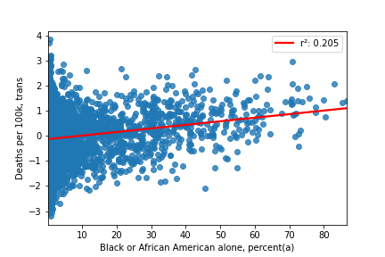
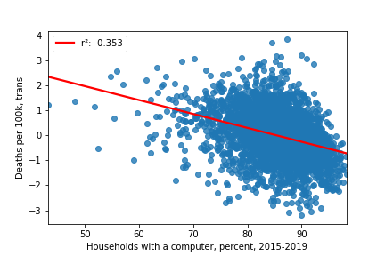
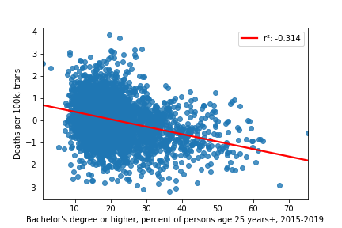
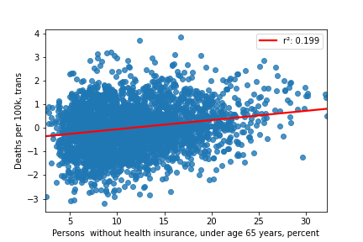

Slide 6
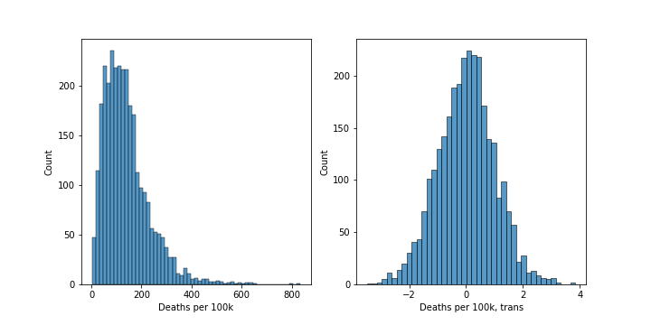

Slide 7
Motivation for model choice

Slide 8
Final Model
LassoCV with standard poly features (all poly features, not just interaction)
Alpha = 4e-4
Coefficients not included here because there are many of them
R2 = 32%
MAE = 182.1 Deaths per 100k
RMSE = 205.5 Deaths per 100k

Slide 9
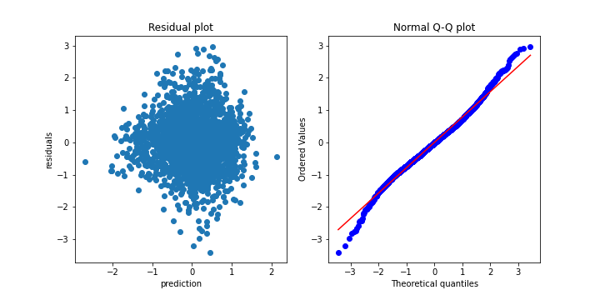

Slide 10
Appendix

Slide 11
Model progression (on training data)
~0.1 with simple linear regression using most correlated features
~0.2 after reducing features manually
~0.27 after Box-Cox transform of target
~0.315 after poly transform of features
~0.36 using Lasso on poly features
Ridge and Lasso were basically equivalent
I chose Lasso because it zeroed out a good amount of the poly features

Slide 12
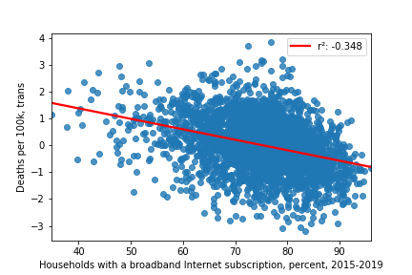
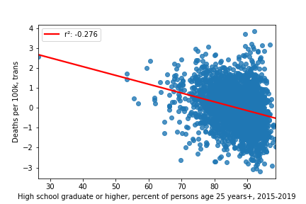
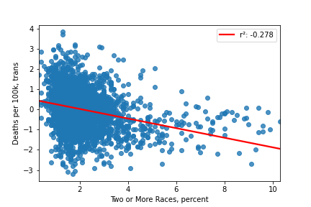
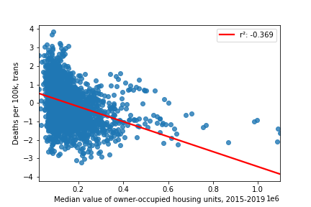

Slide 13
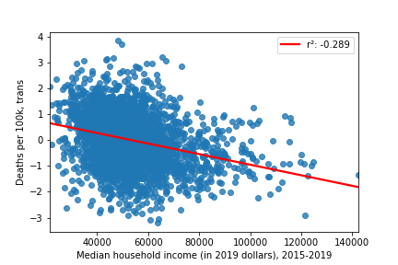
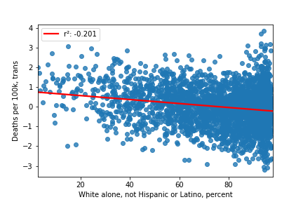

Slide 14
Simpler Model – LassoCV with standard features
Alpha = 0.0014
('Persons 65 years and over, percent', 0.074)
('Black or African American alone, percent(a)', -0.047)
('Two or More Races, percent', -0.228)
('White alone, not Hispanic or Latino, percent', -0.327)
('Median value of owner-occupied housing units, 2015-2019', -0.322)
('Living in same house 1 year ago, percent of persons age 1 year+, 2015-2019', 0.002)
('Households with a computer, percent, 2015-2019', -0.193)
('Households with a broadband Internet subscription, percent, 2015-2019', 0.019)
('High school graduate or higher, percent of persons age 25 years+, 2015-2019', 0.084)
("Bachelor's degree or higher, percent of persons age 25 years+, 2015-2019", -0.057)
('Persons without health insurance, under age 65 years, percent', 0.045)
('Median household income (in 2019 dollars), 2015-2019', 0.162)
R2 = 27%
MAE = 188.2 Deaths per 100k
RMSE = 211.8 Deaths per 100k

Slide 15
