Slide 1
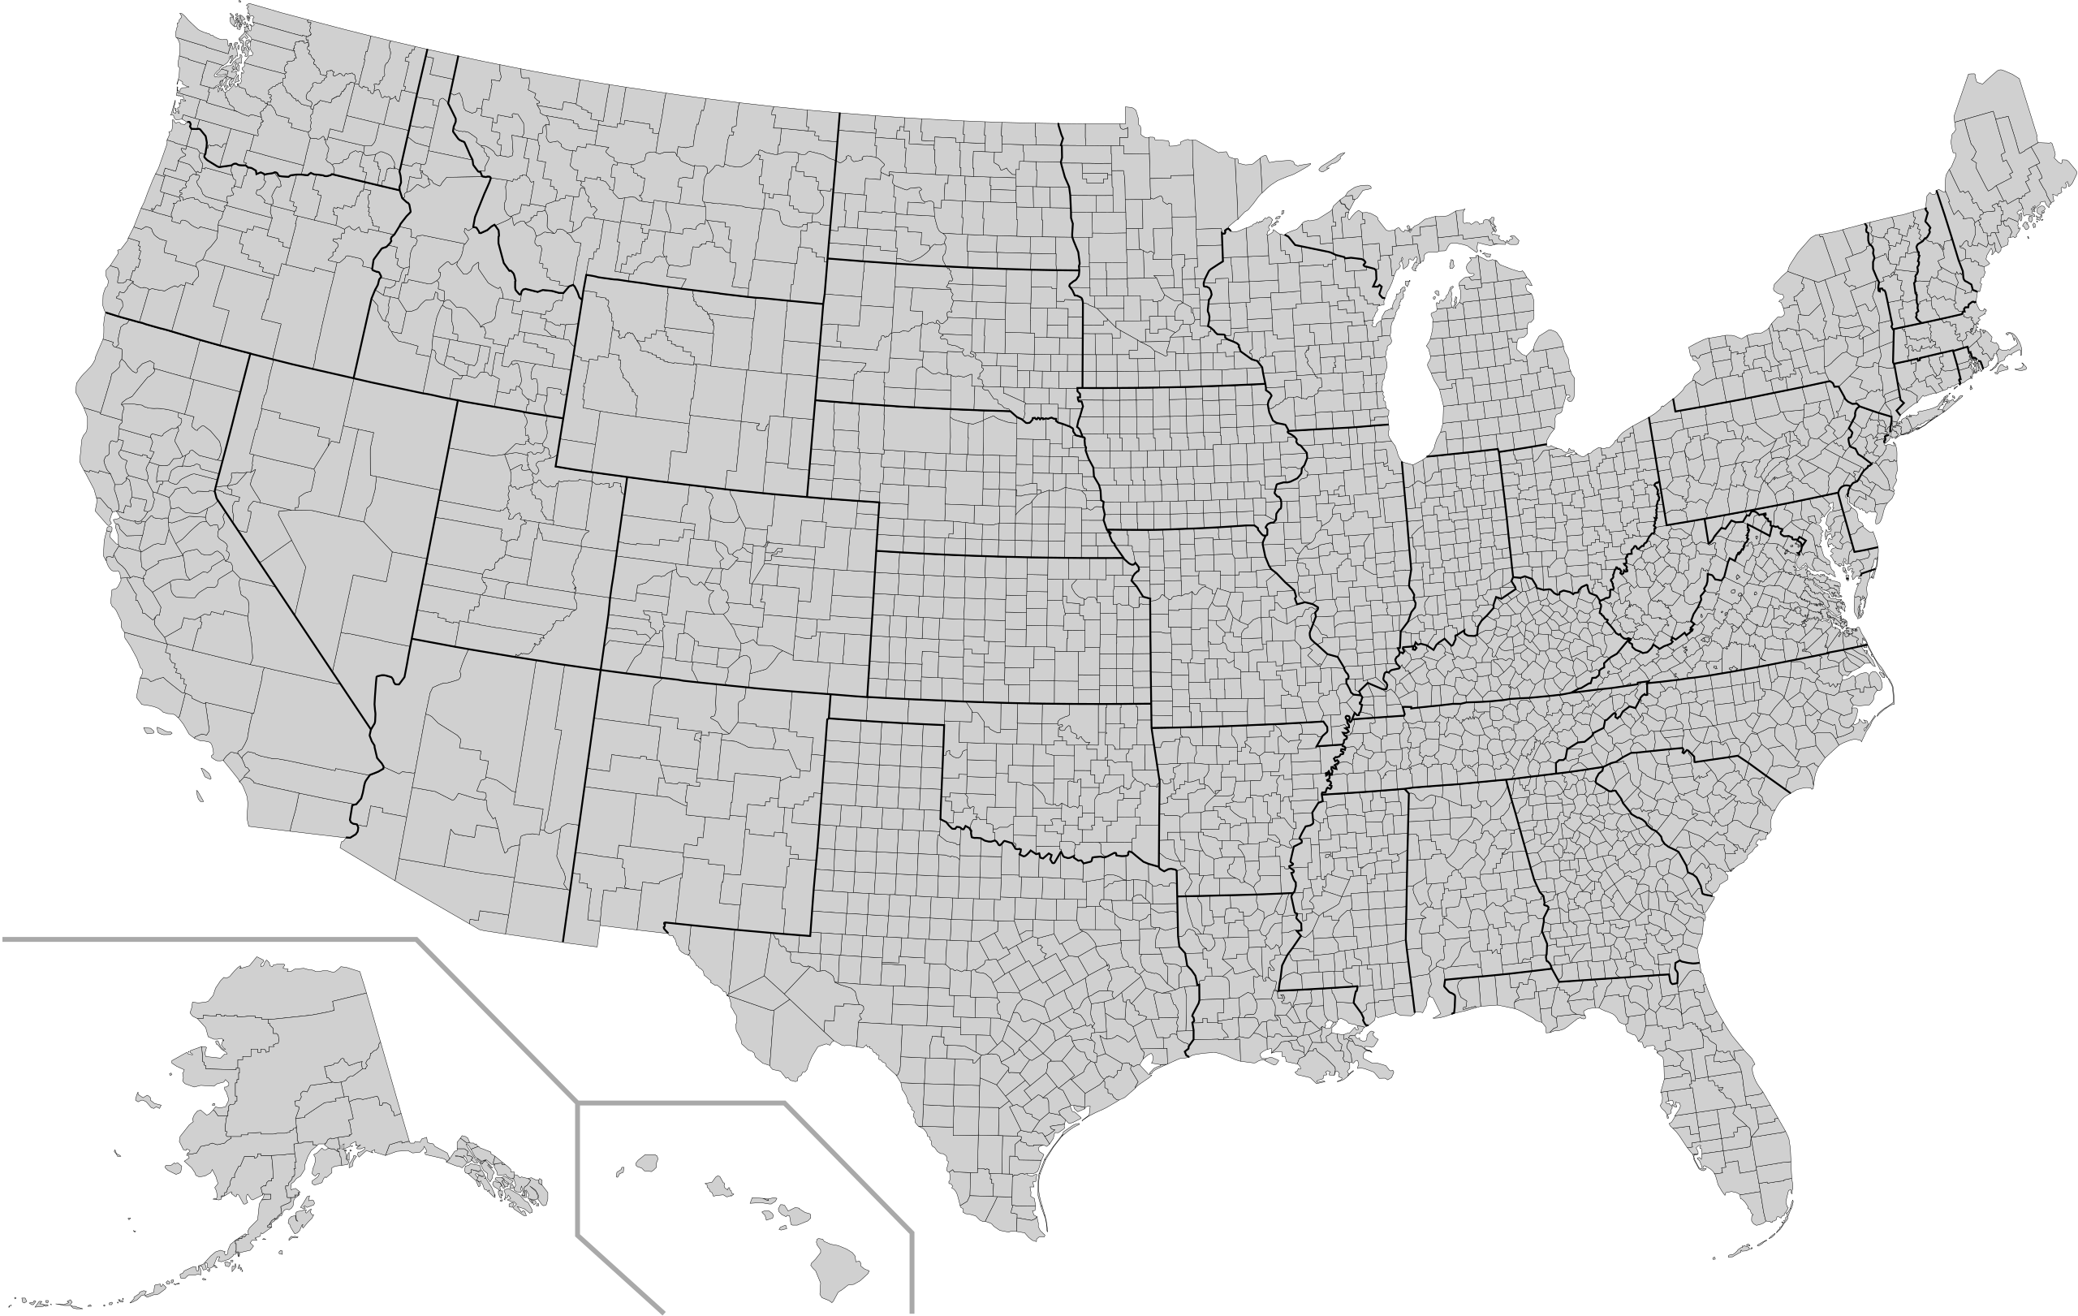
Predicting Covid-19 Deaths at the US County Level Using Census Data
Nick Kinnaird
1/22/2021

Slide 2
Idea: Knowing which counties are more at risk means resources can be deployed more efficiently.
Target variable: Cumulative Covid-19 deaths per county scaled by population
Data acquired from the NYT Covid-19 Github repository
Dated 1/18/2021
~3000 counties
Features: US Census data scraped from the Census Bureau
62 features consisting of various demographic and economic data
Notes:
Originally I scraped the CDC website directly, aiming to predict weekly deaths or some other measure, however that was too fine of a granularity to model.

Slide 3
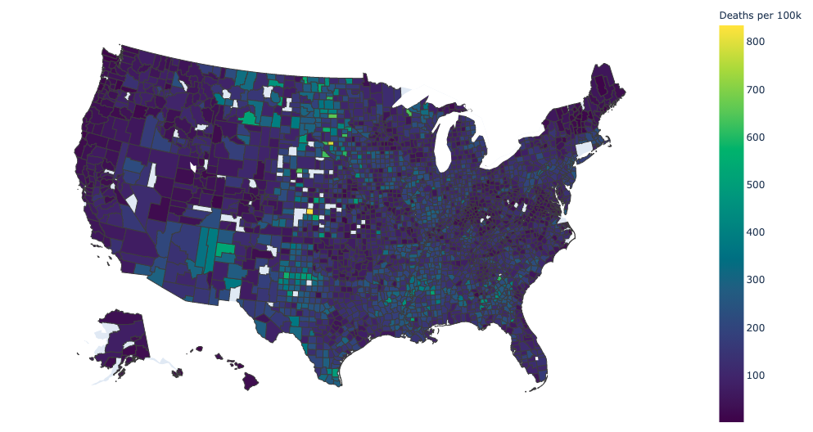
US County Cumulative Deaths per 100k People
Made using Plotly Choropleth Map. Blank counties are places where either my web-scraping failed, or I dropped outliers/entries with issues.

Slide 4
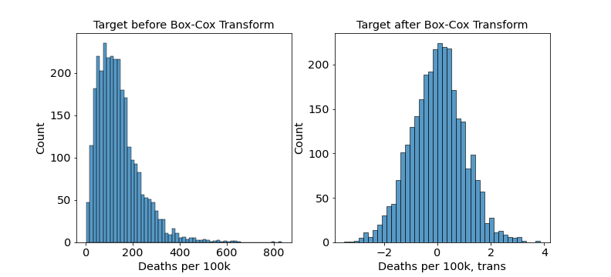
Target Distribution with and without Box-Cox Transform
Transforming the target distribution to a normal shape was necessary for my regression to work consistently.

Slide 5
What influences the number of deaths?
Age
Race
Income
Education
Health care
Etc.
A lot of these are significantly correlated to each other
By trial and error I selected 12 features for my model

Slide 6
Selected Features
Race/Age
Income Related
Education/Information
Number | Features | Correlation to target
1 | Persons 65 years and over, percent | 0.047
2 | Black or African American alone, percent | 0.205
3 | Two or More Races, percent | -0.278
4 | White alone, not Hispanic or Latino, percent | -0.201
5 | Persons without health insurance, under age 65 years, percent | 0.199
6 | Median value of owner-occupied housing units, 2015-2019 | -0.369
7 | Median household income (in 2019 dollars), 2015-2019 | -0.289
8 | Living in same house 1 year ago, percent of persons age 1 year+, 2015-2019 | 0.186
9 | Households with a computer, percent, 2015-2019 | -0.353
10 | Households with a broadband Internet subscription, percent, 2015-2019 | -0.348
11 | High school graduate or higher, percent of persons age 25 years+, 2015-2019 | -0.276
12 | Bachelor's degree or higher, percent of persons age 25 years+, 2015-2019 | -0.314

Slide 7
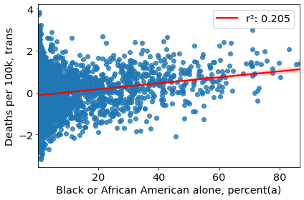
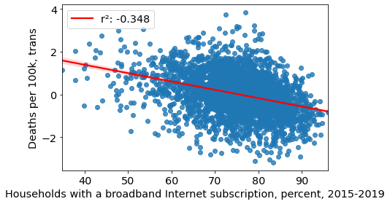
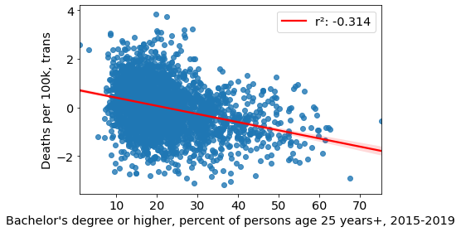
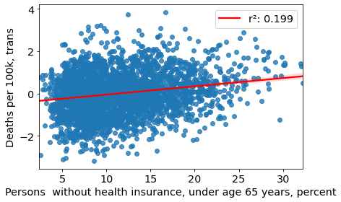

Slide 8
Model Choice: Lasso with standard polynomial features
Polynomial degree 2, including all poly features, not just interaction terms
ƛ = 4e-4
Ultimately I selected the model which performed the best, regardless of complexity
Verified with cross validation
I decided this because this was an analysis on life/death data, and every little bit matters
Did choose Lasso over Ridge for better interpretability
Notes:
Model Tests:
Linear regression with and without polynomial features
Lasso and ridge regression with scaled features, with and without polynomial features

Slide 9
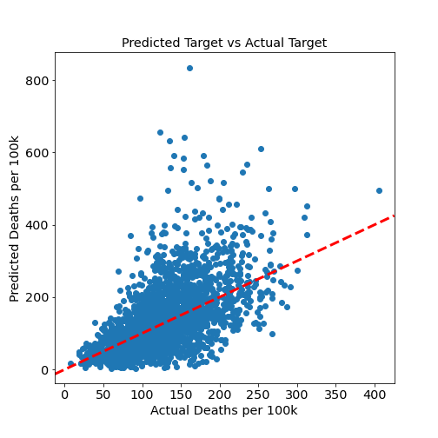
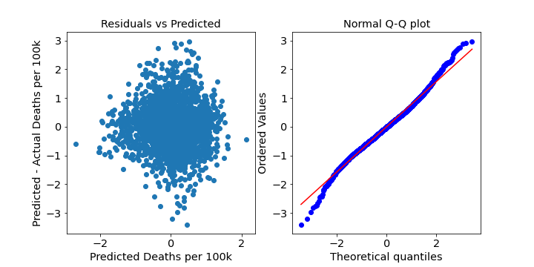
Model Performance
y=x
The predicted vs actual plot shows that my model tends to overestimate the number of deaths
Residuals are relatively happy
Variance is high

Slide 10
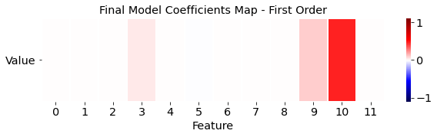
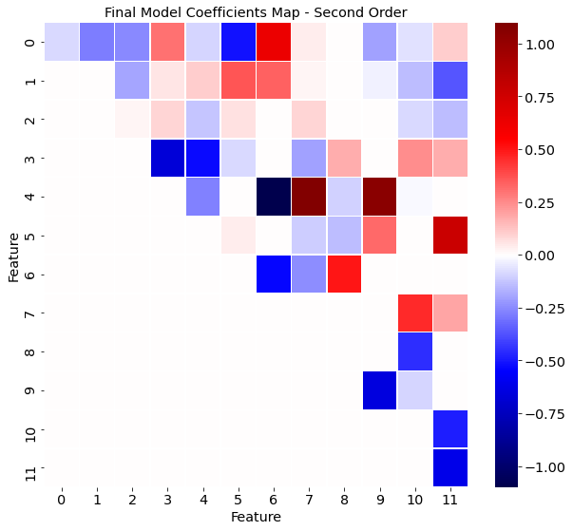
Polynomial Coefficients
# | Feature
0 | Persons 65 years and over, percent
1 | Black or African American alone, percent
2 | Two or More Races, percent
3 | White alone, not Hispanic or Latino, percent
4 | Median value of owner-occupied housing units, 2015-2019
5 | Living in same house 1 year ago, percent of persons age 1 year+, 2015-2019
6 | Households with a computer, percent, 2015-2019
7 | Households with a broadband Internet subscription, percent, 2015-2019
8 | High school graduate or higher, percent of persons age 25 years+, 2015-2019
9 | Bachelor's degree or higher, percent of persons age 25 years+, 2015-2019
10 | Median household income (in 2019 dollars), 2015-2019
11 | Persons without health insurance, under age 65 years, percent
(matrix is symmetric)

Slide 11
Final Model Results
r² = 36% on training data, 32% on the test data
The unexplained variance is high
I’m not surprised by this considering the complexity of the problem
MAE = 182.1 Deaths per 100k
RMSE = 205.5 Deaths per 100k
Notes:
It took my a while even to get to this r2 so I’m happy with it.

Slide 12
Future Work
Investigate trend of model to overestimate the number of deaths
Ultimately the model would need to be improved significantly for it to be of any real use
More features including health care related statistics, time-dependent features, etc.
More sophisticated calculations on those features
Finer granularity: cities or census tracts
Notes:
CDC and others do more complicated calculations on the features that they input into their models.

Slide 13
End - Questions?

Slide 14
Appendix

Slide 15
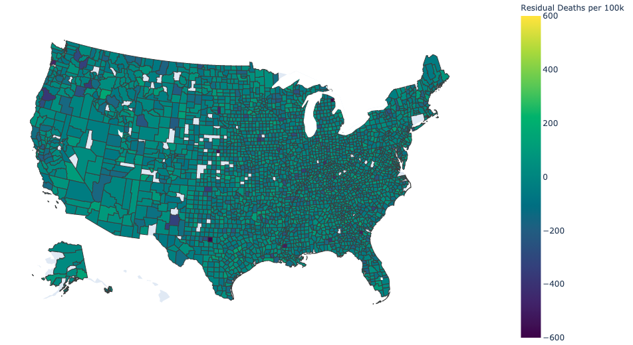
US County Residual Deaths per 100k People

Slide 16
Simpler Model – LassoCV with standard features
('Persons 65 years and over, percent', 0.074)
('Black or African American alone, percent(a)', -0.047)
('Two or More Races, percent', -0.228)
('White alone, not Hispanic or Latino, percent', -0.327)
('Median value of owner-occupied housing units, 2015-2019', -0.322)
('Living in same house 1 year ago, percent of persons age 1 year+, 2015-2019', 0.002)
('Households with a computer, percent, 2015-2019', -0.193)
('Households with a broadband Internet subscription, percent, 2015-2019', 0.019)
('High school graduate or higher, percent of persons age 25 years+, 2015-2019', 0.084)
("Bachelor's degree or higher, percent of persons age 25 years+, 2015-2019", -0.057)
('Persons without health insurance, under age 65 years, percent', 0.045)
('Median household income (in 2019 dollars), 2015-2019', 0.162)
r² = 27%
MAE = 188.2 Deaths per 100k
RMSE = 211.8 Deaths per 100k
ƛ = 0.0014

Slide 17
Model progression (on training data)
~0.1 with simple linear regression using most correlated features
~0.2 after reducing features manually
~0.27 after Box-Cox transform of target
~0.315 after poly transform of features
~0.36 using Lasso on poly features
Ridge and Lasso were basically equivalent
I chose Lasso because it zeroed out a good amount of the polynomial features

Slide 18
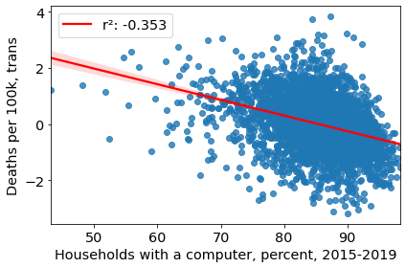
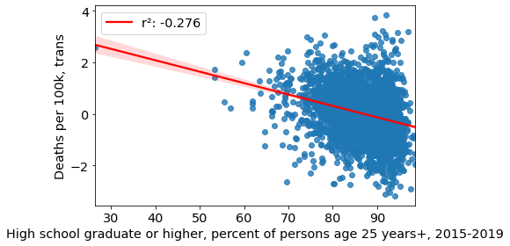
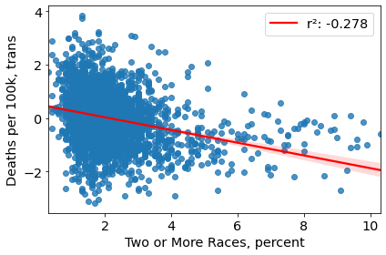
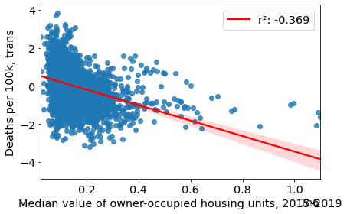

Slide 19
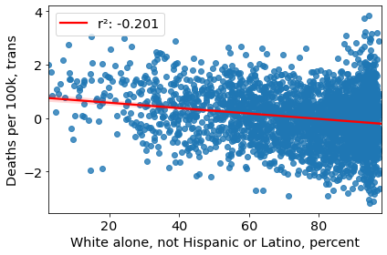
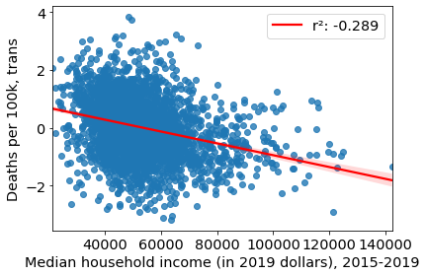

Slide 20
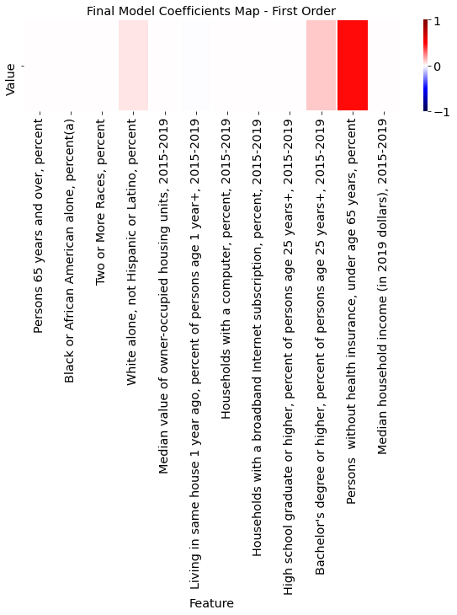

Slide 21
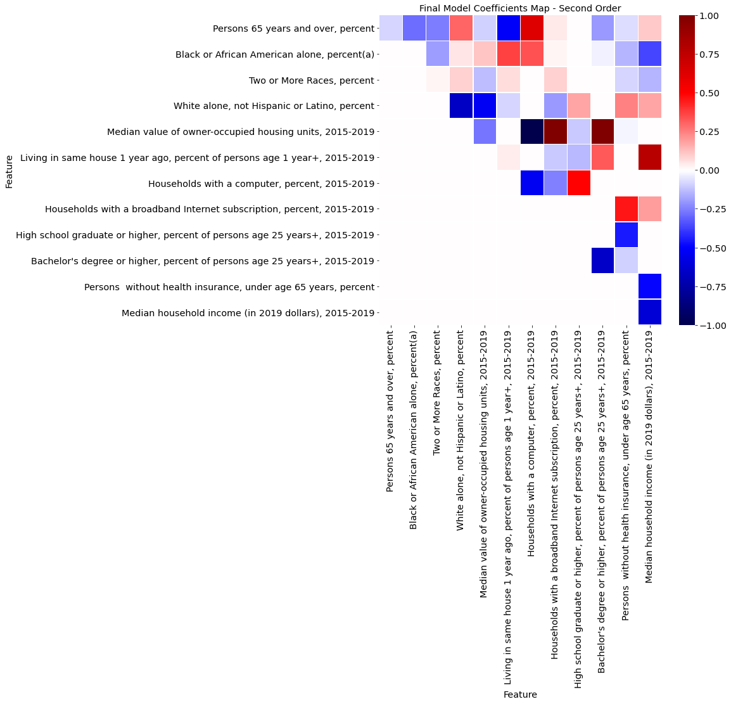

Slide 22
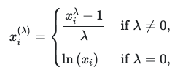
Box-Cox Transform:

