Slide 1
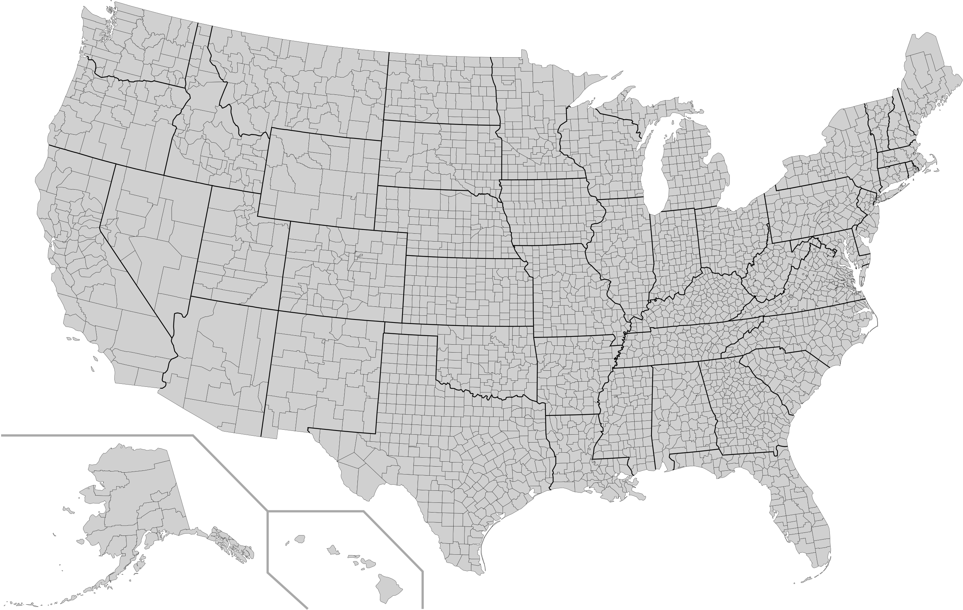
Predicting Covid-19 Deaths at the US County Level
Nick Kinnaird
1/22/2021

Slide 2
Knowing which counties are more at risk means resources can be deployed more efficiently.
Target: Cumulative Covid-19 deaths per county scaled by population
Data acquired from from the NYT Covid-19 Github repository
(Originally I scraped the CDC website directly, aiming to predict weekly deaths or some other measure, however that was too fine of a granularity to model.)
Features: US Census data scraped from the Census Bureau
62 features consisting of various demographic and economic data

Slide 3
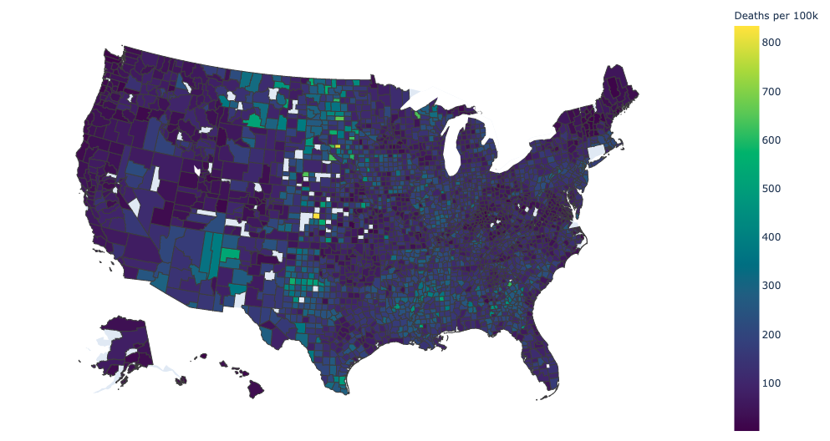
US County Cumulative Deaths per 100k People
Made using Plotly Choropleth Map. Blank counties are places where either my web-scraping failed, or I dropped outliers/entries with issues.

Slide 4
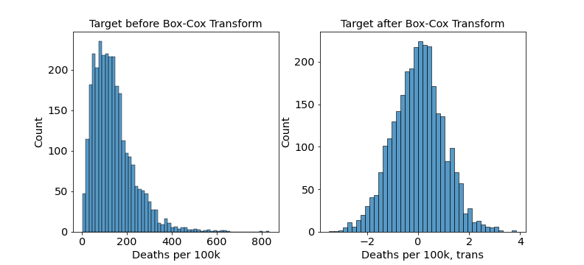
Target Distribution with and without Box-Cox Transform
Transforming the target distribution to a normal shape was necessary for my regression to work consistently.

Slide 5
What influences the number of deaths?
Age
Race
Income
Education
Health
Etc.
A lot of these are somewhat to significantly correlated
By trial and error I selected 12 features for my model

Slide 6
Selected Features
Race/Age
Income Related
Education/Information
Number | Features | Correlation to target
1 | Persons 65 years and over, percent | 0.047
2 | Black or African American alone, percent | 0.205
3 | Two or More Races, percent | -0.278
4 | White alone, not Hispanic or Latino, percent | -0.201
5 | Persons without health insurance, under age 65 years, percent | 0.199
6 | Median value of owner-occupied housing units, 2015-2019 | -0.369
7 | Median household income (in 2019 dollars), 2015-2019 | -0.289
8 | Living in same house 1 year ago, percent of persons age 1 year+, 2015-2019 | 0.186
9 | Households with a computer, percent, 2015-2019 | -0.353
10 | Households with a broadband Internet subscription, percent, 2015-2019 | -0.348
11 | High school graduate or higher, percent of persons age 25 years+, 2015-2019 | -0.276
12 | Bachelor's degree or higher, percent of persons age 25 years+, 2015-2019 | -0.314

Slide 7
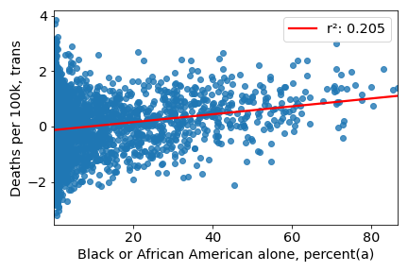
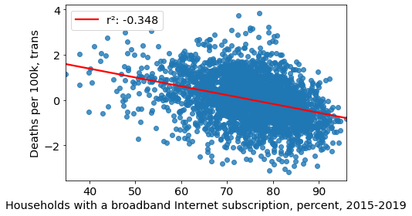
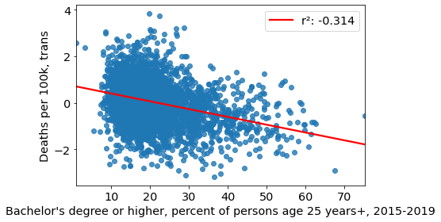
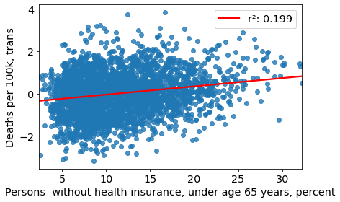

Slide 8
Model Choice
Model Tests:
Linear regression with and without polynomial features
Lasso and ridge regression with scaled features, with and without polynomial features
Ultimately I selected the model which performed the best, regardless of complexity:
LassoCV with standard polynomial features (all poly features, not just interaction)
ƛ = 4e-4

Slide 9
Final Model Results
Coefficients not included here because there are many of them
r² = 32%
The unexplained variance is high
I’m not surprised by this considering the complexity of the problem
It took some effort to even get to this point
MAE = 182.1 Deaths per 100k
RMSE = 205.5 Deaths per 100k

Slide 10
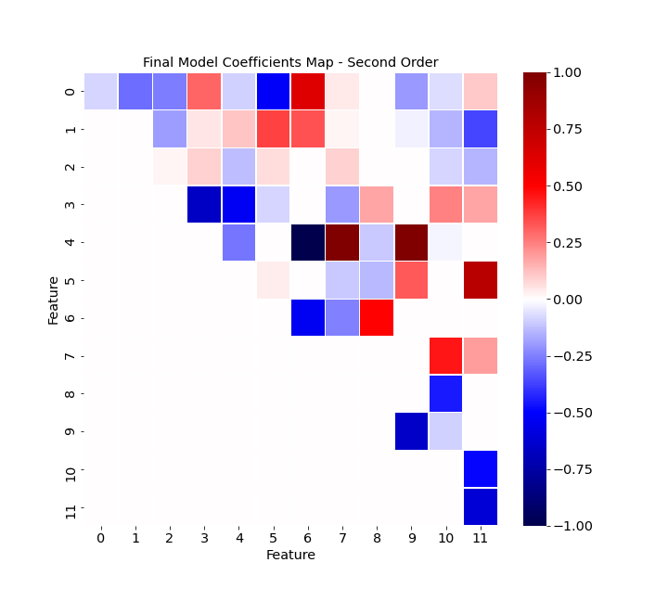
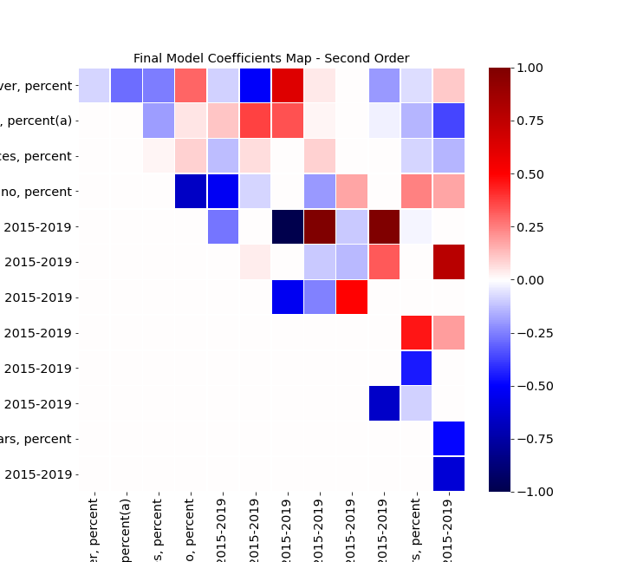
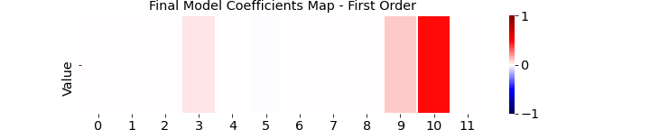
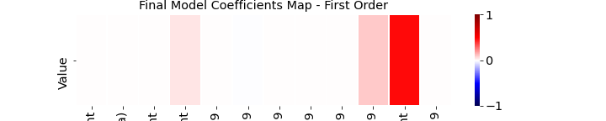

Slide 11
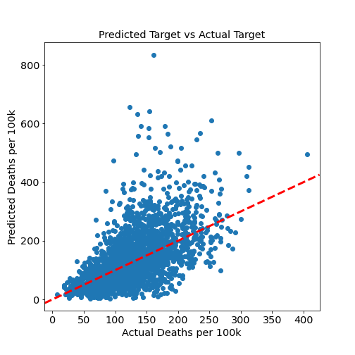
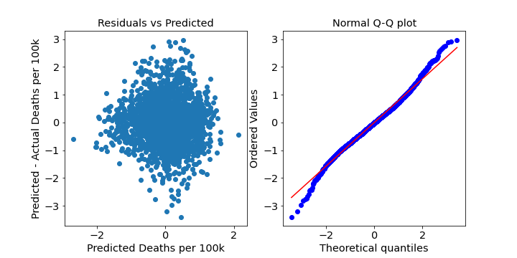
Residuals are relatively happy
The predicted vs actual plot shows that my model tends to overestimate the number of deaths
Ultimately, the explained variance would need to be improved for the model to be of any real use

Slide 12
Future Work
Other features could be included to improve the model
More healthcare related statistics

Slide 13
Appendix

Slide 15
Model progression (on training data)
~0.1 with simple linear regression using most correlated features
~0.2 after reducing features manually
~0.27 after Box-Cox transform of target
~0.315 after poly transform of features
~0.36 using Lasso on poly features
Ridge and Lasso were basically equivalent
I chose Lasso because it zeroed out a good amount of the polynomial features

Slide 16
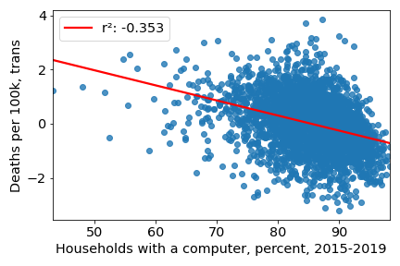
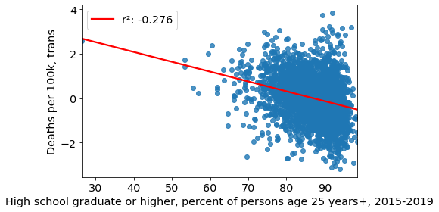
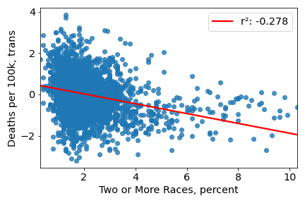
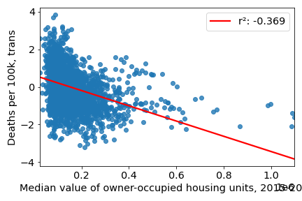

Slide 17
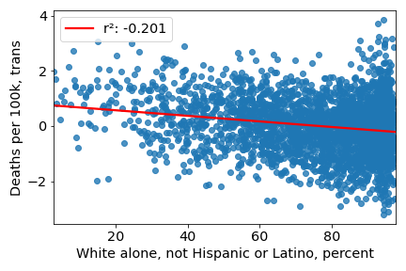
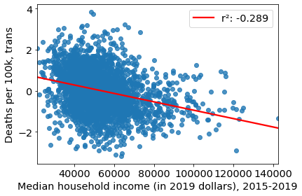

Slide 18
Simpler Model – LassoCV with standard features
Alpha = 0.0014
('Persons 65 years and over, percent', 0.074)
('Black or African American alone, percent(a)', -0.047)
('Two or More Races, percent', -0.228)
('White alone, not Hispanic or Latino, percent', -0.327)
('Median value of owner-occupied housing units, 2015-2019', -0.322)
('Living in same house 1 year ago, percent of persons age 1 year+, 2015-2019', 0.002)
('Households with a computer, percent, 2015-2019', -0.193)
('Households with a broadband Internet subscription, percent, 2015-2019', 0.019)
('High school graduate or higher, percent of persons age 25 years+, 2015-2019', 0.084)
("Bachelor's degree or higher, percent of persons age 25 years+, 2015-2019", -0.057)
('Persons without health insurance, under age 65 years, percent', 0.045)
('Median household income (in 2019 dollars), 2015-2019', 0.162)
R2 = 27%
MAE = 188.2 Deaths per 100k
RMSE = 211.8 Deaths per 100k

Slide 19
