Slide 1
Muon decay in the rest frame
momentum
spin

Slide 2
Y
⍵⟂
⍵∥
β
ᴪ
Z

Slide 3
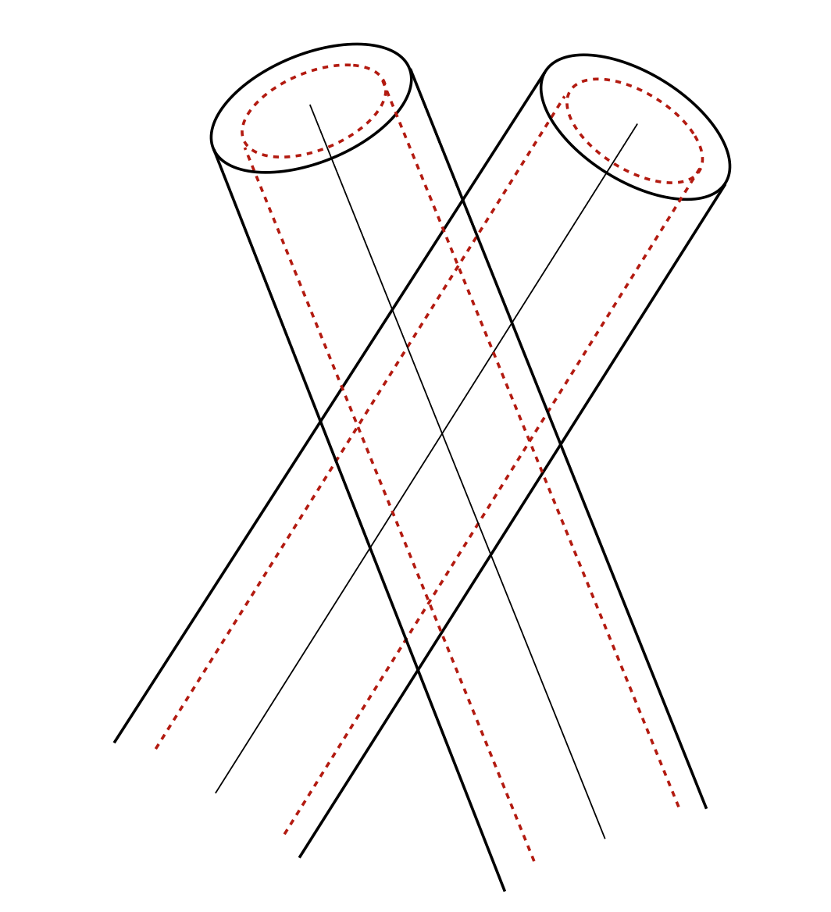
7.5°
U
V

Slide 4
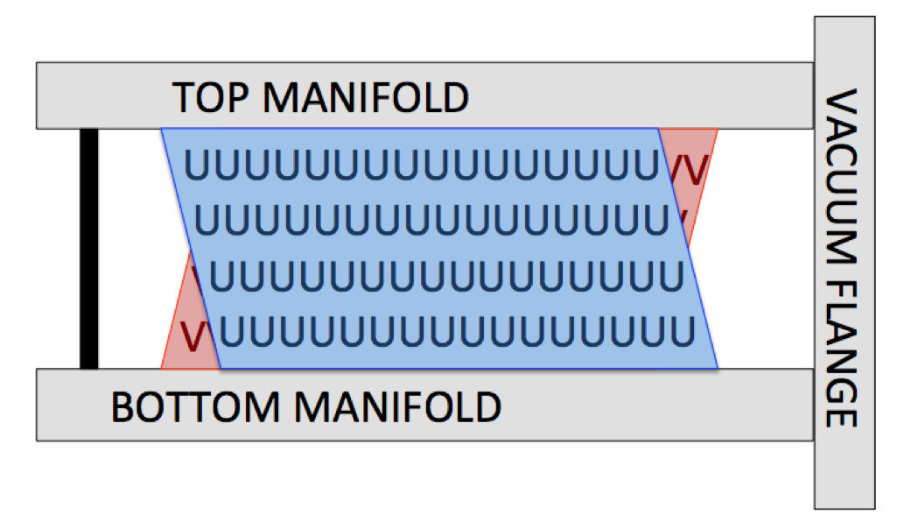
Straws: 32 ----------------------------------------- 1

