Slide 1
Muon decay in the rest frame
momentum
spin

Slide 2
Y
⍵⟂
⍵∥
β
ᴪ
Z

Slide 3
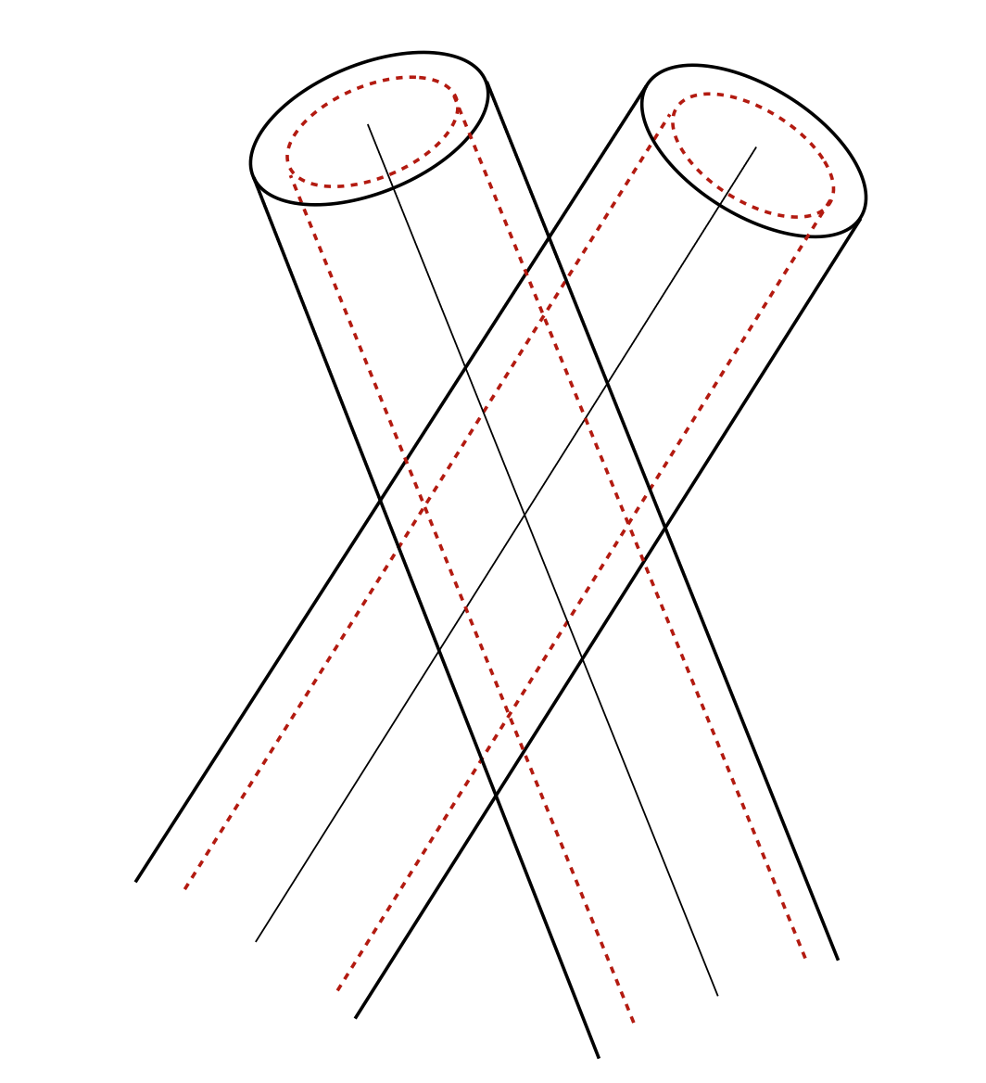
7.5°
U
V

Slide 4
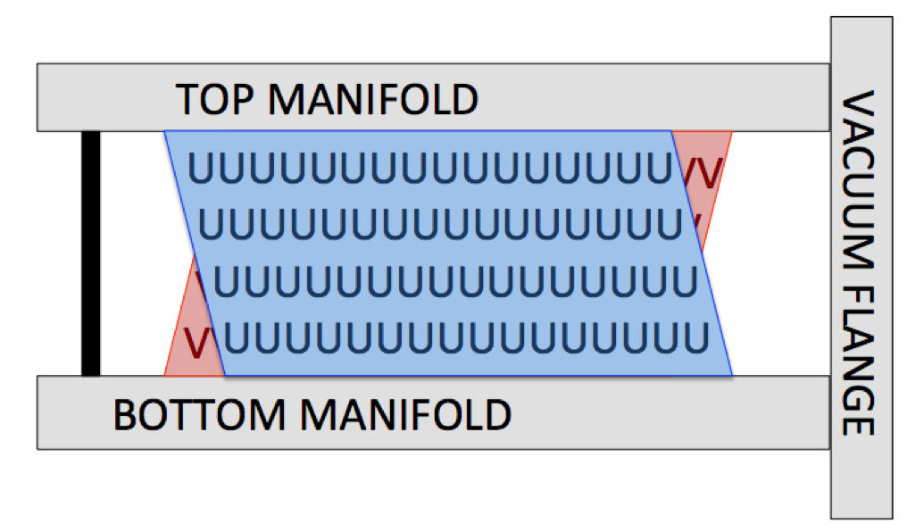
Straws: 32 ----------------------------------------- 1

Slide 5
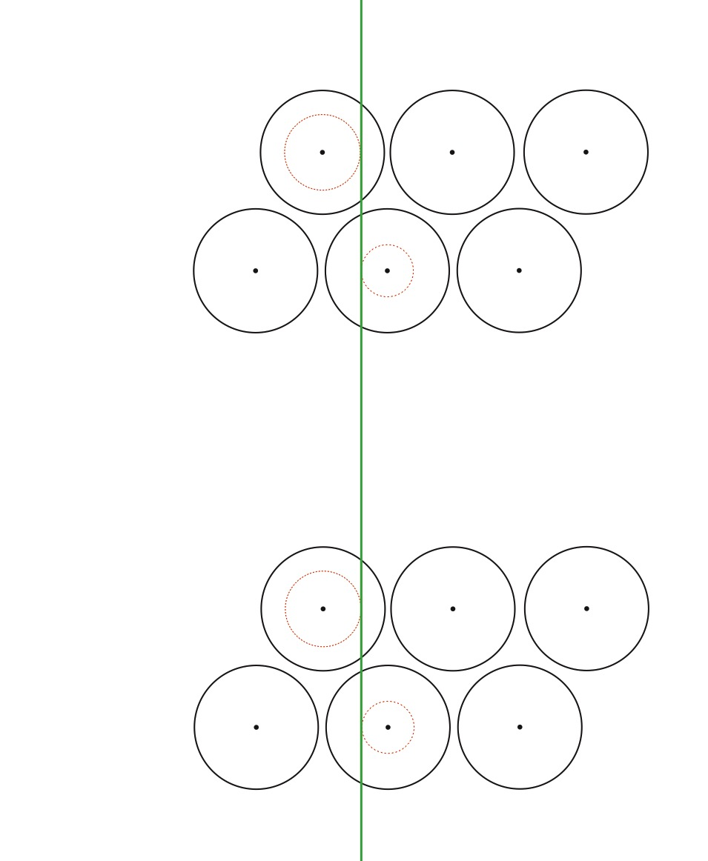

Slide 6
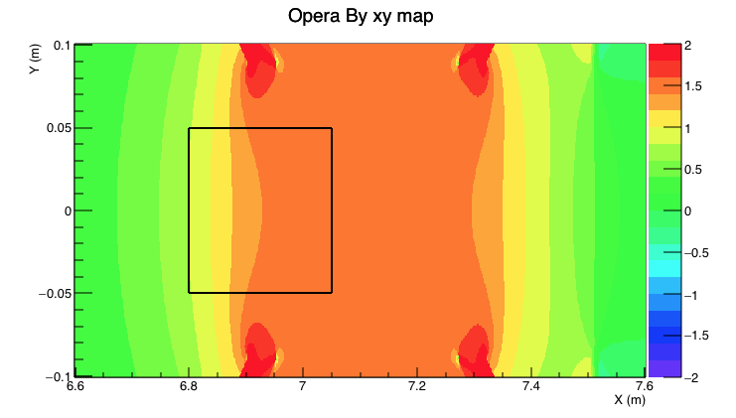
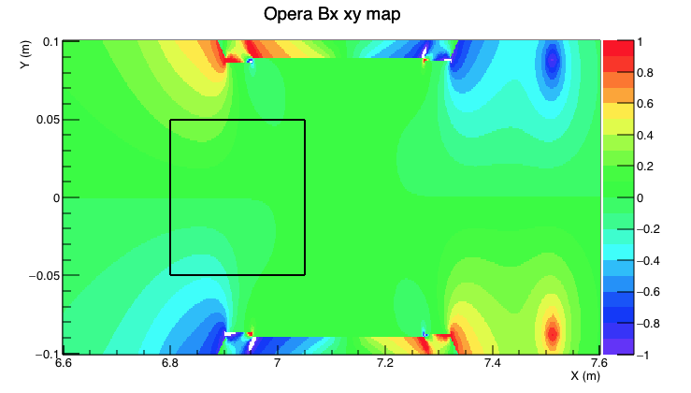
Tracker region
B_{y} (T)
Tracker region
B_{r} (T)
μ⁺
μ⁺
1.45 T

Slide 7
Lines used to line up storage region in previous magnetic field picture slide

Slide 8
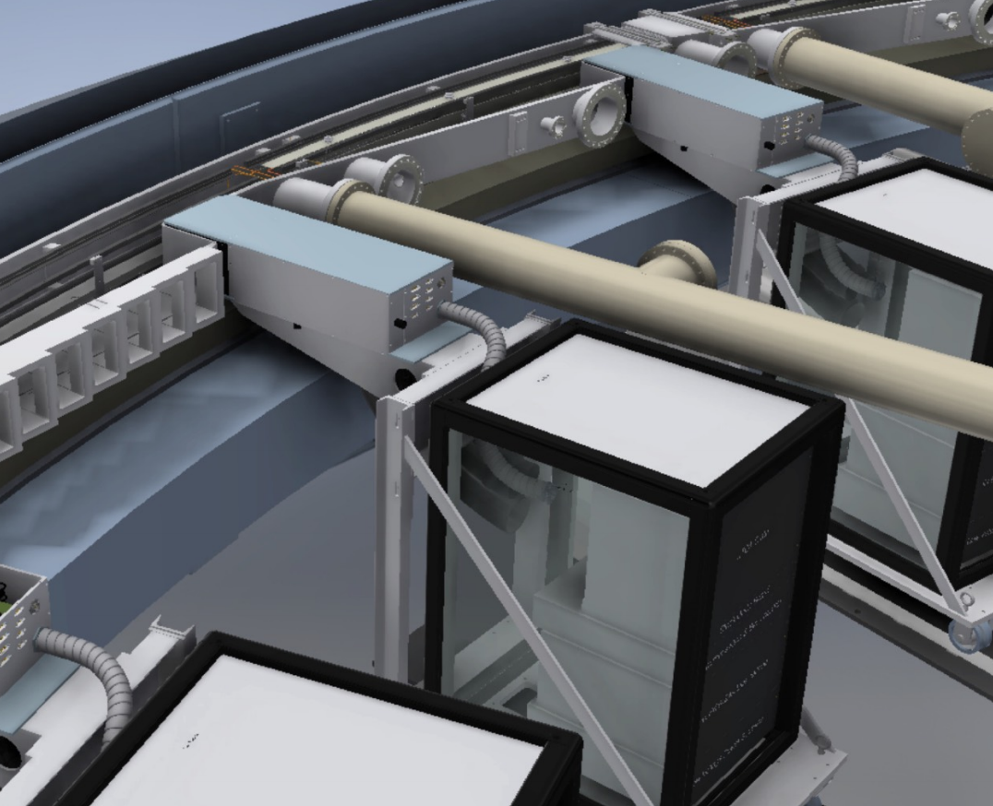
Calorimeter
Electronics

Slide 10
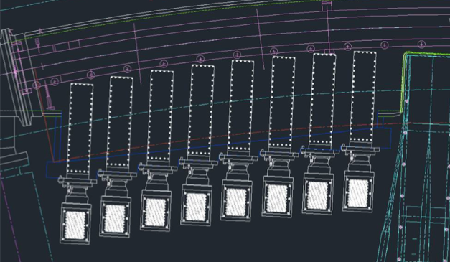
X
Y
Z

Slide 11
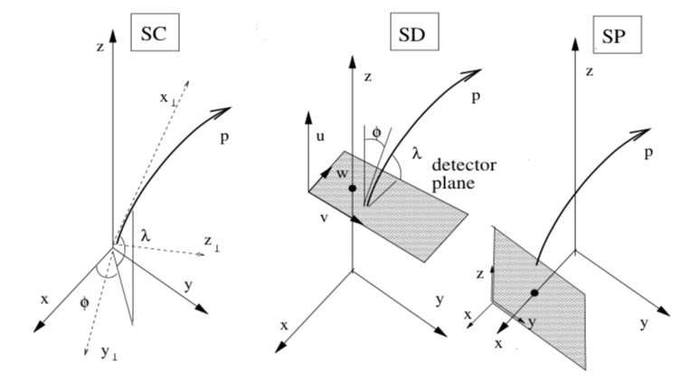

Slide 12
Spin
Low Energy
Spin
High Energy
Calo

Slide 13




shadow dead time
(SDT)
shadow gap time
(SGT)
Trigger cluster
Shadow cluster
Shadow doublet
$$E_{1},t_{1}$$
$$E_{2},t_{2}$$
$$E_{D}=C\left(E_{1}+E_{2}\right)$$
$$t_{D}=\frac{E_{1}t_{1}+E_{2}\left(t_{2}−SGT\right)}{C\left(E_{1}+E_{2}\right)}$$

