Slide 2
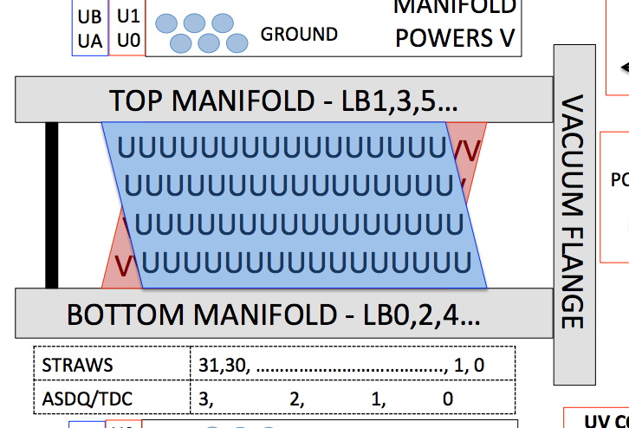

Slide 3
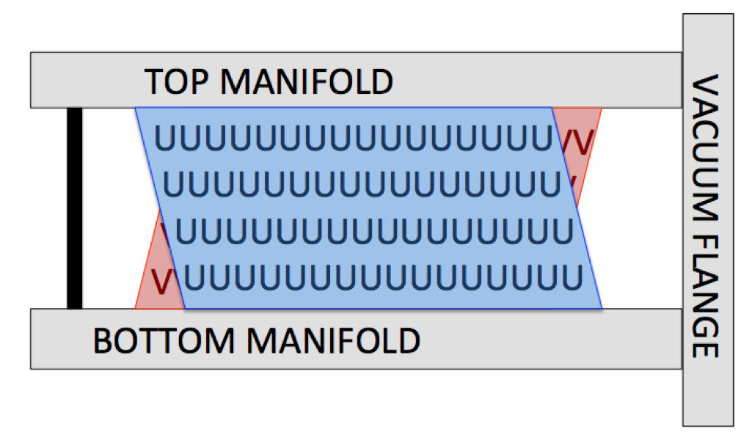
U straw
V straw
Geane Tracker System
Tracker System (is this right?)
Y
Y
X
X
Z
Z
Geane Coord System
Y
V
θ
Z
U
X

Slide 4
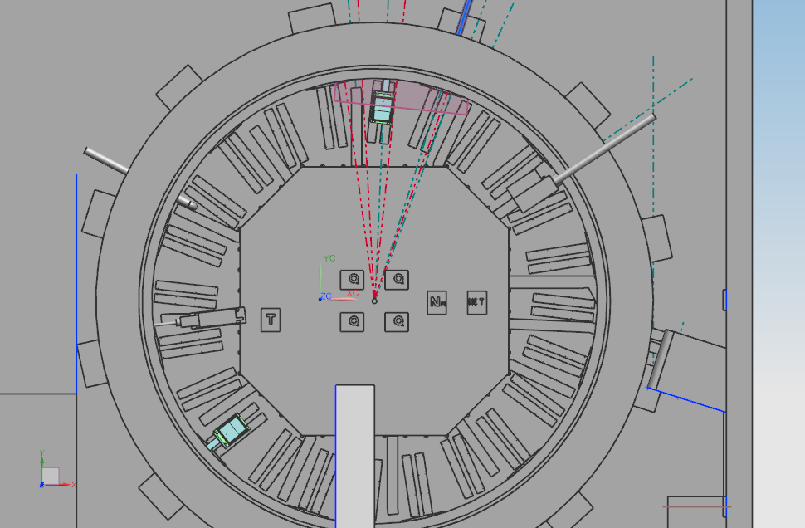
Tracker geometry placement defined in StrawTrackerCadMesh_service
Inflector
“300 degree” tracker, GeaneWorldTracker[18]
“30 degree” tracker, GeaneWorldTracker[0]
-105.52 degrees
-15.52 degrees
Track fitting code tracker
(planes parallel in X)
Geant World System
X
74.48 degrees
Y
Z
“120 degree” tracker, GeaneWorldTracker[12]
(origin at center of ring)

Slide 5
Wire (out of the page)
positron
U measured
d
θ
Straw measurement axis
d
r
r

Slide 6
New Geane Coord System
Y
V
X
θ
U
Z

