Slide 1
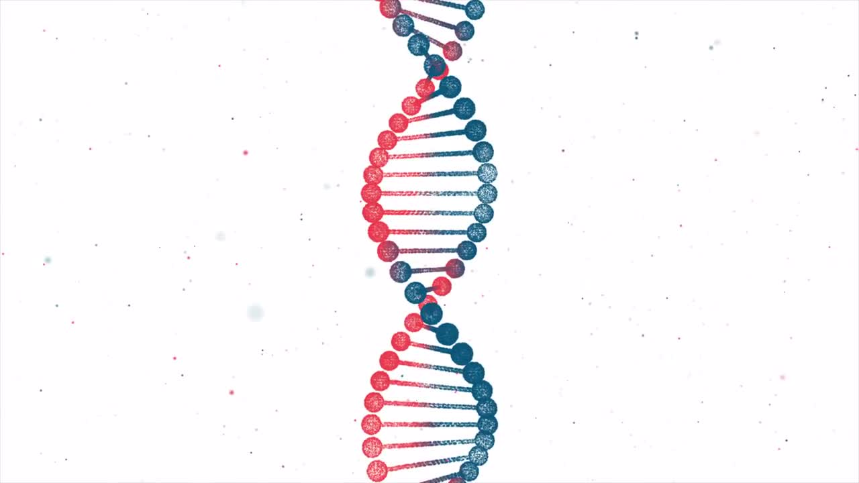
Genetic Variant Classification (Classification)
Nick Kinnaird
2/10/21
Winter 2021 Cohort

Slide 2

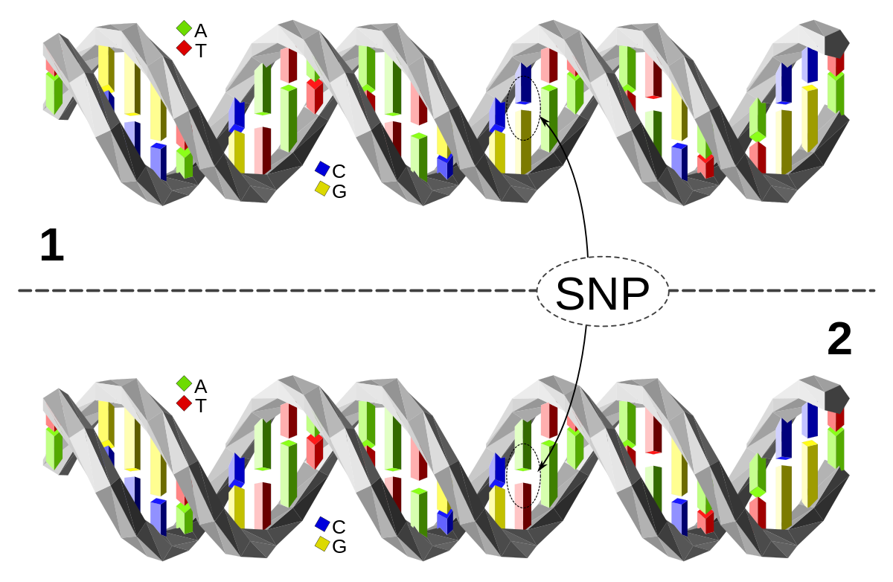
DNA Primer
We all have DNA and genes
Some of those genes are variants
These variants might be common (eg. SNP) or rare (mutations)
Variants might have little to no effect, or a negative effect (sometimes but far less often a positive effect)

Slide 3
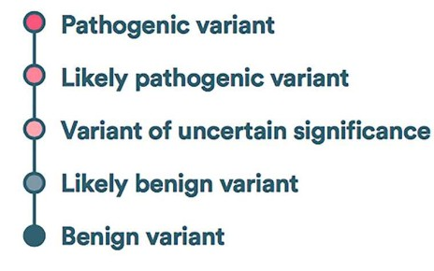
Gene Classification
Genetic variants are classified at labs (usually manually) in one of 5 different ways in terms of clinical significance
These are split into 3 categories
When results from separate labs are classified as different categories, they are said to be “conflicting”

Slide 4
Purpose
By identifying which gene variants are likely to be classified in a conflicting manner or not:
Biologists and genetic labs can better identify those variants which require further study and lab testing
Physicians can better respond to lab results for patient treatment

Slide 5
The Data
Kaggle Dataset: https://www.kaggle.com/kevinarvai/clinvar-conflicting/
ClinVar – public archive of gene reports
Prediction Target: conflicting (1) or non-conflicting (0)
~60,000 entries of data
1:3 conflicting to non-conflicting
Features:
Categorical: Name of the gene, variant type, impact of the variant
Numeric: Variant frequency, ‘deleteriousness’ score, ‘loss-of-function’ score

Slide 6
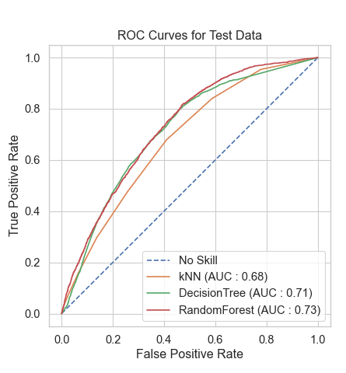
Modeling
Tried kNN, DecisionTree, and RandomForest
Used GridSearchCV to tune parameters
Ultimately chose the RandomForest since it performed the best (and most consistently) on the training and validation data

Slide 7
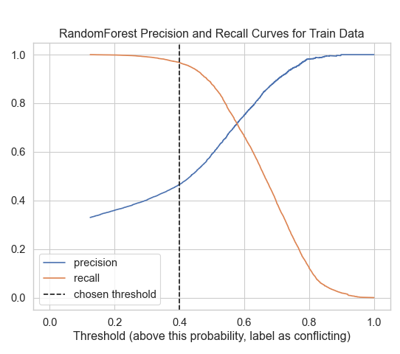
Modeling
Optimized on recall without entirely sacrificing precision
More true positives at the cost of false positives which is acceptable
Chose threshold of 0.4

Slide 8
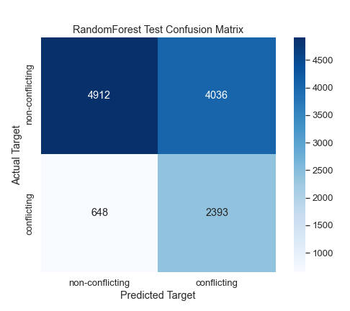
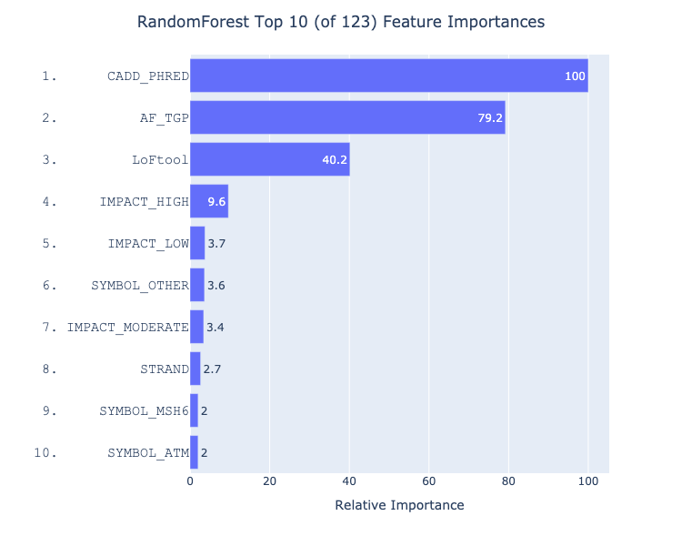
Results
‘deleteriousness’
allele frequency
loss of function
Some specific genes more likely to be classified in a conflicting manner or not
Recall: 0.78
Most important feature: CADD_PHRED

Slide 9
Future Work
There was one or two omitted features which encoded some interesting information which could potentially be used
The project could be changed to a multi-label classification problem on the pathogenicity of the variant
This would be a more useful application
(Indeed there are companies who are working on this stuff)

Slide 10
End
“The human genome is only on the order of a gigabyte of data, which is a tiny little database. If you take the entire living biosphere…about one petabyte…that’s still very small compared with Google or the Wikipedia. And somehow mother nature manages to create…this incredibly rich environment with this amazingly small amount of data.”
- Freeman Dyson

Slide 11
Appendix

Slide 12
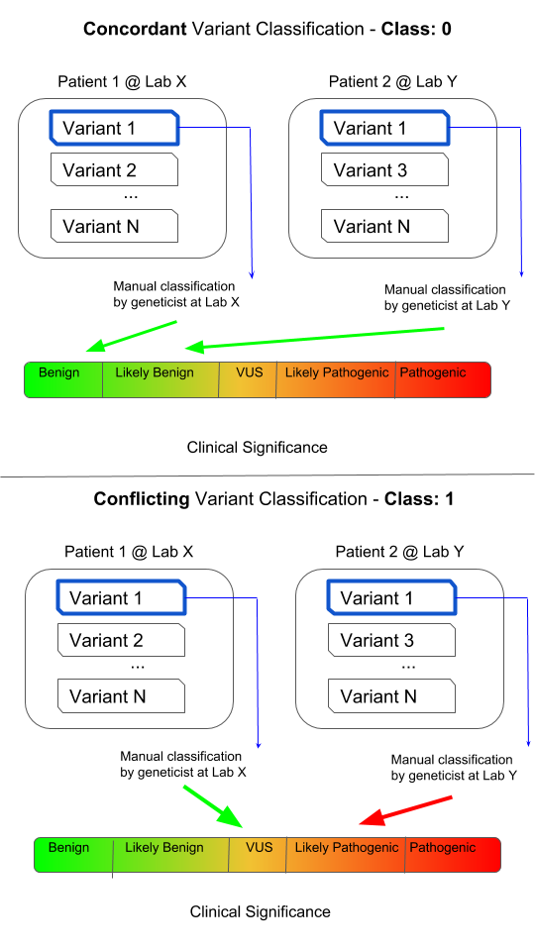

Slide 13
knn_model = KNeighborsClassifier(n_neighbors=10)
dt_model = DecisionTreeClassifier(max_depth=25, max_features=20, random_state=121, class_weight={0:1,1:3})
rf_model = RandomForestClassifier(n_estimators=10, max_depth=25, max_features=20, random_state=121, class_weight={0:1,1:3})

Slide 14
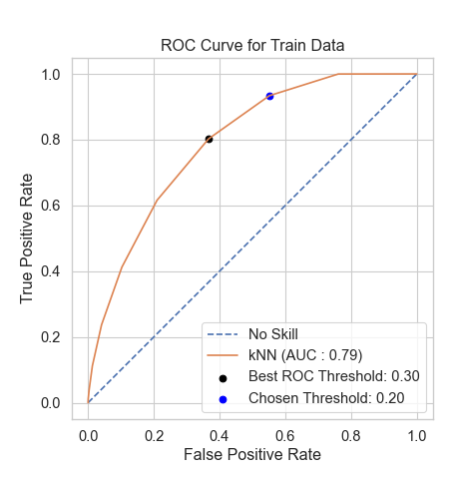
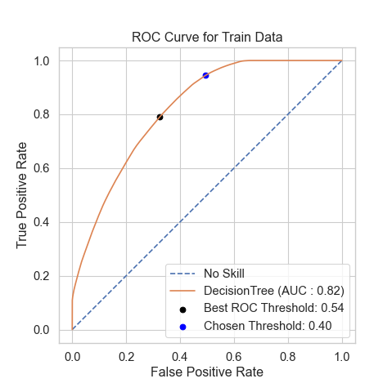
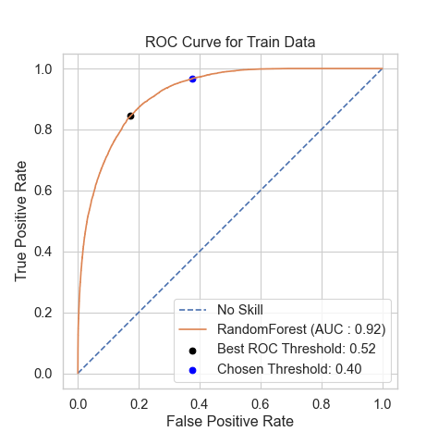

Slide 15
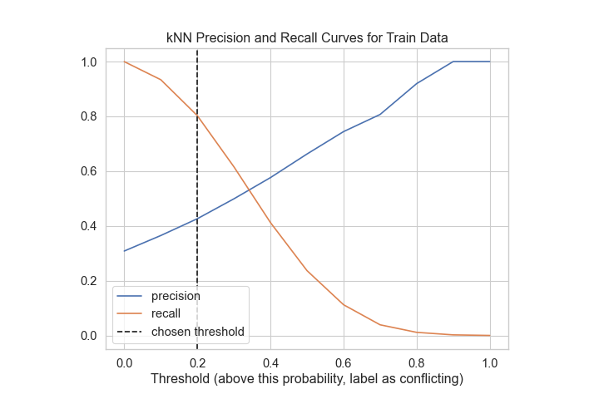
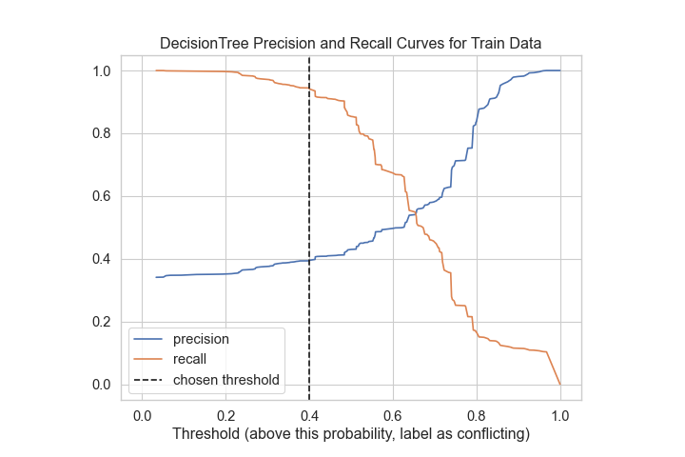

Slide 16
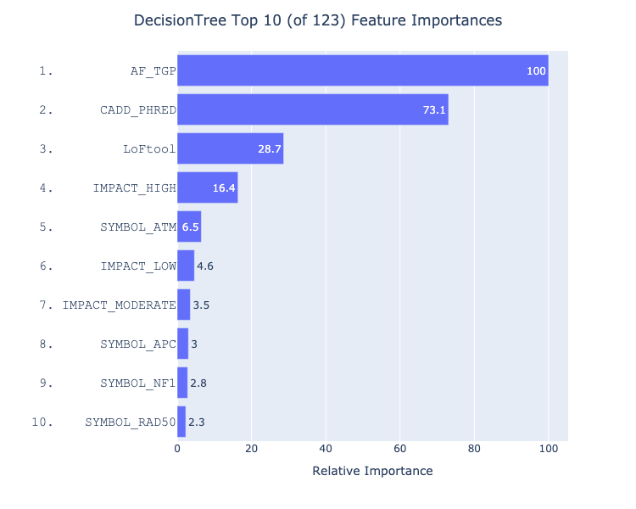

Slide 17
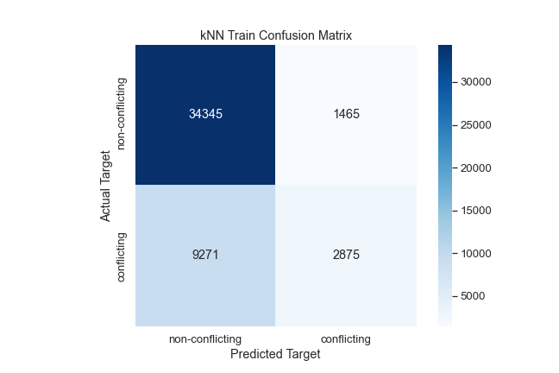
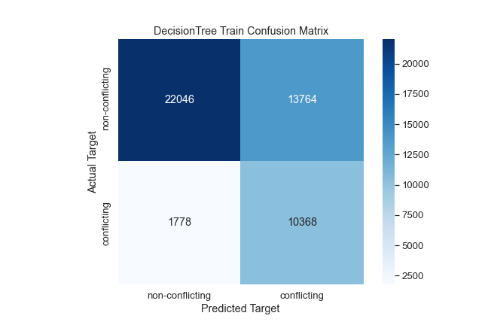
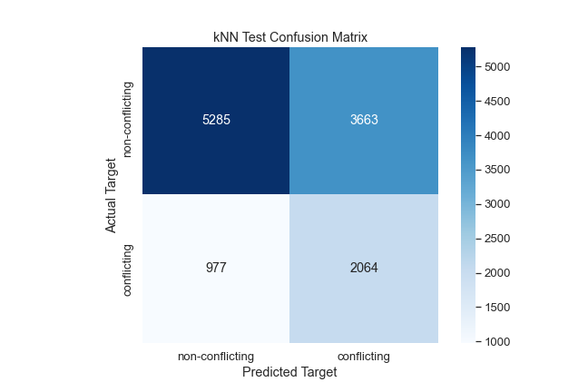
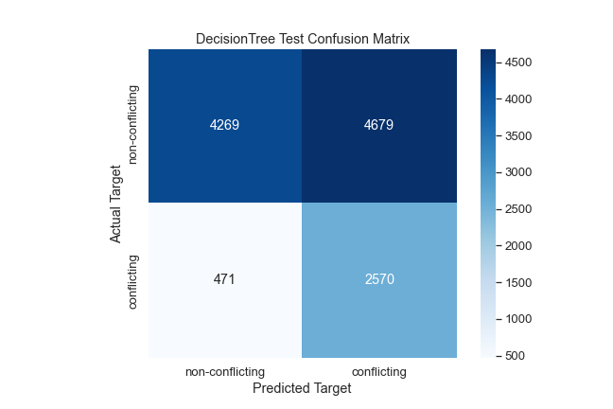

Slide 18
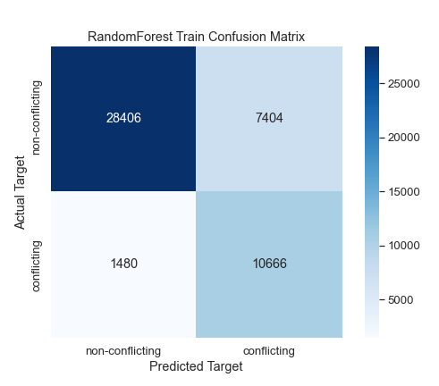

Slide 19
Categorical features
SYMBOL – Name of the gene
CLNVC – Variant type
IMPACT – Impact of the variant
Numeric features
AF_TGP – Frequency of allele
CADD_PHRED – ‘Deleteriousness’ score
LoFtool – Loss of function score
Strand – Forward or backward DNA strand

