Slide 1
An Approach to Detect Unreliable News Articles on Online Media
BA/2019/017
K.A.N.Malkanthi
Supervised by:
Dr. Ruvan Weerasinghe
Notes:
Good morning all of you.I’m Nadeeka Kiringoda and Here I am presenting the masters individual Project,.. An Approach to Detect Unreliable News Articles on Online Media

Slide 2
Presentation Outline
Problem Definition
Methodology
Literature Review
Objectives of the study
Implementation
Findings
Conclusion, Future Works and Limitation
Notes:
This is the flow of my presentation

Slide 3

Problem Definition
Notes:
According to the agender,First I go through the problem definition

Slide 4
Traditional News Process
Controlling
Create
Amplify
Consume
Edit
Publish
Responsible, liable publisher
Notes:
First I go through the traditional news process ,which we can take the news from published news papers etc. As per that writers are creating the news articles and the are editing publishing and amplify the responsible publishers and there ediororial panel are controlling the news article levels and always publishing the highly imporatant and real news and persons can consume these

Slide 5
Enter to the Internet
Anyone can publish
Anyone can amplify
Anyone can edit
Editors are gone
No trashcan
Notes:
But today,all over the world is interacting to the internet and any one can publish any news with or without coping from the credible source contents,so any one can have publish,amplifly edit and always it is not controlling

Slide 6
What Makes News “ FAKE”
It can’t be Verified
It often appeals to emotion
It can’t be found anywhere else
It comes from fake news sites
It isn’t authored by an expert or reputable journalist
Notes:
In this environment ,lot of news are create and publishing and spread all over the world in a simple second of time.SO,at this scenario,people can post fake news well,so how we can identify it,

Slide 7
What is Fake News
Fake news is a piece of information that contains unreliable details
and , it spreads faster like a virus and cannot identify
it as fake or real
(de Beer and Matthee, 2021)
Notes:
SO,as per the definition to the beer and matthee ,

Slide 8

Objectives of the Study
Notes:
SO,Now this is the time to tell the objectives

Slide 9
Main Objective : Detect unreliable news tweets that are spread on the internet using a hybrid approach that includes both user level analysis and tweet content analysis
RO1: Identify the previous models and approaches and do a systematic review
RO2: Identify the user-level features from the literature
RO3: Determine credible sources and cross-check with the Sri Lankan Twitter community
RO4: Make a model to compare tweets from regular people with tweets from reliable sources and figure out how similar they are
RO5: Labelling the tweets using two models as "fake or real"
RO6: Verify the model with SVM and Random Forest classification algorithms.
Notes:
This study is focus to labeling /classifying the news tweets as fake or real so,to fullfil this main objective it has gone thorugh sub objectives

Slide 10

Literature Review
Notes:
After identifying the problem,literature is more valuable to find out if their any solution or any concept to address this problem. Following is the work that had an impact on our findings
This litreatue reviw done based on three aspects and content/context and hybrid models

Slide 11
Content Related Feature-Based Approach (Text/News)
1
Automatic Detection of Fake
[Pérez-Rosas, V., Kleinberg, B., Lefevre, A., Mihalcea, R., 2017. Automatic Detection of Fake News]
In this Study, it use lexicon based approach and focus on sentences and words in a paragraph.
Done with three main methods; Bag of words approach, semantic analysis and deep syntax approach
2
Ban FakeNews: A Dataset for Detecting Fake News in Bangla
[Hossain, M.Z., Rahman, M.A., Islam, M.S., Kar, S., 2020. Ban FakeNews: A Dataset for Detecting Fake News in Bangla. ]
Machine-learning approach is used like Support Vector Machine (SVM), Logistic Regression (LR), and Random Forest (RF) to identify the fake news
Notes:
When come to the this stage,product reviews are extracted from websites and it’s used as primary data.those data has been reviewed by the testing participants .so in this stage primary data is the consumer reviews,but text mining is not used to identify the websites usability.

Slide 12
User Account Feature-Based Approach/Context Based
3
Social computing: an intersection of recommender systems, trust/reputation systems
[Tavakolifard, M., Almeroth, K., 2012. Social computing: an intersection of recommender systems, trust/reputation systems, and social networks. IEEE Netw. 26, 53–58. https://doi.org/10.1109/MNET.2012.6246753 ]
studies human behaviour and social connections in relation to computer networks, which is a new research area, and it is also known as social computing
4
Social Network Analysis Taxonomy Based on Graph Representation[Andry Alamsyah, Budi Rahardjo, Kuspriyanto, 2013. Social Network Analysis Taxonomy Based on Graph Representation. https://doi.org/10.13140/2.1.3221.2160. ]
Graph representation, content mining, and semantic analysis were used to get social network profiles
Notes:
When come to the this stage,product reviews are extracted from websites and it’s used as primary data.those data has been reviewed by the testing participants .so in this stage primary data is the consumer reviews,but text mining is not used to identify the websites usability.

Slide 13
Hybrid (Context +Content) feature-based approach
5
A hybrid approach to fake news detection on social media
[Okoro, E.M., Abara, B.A., Umagba, A.O., Ajonye, A.A., Isa, Z.S., 2018. A hybrid approach to fake news detection on social media. Niger. J. Technol. 37, 454. https://doi.org/10.4314/njt.v37i2.22]
The most recent study in this situation employed a hybrid model that combines human and machine learning techniques to assist in the identification of false information on social media
6
Fake News Detection using Support Vector Machine learning Algorithm [Deokate, S.B., 2019. Fake News Detection using Support Vector Machine learning Algorithm. Int. J. Res. Appl. Sci. Eng. Technol. 7, 438–444. https://doi.org/10.22214/ijraset.2019.7067]
The study use of datasets from Twitter and Buzzfeed and used a machine learning classifier, and the Support vector technique
Notes:
When come to the this stage,product reviews are extracted from websites and it’s used as primary data.those data has been reviewed by the testing participants .so in this stage primary data is the consumer reviews,but text mining is not used to identify the websites usability.

Slide 14
7
Examine Relationship between user features that affect the user level credibility.
[YeKang Yang, Kai Niu, ZhiQiang He, 2015. Exploiting the topology property of social network for rumor detection, in: 2015 12th International Joint Conference on Computer Science and Software Engineering (JCSSE). Presented at the 2015 12th International Joint Conference on Computer Science and Software Engineering (JCSSE), IEEE, Songkhla, Thailand, pp. 41–46. ttps://doi.org/10.1109/JCSSE.2015.7219767 ]
Identified the Features and weight
(Major attributes
Minor attributes
)
Feature | Major/Minor
Number of followers | Major Attributes
Number of friends | Major Attributes
Number of status/tweets | Major Attributes
Age of the account | Major Attributes
Verified status | Major Attributes
Location | Minor Attributes
User Description/Bio | Minor Attributes
Number of Lists | Minor Attributes
Notes:
Further,some other studies done to identify the best suitable methodology and

Slide 15
8
Identify the news sources in Twitter related to Sri Lankan Community
Identified the news sources and popular journalist twitter accounts
[https://blog.feedspot.com/sri_lanka_news_websites/;
https://www.news.lk/]
Notes:
To identify the news sources also need to do in this study ,so lot of article read and identify most credible news sources

Slide 16
Scope of the Study
So many Studies in this area, to identify the fake news, Most are based on content based analysis
So,
This Study address the same problem in a different angle
Hybrid approach including content semantic meaning comparison and user profile analysing
Training done for Easter attack Sri Lanka on 2019
Notes:
According to the litreature and problem ,identify the research gap.still no good solution build for identify the fake news,Still fake news are spreading all over the world
So at this level,scope has identifing

Slide 17

Methodology
Notes:
Methodology is the base of the research and

Slide 18
1.Data Collection & Preprocessing
2.Feature Extraction
3.Model Generating
4.Labelling the twitter dataset
5.Evaluate and validation
Notes:
Methodology has five main processess.and first one been the data collection and ending model evaluating and validating

Slide 19
1.Data Collection and Preprocessing
Data Collection
Data Source : Tweets from 20th Apr 2019 -21st May 2019
Two Data sets : ordinary tweets and tweets collected from credible sources
Preprocessing
Remove URL
Remove emotions and punctuations
Tokenize
Stemming
combine
Notes:
First stage is been data collection and preprocessing.primary data are collected from twitter based on the hashtags like #Sunday#easterattack#sri Lanka,#sri lanka#easter attack
Huge number of dataset collected and clear the data and filter down the data based on the location as Sri lanka
Further,based on the past studies and survey it has collected credible source tweets and same are preprocessed

Slide 20
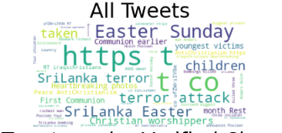
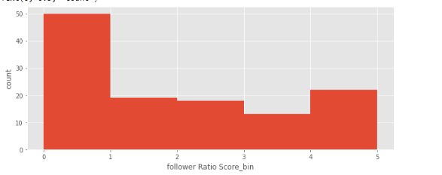
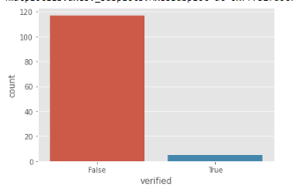
Understanding the Data

Slide 21
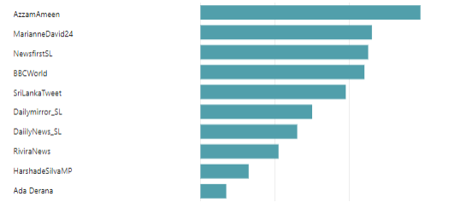
Survey Results

Slide 22
2.Feature Extraction
Filter the Tweets from the ordinary dataset using Location as Sri Lanka
Identify the unique users from the filtered list
Extract the user metadata from the twitter based on features dictionary created from the literature
Create a dataset with User’s Metadata
Notes:
Data set has been cleansing for punctuation and other outlier correction and filter
\

Slide 23




Twitter cloud
Filtered tweet dataset
Filtered unique users
Hash tags
Twitter cloud
Filtered unique users metadata

Slide 24
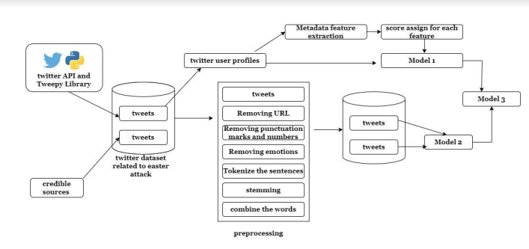
3.Model Generating -Overview

Slide 25

3.Model Generating –Model One
Features from literature
Ordinary Tweets
Feature Extraction
Users details based on Sri Lanka
Feature extraction of the user profile
Assign scores for features
Get credibility score for each user account

Slide 26
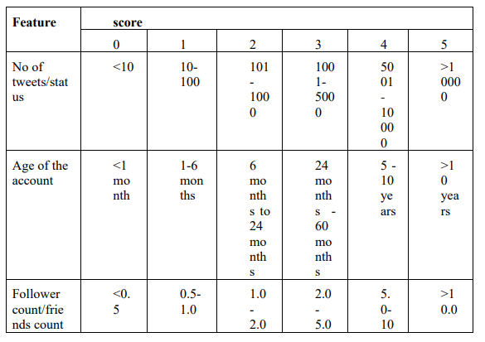
Construct Model 1 results
“Ex:User Henry has 100 followers and 50 friends and he posted 50 tweets and he located at Colombo,Sri Lanka
Score Metrix
Score vector
User name | Follower friends ratio | Tweet_score | Location
Henry | 2 | 1 | 5
Notes:
After generating the two dictionaries,first step of model generating is started.It is a key word vector.Here I’m use example to explain it.
Perfect meaning this and it get +2 polarity.
I’m explaining model generating step by step through an example.example is graphics are perfect and colors are good.According to this example,first step is been creating keyword vector.So that.graphics are perfect,and graphics is a attribute related to hci and perfect is a sentiment word which has +2 polarity.So in the key word vector graphics get +2 polarity.And the other sentence colors are good and also colors is a attribute and good is a positive sentiment word and it get +1 polarity.so in the keyword vector it can be display as +1 weight.

Slide 27
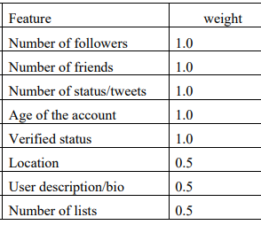
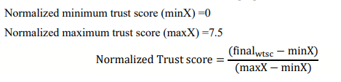
Score vector
User name | Follower friends ratio | Tweet_score | Location
Henry | 5 | 1 | 5
Score vector
User name | Follower friends ratio | Tweet score | Location | Major attributes trust score | Minor attributes trust score | final weighted score | Normalized Trust score
Henry | 2 | 1 | 5 | 3 | 2.5 | 5.5 | 0.733

Slide 28


3.Model Generating –Model Two
Preprocessed Tweets of credible source with source content
Preprocessed Tweets of ordinary source
Identify the list of credible tweet news sources
Done a survey and Identify most credible sources among the list
Vector representation
Vector representation
Tweets and it’s source details collected
comparison
Cosine similarity

Slide 29


3.Model Generating –Model Three
Model 1
Model 2
Model 3
Notes:
After creating the keyword vector,it must be extended into number of reviews which is in dataset.so model is a set of reviews which arrange as multidimenctional array.

Slide 30
3.Model Generating –Model Three
Score vector
User name | Normalized Trust score
Henry | 0.733
Tweet ID | User ID | Cosine Similarity
123456 | Henry | 0.0452
123458 | x | 0.1123
178930 | Henry | 0.6234
Tweet ID | User ID | Final Trust Score
123456 | Henry | 0.3891
178930 | Henry | 0.6782
Assumption;
At the moment T value assigned as 0.5
Notes:
After creating the keyword vector,it must be extended into number of reviews which is in dataset.so model is a set of reviews which arrange as multidimenctional array.

Slide 31
Labelling the tweets
If T=0.5 and then
Final Trust Score >=0.5
then ‘Real’
Else
‘Fake’
Tweet ID | User ID | Final Trust Score
123456 | Henry | 0.3891
178930 | Henry | 0.6782
Tweet ID | User ID | Final Trust Score | Label
123456 | Henry | 0.3891 | Fake
178930 | Henry | 0.6782 | Real
Notes:
After creating the model measuring the consumer experiences with respect to each hci attributes give the full weight of each attributes which makes better usability to the consumer.For that this formulation is beign using.in the formula,CE means…………..Pi means

Slide 32
Validation of the Model
Using SVM and Random Forest classifier;
Compare Results from the model and validate the model
* Break down to train and test datasets
* Train the classifier
* Test the classifier
* Accuracy, FI score check
Notes:
After creating the model one validation part can be the final steps of methodology and so that I have used another set of data for validate the model and check the two results which is gain from two data set and validate the model for future purpose.

Slide 33

Implementation of the Methodology

Slide 34
Tools and Technologies
Python libraries and IDE used as Google colab
Twitter developer API used to extract the data from the Twitter

Slide 35
Pseudocodes for Tweets and User Profile extraction

Slide 36
Input
# Read standard hashtags for Easter attack sri Lanka
# Read api keys
# Read features dictionary build from literature
Initialize
Get output of tweets with the time period of 20th apr 2019 to 21st may 2019
Feature Extraction
#clean tweets and filter based on the location
#extract user details from the tweet dataset and extract user level features
#Get word cloud
#visualize

Slide 37
Pseudocodes for credible Tweets extraction

Slide 38
Input
# identified list of news sources from the past studies
# standard hash tags for Easter attack
Initialize
Get output of tweets with source content from highly credible news sources
Time period 20th Apr 2019 -21st may 2019
Feature Extraction
#design a survey
#collecting the survey results from twitter community
#Identified the most credible news sources
#Extract Tweets from these news sources
# visualize

Slide 39
Findings of the Study

Slide 40
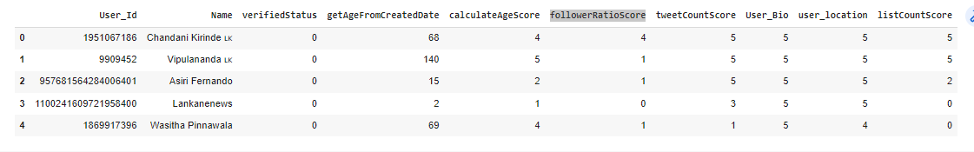
Results From Model One

Slide 41
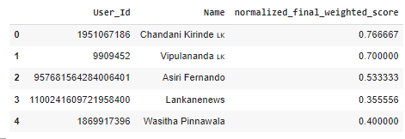

Slide 42
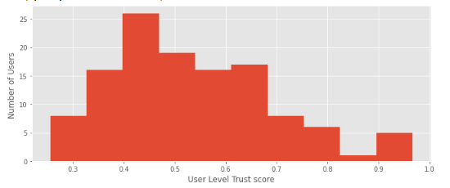

Slide 43
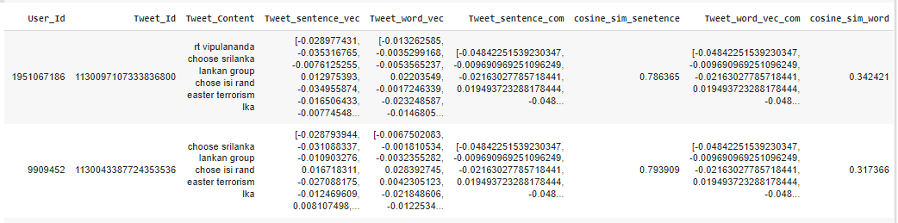
Results From Model Two

Slide 44
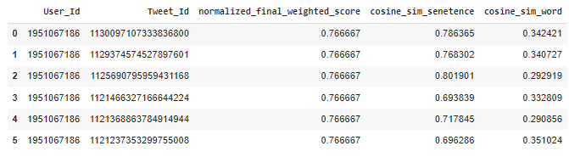
Results From Model Three

Slide 45
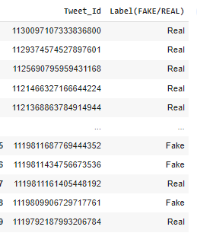

Slide 46
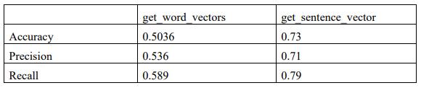
Validation Results

Slide 47
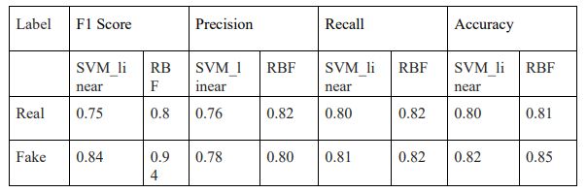
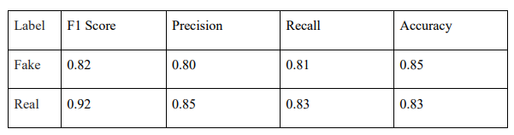
Validation Results
SVM
Random Forest

Slide 48
Conclusion
A hybrid method—a combination of user-account-associated characteristics and text verifiability against reliable sources to identify fake news on social media platforms
This study identified the factors which are affect to user level credibility from the literature and apply to the model
This study has open different paths to growing the model including this can apply to other languages with minimum changes
This Study can apply to any incident rather than Easter attack, with the training model

Slide 49
Future Works
Further improve and apply model to get more accuracy analysis by including the users network
Apply this into different language

Slide 50
Limitation
Collection of Data set –due to users not using the standard hashtags
Tweet content is not limit and always credible sources not link to the government news department

Slide 51
Demonstration

Slide 52

Approach to Detect Unreliable News Articles on Online Media
Notes:
Finally I also said my topic is
Thank you
usability is the degree to which a software can be used by specified consumers to achieve quantified objectives with effectiveness, efficiency, and satisfaction in a quantified context of use.
Demographic identified and it changing the portal.
Satisfy the consumer,so e commerce site also want to perceive the consumer to give better interaction.
You are very old/disable/even more the cant move curser.so computers want to make satisfy those also.this is the perception to use HCI into e commece site well.
specially designed website that often serves as the single point of access for information.
User experience (UX) refers to a person's total experience using a particular product, system or service. The first requirement for a great user experience is to meet the exact needs for the usage of a product or a service, without fuss or bother.
Demographic factors are personal characteristics are used to collect and evaluate data on people in a given population. Typical factors include age, gender, marital status, race, education, income and occupation.

Slide 53
References
de Beer, D., Matthee, M., 2021. Approaches to Identify Fake News: A Systematic Literature Review, in: Antipova, T. (Ed.), Integrated Science in Digital Age 2020, Lecture Notes in Networks and Systems. Springer International Publishing, Cham, pp. 13–22. https://doi.org/10.1007/978-3-030-49264-9_2
YeKang Yang, Kai Niu, ZhiQiang He, 2015. Exploiting the topology property of social network for rumor detection, in: 2015 12th International Joint Conference on Computer Science and Software Engineering (JCSSE). Presented at the 2015 12th International Joint Conference on Computer Science and Software Engineering (JCSSE), IEEE, Songkhla, Thailand, pp. 41–46. https://doi.org/10.1109/JCSSE.2015.7219767

