Slide 1
Text Mining and Human Computer Interaction (HCI Approach for Online Purchasing
IM/2011/033
Nadeeka Kiringoda
Supervised by:
Dr.Thashika D. Rupasinghe
Notes:
Good morning.Here I’m going to present my research progress and my topic is been

Slide 2
Overview
Research Problem
Methodology
Literature Review
Objectives of the research
Notes:
This is the flow of my presentation

Slide 3

Research Problem
Notes:
According to the agender,First I go through the research problem

Slide 4







Human Factors
Age
Profession
Education
Organization
HCI Factors
Useful
Simple
Accessibility
Make Decisions
Dependent upon
Wants to buy Reading Materials
Online Purchasing
Notes:
When people buy a book,it dependent upon their different types of demographic factors such as age,profeesion,educational level and so many other factors.Furthermore modern world,lot of people access the internet and lot of works done through online.hence people buy inline it depend on hci factors which are embedded to the websites.such as useful,simple,accessible.Today number of e-commerce sites are increase.so give a better compition to the other companies,organization need to tharrow evaluation about their websites.so this is the problem,today organization faced on….

Slide 5
Difficulty in making decisions to better market the consumers, according to the HCI factors such as simple, useful and accessibility of the website
Notes:
So,
Modern people lot of do onlne purchasing .when some people go reviews .some are satisfied.some are not.It is difficult to find out what kind of preferences people eventually have.so this research try to identifyied what demographic factors are influence to online purchasing

Slide 6

Objective (s) of Research
Notes:
Now this is the time to tell the objectives

Slide 7
Research Objective (s)
RO1:Identify the HCI factors
RO2. Identify the relationship between HCI and Online Purchasing
RO3. Develop a framework to evaluate the e-commerce website, based on HCI factors and sentiment mining. That means to prioritize the factors which affect “good browsing” experience
RO4. Use it to make possible prediction to better market the consumer with appropriate tolerance
Notes:
Identify the quality of different attributes/features related to HCI of this website to interact the consumers.
Analyzing historical data related to online purchasing of reading materials for identify the Human Computer Interaction factors which affect the customer buying behavior.
Develop a framework to evaluate the e-commerce website, based on HCI factors and sentiment mining. That means to prioritize the factors which affect “good browsing” experience.

Slide 8

Literature Review
Notes:
After identifying the problem,literature is more valuable to find out before my solution is build up/I want to address the past literature.

Slide 9
Factors which Influence to Online Buying Behavior
Buyer’s Decision
Brand Choice
Product Choice
Personal and Environmental Factors (Uncontrollable)
Marketing Factors
Buyer’s Decision Process
Web Experiences (Controllable)
Kotler, P., Marketing Management, 11th ed.,Prentice-Hall International Editions, Englewood Cliffs, NJ,2003.
Notes:
When come to the online buying behavior,it depend on different type of factors,like and it make influence to buyer to make decisions such as brand choice,product choice

Slide 10
1
Examine Relationship between various factors that affect the consumer behavior towards online shopping.
Data collected through questionaries''.
[Rizwana, B.,Irsa, M., Waqus, K.B., Effects of online shopping trends on consumer buying behavior:
an empirical study on Pakistan, Journal f Management and research, vol.2, 2015]
Websites need to manage it’s usability
No framework and no consumer reviews used to find web usability
2
Investigate the important attributes of online webstores in e-commerce by examining the possible website elements that determine different aspects of association between customer's satisfaction and e-commerce website.
Data collected through questionaries' based on “SERVQUAL” using 5 point Likert scale and completed by 60 respondents.
[http://www.wbiconpro.com/518-Aum.pdf,accessed on 09/10/2016]
Notes:
In this stage studies done to identify the relationship between consumer behaviour and online shopping.,and lot of studies are done through questionaries and through this primary data are collected,and also rating type of questionaries also used.so in this stage through this data identify the relationship.but no frameworks,no consumer reviews are used to identify that link.

Slide 11
4
Product reviews are the data and use observation for identify the effect of the reviews
[Sen, S., and Lerman, D., Why are you telling me this? An examination into negative consumer reviews on the web. Journal of interactive marketing, vol.4,pp. 76-94,2007]
Consumer reviews are used as data
BUT
Text mining is not used to check web usability
5
Effect of consumer reviews are identify through perception of the reviewers
[Hedegaard, S., and Simonsen, J. G., Extracting usability and user experience information from online user reviews. In Proceedings of the SIGCHI Conference on Human Factors in Computing Systems,ACM, pp. 2089-2098,2013]
Notes:
When come to the this stage,product reviews are extracted from websites and it’s used as primary data.those data has been reviewed by the testing participants .so in this stage primary data is the consumer reviews,but text mining is not used to identify the websites usability.

Slide 12
VIKOR method is not suitable for measure the web usability
This Framework can’t be used to measure web usability
6
Sentiment analysis used to analysis consumer reviews.
This study has been proposed framework to measure the consumer satisfaction with mobile services by combining VIKOR and sentiment method.
Lexicon based dictionaries are used.
[Kang, D., and Park, Y., Review-based measurement of customer satisfaction in mobile service: Sentiment analysis and VIKOR approach. Expert Systems with Applications, vol:41(4), PP.1041-1050,2014.]
7
Importance Performance Analysis (IPA) is a
simple and effective tool which analysis, quality attributes on two dimensions. Performance and importance and depicted on a two-dimensional grid .
[Martilla, J.A. and James, J.C., Importance-performance analysis, Journal of Marketing, Vol. 41 No. 1, pp. 77-99,1977.]
Need to come up with a novel framework that measure web usability
Notes:
Finally come to this stage,here sentiment analysis ues to analysis the reviews and ,here used VIKOR method to compare number of services.so this VIKOR method can’t be used for measure web userbility.bcz VIKOR is multi criteria method.
SO IPA is a another type of comparison and simple tool which help to compare different attributes related only to one website.So through thos IPA and Keyword vector,we neeed to come up with a new method.
With VIKOR, which is a compromise ranking method of the multicriteria
decision making (MCDM) approach, customer satisfaction for mobile services can be accurately measured

Slide 13

Methodology
Notes:
Methodology is the base of the research and

Slide 14
1.Data Collection & Preprocessing
2.Feature Extraction
3.Model Generating
4.Measure Consumer Experience with Respect to each HCI Attributes
5.Evaluate Final Level of Consumer Experience
Visualize
Notes:
Methodology have five main steps.first one been the
Finally it is visualize.

Slide 15
1.Data Collection and Preprocessing
Data Collection
Data Source : https://Stanford.edu/
Preprocessing
Identify outliers in the data set
Cleaned all outliers
Remove N/A values
Remove unknown values
Notes:
First stage is been data collection and preprocessing.primary data are collected from Stanford repsitary.But it is a large data set and so using datadives.com,extracted dataset.
Extracted data set must be preprocess for further porpose.so that first using R and identify if their any outliers ,then remove N/A values and unkonown values as skipping rows.

Slide 16
2.Feature Extraction
Remove Punctuation
Remove Numbers
Filter Noisy data
Remove stop words
Stemming
Compile two dictionaries
Notes:
After preprocessisng the data set,has been used to feature extraction.For that first remove punctuations like …,???,after that remove unwanted numbers which is in the reviews.thenafter remove noicy words like,haaaappppy--→ happy type words.furthermore want to remove stop words like am,is are .
After that stemming is done through reduce to stem which words are give same meaning.
Finaly compile two dictionaries,attributes related to HCI and sentiment words,for that Sandford pracer and word net is using.standford pracer used to identify the attributes and sentiment words and other hand word net gives different polarity for sentiment words

Slide 17
3.Model Generating
Construct keyword vector to consumer reviews
“Graphics are perfect. Colors are also good.”
Attributes related to HCI
Sentiment Words
Graphics
Color
Perfect | +2
Good | +1
Terrible | -1
Necessary | -2
Dictionaries
Graphics | +2
Colors | +1
Keyword Vector
Notes:
After generating the two dictionaries,first step of model generating is started.It is a key word vector.Here I’m use example to explain it.

Slide 18
Attributes related to HCI
Sentiment Words
Consumer Reviews
Graphics
Color
Perfect | +2
Good | +1
Terrible | -1
Necessary | -2
Review No:01 | Review No:02 | Review No: n
Full Count
Model
Graphics
Colors
+2 | -1 | -3
+1 | +2 | +2
-2
+5
Multidimensional Array
Notes:
After creating the keyword vector,it must be extended into number of reviews which is in dataset.so model is a set of reviews which arrange as multidimenctional array.

Slide 19
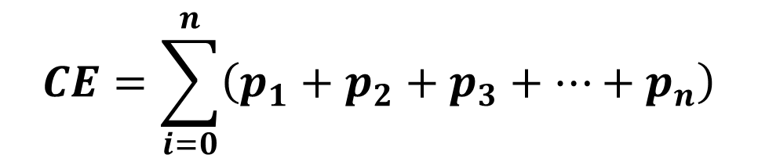
4.Measure Consumer Experience with Respect to each HCI Attributes
Review No:01 | Review No:02 | Review No: n
Full Count
Graphics
Colors
+2 | -1 | -3
+1 | +2 | +2
-2
+5
$$CE=\sum_{i=0}^{n}{\left(p_{1}+p_{2}+p_{3}+…+p_{n}\right)}$$
CE: Total sentiment polarity for attribute related to HCI
P_{i}: Polarity of Sentiment word
Notes:
After creating the model it is validate through this type of measuring.It is measure consumer experience with respect to each HCI attributes.For that full count of each attributes are taken.For that formulation using.It is being,

Slide 20
5.Evaluate Final Level of Consumer Experience
Review No:01 | Review No:02 | Review No: n
Full Count
Graphics
Colors
+2 | -1 | -3
+1 | +2 | +2
-2
+5
>
Colors
Graphics
Notes:
Finding out the full count of polaritiesy related to attributes,it must be evaluate finally.for that this study has been used IPA.so IPA is a simple and effective tool which analysis, quality attributes on two dimensions. Performance and importance of attributes are depicted on a two-dimensional grid through that it evaluate the all attributes performance and importance,according to the example colors are better than grahics.so

Slide 21
Validation of the Model
Using test data set;
Compare Results from training data set and Results from test data set
Notes:
After creating the model one validation part can be the final steps of methodology and so that I have used another set of data for validate the model and check the two results which is gain from two data set and validate the model for future purpose.

Slide 22

Implementation of the Methodology

Slide 23
Pseudocodes for HCI Attribute Extraction

Slide 24
Input
Reading data from HCI related attributes dictionary (Pre-defined from previous literature)
Reading data from consumer reviews related to online purchasing website
Initialize
Get output of HCI related to online purchasing related dictionary
Feature Extraction
#split reviews into sentences
#spilt sentences into words
#compare and get intersection of words and compile HCI attributes dictionary
#Get TDM
#Get word cloud
#visualize

Slide 25
Pseudocodes for Model Development

Slide 26
Input
Read dictionary- HCI related attribute dictionary
Read dictionary- sentiment data dictionary
Read dataset- data set which contains reviews
Initialization
Create different variable to store scores, data
Get the full score of sentiment according to each category

Slide 27
Model
Loop1{
#select sentences which contains each HCI factors/categorize sentences according to HCI factors
Loop 2{
# use this to mining the text and identify each category and its sentiments
Function () {
#Score for HCI factors and get final score of each category
# visualize results
}
}
}

Slide 28
Model
Function1 () {
# split reviews and calculate scores according to each category.
}
Function 2 () {
For loop2 {
#call function 1() to get negative and positive score and overall score for each HCI related attributes
}
}
Main body
For loop1 {
# call for function 2 () to categorize reviews sentences according to HCI related attributes
}

Slide 29
Findings of the Research

Slide 30
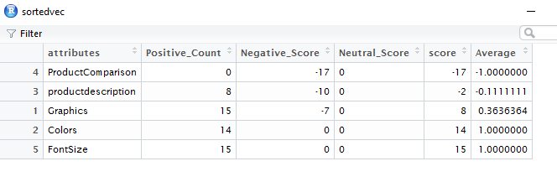
Results

Slide 31
Polarity Scores for each Categories

Slide 32
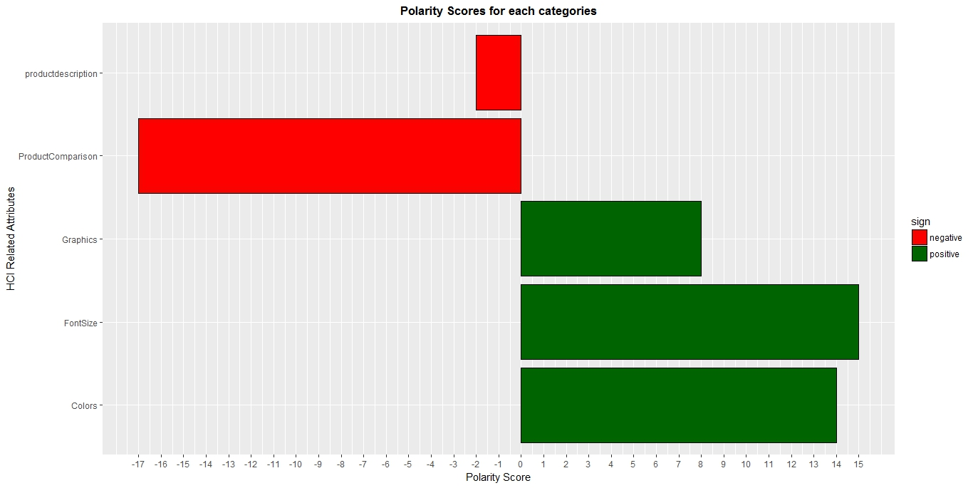

Slide 33
Negative and positive opinion score comparison

Slide 34
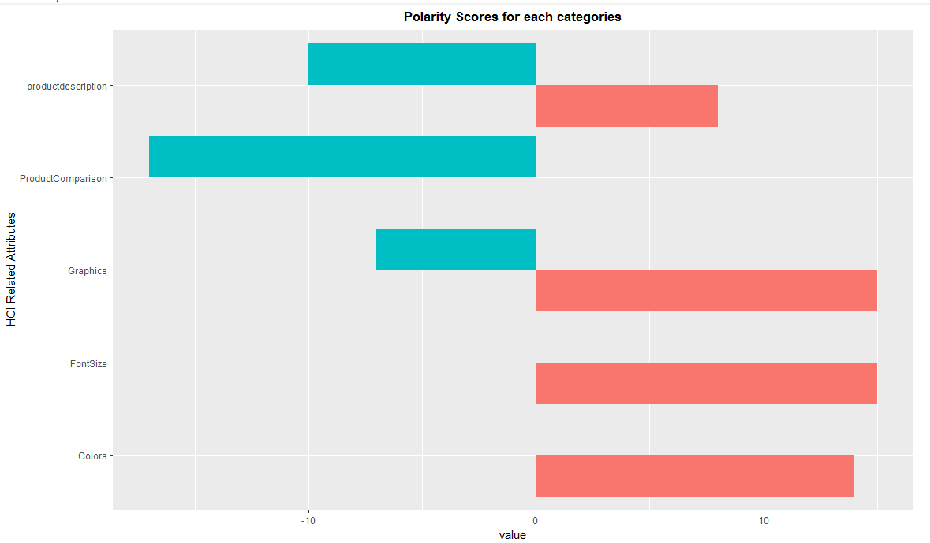

Slide 35
Satisfaction Scale according to each HCI factors

Slide 36
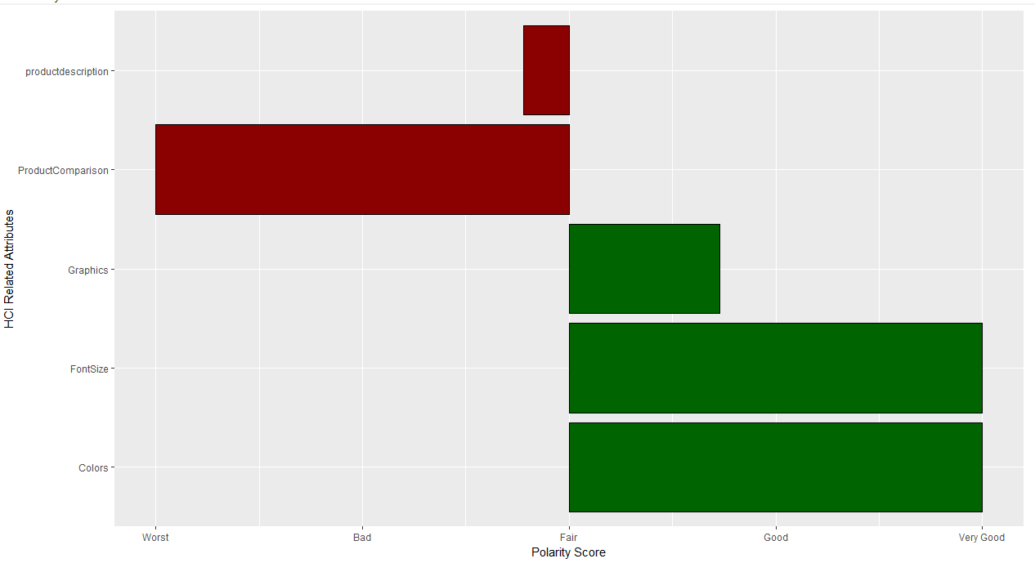

Slide 37
Conclusion
HCI based text mining approach to the online purchasing website.
this study identified the factors which are affect to increase and decrease the consumer interaction with the online purchasing website
this study has open different paths to growing the HCI. Mainly this is open path to further develop and apply model to identify the human factors, like their different visual incompatibilities.

Slide 38
Future Works
Further improve and apply model to identify consumers through their reviews(if they are in different able )
Develop Predictive analytics dashboard to make different prediction

Slide 39
Limitation
Collection of Web site related reviews
Identify and extract different HCI related attributes

Slide 40

Predictive Analytics for Decision Making: Human Computer Interaction (HCI) Perspective from Online Purchasing
Notes:
Finally I also said my topic is
Thank you
usability is the degree to which a software can be used by specified consumers to achieve quantified objectives with effectiveness, efficiency, and satisfaction in a quantified context of use.
Demographic identified and it changing the portal.
Satisfy the consumer,so e commerce site also want to perceive the consumer to give better interaction.
You are very old/disable/even more the cant move curser.so computers want to make satisfy those also.this is the perception to use HCI into e commece site well.
specially designed website that often serves as the single point of access for information.
User experience (UX) refers to a person's total experience using a particular product, system or service. The first requirement for a great user experience is to meet the exact needs for the usage of a product or a service, without fuss or bother.
Demographic factors are personal characteristics are used to collect and evaluate data on people in a given population. Typical factors include age, gender, marital status, race, education, income and occupation.

Slide 41
