Slide 1
Chapter 1 – Introduction to Computers and C++ Programming
Outline
1.1 Introduction
1.2 What is a Computer?
1.3 Computer Organization
1.4 Evolution of Operating Systems
1.5 Personal Computing, Distributed Computing and Client/Server Computing
1.6 Machine Languages, Assembly Languages, and High-Level Languages
1.7 History of C and C++
1.8 C++ Standard Library
1.9 Java
1.10 Visual Basic, Visual C++ and C#
1.11 Other High-Level Languages
1.12 Structured Programming
1.13 The Key Software Trend: Object Technology
1.14 Basics of a Typical C++ Environment
1.15 Hardware Trends

Slide 2
Chapter 1 – Introduction to Computers and C++ Programming
Outline
1.16 History of the Internet
1.17 History of the World Wide Web
1.18 World Wide Web Consortium (W3C)
1.19 General Notes About C++ and This Book
1.20 Introduction to C++ Programming
1.21 A Simple Program: Printing a Line of Text
1.22 Another Simple Program: Adding Two Integers
1.23 Memory Concepts
1.24 Arithmetic
1.25 Decision Making: Equality and Relational Operators
1.26 Thinking About Objects: Introduction to Object Technology and the Unified Modeling Language

Slide 3
1.1 Introduction
Software
  Instructions to command computer to perform actions and make decisions
Hardware
Standardized version of C++
  United States
    American National Standards Institute (ANSI)
  Worldwide
    International Organization for Standardization (ISO)
Structured programming
Object-oriented programming

Slide 4
1.2 What is a Computer?
Computer
  Device capable of performing computations and making logical decisions
Computer programs
  Sets of instructions that control computer’s processing of data
Hardware
  Various devices comprising computer
    Keyboard, screen, mouse, disks, memory, CD-ROM, processing units, …
Software
  Programs that run on computer

Slide 5
1.3 Computer Organization
Six logical units of computer
  Input unit
    “Receiving” section
    Obtains information from input devices
      Keyboard, mouse, microphone, scanner, networks, …
  Output unit
    “Shipping” section
    Takes information processed by computer
    Places information on output devices
      Screen, printer, networks, …
      Information used to control other devices

Slide 6
1.3 Computer Organization
Six logical units of computer
  Memory unit
    Rapid access, relatively low capacity “warehouse” section
    Retains information from input unit
      Immediately available for processing
    Retains processed information
      Until placed on output devices
    Memory, primary memory
  Arithmetic and logic unit (ALU)
    “Manufacturing” section
    Performs arithmetic calculations and logic decisions

Slide 7
1.3 Computer Organization
Six logical units of computer
  Central processing unit (CPU)
    “Administrative” section
    Supervises and coordinates other sections of computer
  Secondary storage unit
    Long-term, high-capacity “warehouse” section
    Storage
      Inactive programs or data
    Secondary storage devices
      Disks
    Longer to access than primary memory
    Less expensive per unit than primary memory

Slide 8
1.4 Evolution of Operating Systems
Early computers
  Single-user batch processing
    Only one job or task at a time
    Process data in groups (batches)
    Decks of punched cards
Operating systems
  Software systems
  Manage transitions between jobs
  Increased throughput
    Amount of work computers process

Slide 9
1.4 Evolution of Operating Systems
Multiprogramming
  Many jobs or tasks sharing computer’s resources
  “Simultaneous” operation of many jobs
Timesharing
  1960s
  Special case of multiprogramming
  Users access computer through terminals
    Devices with keyboards and screens
    Dozens, even hundreds of users
  Perform small portion of one user’s job, then moves on to service next user
  Advantage:
    User receives almost immediate responses to requests

Slide 10
1.5 Personal Computing, Distributed Computing, and Client/Server Computing
Personal computers
  1977: Apple Computer
  Economical enough for individual
  1981: IBM Personal Computer
  “Standalone” units
Computer networks
  Over telephone lines
  Local area networks (LANs)
Distributed computing
  Organization’s computing distributed over networks

Slide 11
1.5 Personal Computing, Distributed Computing, and Client/Server Computing
Workstations
  Provide enormous capabilities
  Information shared across networks
Client/server computing
  File servers
    Offer common store of programs and data
  Client computers
    Access file servers across network
UNIX, Linux, Microsoft’s Window-based systems

Slide 12
1.6 Machine Languages, Assembly Languages, and High-level Languages
Three types of computer languages
  Machine language
    Only language computer directly understands
    “Natural language” of computer
    Defined by hardware design
      Machine-dependent
    Generally consist of strings of numbers
      Ultimately 0s and 1s
    Instruct computers to perform elementary operations
      One at a time
    Cumbersome for humans
    Example:
      +1300042774
      +1400593419
      +1200274027

Slide 13
1.6 Machine Languages, Assembly Languages, and High-level Languages
Three types of computer languages
  Assembly language
    English-like abbreviations representing elementary computer operations
    Clearer to humans
    Incomprehensible to computers
      Translator programs (assemblers)
        Convert to machine language
    Example:
      LOAD BASEPAY
      ADD OVERPAY
      STORE GROSSPAY

Slide 14
1.6 Machine Languages, Assembly Languages, and High-level Languages
Three types of computer languages
  High-level languages
    Similar to everyday English, use common mathematical notations
    Single statements accomplish substantial tasks
      Assembly language requires many instructions to accomplish simple tasks
    Translator programs (compilers)
      Convert to machine language
    Interpreter programs
      Directly execute high-level language programs
    Example:
      grossPay = basePay + overTimePay

Slide 15
1.7 History of C and C++
History of C
  Evolved from two other programming languages
    BCPL and B
      “Typeless” languages
  Dennis Ritchie (Bell Laboratories)
    Added data typing, other features
  Development language of UNIX
  Hardware independent
    Portable programs
  1989: ANSI standard
  1990: ANSI and ISO standard published
    ANSI/ISO 9899: 1990

Slide 16
1.7 History of C and C++
History of C++
  Extension of C
  Early 1980s: Bjarne Stroustrup (Bell Laboratories)
  “Spruces up” C
  Provides capabilities for object-oriented programming
    Objects: reusable software components
      Model items in real world
    Object-oriented programs
      Easy to understand, correct and modify
  Hybrid language
    C-like style
    Object-oriented style
    Both

Slide 17
1.8 C++ Standard Library
C++ programs
  Built from pieces called classes and functions
C++ standard library
  Rich collections of existing classes and functions
“Building block approach” to creating programs
  “Software reuse”

Slide 18
1.9 Java
Java
  1991: Sun Microsystems
    Green project
  1995: Sun Microsystems
    Formally announced Java at trade show
  Web pages with dynamic and interactive content
  Develop large-scale enterprise applications
  Enhance functionality of web servers
  Provide applications for consumer devices
    Cell phones, pagers, personal digital assistants, …

Slide 19
1.10 Visual Basic, Visual C++ and C#
BASIC
  Beginner’s All-Purpose Symbolic Instruction Code
  Mid-1960s: Prof. John Kemeny and Thomas Kurtz (Dartmouth College)
Visual Basic
  1991
    Result of Microsoft Windows graphical user interface (GUI)
      Developed late 1980s, early 1990s
  Powerful features
    GUI, event handling, access to Win32 API, object-oriented programming, error handling
  Visual Basic .NET

Slide 20
1.10 Visual Basic, Visual C++ and C#
Visual C++
  Microsoft’s implementation of C++
    Includes extensions
    Microsoft Foundation Classes (MFC)
    Common library
      GUI, graphics, networking, multithreading, …
      Shared among Visual Basic, Visual C++, C#
.NET platform
  Web-based applications
    Distributed to great variety of devices
      Cell phones, desktop computers
  Applications in disparate languages can communicate

Slide 21
1.10 Visual Basic, Visual C++ and C#
C#
  Anders Hejlsberg and Scott Wiltamuth (Microsoft)
  Designed specifically for .NET platform
  Roots in C, C++ and Java
    Easy migration to .NET
  Event-driven, fully object-oriented, visual programming language
  Integrated Development Environment (IDE)
    Create, run, test and debug C# programs
    Rapid Application Development (RAD)
  Language interoperability

Slide 22
1.11 Other High-level Languages
FORTRAN
  FORmula TRANslator
  1954-1957: IBM
  Complex mathematical computations
    Scientific and engineering applications
COBOL
  COmmon Business Oriented Language
  1959: computer manufacturers, government and industrial computer users
  Precise and efficient manipulation of large amounts of data
    Commercial applications

Slide 23
1.11 Other High-level Languages
Pascal
  Prof. Niklaus Wirth
  Academic use

Slide 24
1.12 Structured Programming
Structured programming (1960s)
  Disciplined approach to writing programs
  Clear, easy to test and debug, and easy to modify
Pascal
  1971: Niklaus Wirth
Ada
  1970s - early 1980s: US Department of Defense (DoD)
  Multitasking
    Programmer can specify many activities to run in parallel

Slide 25
1.13 The Key Software Trend: Object Technology
Objects
  Reusable software components that model real world items
  Meaningful software units
    Date objects, time objects, paycheck objects, invoice objects, audio objects, video objects, file objects, record objects, etc.
    Any noun can be represented as an object
  More understandable, better organized and easier to maintain than procedural programming
  Favor modularity
    Software reuse
      Libraries
        MFC (Microsoft Foundation Classes)
        Rogue Wave

Slide 26
1.14 Basics of a Typical C++ Environment
C++ systems
  Program-development environment
  Language
  C++ Standard Library

Slide 27
1.14 Basics of a Typical C++ Environment
Phases of C++ Programs:
  Edit
  Preprocess
  Compile
  Link
  Load
  Execute
Program is created in
the editor and stored
on disk.
Editor
Disk
Preprocessor
Disk
Preprocessor program
processes the code.
Compiler creates
object code and stores
it on disk.
Compiler
Disk
Linker links the object
code with the libraries,
creates a.out and
stores it on disk
Linker
Disk
Primary
Memory
Loader
Loader puts program
in memory.
Disk
.
.
.
.
.
.
Primary
Memory
CPU
CPU takes each
instruction and
executes it, possibly
storing new data
values as the program
executes.
.
.
.
.
.
.

Slide 28
1.14 Basics of a Typical C++ Environment
Input/output
  cin
    Standard input stream
    Normally keyboard
  cout
    Standard output stream
    Normally computer screen
  cerr
    Standard error stream
    Display error messages

Slide 29
1.15 Hardware Trends
Capacities of computers
  Approximately double every year or two
  Memory used to execute programs
  Amount of secondary storage
    Disk storage
    Hold programs and data over long term
  Processor speeds
    Speed at which computers execute programs

Slide 30
1.16 History of the Internet
Late 1960s: ARPA
  Advanced Research Projects Agency
    Department of Defense
  ARPAnet
  Electronic mail (e-mail)
Packet switching
  Transfer digital data via small packets
  Allow multiple users to send/receive data simultaneously over same communication paths
No centralized control
  If one part of network fails, other parts can still operate

Slide 31
1.16 History of the Internet
TCP/IP
  Transmission Control Protocol (TCP)
    Messages routed properly
    Messages arrived intact
  Internet Protocol (IP)
    Communication among variety of networking hardware and software
    Current architecture of Internet
Bandwidth
  Carrying capacity of communications lines

Slide 32
1.17 History of the World Wide Web
World Wide Web
  1990: Tim Berners-Lee (CERN)
  Locate and view multimedia-based documents
  Information instantly and conveniently accessible worldwide
  Possible worldwide exposure
    Individuals and small businesses
  Changing way business done

Slide 33
1.18 World Wide Web Consortium (W3C)
World Wide Web Consortium (W3C)
  1994: Tim Berners-Lee
  Develop nonproprietary, interoperable technologies
  Standardization organization
  Three hosts
    Massachusetts Institute of Technology (MIT)
    France’s INRIA (Institut National de Recherche en Informatique et Automatique)
    Keio University of Japan
  Over 400 members
    Primary financing
    Strategic direction

Slide 34
1.18 World Wide Web Consortium (W3C)
Recommendations
  3 phases
    Working Draft
      Specifies evolving draft
    Candidate Recommendation
      Stable version that industry can begin to implement
    Proposed Recommendation
      Considerably mature Candidate Recommendation

Slide 35
1.19 General Notes About C++ and This Book
Book geared toward novice programmers
  Stress programming clarity
  C and C++ are portable languages
Portability
  C and C++ programs can run on many different computers
Compatibility
  Many features of current versions of C++ not compatible with older implementations

Slide 36
1.20 Introduction to C++ Programming
C++ language
  Facilitates structured and disciplined approach to computer program design
Following several examples
  Illustrate many important features of C++
  Each analyzed one statement at a time
Structured programming
Object-oriented programming

Slide 37
1.21 A Simple Program:
Printing a Line of Text
Comments
  Document programs
  Improve program readability
  Ignored by compiler
  Single-line comment
    Begin with //
Preprocessor directives
  Processed by preprocessor before compiling
  Begin with #

Slide 38
fig01_02.cpp
(1 of 1) fig01_02.cpp output (1 of 1)
1 // Fig. 1.2: fig01_02.cpp
2 // A first program in C++.
3 #include <iostream>
4
5 // function main begins program execution
6 int main()
7 {
8 std::cout << "Welcome to C++!\n";
9
10 return 0; // indicate that program ended successfully
11
12 } // end function main
Single-line comments.
Function main returns an integer value.
Left brace { begins function body.
Preprocessor directive to include input/output stream header file <iostream>.
Function main appears exactly once in every C++ program..
Statements end with a semicolon ;.
Corresponding right brace } ends function body.
Stream insertion operator.
Name cout belongs to namespace std.
Keyword return is one of several means to exit function; value 0 indicates program terminated successfully.
Welcome to C++!

Slide 39
1.21 A Simple Program:
Printing a Line of Text
Standard output stream object
  std::cout
  “Connected” to screen
  <<
    Stream insertion operator
    Value to right (right operand) inserted into output stream
Namespace
  std:: specifies using name that belongs to “namespace” std
  std:: removed through use of using statements
Escape characters
  \
  Indicates “special” character output

Slide 40
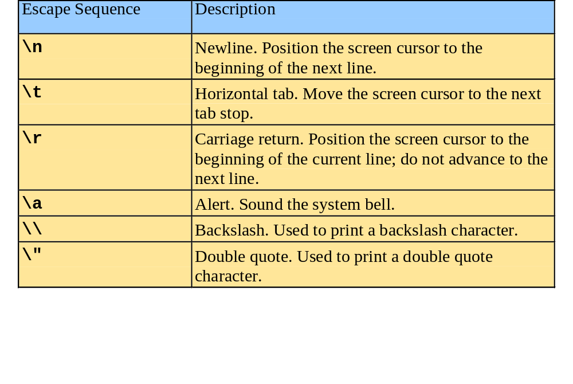
1.21 A Simple Program:
Printing a Line of Text

Slide 41
fig01_04.cpp
(1 of 1) fig01_04.cpp output (1 of 1)
1 // Fig. 1.4: fig01_04.cpp
2 // Printing a line with multiple statements.
3 #include <iostream>
4
5 // function main begins program execution
6 int main()
7 {
8 std::cout << "Welcome ";
9 std::cout << "to C++!\n";
10
11 return 0; // indicate that program ended successfully
12
13 } // end function main
Multiple stream insertion statements produce one line of output.
Welcome to C++!

Slide 42
fig01_05.cpp
(1 of 1) fig01_05.cpp output (1 of 1)
1 // Fig. 1.5: fig01_05.cpp
2 // Printing multiple lines with a single statement
3 #include <iostream>
4
5 // function main begins program execution
6 int main()
7 {
8 std::cout << "Welcome\nto\n\nC++!\n";
9
10 return 0; // indicate that program ended successfully
11
12 } // end function main
Using newline characters to print on multiple lines.
Welcome
to
C++!

Slide 43
1.22 Another Simple Program:
Adding Two Integers
Variables
  Location in memory where value can be stored
  Common data types
    int - integer numbers
    char - characters
    double - floating point numbers
  Declare variables with name and data type before use
    int integer1;
    int integer2;
    int sum;
  Can declare several variables of same type in one declaration
    Comma-separated list
    int integer1, integer2, sum;

Slide 44
1.22 Another Simple Program:
Adding Two Integers
Variables
  Variable names
    Valid identifier
      Series of characters (letters, digits, underscores)
      Cannot begin with digit
      Case sensitive

Slide 45
1.22 Another Simple Program:
Adding Two Integers
Input stream object
  >> (stream extraction operator)
    Used with std::cin
    Waits for user to input value, then press Enter (Return) key
    Stores value in variable to right of operator
      Converts value to variable data type
= (assignment operator)
  Assigns value to variable
  Binary operator (two operands)
  Example:
      sum = variable1 + variable2;

Slide 46
fig01_06.cpp
(1 of 1)
1 // Fig. 1.6: fig01_06.cpp
2 // Addition program.
3 #include <iostream>
4
5 // function main begins program execution
6 int main()
7 {
8 int integer1; // first number to be input by user
9 int integer2; // second number to be input by user
10 int sum; // variable in which sum will be stored
11
12 std::cout << "Enter first integer\n"; // prompt
13 std::cin >> integer1; // read an integer
14
15 std::cout << "Enter second integer\n"; // prompt
16 std::cin >> integer2; // read an integer
17
18 sum = integer1 + integer2; // assign result to sum
19
20 std::cout << "Sum is " << sum << std::endl; // print sum
21
22 return 0; // indicate that program ended successfully
23
24 } // end function main
Declare integer variables.
Use stream extraction operator with standard input stream to obtain user input.
Calculations can be performed in output statements: alternative for lines 18 and 20:
std::cout << "Sum is " << integer1 + integer2 << std::endl;
Stream manipulator std::endl outputs a newline, then “flushes output buffer.”
Concatenating, chaining or cascading stream insertion operations.

Slide 47
fig01_06.cpp output (1 of 1)
Enter first integer
45
Enter second integer
72
Sum is 117

Slide 48
1.23 Memory Concepts
Variable names
  Correspond to actual locations in computer's memory
  Every variable has name, type, size and value
  When new value placed into variable, overwrites previous value
  Reading variables from memory nondestructive

Slide 49
1.23 Memory Concepts
std::cin >> integer1;
  Assume user entered 45
std::cin >> integer2;
  Assume user entered 72
sum = integer1 + integer2;
integer1
45
integer1
45
integer2
72
integer1
45
integer2
72
sum
117

Slide 50
1.24 Arithmetic
Arithmetic calculations
  *
    Multiplication
  /
    Division
    Integer division truncates remainder
      7 / 5 evaluates to 1
  %
    Modulus operator returns remainder
      7 % 5 evaluates to 2

Slide 51
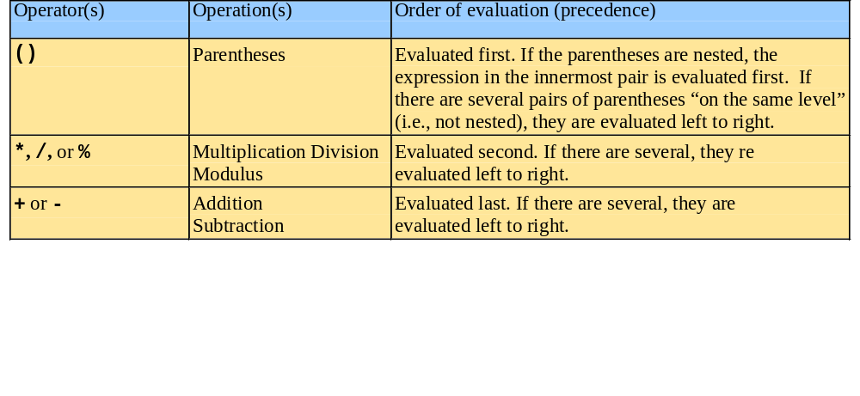
1.24 Arithmetic
Rules of operator precedence
  Operators in parentheses evaluated first
    Nested/embedded parentheses
      Operators in innermost pair first
  Multiplication, division, modulus applied next
    Operators applied from left to right
  Addition, subtraction applied last
    Operators applied from left to right

Slide 52
1.25 Decision Making: Equality and Relational Operators
if structure
  Make decision based on truth or falsity of condition
    If condition met, body executed
    Else, body not executed
Equality and relational operators
  Equality operators
    Same level of precedence
  Relational operators
    Same level of precedence
  Associate left to right

Slide 53
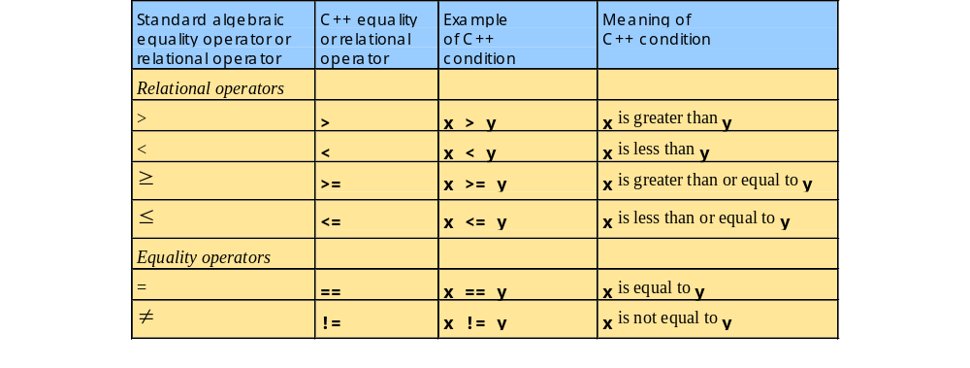
1.25 Decision Making: Equality and Relational Operators

Slide 54
1.25 Decision Making: Equality and Relational Operators
using statements
  Eliminate use of std:: prefix
  Write cout instead of std::cout

Slide 55
fig01_14.cpp
(1 of 2)
1 // Fig. 1.14: fig01_14.cpp
2 // Using if statements, relational
3 // operators, and equality operators.
4 #include <iostream>
5
6 using std::cout; // program uses cout
7 using std::cin; // program uses cin
8 using std::endl; // program uses endl
9
10 // function main begins program execution
11 int main()
12 {
13 int num1; // first number to be read from user
14 int num2; // second number to be read from user
15
16 cout << "Enter two integers, and I will tell you\n"
17 << "the relationships they satisfy: ";
18 cin >> num1 >> num2; // read two integers
19
20 if ( num1 == num2 )
21 cout << num1 << " is equal to " << num2 << endl;
22
23 if ( num1 != num2 )
24 cout << num1 << " is not equal to " << num2 << endl;
25
using statements eliminate need for std:: prefix.
Declare variables.
Can write cout and cin without std:: prefix.
if structure compares values of num1 and num2 to test for equality.
If condition is true (i.e., values are equal), execute this statement.
if structure compares values of num1 and num2 to test for inequality.
If condition is true (i.e., values are not equal), execute this statement.

Slide 56
fig01_14.cpp
(2 of 2) fig01_14.cpp output (1 of 2)
26 if ( num1 < num2 )
27 cout << num1 << " is less than " << num2 << endl;
28
29 if ( num1 > num2 )
30 cout << num1 << " is greater than " << num2 << endl;
31
32 if ( num1 <= num2 )
33 cout << num1 << " is less than or equal to "
34 << num2 << endl;
35
36 if ( num1 >= num2 )
37 cout << num1 << " is greater than or equal to "
38 << num2 << endl;
39
40 return 0; // indicate that program ended successfully
41
42 } // end function main
Statements may be split over several lines.
Enter two integers, and I will tell you
the relationships they satisfy: 22 12
22 is not equal to 12
22 is greater than 12
22 is greater than or equal to 12

Slide 57
fig01_14.cpp output (2 of 2)
Enter two integers, and I will tell you
the relationships they satisfy: 7 7
7 is equal to 7
7 is less than or equal to 7
7 is greater than or equal to 7

Slide 58
1.26 Thinking About Objects: Introduction to Object Technology and the Unified Modeling Language
Object oriented programming (OOP)
  Model real-world objects with software counterparts
  Attributes (state) - properties of objects
    Size, shape, color, weight, etc.
  Behaviors (operations) - actions
    A ball rolls, bounces, inflates and deflates
    Objects can perform actions as well
  Inheritance
    New classes of objects absorb characteristics from existing classes
  Objects
    Encapsulate data and functions
    Information hiding
      Communicate across well-defined interfaces

Slide 59
1.26 Thinking About Objects: Introduction to Object Technology and the Unified Modeling Language
User-defined types (classes, components)
  Data members
    Data components of class
  Member functions
    Function components of class
  Association
  Reuse classes

Slide 60
1.26 Thinking About Objects: Introduction to Object Technology and the Unified Modeling Language
Object-oriented analysis and design (OOAD) process
  Analysis of project’s requirements
  Design for satisfying requirements
  Pseudocode
    Informal means of expressing program
    Outline to guide code

Slide 61
1.26 Thinking About Objects: Introduction to Object Technology and the Unified Modeling Language
Unified Modeling Language (UML)
  2001: Object Management Group (OMG)
    Released UML version 1.4
  Model object-oriented systems and aid design
  Flexible
    Extendable
    Independent of many OOAD processes
    One standard set of notations
  Complex, feature-rich graphical language

