Slide 1
Chapter 16 - Web Programming with CGI
Outline
16.1 Introduction
16.2 HTTP Request Types
16.3 Multi-Tier Architecture
16.4 Accessing Web Servers
16.5 Apache HTTP Server
16.6 Requesting XHTML Documents
16.7 Introduction to CGI
16.8 Simple HTTP Transaction
16.9 Simple CGI Script
16.10 Sending Input to a CGI Script
16.11 Using XHTML Forms to Send Input
16.12 Other Headers
16.13 Case Study: An Interactive Web Page
16.14 Cookies
16.15 Server-Side Files
16.16 Case Study: Shopping Cart
16.17 Internet and Web Resources

Slide 2
16.1 Introduction
Web server
  Responds to client, provides resource (like XHTML page)
    XHTML replacing HTML
    More information in Appendix B of book
  URL is a request for a document
  Web server maps URL (Uniform Resource Locator) to file
    Returns requested document
HTTP
  Hypertext Transfer Protocol
  Platform independent
  Transfer requests and files over Internet

Slide 3
16.2 HTTP Request Types
HTTP request methods (types)
  Specifies how client makes requests of server
  Form
    XHTML element with buttons, text fields, GUI components
    Used to enter data into a web page
  Get
    Used to send data to server; part of URL
    www.searchsomething.com/search?query=userquery
    Info after ? is user input (query string)
    Max limit on size (depends on server)
  Post
    User cannot see query fields
    Fields can exceed get size limit

Slide 4
16.3 Multi-Tier Architecture
N-tier application (multi-tier)
  Divide functionality
  Information tier
    Stores data in database
  Middle tier
    Business and presentation logic
    Controls interaction of clients and data
      What is and is not allowed
    Processes data from information tier, presents to client
  Client tier (top tier)
    User interface (users act directly with this tier)
    Requests middle tier to get data from information tier

Slide 5
16.3 Multi-Tier Architecture
Client tier
Middle tier
Application
Information tier
Database

Slide 6
16.4 Accessing Web Servers
Need URL to access Web server
  Contains machine name (host name)
  Local Web server (on own machine)
    localhost references local machine
  Remote Web server (machine on network)
  Domain name
    Represents group of hosts on Internet
    Combines with top-level-domain and host name (www.)
      Top-level-domain (.com, .org, etc.)
  Domain Name Server (DNS) translates name to IP address
    IP used by computers
    www.deitel.com is 63.110.43.82
    localhost is always 127.0.0.1

Slide 7

16.5 Apache HTTP Server
Popular Web server
  Stability, cost (free), efficiency
  Open-source
  Runs on Unix, Linux, Windows
www.apache.org for download
  Installation instructions at www.deitel.com
  When running, command-prompt window opens

Slide 8
16.6 Requesting XHTML Documents
Apache HTTP server
  Store XHTML documents in htdocs directory
    Windows, C:\Program Files\Apache Group\Apache
    For Linux, /usr/local/httpd (exact location may vary)
  Copy test.html from Chapter 16 examples on CD-ROM
    Put into htdocs
Request the document
  Open http://localhost/test.html
  In Apache, root of URL refers to default directory
    No need to enter directory name

Slide 9
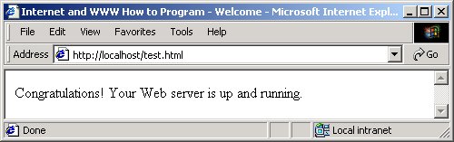
16.6 Requesting XHTML Documents

Slide 10
16.7 Introduction to CGI
Common Gateway Interface (CGI)
  Enables applications to interact with Web servers
    Indirectly interact with clients/Web browsers
  Can make decision based on user input
  Dynamic Web pages
    Content generated when page requested
  Static Web pages
    Exists before request made (like test.html)
"Common"
  Not specific to any operating system or language
  Can use C, C++, Perl, Python, Visual Basic…

Slide 11
16.8 Simple HTTP Transaction
Get basic understanding of networking
  HTTP
    Describes methods and headers
    Allow server/client to interact in uniform, predictable way
  Web page
    Simplest form, XHTML document
    Plain text file, has markings (markup) to describe data
    <title>My Web Page</title>
    Indicates text between markup elements is title of web page
  Hyperlinks
    When user clicks, Web browser loads new page

Slide 12
16.8 Simple HTTP Transaction
URL
  http://www.deitel.com/books/downloads.html
  http://
    Use the HTTP protocol
  www.deitel.com
    Hostname of server
  /books/downloads.html
    Name of resource (downloads.html)
    Path (/books)
      Often a virtual directory, hides real location

Slide 13
16.8 Simple HTTP Transaction
HTTP Transaction
  Step 1: Send HTTP request to server
    GET /books/downloads/html HTTP/1.1
    Host: www.deitel.com
    GET is HTTP method (client wants to get resource)
    Name and path of resource
    Protocol name and version number
  Step 2: Server response
    First line of response could be
      HTTP/1.1 200 OK
      HTTP/1.1 404 Not Found

Slide 14
16.8 Simple HTTP Transaction
HTTP Transaction
  Step 2: Server response (continued)
    Send headers (info about data being sent)
    Content-Type: text/html
    MIME types used by browser to process data
      image/gif
      text/plain
    Next, blank line
      Indicates end of HTTP headers
    Finally, contents of document sent
  Client interprets XHTML, displays results

Slide 15
16.9 Simple CGI Script
Altering a page continuously
  Display current time or weather
  Manually editing is tedious
  However, can write C++ program easily
Program to output current time and date
  time_t currentTime; // time_t defined in <ctime>
  time( &currentTime ); // asctime and localtime defined in <ctime>
  cout << asctime( localtime( &currentTime ) );
  localtime returns pointer to "broken-down" time
    Hours, seconds, minutes separate
  asctime converts "broken-down" time into string
    Wed Jul 31 13:10:37 2002

Slide 16
16.9 Simple CGI Script
Now, need to output to Web browser
  With CGI, redirect output to Web server itself
  Output goes to client's browser
  cout goes to standard output
    When C++ program executed as CGI script
    Standard output redirected to client Web browser
To execute program
  Put C++ executable in cgi-bin directory
  Changed extension from .exe to .cgi
    localtime.cgi
  To run script
    http://localhost/cgi-bin/localtime.cgi

Slide 17
localtime.cpp
(1 of 2)
1 // Fig. 16.5: localtime.cpp
2 // Displays the current date and time in a Web browser.
3
4 #include <iostream>
5
6 using std::cout;
7
8 #include <ctime>
9
10 int main()
11 {
12 time_t currentTime; // variable for storing time
13
14 // output header
15 cout << "Content-Type: text/html\n\n";
16
17 // output XML declaration and DOCTYPE
18 cout << "<?xml version = \"1.0\"?>"
19 << "<!DOCTYPE html PUBLIC \"-//W3C//DTD XHTML 1.0 "
20 << "Transitional//EN\" \"http://www.w3.org/TR/xhtml1"
21 << "/DTD/xhtml1-transitional.dtd\">";
22
23 time( &currentTime ); // store time in currentTime
24
Most of program creates the text HTTP response, containing the contents of the XHTML file.

Slide 18
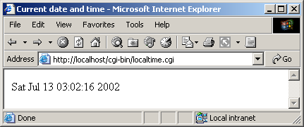
localtime.cpp
(2 of 2) localtime.cpp output (1 of 1)
25 // output html element and some of its contents
26 cout << "<html xmlns = \"http://www.w3.org/1999/xhtml\">"
27 << "<head><title>Current date and time</title></head>"
28 << "<body><p>" << asctime( localtime( &currentTime ) )
29 << "</p></body></html>";
30
31 return 0;
32
33 } // end main
Output the current time

Slide 19
16.9 Simple CGI Script
Program sends output to client via HTTP
  Client treats it like a server response
  Reads header, XHTML elements, etc.
More detailed look
  Step 1: Client request
    http://localhost/cgi-bin/localtime.cgi
    Properly configured server realizes CGI script
      Knows not to deliver it like a regular document
  Step 2: Server runs script
  Step 3: Output of script goes to Web server
  Step 4: Server adds header (HTTP/1.1 200 OK)
    Sends entire output to client, which processes and displays

Slide 20
16.9 Simple CGI Script
To view output of script
  Run localtime.cgi from command line
    Just like in other chapters
    For Windows, change back to .exe
  CGI programs must insert Content-Type
    For XHTML file, Web server adds header

Slide 21
localtime.cgi output (1 of 1)
Content-Type: text/html
<?xml version = "1.0"?>
<!DOCTYPE html PUBLIC "-//W3C//DTD XHTML 1.0 Transitional//EN"
"http://www.w3.org/TR/xhtml1/DTD/xhtml1-transitional.dtd">
<html xmlns = "http://www.w3.org/1999/xhtml">
<head>
<title>Current date and time</title>
</head>
<body>
<p>Mon Jul 15 13:52:45 2002</p>
</body>
</html>

Slide 22
16.9 Simple CGI Script
Environment variables
  Info about client and server environment
    Type of Web browser
    Location of document on server
  getenv( const char * variableName )
    Outputs value of environment variable
Tables in XHTML
  <tr> table row start
    Ends with </tr>
  <td> new table cell
    End with </td>
    <td> My data </td>

Slide 23
environment.cpp
(1 of 2)
1 // Fig. 16.8: environment.cpp
2 // Program to display CGI environment variables.
3 #include <iostream>
4
5 using std::cout;
6
7 #include <string>
8
9 using std::string;
10
11 #include <cstdlib>
12
13 int main()
14 {
15 string environmentVariables[ 24 ] = {
16 "COMSPEC", "DOCUMENT_ROOT", "GATEWAY_INTERFACE",
17 "HTTP_ACCEPT", "HTTP_ACCEPT_ENCODING",
18 "HTTP_ACCEPT_LANGUAGE", "HTTP_CONNECTION",
19 "HTTP_HOST", "HTTP_USER_AGENT", "PATH",
20 "QUERY_STRING", "REMOTE_ADDR", "REMOTE_PORT",
21 "REQUEST_METHOD", "REQUEST_URI", "SCRIPT_FILENAME",
22 "SCRIPT_NAME", "SERVER_ADDR", "SERVER_ADMIN",
23 "SERVER_NAME","SERVER_PORT","SERVER_PROTOCOL",
24 "SERVER_SIGNATURE","SERVER_SOFTWARE" };
25
26 // output header
27 cout << "Content-Type: text/html\n\n";
28
Array of strings containing the various environment variables.

Slide 24
environment.cpp
(2 of 2)
29 // output XML declaration and DOCTYPE
30 cout << "<?xml version = \"1.0\"?>"
31 << "<!DOCTYPE html PUBLIC \"-//W3C//DTD XHTML 1.0 "
32 << "Transitional//EN\" \"http://www.w3.org/TR/xhtml1"
33 << "/DTD/xhtml1-transitional.dtd\">";
34
35 // output html element and some of its contents
36 cout << "<html xmlns = \"http://www.w3.org/1999/xhtml\">"
37 << "<head><title>Environment Variables</title></head>"
38 << "<body>";
39
40 // begin outputting table
41 cout << "<table border = \"0\" cellspacing = \"2\">";
42
43 // iterate through environment variables
44 for ( int i = 0; i < 24; i++ )
45 cout << "<tr><td>" << environmentVariables[ i ]
46 << "</td><td>"
47 << getenv( environmentVariables[ i ].data() )
48 << "</td></tr>";
49
50 cout << "</table></body></html>";
51
52 return 0;
53
54 } // end main
Use string function data to output a C-style char *.

Slide 25
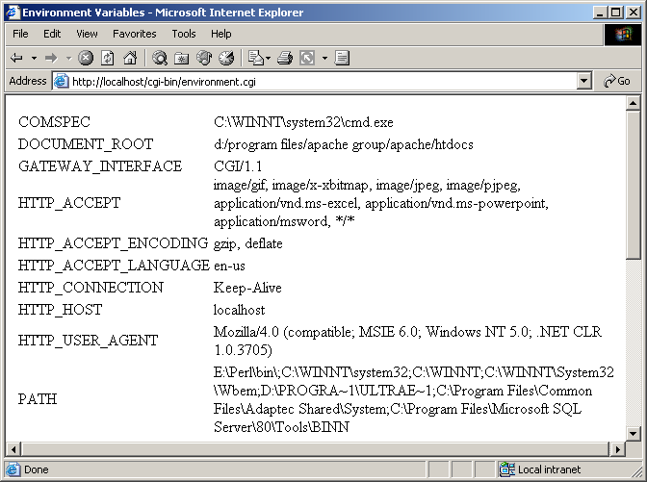
environment.cpp output (1 of 2)

Slide 26
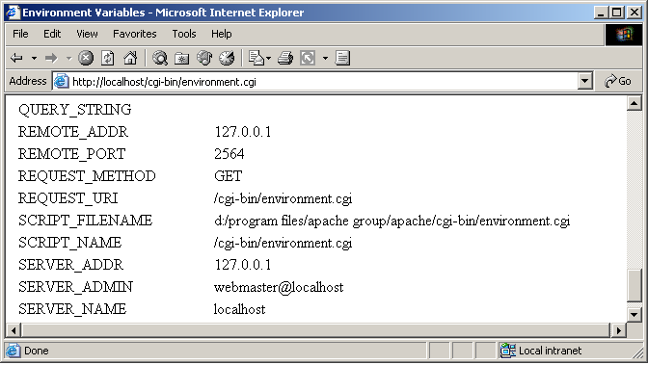
environment.cpp output (2 of 2)

Slide 27
16.10 Sending Input to a CGI Script
Supply any data to CGI script
  Environment variable QUERY_STRING
  Contains info appended to URL in get request
  www.somesite.com/cgi-bin/script.cgi?state=California
  Stores data following ? in QUERY_STRING
    state=California
    Question mark delimiter (not stored in query string)
  Upcoming example
    Have user entry query string
    name=Jill&age=22

Slide 28
querystring.cpp
(1 of 2)
1 // Fig. 16.9: querystring.cpp
2 // Demonstrating QUERY_STRING.
3 #include <iostream>
4
5 using std::cout;
6
7 #include <string>
8
9 using std::string;
10
11 #include <cstdlib>
12
13 int main()
14 {
15 string query = getenv( "QUERY_STRING" );
16
17 // output header
18 cout << "Content-Type: text/html\n\n";
19
20 // output XML declaration and DOCTYPE
21 cout << "<?xml version = \"1.0\"?>"
22 << "<!DOCTYPE html PUBLIC \"-//W3C//DTD XHTML 1.0 "
23 << "Transitional//EN\" \"http://www.w3.org/TR/xhtml1"
24 << "/DTD/xhtml1-transitional.dtd\">";
25
Store QUERY_STRING, located in the URL.

Slide 29
querystring.cpp
(2 of 2)
26 // output html element and some of its contents
27 cout << "<html xmlns = \"http://www.w3.org/1999/xhtml\">"
28 << "<head><title>Name/Value Pairs</title></head>"
29 << "<body>";
30
31 cout << "<h2>Name/Value Pairs</h2>";
32
33 // if query contained no data
34 if ( query == "" )
35 cout << "Please add some name-value pairs to the URL "
36 << "above.<br/>Or try "
37 << "<a href=\"querystring.cgi?name=Joe&age=29\">"
38 << "this</a>.";
39
40 // user entered query string
41 else
42 cout << "<p>The query string is: " << query << "</p>";
43
44 cout << "</body></html>";
45
46 return 0;
47
48 } // end main
Link to URL with query string inserted.
If query is not empty, print it.

Slide 30
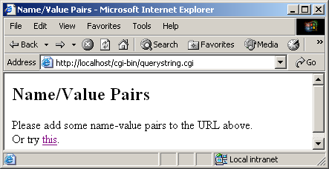
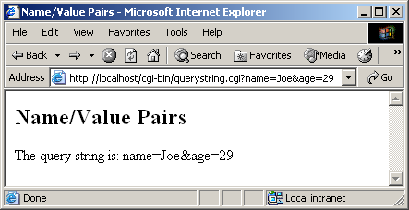
querystring.cpp output (1 of 2)

Slide 31
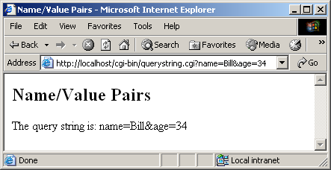
querystring.cpp output (2 of 2)

Slide 32
16.11 Using XHTML Forms to Send Input
Typing input into URLs clumsy
  Forms on Web pages
  Easy way to input information
Form element
  action
    Occurs when user submits form
    For us, will call CGI script
  method
    Type of HTTP request to use (GET, POST)
    Will demonstrate both types
  XHTML form can have any number of elements

Slide 33
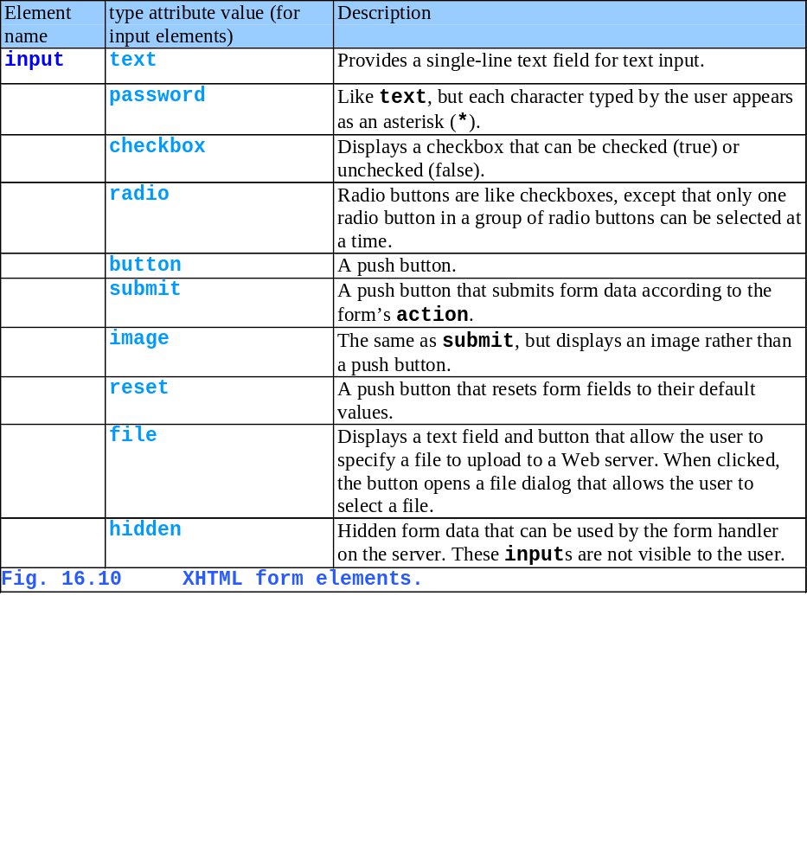

Slide 34
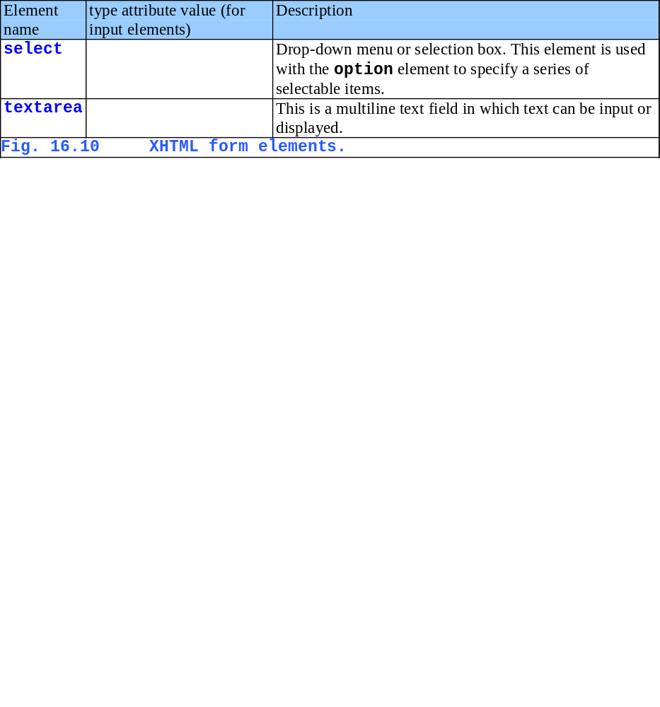

Slide 35
16.11 Using XHTML Forms to Send Input
Example usage
    <form method = "get" action = "getquery.cgi">
    <input type = "text" name = "word"/>
    <input type = "submit" value = "Submit Word"/>
    </form>
  word is a single-line text input box
  When submit button pressed
    word=wordEntered appended to QUERY_STRING

Slide 36
getquery.cpp
(1 of 3)
1 // Fig. 16.11: getquery.cpp
2 // Demonstrates GET method with XHTML form.
3 #include <iostream>
4
5 using std::cout;
6
7 #include <string>
8
9 using std::string;
10
11 #include <cstdlib>
12
13 int main()
14 {
15 string nameString = "";
16 string wordString = "";
17 string query = getenv( "QUERY_STRING" );
18
19 // output header
20 cout << "Content-Type: text/html\n\n";
21
Get query string, if any. If this is the first time the page is loaded, this will be empty.

Slide 37
getquery.cpp
(2 of 3)
22 // output XML declaration and DOCTYPE
23 cout << "<?xml version = \"1.0\"?>"
24 << "<!DOCTYPE html PUBLIC \"-//W3C//DTD XHTML 1.0 "
25 << "Transitional//EN\" \"http://www.w3.org/TR/xhtml1"
26 << "/DTD/xhtml1-transitional.dtd\">";
27
28 // output html element and some of its contents
29 cout << "<html xmlns = \"http://www.w3.org/1999/xhtml\">"
30 << "<head><title>Using GET with Forms</title></head>"
31 << "<body>";
32
33 // output xhtml form
34 cout << "<p>Enter one of your favorite words here:</p>"
35 << "<form method = \"get\" action = \"getquery.cgi\">"
36 << "<input type = \"text\" name = \"word\"/>"
37 << "<input type = \"submit\" value = \"Submit Word\"/>"
38 << "</form>";
39
Create form. Note that the form calls this CGI script when submit pressed.

Slide 38
getquery.cpp
(3 of 3)
40 // query is empty
41 if ( query == "" )
42 cout << "<p>Please enter a word.</p>";
43
44 // user entered query string
45 else {
46 int wordLocation = query.find_first_of( "word=" ) + 5;
47
48 wordString = query.substr( wordLocation );
49
50 // no word was entered
51 if ( wordString == "" )
52 cout << "<p>Please enter a word.</p>";
53
54 // word was entered
55 else
56 cout << "<p>Your word is: " << wordString << "</p>";
57 }
58
59 cout << "</body></html>";
60
61 return 0;
62
63 } // end main
On the first execution of this script, query is empty. When the user enters a word, the script is run again.
Decode the query string on the second execution of the script.

Slide 39
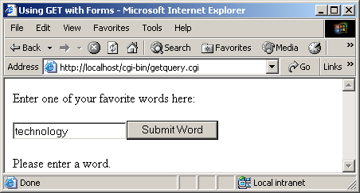
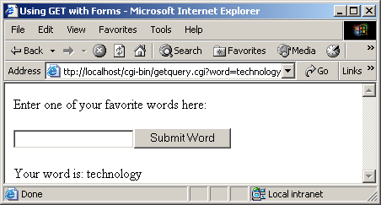
getquery.cpp output (1 of 2)

Slide 40

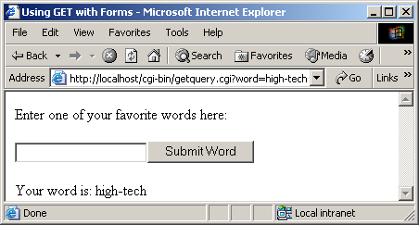
getquery.cpp output (2 of 2)

Slide 41
16.11 Using XHTML Forms to Send Input
Previously, used GET
  Now, use POST method
  Doesn't use QUERY_STRING
  Instead, CONTENT_LENGTH
    Number of characters read by POST
  Read data using cin
    Use cin.read
    cin >> data waits for newline, which may never come
    Eventually will time out and script terminates
  Other issues
    URLs do not allow certain characters
    Spaces replaced by plus signs

Slide 42
post.cpp (1 of 3)
1 // Fig. 16.12: post.cpp
2 // Demonstrates POST method with XHTML form.
3 #include <iostream>
4
5 using std::cout;
6 using std::cin;
7
8 #include <string>
9
10 using std::string;
11
12 #include <cstdlib>
13
14 int main()
15 {
16 char postString[ 1024 ] = ""; // variable to hold POST data
17 string dataString = "";
18 string nameString = "";
19 string wordString = "";
20 int contentLength = 0;
21
22 // content was submitted
23 if ( getenv( "CONTENT_LENGTH" ) ) {
24 contentLength = atoi( getenv( "CONTENT_LENGTH" ) );
25
26 cin.read( postString, contentLength );
27 dataString = postString;
28 } // end if
Read CONTENT_LENGTH characters of POST data.

Slide 43
post.cpp (2 of 3)
29
30 // output header
31 cout << "Content-Type: text/html\n\n";
32
33 // output XML declaration and DOCTYPE
34 cout << "<?xml version = \"1.0\"?>"
35 << "<!DOCTYPE html PUBLIC \"-//W3C//DTD XHTML 1.0 "
36 << "Transitional//EN\" \"http://www.w3.org/TR/xhtml1"
37 << "/DTD/xhtml1-transitional.dtd\">";
38
39 // output XHTML element and some of its contents
40 cout << "<html xmlns = \"http://www.w3.org/1999/xhtml\">"
41 << "<head><title>Using POST with Forms</title></head>"
42 << "<body>";
43
44 // output XHTML form
45 cout << "<p>Enter one of your favorite words here:</p>"
46 << "<form method = \"post\" action = \"post.cgi\">"
47 << "<input type = \"text\" name = \"word\" />"
48 << "<input type = \"submit\" value = \"Submit Word\" />"
49 << "</form>";
50
Create form as before, but use method post.

Slide 44
post.cpp (3 of 3)
51 // data was sent using POST
52 if ( contentLength > 0 ) {
53 int nameLocation =
54 dataString.find_first_of( "word=" ) + 5;
55
56 int endLocation = dataString.find_first_of( "&" ) - 1;
57
58 // retrieve entered word
59 wordString = dataString.substr( nameLocation,
60 endLocation - nameLocation );
61
62 // no data was entered in text field
63 if ( wordString == "" )
64 cout << "<p>Please enter a word.</p>";
65
66 // output word
67 else
68 cout << "<p>Your word is: " << wordString << "</p>";
69
70 } // end if
71
72 // no data was sent
73 else
74 cout << "<p>Please enter a word.</p>";
75
76 cout << "</body></html>";
77
78 return 0;
79
80 } // end main

Slide 45
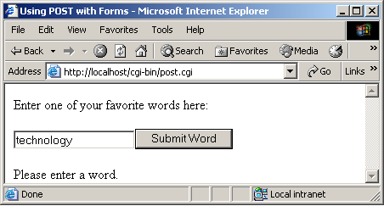
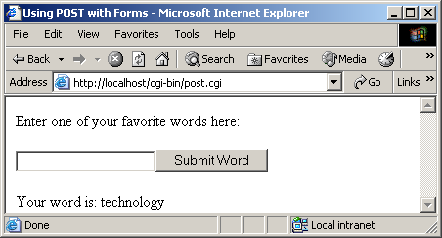
post.cpp output (1 of 2)
Note that post hides the input from the URL.

Slide 46


post.cpp output (2 of 2)

Slide 47
16.12 Other Headers
Several HTTP headers
  Content-Type
  Refresh: redirects client to new location after some time
    Refresh: "5; URL = http://www.deitel.com/newpage.html"
    Refreshes after 5 seconds
    Without URL, refreshes current page
  Location: redirects client immediately
    Location: http://www.deitel.com/newpage.html
    Performed by server, client unaware
  Status: change status response (i.e., 200 OK)
    Status: 204 No Response
    Indicates successful request, but no new page loaded

Slide 48
16.12 Other Headers
Review of CGI interaction with servers
  Output of headers and content via standard out
  Server setting environment variables
    QUERY_STRING
    Getenv
  POST data
    Standard input

Slide 49
16.13 Case Study: An Interactive Web Page
Web page to display weekly specials
  Query for name and password
  For simplicity, does not encrypt
  Opening page static XHTML
    POSTs data to portal.cgi
    portal.cgi display specials, if password correct
  Note separation of functionality
    One static XHTML page
    Requests a dynamic page

Slide 50
travel.html
(1 of 1)
1 <?xml version = "1.0"?>
2 <!DOCTYPE html PUBLIC "-//W3C//DTD XHTML 1.0 Transitional//EN"
3 "http://www.w3.org/TR/xhtml1/DTD/xhtml1-transitional.dtd">
4
5 <!-- Fig. 16.13: travel.html -->
6 <!-- Bug2Bug Travel Homepage -->
7
8 <html xmlns = "http://www.w3.org/1999/xhtml">
9 <head>
10 <title>Bug2Bug Travel</title>
11 </head>
12
13 <body>
14 <h1>Welcome to Bug2Bug Travel</h1>
15
16 <form method = "post" action = "/cgi-bin/portal.cgi">
17 <p>Please enter your name:</p>
18 <input type = "text" name = "namebox" />
19 <input type = "password" name = "passwordbox" />
20 <p>password is not encrypted</p>
21 <input type = "submit" name = "button" />
22 </form>
23
24 </body>
25 </html>

Slide 51
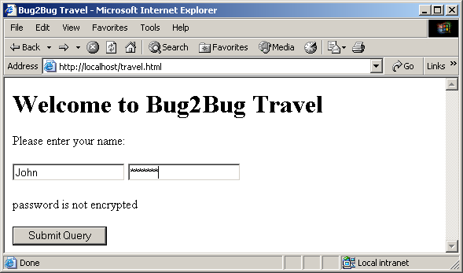
travel.html output (1 of 1)

Slide 52
portal.cpp (1 of 3)
1 // Fig. 16.14: portal.cpp
2 // Handles entry to Bug2Bug Travel.
3 #include <iostream>
4
5 using std::cout;
6 using std::cin;
7
8 #include <string>
9
10 using std::string;
11
12 #include <cstdlib>
13
14 int main()
15 {
16 char postString[ 1024 ] = "";
17 string dataString = "";
18 string nameString = "";
19 string passwordString = "";
20 int contentLength = 0;
21
22 // data was posted
23 if ( getenv( "CONTENT_LENGTH" ) )
24 contentLength = atoi( getenv( "CONTENT_LENGTH" ) );
25

Slide 53
portal.cpp (2 of 3)
26 cin.read( postString, contentLength );
27 dataString = postString;
28
29 // search string for input data
30 int namelocation = dataString.find( "namebox=" ) + 8;
31 int endNamelocation = dataString.find( "&" );
32
33 int password = dataString.find( "passwordbox=" ) + 12;
34 int endPassword = dataString.find( "&button" );
35
36 // get values for name and password
37 nameString = dataString.substr( namelocation,
38 endNamelocation - namelocation );
39
40 passwordString = dataString.substr( password, endPassword -
41 password );
42
43 // output header
44 cout << "Content-Type: text/html\n\n";
45
46 // output XML declaration and DOCTYPE
47 cout << "<?xml version = \"1.0\"?>"
48 << "<!DOCTYPE html PUBLIC \"-//W3C//DTD XHTML 1.0 "
49 << "Transitional//EN\" \"http://www.w3.org/TR/xhtml1"
50 << "/DTD/xhtml1-transitional.dtd\">";
51
Read POST data from standard input.

Slide 54
portal.cpp (3 of 3)
52 // output html element and some of its contents
53 cout << "<html xmlns = \"http://www.w3.org/1999/xhtml\">"
54 << "<head><title>Bug2Bug Travel</title></head>"
55 << "<body>";
56
57 // output specials
58 cout << "<h1>Welcome " << nameString << "!</h1>"
59 << "<p>Here are our weekly specials:</p>"
60 << "<ul><li>Boston to Taiwan ($875)</li>"
61 << "<li>San Diego to Hong Kong ($750)</li>"
62 << "<li>Chicago to Mexico City ($568)</li></ul>";
63
64 // password is correct
65 if ( passwordString == "coast2coast" )
66 cout << "<hr /><p>Current member special: "
67 << "Seattle to Tokyo ($400)</p>";
68
69 // password was incorrect
70 else
71 cout << "<p>Sorry. You have entered an incorrect "
72 << "password</p>";
73
74 cout << "</body></html>";
75 return 0;
76
77 } // end main
Check password, display special if correct.

Slide 55
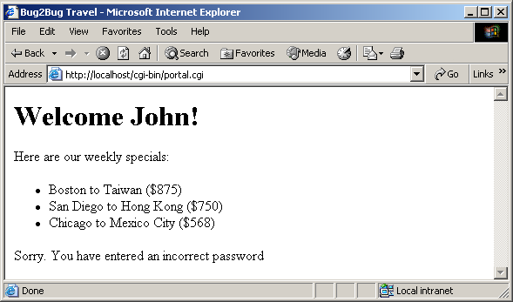
portal.cpp output (1 of 2)

Slide 56
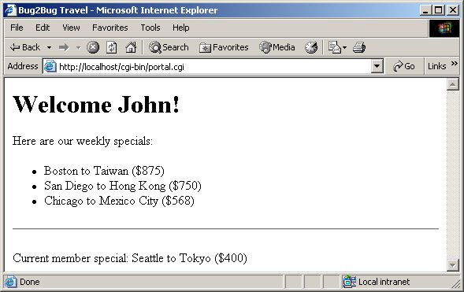
portal.cpp output (2 of 2)

Slide 57
16.14 Cookies
Cookies
  Small text files Web server sends the browser
  Stores information, track user's progress in site
    Shopping cart
    Custom site settings
    Used by most major websites
  Can keep track of identity, how often visit a site
    For this reason, security/privacy concern
    Do not erase hard drive, breaking into computer
    Can be disabled

Slide 58
16.14 Cookies
Creation
  Output lines of text before header
  First line Set-Cookie:
    Indicates that following data stored in cookie
    In our example, output post data, delimited with :
  Expiration date
    expires=+30d;
      Last for 30 days
    expires=Friday, 14-MAY-10 16:00:00 GMT;
  Path
    Specifies which servers in domain can read cookie
    If empty, any server in domain can read
    path=\n

Slide 59
16.14 Cookies
Reading
  dataString = getenv( "HTTP_COOKIE" );
  Search for data fields

Slide 60
cookieform.html
(1 of 2)
1 <?xml version = "1.0"?>
2 <!DOCTYPE html PUBLIC "-//W3C//DTD XHTML 1.0 Transitional//EN"
3 "http://www.w3.org/TR/xhtml1/DTD/xhtml1-transitional.dtd">
4
5 <!-- Fig. 16.15: cookieform.html -->
6 <!-- Cookie Demonstration -->
7
8 <html xmlns = "http://www.w3.org/1999/xhtml">
9 <head>
10 <title>Writing a cookie to the client computer</title>
11 </head>
12
13 <body>
14 <h1>Click Write Cookie to save your cookie data.</h1>
15
16 <form method = "post"
17 action = "/cgi-bin/writecookie.cgi">
18
19 <p>Name:<br />
20 <input type = "text" name = "name" />
21 </p>
22
23 <p>Age:<br />
24 <input type = "text" name = "age" />
25 </p>

Slide 61
cookieform.html
(2 of 2)
26
27 <p>Favorite Color:<br />
28 <input type = "text" name = "color" />
29 </p>
30
31 <p>
32 <input type = "submit" name = "button" />
33 </p>
34 </form>
35
36 </body>
37 </html>

Slide 62
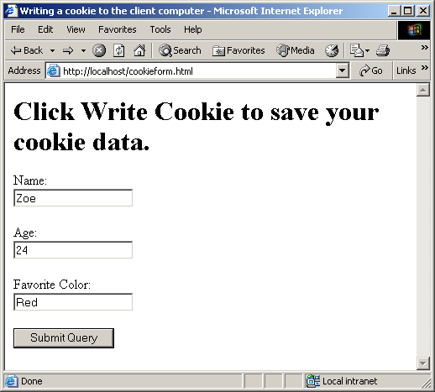
cookieform.html output (1 of 1)

Slide 63
writecookie.cpp
(1 of 4)
1 // Fig. 16.16: writecookie.cpp
2 // Program to write a cookie to a client's machine.
3 #include <iostream>
4
5 using std::cout;
6 using std::cin;
7
8 #include <cstdlib>
9 #include <string>
10
11 using std::string;
12
13 int main()
14 {
15 char query[ 1024 ] = "";
16 string dataString = "";
17 string nameString = "";
18 string ageString = "";
19 string colorString = "";
20
21 int contentLength = 0;
22
23 // expiration date of cookie
24 string expires = "Friday, 14-MAY-10 16:00:00 GMT";
25
Specify expiration date of cookie.

Slide 64
writecookie.cpp
(2 of 4)
26 // data was entered
27 if ( getenv( "CONTENT_LENGTH" ) ) {
28 contentLength = atoi( getenv( "CONTENT_LENGTH" ) );
29
30 // read data from standard input
31 cin.read( query, contentLength );
32 dataString = query;
33
34 // search string for data and store locations
35 int nameLocation = dataString.find( "name=" ) + 5;
36 int endName = dataString.find( "&" );
37
38 int ageLocation = dataString.find( "age=" ) + 4;
39 int endAge = dataString.find( "&color" );
40
41 int colorLocation = dataString.find( "color=" ) + 6;
42 int endColor = dataString.find( "&button" );
43
44 // get value for user's name
45 nameString = dataString.substr( nameLocation, endName -
46 nameLocation );
47
48 // get value for user's age
49 if ( ageLocation > 0 )
50 ageString = dataString.substr( ageLocation, endAge -
51 ageLocation );
52

Slide 65
writecookie.cpp
(3 of 4)
53 // get value for user's favorite color
54 if ( colorLocation > 0 )
55 colorString = dataString.substr( colorLocation,
56 endColor - colorLocation );
57
58 // set cookie
59 cout << "Set-Cookie: Name=" << nameString << "age:"
60 << ageString << "color:" << colorString
61 << "; expires=" << expires << "; path=\n";
62
63 } // end if
64
65 // output header
66 cout << "Content-Type: text/html\n\n";
67
68 // output XML declaration and DOCTYPE
69 cout << "<?xml version = \"1.0\"?>"
70 << "<!DOCTYPE html PUBLIC \"-//W3C//DTD XHTML 1.0 "
71 << "Transitional//EN\" \"http://www.w3.org/TR/xhtml1"
72 << "/DTD/xhtml1-transitional.dtd\">";
73
74 // output html element and some of its contents
75 cout << "<html xmlns = \"http://www.w3.org/1999/xhtml\">"
76 << "<head><title>Cookie Saved</title></head>"
77 << "<body>";
78
Set cookie data (comes before other headers).

Slide 66
writecookie.cpp
(4 of 4)
79 // output user's information
80 cout << "<p>The cookies have been set with the following"
81 << " data:</p>"
82 << "<p>Name: " << nameString << "<br/></p>"
83 << "<p>Age:" << ageString << "<br/></p>"
84 << "<p>Color:" << colorString << "<br/></p>"
85 << "<p>Click <a href=\"/cgi-bin/read_cookie.cgi\">"
86 << "here</a> to read saved cookie data:</p>"
87 << "</body></html>";
88
89 return 0;
90
91 } // end main

Slide 67
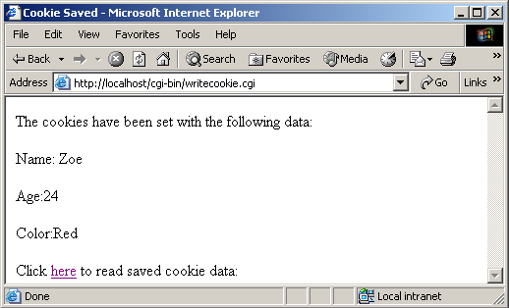
writecookie.cpp output (1 of 1)

Slide 68
readcookie.cpp
(1 of 3)
1 // Fig. 16.17: readcookie.cpp
2 // Program to read cookie data.
3 #include <iostream>
4
5 using std::cout;
6 using std::cin;
7
8 #include <cstdlib>
9 #include <string>
10
11 using std::string;
12
13 int main()
14 {
15 string dataString = "";
16 string nameString = "";
17 string ageString = "";
18 string colorString = "";
19
20 dataString = getenv( "HTTP_COOKIE" );
21
22 // search through cookie data string
23 int nameLocation = dataString.find( "Name=" ) + 5;
24 int endName = dataString.find( "age:" );
25
Read cookie data.

Slide 69
readcookie.cpp
(2 of 3)
26 int ageLocation = dataString.find( "age:" ) + 4;
27 int endAge = dataString.find( "color:" );
28
29 int colorLocation = dataString.find( "color:" ) + 6;
30
31 // store cookie data in strings
32 nameString = dataString.substr( nameLocation, endName -
33 nameLocation );
34 ageString = dataString.substr( ageLocation, endAge -
35 ageLocation);
36 colorString = dataString.substr( colorLocation );
37
38 // output header
39 cout << "Content-Type: text/html\n\n";
40
41 // output XML declaration and DOCTYPE
42 cout << "<?xml version = \"1.0\"?>"
43 << "<!DOCTYPE html PUBLIC \"-//W3C//DTD XHTML 1.0 "
44 << "Transitional//EN\" \"http://www.w3.org/TR/xhtml1"
45 << "/DTD/xhtml1-transitional.dtd\">";
46
47 // output html element and some of its contents
48 cout << "<html xmlns = \"http://www.w3.org/1999/xhtml\">"
49 << "<head><title>Read Cookies</title></head>"
50 << "<body>";
51

Slide 70
readcookie.cpp
(3 of 3)
52 // data was found
53 if ( dataString != "" )
54 cout << "<h3>The following data is saved in a cookie on"
55 << " your computer</h3>"
56 << "<p>Name: " << nameString << "<br/></p>"
57 << "<p>Age: " << ageString << "<br/></p>"
58 << "<p>Color: " << colorString << "<br/></p>";
59
60 // no data was found
61 else
62 cout << "<p>No cookie data.</p>";
63
64 cout << "</body></html>";
65
66 return 0;
67 } // end main

Slide 71
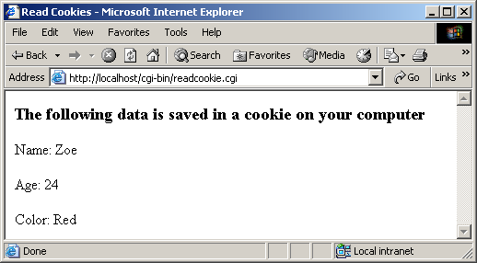
readcookie.cpp output (1 of 1)

Slide 72
16.15 Server-Side Files
Files located on server
  More secure way of maintaining important info
  Need permission to change files
Example
  Post data to clients.dat
  Password requested
  Example simplified
    clients.dat stored in cgi-bin, publicly accessible
    No data validation (proper format for entries)

Slide 73
savefile.html output (1 of 2)
1 <?xml version = "1.0"?>
2 <!DOCTYPE html PUBLIC "-//W3C//DTD XHTML 1.0 Transitional//EN"
3 "http://www.w3.org/TR/xhtml1/DTD/xhtml1-transitional.dtd">
4
5 <!-- Fig. 16.18: savefile.html -->
6 <!-- Form to input client information -->
7
8 <html xmlns = "http://www.w3.org/1999/xhtml">
9 <head>
10 <title>Please enter your contact information</title>
11 </head>
12
13 <body>
14 <p>Please enter your information in the form below.</p>
15 <p>Note: You must fill in all fields.</p>
16 <form method = "post"
17 action = "/cgi-bin/savefile.cgi">
18 <p>
19 First Name:
20 <input type = "text" name = "firstname" size = "10" />
21 Last Name:
22 <input type = "text" name = "lastname" size = "15" />
23 </p>
24

Slide 74
savefile.html output (2 of 2)
25 <p>
26 Address:
27 <input type = "text" name = "address" size = "25" />
28 <br />
29 Town:
30 <input type = "text" name = "town" size = "10" />
31 State:
32 <input type = "text" name = "state" size = "2" />
33 <br/>
34 Zip Code:
35 <input type = "text" name = "zipcode" size = "5" />
36 Country:
37 <input type = "text" name = "country" size = "10" />
38 </p>
39 <p>
40 E-mail Address:
41 <input type = "text" name = "email" />
42 </p>
43 <input type = "submit" value = "Enter" />
44 <input type = "reset" value = "Clear" />
45 </form>
46 </body>
47 </html>

Slide 75
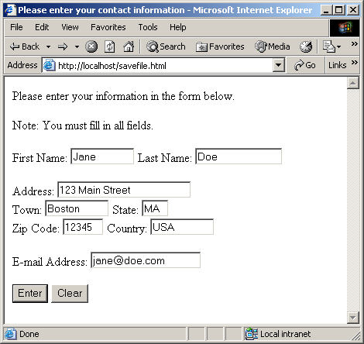
savefile.html output (1 of 1)

Slide 76
savefile.cpp
(1 of 7)
1 // Fig. 16.19: savefile.cpp
2 // Program to enter user's contact information into a
3 // server-side file.
4
5 #include <iostream>
6
7 using std::cerr;
8 using std::cout;
9 using std::cin;
10 using std::ios;
11
12 #include <fstream>
13
14 using std::ofstream;
15
16 #include <string>
17
18 using std::string;
19
20 #include <cstdlib>
21
22 int main()
23 {
24 char postString[ 1024 ] = "";
25 int contentLength = 0;
26

Slide 77
savefile.cpp
(2 of 7)
27 // variables to store user data
28 string dataString = "";
29 string firstname = "";
30 string lastname = "";
31 string address = "";
32 string town = "";
33 string state = "";
34 string zipcode = "";
35 string country = "";
36 string email = "";
37
38 // data was posted
39 if ( getenv( "CONTENT_LENGTH" ) )
40 contentLength = atoi( getenv( "CONTENT_LENGTH" ) );
41
42 cin.read( postString, contentLength );
43 dataString = postString;
44
45 // search for first '+' character
46 int charLocation = dataString.find( "+" );
47
48 // search for next '+' character
49 while ( charLocation < string::npos ) {
50 dataString.replace( charLocation, 1, " " );
51 charLocation = dataString.find( "+", charLocation + 1 );
52 } // end while

Slide 78
savefile.cpp
(3 of 7)
53
54 // find location of firstname
55 int firstStart = dataString.find( "firstname=" ) + 10;
56 int endFirst = dataString.find( "&lastname" );
57
58 firstname = dataString.substr( firstStart,
59 endFirst - firstStart );
60
61 // find location of lastname
62 int lastStart = dataString.find( "lastname=" ) + 9;
63 int endLast = dataString.find( "&address" );
64
65 lastname = dataString.substr( lastStart,
66 endLast - lastStart );
67
68 // find location of address
69 int addressStart = dataString.find( "address=" ) + 8;
70 int endAddress = dataString.find( "&town" );
71
72 address = dataString.substr( addressStart,
73 endAddress - addressStart );
74
75 // find location of town
76 int townStart = dataString.find( "town=" ) + 5;
77 int endTown = dataString.find( "&state" );
78
79 town = dataString.substr( townStart, endTown - townStart);
80

Slide 79
savefile.cpp
(4 of 7)
81 // find location of state
82 int stateStart = dataString.find( "state=" ) + 6;
83 int endState = dataString.find( "&zipcode" );
84
85 state = dataString.substr( stateStart,
86 endState - stateStart );
87
88 // find location of zip code
89 int zipStart = dataString.find( "zipcode=" ) + 8;
90 int endZip = dataString.find( "&country" );
91
92 zipcode = dataString.substr( zipStart, endZip - zipStart );
93
94 // find location of country
95 int countryStart = dataString.find( "country=" ) + 8;
96 int endCountry = dataString.find( "&email" );
97
98 country = dataString.substr( countryStart,
99 endCountry - countryStart );
100
101 // find location of e-mail address
102 int emailStart = dataString.find( "email=" ) + 6;
103 int endEmail = dataString.find( "&submit" );
104
105 email = dataString.substr( emailStart,
106 endEmail - emailStart );
107

Slide 80
savefile.cpp
(5 of 7)
108 // output header
109 cout << "Content-Type: text/html\n\n";
110
111 // output XML declaration and DOCTYPE
112 cout << "<?xml version = \"1.0\"?>"
113 << "<!DOCTYPE html PUBLIC \"-//W3C//DTD XHTML 1.0 "
114 << "Transitional//EN\" \"http://www.w3.org/TR/xhtml1"
115 << "/DTD/xhtml1-transitional.dtd\">";
116
117 // output html element and some of its contents
118 cout << "<html xmlns = \"http://www.w3.org/1999/xhtml\">"
119 << "<head><title>Contact Information entered"
120 << "</title></head><body>";
121
122 // output to file
123 ofstream outFile( "clients.txt", ios::app );
124
125 // file was not opened properly
126 if ( !outFile ) {
127 cerr << "Error: could not open contact file.";
128 exit( 1 );
129 } // end if
Open clients.txt for writing.

Slide 81
savefile.cpp
(6 of 7)
130
131 // append data to clients.txt file
132 outFile << firstname << " " << lastname << "\n"
133 << address << "\n" << town << " "
134 << state << " " << country << " "
135 << zipcode << "\n" << email
136 << "\n\n";
137
138 // output data to user
139 cout << "<table><tbody>"
140 << "<tr><td>First Name:</td><td>"
141 << firstname << "</td></tr>"
142 << "<tr><td>Last Name:</td><td>"
143 << lastname << "</td></tr>"
144 << "<tr><td>Address:</td><td>"
145 << address << "</td></tr>"
146 << "<tr><td>Town:</td><td>"
147 << town << "</td></tr>"
148 << "<tr><td>State:</td><td>"
149 << state << "</td></tr>"
150 << "<tr><td>Zip Code:</td><td>"
151 << zipcode << "</td></tr>"
152 << "<tr><td>Country:</td><td>"
153 << country << "</td></tr>"
154 << "<tr><td>Email:</td><td>"
155 << email << "</td></tr>"
156 << "</tbody></table>"
157 << "</body>\n</html>\n";

Slide 82
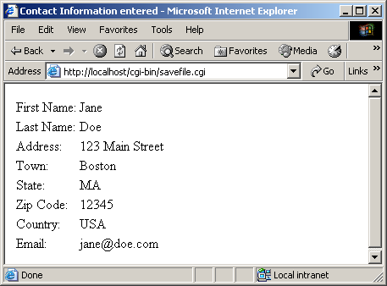
savefile.cpp
(7 of 7) savefile.cpp output (1 of 1)
158
159 return 0;
160
161 } // end main
clients.dat:
Jane Doe
123 Main Street
Boston MA USA 12345
jane@doe.com

Slide 83
16.16 Case Study: Shopping Cart
Shopping cart
  Record what user wants to purchase
  Add, remove items
    Example at www.amazon.com
  Add, remove items
This example
  Buy books from virtual bookstore
  Four scripts, 2 server-side files, cookies
  First script: user login
    Option to create new membership
      Add name/password pairs to userdata.txt
    Password validation

Slide 84
login.cpp (1 of 11)
1 // Fig. 16.21: login.cpp
2 // Program to output an XHTML form, verify the
3 // username and password entered, and add members.
4 #include <iostream>
5
6 using std::cerr;
7 using std::cout;
8 using std::cin;
9 using std::ios;
10
11 #include <fstream>
12
13 using std::ifstream;
14 using std::ofstream;
15
16 #include <string>
17
18 using std::string;
19
20 #include <cstdlib>
21
22 void header();
23 void writeCookie();
24
Write XHTML header information, set page title, etc.
Writes empty cookie to user's machine.

Slide 85
login.cpp (2 of 11)
25 int main()
26 {
27 char query[ 1024 ] = "";
28 string dataString = "";
29
30 // strings to store username and password
31 string userName = "";
32 string passWord = "";
33 string newCheck = "";
34
35 int contentLength = 0;
36 int endPassword = 0;
37
38 // data was posted
39 if ( getenv( "CONTENT_LENGTH" ) ) {
40
41 // retrieve query string
42 contentLength = atoi( getenv( "CONTENT_LENGTH" ) );
43 cin.read( query, contentLength );
44 dataString = query;
45
46 // find username location
47 int userLocation = dataString.find( "user=" ) + 5;
48 int endUser = dataString.find( "&" );
49
Get user data.

Slide 86
login.cpp (3 of 11)
50 // find password location
51 int passwordLocation = dataString.find( "password=" ) + 9;
52
53 endPassword = dataString.find( "&new" );
54
55 // new membership requested
56 if ( endPassword > 0 )
57 passWord = dataString.substr( passwordLocation,
58 endPassword - passwordLocation );
59
60 // existing member
61 else
62 passWord = dataString.substr( passwordLocation );
63
64 userName = dataString.substr( userLocation, endUser -
65 userLocation );
66
67 } // end if
68
69 // no data was retrieved
70 if ( dataString == "" ) {
71 header();
72 cout << "<p>Please login.</p>";
73
If no data provided, show login form.

Slide 87
login.cpp (4 of 11)
74 // output login form
75 cout << "<form method = \"post\" "
76 << "action = \"/cgi-bin/login.cgi\"><p>"
77 << "User Name: "
78 << "<input type = \"text\" name = \"user\"/><br/>"
79 << "Password: "
80 << "<input type = \"password\" "
81 << "name = \"password\"/><br/>"
82 << "New? <input type = \"checkbox\""
83 << " name = \"new\" "
84 << "value = \"1\"/></p>"
85 << "<input type = \"submit\" value = \"login\"/>"
86 << "</form>";
87
88 } // end if
89

Slide 88
login.cpp (5 of 11)
90 // process entered data
91 else {
92
93 // add new member
94 if ( endPassword > 0 ) {
95 string fileUsername = "";
96 string filePassword = "";
97 bool nameTaken = false;
98
99 // open password file
100 ifstream userData( "userdata.txt", ios::in );
101
102 // could not open file
103 if ( !userData ) {
104 cerr << "Could not open database.";
105 exit( 1 );
106 } // end if
107
108 // read username and password from file
109 while ( userData >> fileUsername >> filePassword ) {
110
111 // name is already taken
112 if ( userName == fileUsername )
113 nameTaken = true;
114
115 } // end while
If a new member, check that the name is not taken.

Slide 89
login.cpp (6 of 11)
116
117 // user name is taken
118 if ( nameTaken ) {
119 header();
120 cout << "<p>This name has already been taken.</p>"
121 << "<a href=\"/cgi-bin/login.cgi\">"
122 << "Try Again</a>";
123 } // end if
124
125 // process data
126 else {
127
128 // write cookie
129 writeCookie();
130 header();
131
132 // open user data file
133 ofstream userData( "userdata.txt", ios::app );
134

Slide 90
login.cpp (7 of 11)
135 // could not open file
136 if ( !userData ) {
137 cerr << "Could not open database.";
138 exit( 1 );
139 } // end if
140
141 // write user data to file
142 userData << "\n" << userName << "\n" << passWord;
143
144 cout << "<p>Your information has been processed."
145 << "<a href=\"/cgi-bin/shop.cgi\">"
146 << "Start Shopping</a></p>";
147
148 } // end else
149 } // end if
150
151 // search for password if entered
152 else {
153
154 // strings to store username and password from file
155 string fileUsername = "";
156 string filePassword = "";
157 bool authenticated = false;
158 bool userFound = false;
159
After password saved to file, provide link for next page.

Slide 91
login.cpp (8 of 11)
160 // open password file
161 ifstream userData( "userdata.txt", ios::in );
162
163 // could not open file
164 if ( !userData ) {
165 cerr << "Could not open database.";
166 exit( 1 );
167 } // end if
168
169 // read in user data
170 while ( userData >> fileUsername >> filePassword ) {
171
172 // username and password match
173 if ( userName == fileUsername &&
174 passWord == filePassword )
175 authenticated = true;
176
177 // username was found
178 if ( userName == fileUsername )
179 userFound = true;
180 } // end while
181
182 // user is authenticated
183 if ( authenticated ) {
184 writeCookie();
185 header();
186

Slide 92
login.cpp (9 of 11)
187 cout << "<p>Thank you for returning, "
188 << userName << "!</p>"
189 << "<a href=\"/cgi-bin/shop.cgi\">"
190 << "Start Shopping</a>";
191 } // end if
192
193 // user not authenticated
194 else {
195 header();
196
197 // password is incorrect
198 if ( userFound )
199 cout << "<p>You have entered an incorrect "
200 << "password. Please try again.</p>"
201 << "<a href=\"/cgi-bin/login.cgi\">"
202 << "Back to login</a>";
203
204 // user is not registered
205 else
206 cout << "<p>You are not a registered user.</p>"
207 << "<a href=\"/cgi-bin/login.cgi\">"
208 << "Register</a>";
209
210 } // end else
211 } // end else
212 } // end if
Registered user authenticated, provide link for next page.

Slide 93
login.cpp (10 of 11)
213
214 cout << "</body>\n</html>\n";
215 return 0;
216
217 } // end main
218
219 // function to output header
220 void header()
221 {
222 // output header
223 cout << "Content-Type: text/html\n\n";
224
225 // output XML declaration and DOCTYPE
226 cout << "<?xml version = \"1.0\"?>"
227 << "<!DOCTYPE html PUBLIC \"-//W3C//DTD XHTML 1.0 "
228 << "Transitional//EN\" \"http://www.w3.org/TR/xhtml1"
229 << "/DTD/xhtml1-transitional.dtd\">";
230
231 // output html element and some of its contents
232 cout << "<html xmlns = \"http://www.w3.org/1999/xhtml\">"
233 << "<head><title>Login Page</title></head>"
234 << "<body>";
235
236 } // end header
237

Slide 94
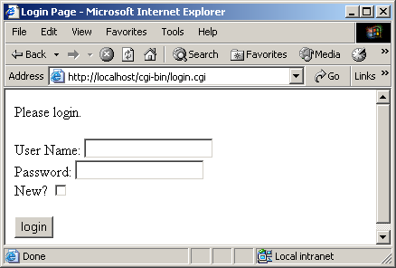
login.cpp (11 of 11) login.cpp output (1 of 3)
238 // function to write cookie data
239 void writeCookie()
240 {
241 string expires = "Friday, 14-MAY-04 16:00:00 GMT";
242 cout << "Set-Cookie: CART=; expires="
243 << expires << "; path=\n";
244
245 } // end writeCookie

Slide 95
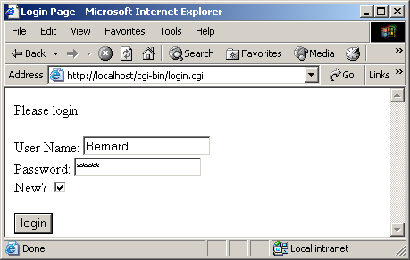
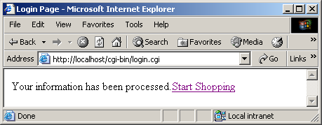
login.cpp output (2 of 3)

Slide 96
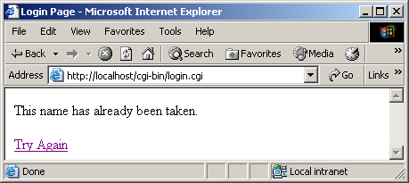
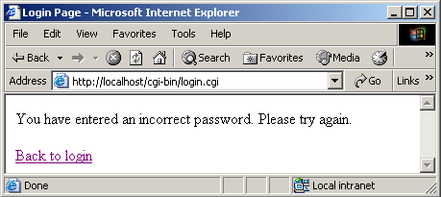
login.cpp output (3 of 3)

Slide 97
16.16 Case Study: Shopping Cart
shop.cpp
  Display books user can purchase
    Get data from catalog.txt
  Have "buy" form button
    Value is ISBN number
    After pushed, run viewcart.cgi

Slide 98
shop.cpp (1 of 5)
1 // Fig. 16.22: shop.cpp
2 // Program to display available books.
3 #include <iostream>
4
5 using std::cerr;
6 using std::cout;
7 using std::cin;
8 using std::ios;
9
10 #include <istream>
11
12 #include <fstream>
13
14 using std::ifstream;
15 using std::ofstream;
16
17 #include <string>
18
19 using std::string;
20
21 #include <cstdlib>
22
23 void header();
24

Slide 99
shop.cpp (2 of 5)
25 int main()
26 {
27 // variables to store product information
28 char book[ 50 ] = "";
29 char year[ 50 ] = "";
30 char isbn[ 50 ] = "";
31 char price[ 50 ] = "";
32
33 string bookString = "";
34 string yearString = "";
35 string isbnString = "";
36 string priceString = "";
37
38 bool nameTaken = false;
39
40 // open file for input
41 ifstream userData( "catalog.txt", ios::in );
42
43 // file could not be opened
44 if ( !userData ) {
45 cerr << "Could not open database.";
46 exit( 1 );
47 } // end if
48
49 header(); // output header
50

Slide 100
shop.cpp (3 of 5)
51 // output available books
52 cout << "<center><br/>Books available for sale<br/>"
53 << "<a href=\"/cgi-bin/logout.cgi\">Sign Out"
54 << "</a><br/><br/>"
55 << "<table border = \"1\" cellpadding = \"7\" >";
56
57 // file is open
58 while ( userData ) {
59
60 // retrieve data from file
61 userData.getline( book, 50 );
62 bookString = book;
63
64 userData.getline( year, 50 );
65 yearString = year;
66
67 userData.getline( isbn, 50 );
68 isbnString = isbn;
69
70 userData.getline( price, 50 );
71 priceString = price;
72

Slide 101
shop.cpp (4 of 5)
73 cout << "<tr>"
74 << "<td>" << bookString << "</td>"
75 << "<td>" << yearString << "</td>"
76 << "<td>" << isbnString << "</td>"
77 << "<td>" << priceString << "</td>";
78
79 // file is still open after reads
80 if ( userData )
81
82 // output form with buy button
83 cout << "<td><form method=\"post\" "
84 << "action=\"/cgi-bin/viewcart.cgi\">"
85 << "<input type=\"hidden\" name=\"add\""
86 << "value=\"true\"/>"
87 << "<input type=\"hidden\" name=\"isbn\""
88 << "value=\"" << isbnString << "\"/>"
89 << "<input type=\"submit\""
90 << "value=\"Buy\"/>\n"
91 << "</form></td>\n";
92
93 cout << "</tr>\n";
94
95 } // end while
96
97 cout << "</table></center></body></html>";
98 return 0;
99 }

Slide 102
shop.cpp (5 of 5)
100
101 // function to output header information
102 void header()
103 {
104 // output header
105 cout << "Content-Type: text/html\n\n";
106
107 // output XML declaration and DOCTYPE
108 cout << "<?xml version = \"1.0\"?>"
109 << "<!DOCTYPE html PUBLIC \"-//W3C//DTD XHTML 1.0 "
110 << "Transitional//EN\" \"http://www.w3.org/TR/xhtml1"
111 << "/DTD/xhtml1-transitional.dtd\">";
112
113 // output html element and some of its contents
114 cout << "<html xmlns = \"http://www.w3.org/1999/xhtml\">"
115 << "<head><title>Login Page</title></head>"
116 << "<body>";
117 } // end header

Slide 103
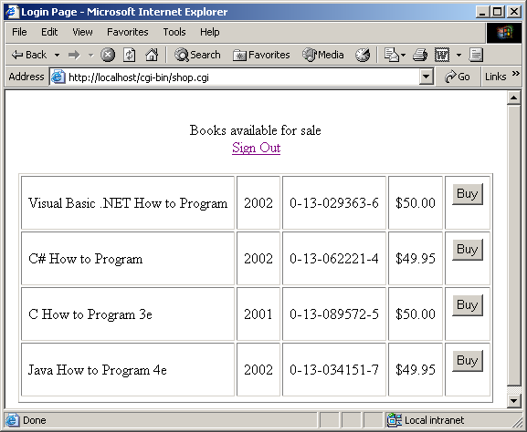
shop.cpp output (1 of 1)

Slide 104
viewcart.cpp
(1 of 7)
1 // Fig. 16.23: viewcart.cpp
2 // Program to view books in the shopping cart.
3 #include <iostream>
4
5 using std::cerr;
6 using std::cout;
7 using std::cin;
8 using std::ios;
9
10 #include <istream>
11
12 #include <fstream>
13
14 using std::ifstream;
15 using std::ofstream;
16
17 #include <string>
18
19 using std::string;
20
21 #include <cstdlib>
22
23 void outputBooks( const string &, const string & );
24

Slide 105
viewcart.cpp
(2 of 7)
25 int main()
26 {
27 // variable to store query string
28 char query[ 1024 ] = "";
29 char *cartData; // variable to hold contents of cart
30
31 string dataString = "";
32 string cookieString = "";
33 string isbnEntered = "";
34 int contentLength = 0;
35
36 // retrieve cookie data
37 if ( getenv( "HTTP_COOKIE" ) ) {
38 cartData = getenv( "HTTP_COOKIE" );
39 cookieString = cartData;
40 } // end if
41
42 // data was entered
43 if ( getenv( "CONTENT_LENGTH" ) ) {
44 contentLength = atoi( getenv( "CONTENT_LENGTH" ) );
45 cin.read( query, contentLength );
46 dataString = query;
47
48 // find location of isbn value
49 int addLocation = dataString.find( "add=" ) + 4;
50 int endAdd = dataString.find( "&isbn" );
51 int isbnLocation = dataString.find( "isbn=" ) + 5;
52

Slide 106
viewcart.cpp
(3 of 7)
53 // retrieve isbn number to add to cart
54 isbnEntered = dataString.substr( isbnLocation );
55
56 // write cookie
57 string expires = "Friday, 14-MAY-10 16:00:00 GMT";
58 int cartLocation = cookieString.find( "CART=" ) + 5;
59
60 // cookie exists
61 if ( cartLocation > 0 )
62 cookieString = cookieString.substr( cartLocation );
63
64 // no cookie data exists
65 if ( cookieString == "" )
66 cookieString = isbnEntered;
67
68 // cookie data exists
69 else
70 cookieString += "," + isbnEntered;
71
72 // set cookie
73 cout << "Set-Cookie: CART=" << cookieString << "; expires="
74 << expires << "; path=\n";
75
76 } // end if
77
Append to old cookie

Slide 107
viewcart.cpp
(4 of 7)
78 // output header
79 cout << "Content-Type: text/html\n\n";
80
81 // output XML declaration and DOCTYPE
82 cout << "<?xml version = \"1.0\"?>"
83 << "<!DOCTYPE html PUBLIC \"-//W3C//DTD XHTML 1.0 "
84 << "Transitional//EN\" \"http://www.w3.org/TR/xhtml1"
85 << "/DTD/xhtml1-transitional.dtd\">";
86
87 // output html element and some of its contents
88 cout << "<html xmlns = \"http://www.w3.org/1999/xhtml\">"
89 << "<head><title>Shopping Cart</title></head>"
90 << "<body><center>"
91 << "<p>Here is your current order:</p>";
92
93 // cookie data exists
94 if ( cookieString != "" )
95 outputBooks( cookieString, isbnEntered );
96
97 cout << "</body></html>\n";
98 return 0;
99
100 } // end main

Slide 108
viewcart.cpp
(5 of 7)
101
102 // function to output books in catalog.txt
103 void outputBooks( const string &cookieRef, const string &isbnRef )
104 {
105 char book[ 50 ] = "";
106 char year[ 50 ] = "";
107 char isbn[ 50 ] = "";
108 char price[ 50 ] = "";
109
110 string bookString = "";
111 string yearString = "";
112 string isbnString = "";
113 string priceString = "";
114
115 // open file for input
116 ifstream userData( "catalog.txt", ios::in );
117
118 // file could not be opened
119 if ( !userData ) {
120 cerr << "Could not open database.";
121 exit( 1 );
122 } // end if
123

Slide 109
viewcart.cpp
(6 of 7)
124 // output link to log out and table to display books
125 cout << "<a href=\"/cgi-bin/logout.cgi\">Sign Out";
126 cout << "</a><br><br>";
127 cout << "<table border = 1 cellpadding = 7 >";
128
129 // file is open
130 while ( userData ) {
131
132 // retrieve book information
133 userData.getline( book, 50 );
134 bookString = book;
135
136 // retrieve year information
137 userData.getline( year, 50 );
138 yearString = year;
139
140 // retrieve isbn number
141 userData.getline( isbn, 50 );
142 isbnString = isbn;
143
144 // retrieve price
145 userData.getline( price, 50 );
146 priceString = price;
147

Slide 110
viewcart.cpp
(7 of 7)
148 int match = cookieRef.find( isbn );
149
150 // match has been made
151 if ( match > 0 || isbnRef == isbnString ) {
152
153 // output table row with book information
154 cout << "<tr>"
155 << "<form method=\"post\""
156 << "action=\"/cgi-bin/viewcart.cgi\">"
157 << "<td>" << bookString << "</td>"
158 << "<td>" << yearString << "</td>"
159 << "<td>" << isbnString << "</td>"
160 << "<td>" << priceString << "</td>";
161
162 } // end if
163
164 cout << "</form></tr>";
165
166 } // end while
167
168 // output link to add more books
169 cout << "<a href=\"/cgi-bin/shop.cgi\">Back to book list</a>";
170 } // end outputBooks

Slide 111
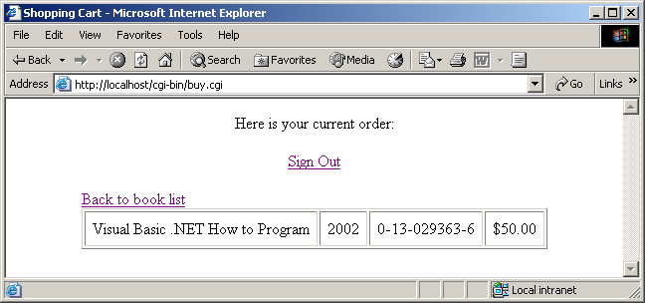
viewcart.cpp output (1 of 1)

Slide 112
logout.cpp (1 of 3)
1 // Fig. 16.24: logout.cpp
2 // Program to log out of the system.
3 #include <iostream>
4
5 using std::cout;
6
7 #include <string>
8
9 using std::string;
10
11 #include <ctime>
12
13 #include <cstdlib>
14
15 void writeCookie();
16
17 int main()
18 {
19 // write the cookie
20 writeCookie();
21
22 // output header
23 cout << "Content-Type: text/html\n\n";
24
Call writeCookie to erase previous information.

Slide 113
logout.cpp (2 of 3)
25 // output XML declaration and DOCTYPE
26 cout << "<?xml version = \"1.0\"?>"
27 << "<!DOCTYPE html PUBLIC \"-//W3C//DTD XHTML 1.0 "
28 << "Transitional//EN\"";
29
30 // output html element and its contents
31 cout << "<html xmlns = \"http://www.w3.org/1999/xhtml\">"
32 << "<head><title>Logged Out</title></head>"
33 << "<body>"
34 << "<center><p>You are now logged out<br>"
35 << "You will be billed accordingly<br>"
36 << "To login again, "
37 << "<a href=\"/cgi-bin/login.cgi\">click here</a>"
38 << "</body></html>\n";
39
40 return 0;
41
42 } // end main
43

Slide 114
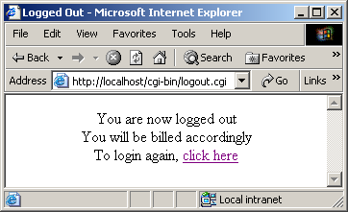
logout.cpp (3 of 3) logout.cpp output (1 of 1)
44 // function to write cookie
45 void writeCookie()
46 {
47 // string containing expiration date
48 string expires = "Friday, 14-MAY-10 16:00:00 GMT";
49
50 // set cookie
51 cout << "Set-Cookie: CART=; expires=" << expires
52 << "; path=\n";
53
54 } // end writeCookie

