Slide 1
Computer System Overview
Chapter 1

Slide 2
Operating System
Exploits the hardware resources of one or more processors
Provides a set of services to system users
Manages secondary memory and I/O devices

Slide 3
Basic Elements
Processor
Main Memory
  volatile
  referred to as real memory or primary memory
I/O modules
  secondary memory devices
  communications equipment
  terminals
System bus
  communication among processors, memory, and I/O modules

Slide 4
Processor
Two internal registers
  Memory address register (MAR)
    Specifies the address for the next read or write
  Memory buffer register (MBR)
    Contains data written into memory or receives data read from memory
  I/O address register
  I/O buffer register

Slide 5
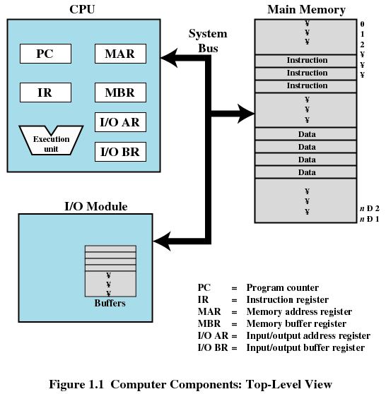
Top-Level Components

Slide 6
Processor Registers
User-visible registers
  Enable programmer to minimize main-memory references by optimizing register use
Control and status registers
  Used by processor to control operating of the processor
  Used by privileged operating-system routines to control the execution of programs

Slide 7
User-Visible Registers
May be referenced by machine language
Available to all programs - application programs and system programs
Types of registers
  Data
  Address
    Index
    Segment pointer
    Stack pointer

Slide 8
User-Visible Registers
Address Registers
  Index
    Involves adding an index to a base value to get an address
  Segment pointer
    When memory is divided into segments, memory is referenced by a segment and an offset
  Stack pointer
    Points to top of stack

Slide 9
Control and Status Registers
Program Counter (PC)
  Contains the address of an instruction to be fetched
Instruction Register (IR)
  Contains the instruction most recently fetched
Program Status Word (PSW)
  Condition codes
  Interrupt enable/disable
  Supervisor/user mode

Slide 10
Control and Status Registers
Condition Codes or Flags
  Bits set by the processor hardware as a result of operations
  Examples
    Positive result
    Negative result
    Zero
    Overflow

Slide 11
Instruction Execution
Two steps
  Processor reads instructions from memory
    Fetches
  Processor executes each instruction

Slide 12
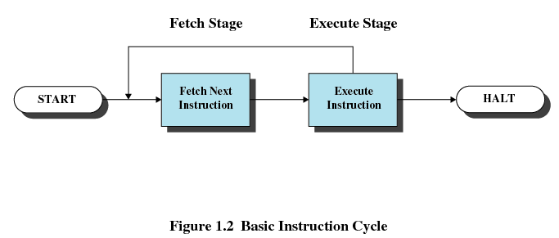
Instruction Cycle

Slide 13
Instruction Fetch and Execute
The processor fetches the instruction from memory
Program counter (PC) holds address of the instruction to be fetched next
Program counter is incremented after each fetch

Slide 14
Instruction Register
Fetched instruction is placed in the instruction register
Categories
  Processor-memory
    Transfer data between processor and memory
  Processor-I/O
    Data transferred to or from a peripheral device
  Data processing
    Arithmetic or logic operation on data
  Control
    Alter sequence of execution

Slide 15
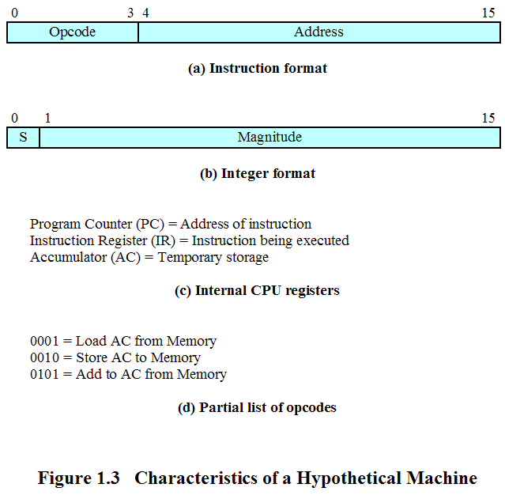
Characteristics of a Hypothetical Machine

Slide 16
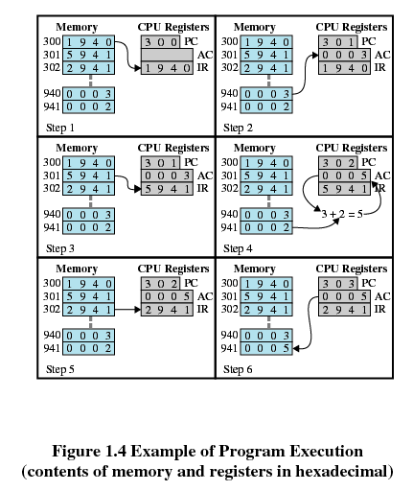
Example of Program Execution

Slide 17
Direct Memory Access (DMA)
I/O exchanges occur directly with memory
Processor grants I/O module authority to read from or write to memory
Relieves the processor responsibility for the exchange

Slide 18
Interrupts
Interrupt the normal sequencing of the processor
Most I/O devices are slower than the processor
  Processor must pause to wait for device

Slide 19
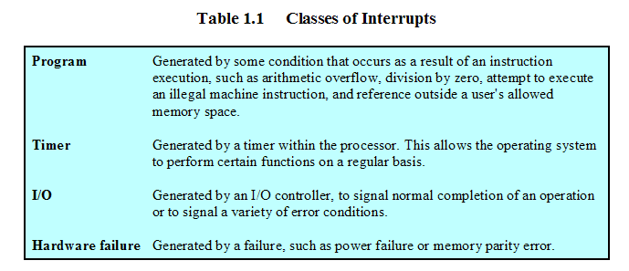
Classes of Interrupts

Slide 20
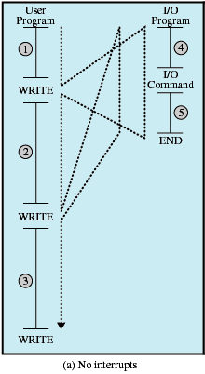
Program Flow of Control Without Interrupts

Slide 21
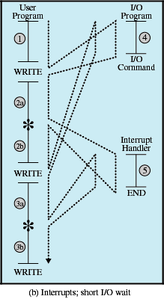
Program Flow of Control With Interrupts, Short I/O Wait

Slide 22
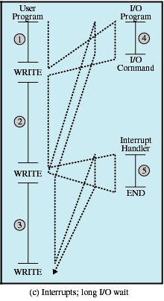
Program Flow of Control With Interrupts; Long I/O Wait

Slide 23
Interrupt Handler
Program to service a particular I/O device
Generally part of the operating system

Slide 24
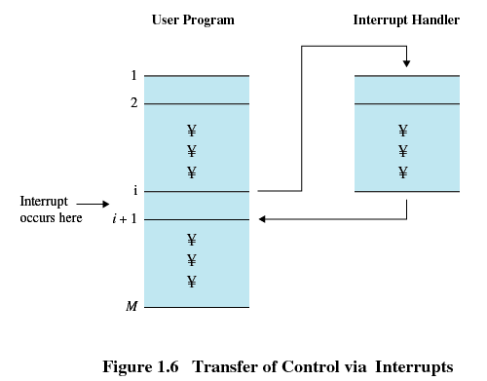
Interrupts
Suspends the normal sequence of execution

Slide 25
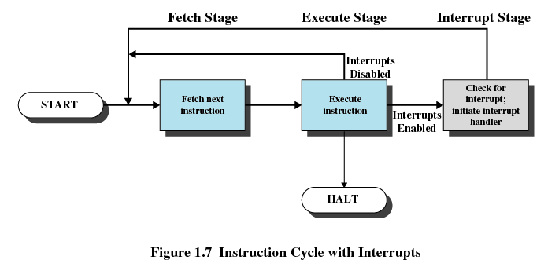
Interrupt Cycle

Slide 26
Interrupt Cycle
Processor checks for interrupts
If no interrupts fetch the next instruction for the current program
If an interrupt is pending, suspend execution of the current program, and execute the interrupt-handler routine

Slide 27
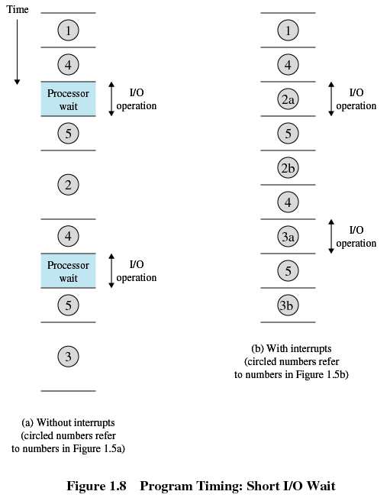
Timing Diagram Based on Short I/O Wait

Slide 28
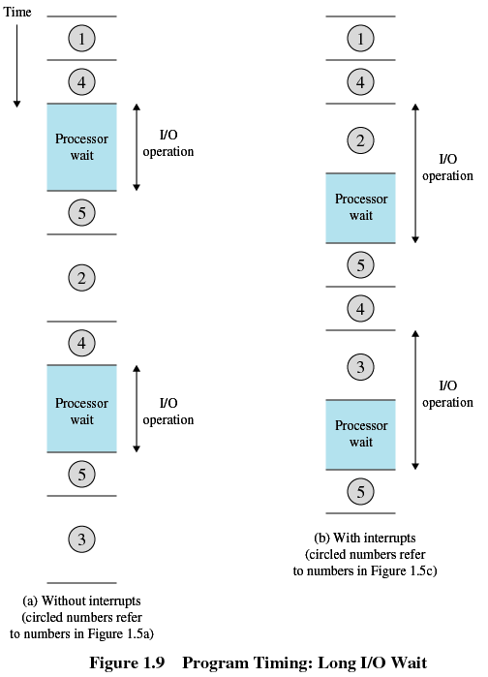
Timing Diagram Based on Short I/O Wait

Slide 29
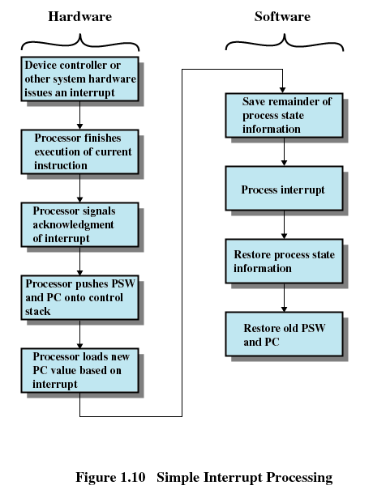
Simple Interrupt Processing

Slide 30
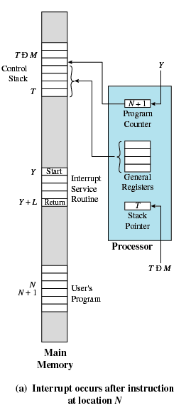
Changes in Memory and Registers for an Interrupt

Slide 31
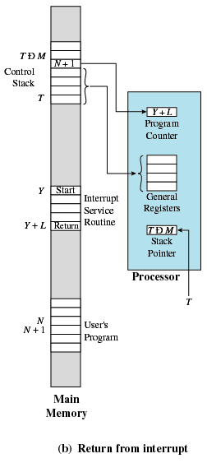
Changes in Memory and Registers for an Interrupt

Slide 32
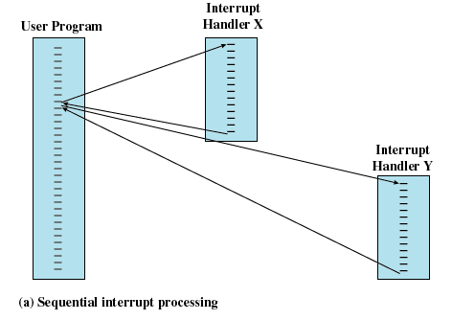
Multiple Interrupts
Disable interrupts while an interrupt is being processed

Slide 33
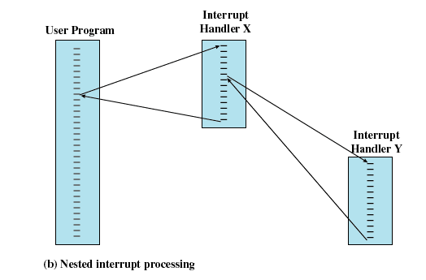
Multiple Interrupts
Define priorities for interrupts

Slide 34
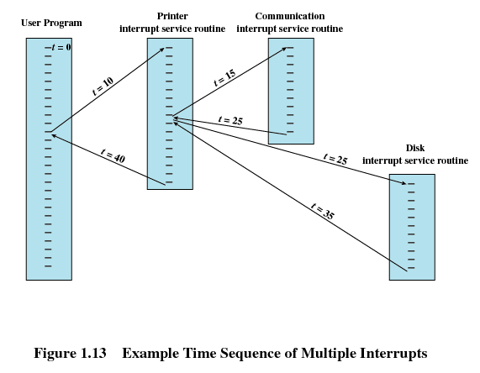
Multiple Interrupts

Slide 35
Multiprogramming
Processor has more than one program to execute
The sequence the programs are executed depend on their relative priority and whether they are waiting for I/O
After an interrupt handler completes, control may not return to the program that was executing at the time of the interrupt

Slide 36
Memory Hierarchy
Faster access time, greater cost per bit
Greater capacity, smaller cost per bit
Greater capacity, slower access speed

Slide 37
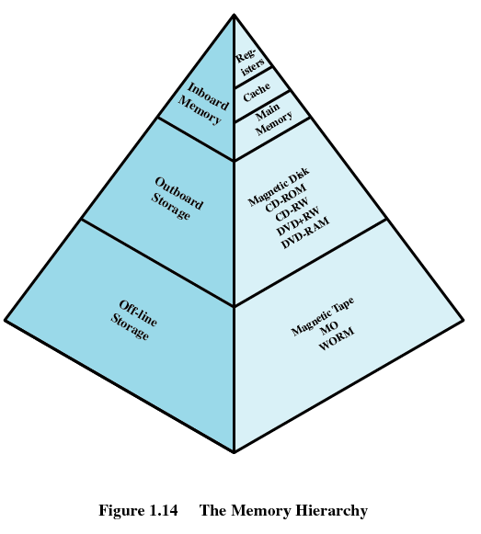
Memory Hierarchy

Slide 38
Going Down the Hierarchy
Decreasing cost per bit
Increasing capacity
Increasing access time
Decreasing frequency of access of the memory by the processor
  Locality of reference

Slide 39
Secondary Memory
Nonvolatile
Auxiliary memory
Used to store program and data files

Slide 40
Disk Cache
A portion of main memory used as a buffer to temporarily to hold data for the disk
Disk writes are clustered
Some data written out may be referenced again. The data are retrieved rapidly from the software cache instead of slowly from disk

Slide 41
Cache Memory
Invisible to operating system
Increase the speed of memory
Processor speed is faster than memory speed
Exploit the principle of locality

Slide 42
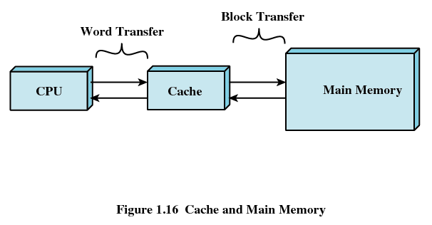
Cache Memory

Slide 43
Cache Memory
Contains a copy of a portion of main memory
Processor first checks cache
If not found in cache, the block of memory containing the needed information is moved to the cache and delivered to the processor

Slide 44
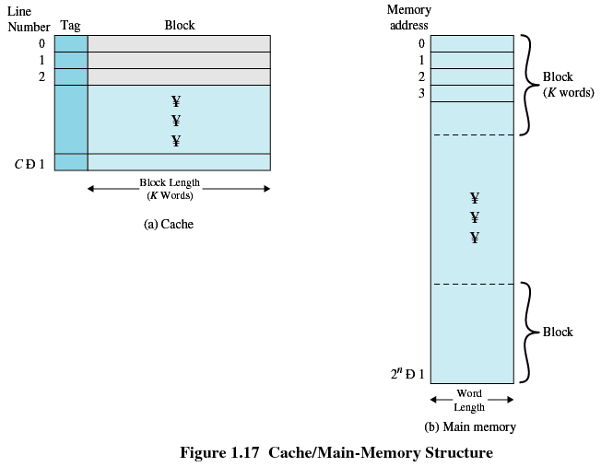
Cache/Main Memory System

Slide 45
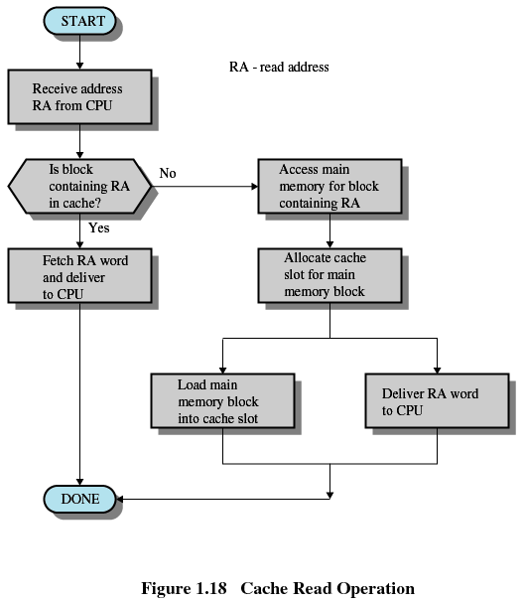
Cache Read Operation

Slide 46
Cache Design
Cache size
  Small caches have a significant impact on performance
Block size
  The unit of data exchanged between cache and main memory
  Larger block size more hits until probability of using newly fetched data becomes less than the probability of reusing data that have to be moved out of cache

Slide 47
Cache Design
Mapping function
  Determines which cache location the block will occupy
Replacement algorithm
  Determines which block to replace
  Least-Recently-Used (LRU) algorithm

Slide 48
Cache Design
Write policy
  When the memory write operation takes place
  Can occur every time block is updated
  Can occur only when block is replaced
    Minimizes memory write operations
    Leaves main memory in an obsolete state

Slide 49
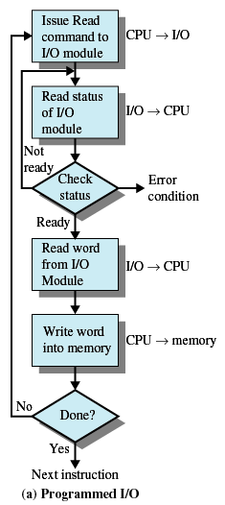
Programmed I/O
I/O module performs the action, not the processor
Sets appropriate bits in the I/O status register
No interrupts occur
Processor checks status until operation is complete

Slide 50
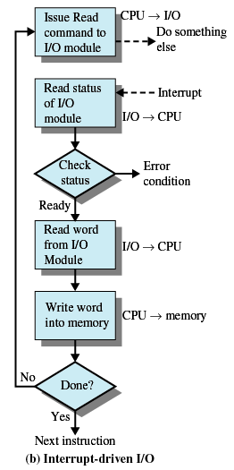
Interrupt-Driven I/O
Processor is interrupted when I/O module ready to exchange data
Processor saves context of program executing and begins executing interrupt-handler
No needless waiting
Consumes a lot of processor time because every word read or written passes through the processor

Slide 51
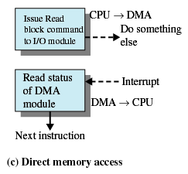
Direct Memory Access
Transfers a block of data directly to or from memory
An interrupt is sent when the transfer is complete
Processor continues with other work

