Slide 1
Threads, SMP, and Microkernels
Chapter 4

Slide 2
Process
Resource ownership - process includes a virtual address space to hold the process image
Scheduling/execution- follows an execution path that may be interleaved with other processes
These two characteristics are treated independently by the operating system

Slide 3
Process
Dispatching is referred to as a thread or lightweight process
Resource of ownership is referred to as a process or task

Slide 4
Multithreading
Operating system supports multiple threads of execution within a single process
MS-DOS supports a single thread
UNIX supports multiple user processes but only supports one thread per process
Windows, Solaris, Linux, Mach, and OS/2 support multiple threads

Slide 5
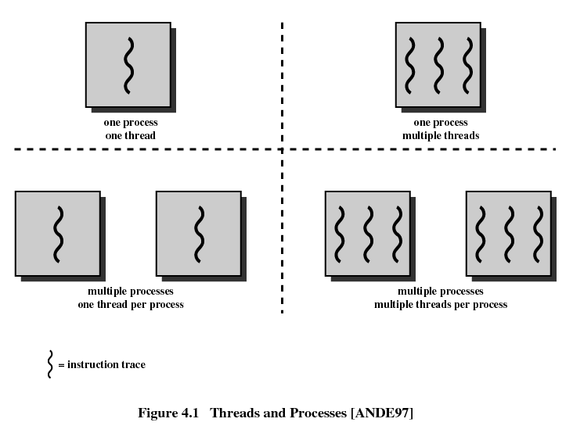

Slide 6
Process
Have a virtual address space which holds the process image
Protected access to processors, other processes, files, and I/O resources

Slide 7
Thread
An execution state (running, ready, etc.)
Saved thread context when not running
Has an execution stack
Some per-thread static storage for local variables
Access to the memory and resources of its process
  all threads of a process share this

Slide 8
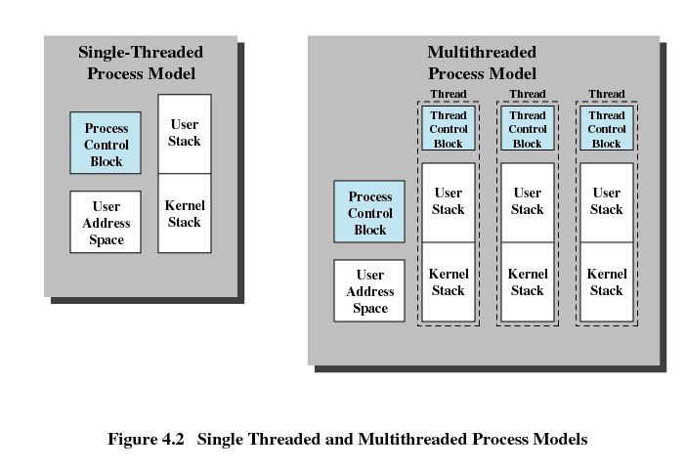

Slide 9
Benefits of Threads
Takes less time to create a new thread than a process
Less time to terminate a thread than a process
Less time to switch between two threads within the same process
Since threads within the same process share memory and files, they can communicate with each other without invoking the kernel

Slide 10
Uses of Threads in a Single-User Multiprocessing System
Foreground to background work
Asynchronous processing
Speed of execution
Modular program structure

Slide 11
Threads
Suspending a process involves suspending all threads of the process since all threads share the same address space
Termination of a process, terminates all threads within the process

Slide 12
Thread States
States associated with a change in thread state
  Spawn
    Spawn another thread
  Block
  Unblock
  Finish
    Deallocate register context and stacks

Slide 13
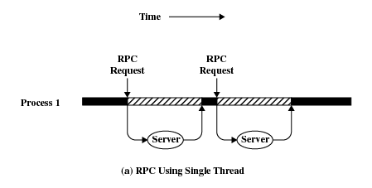
Remote Procedure Call Using Single Thread

Slide 14
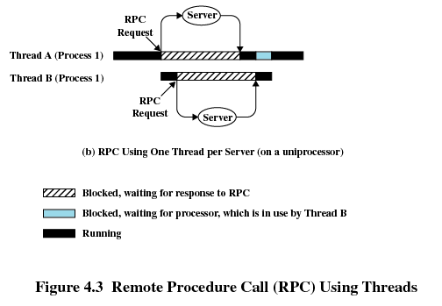
Remote Procedure Call Using Threads

Slide 15
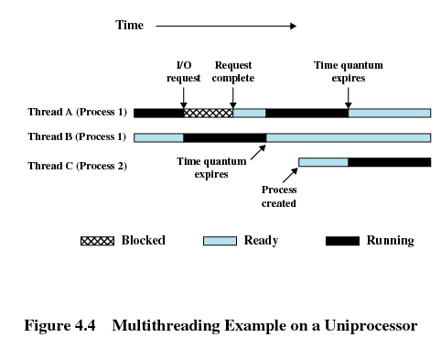
Multithreading

Slide 16
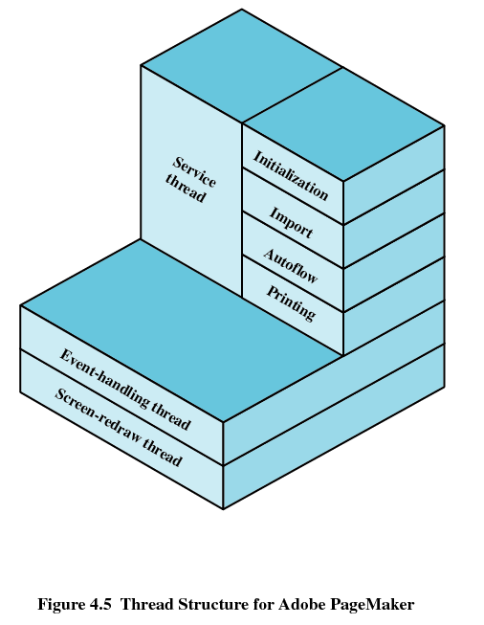
Adobe PageMaker

Slide 17
User-Level Threads
All thread management is done by the application
The kernel is not aware of the existence of threads

Slide 18
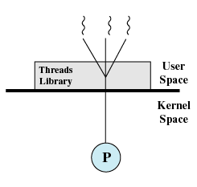
User-Level Threads

Slide 19
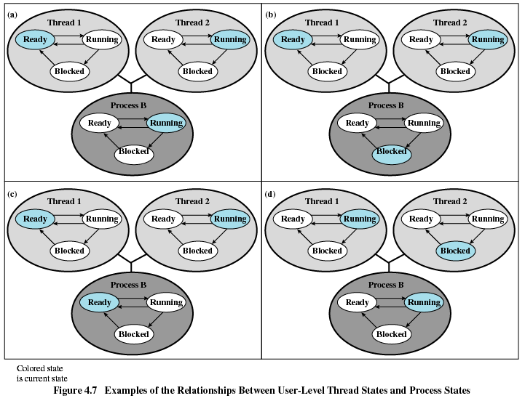

Slide 20
Kernel-Level Threads
Windows is an example of this approach
Kernel maintains context information for the process and the threads
Scheduling is done on a thread basis

Slide 21
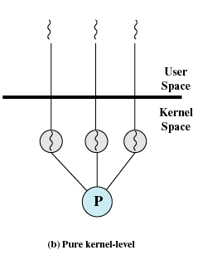
Kernel-Level Threads

Slide 22
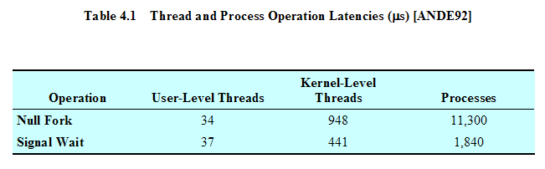
VAX Running UNIX-Like Operating System

Slide 23
Combined Approaches
Example is Solaris
Thread creation done in the user space
Bulk of scheduling and synchronization of threads within application

Slide 24
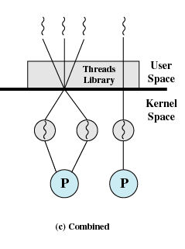
Combined Approaches

Slide 25
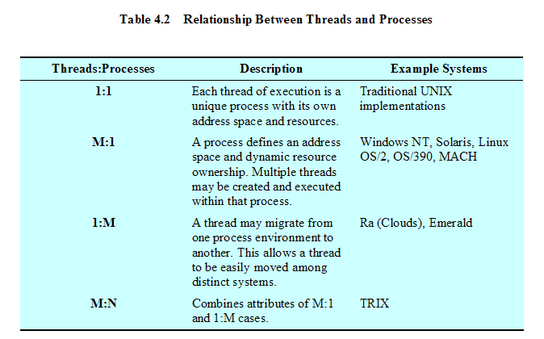
Relationship Between Threads and Processes

Slide 26
Categories of Computer Systems
Single Instruction Single Data (SISD) stream
  Single processor executes a single instruction stream to operate on data stored in a single memory
Single Instruction Multiple Data (SIMD) stream
  Each instruction is executed on a different set of data by the different processors

Slide 27
Categories of Computer Systems
Multiple Instruction Single Data (MISD) stream
  A sequence of data is transmitted to a set of processors, each of which executes a different instruction sequence. Never implemented
Multiple Instruction Multiple Data (MIMD)
  A set of processors simultaneously execute different instruction sequences on different data sets

Slide 28
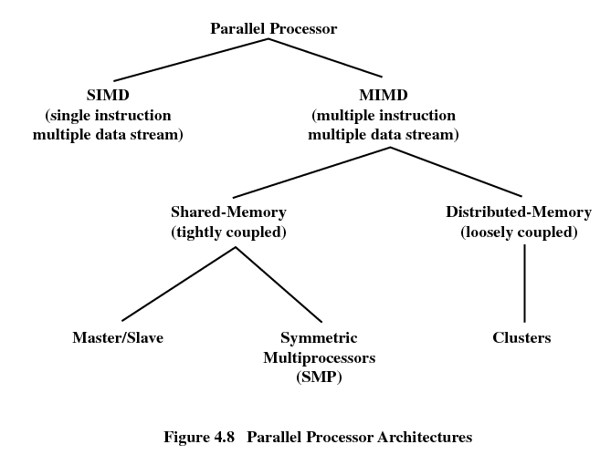

Slide 29
Symmetric Multiprocessing
Kernel can execute on any processor
Typically each processor does self-scheduling form the pool of available process or threads

Slide 30
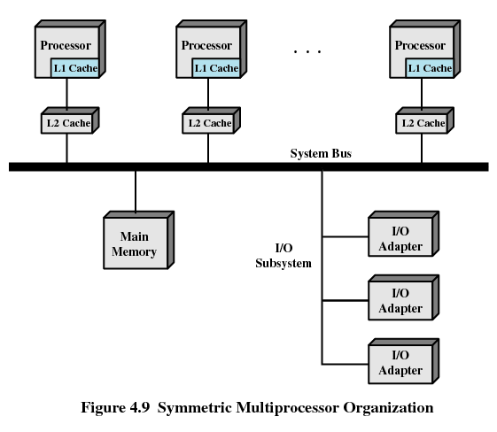

Slide 31
Multiprocessor Operating System Design Considerations
Simultaneous concurrent processes or threads
Scheduling
Synchronization
Memory management
Reliability and fault tolerance

Slide 32
Microkernels
Small operating system core
Contains only essential core operating systems functions
Many services traditionally included in the operating system are now external subsystems
  Device drivers
  File systems
  Virtual memory manager
  Windowing system
  Security services

Slide 33
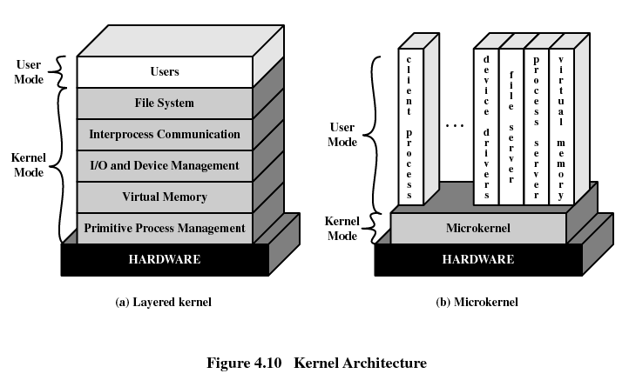

Slide 34
Benefits of a Microkernel Organization
Uniform interface on request made by a process
  Don’t distinguish between kernel-level and user-level services
  All services are provided by means of message passing
Extensibility
  Allows the addition of new services
Flexibility
  New features added
  Existing features can be subtracted

Slide 35
Benefits of a Microkernel Organization
Portability
  Changes needed to port the system to a new processor is changed in the microkernel - not in the other services
Reliability
  Modular design
  Small microkernel can be rigorously tested

Slide 36
Benefits of Microkernel Organization
Distributed system support
  Message are sent without knowing what the target machine is
Object-oriented operating system
  Components are objects with clearly defined interfaces that can be interconnected to form software

Slide 37
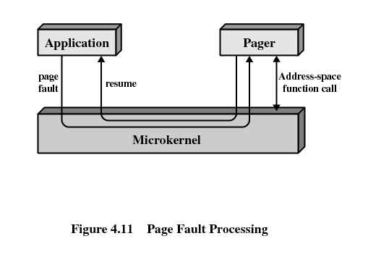
Microkernel Design
Low-level memory management
  Mapping each virtual page to a physical page frame

Slide 38
Microkernel Design
Interprocess communication
I/O and interrupt management

Slide 39
Windows Processes
Implemented as objects
An executable process may contain one or more threads
Both processes and thread objects have built-in synchronization capabilities

Slide 40
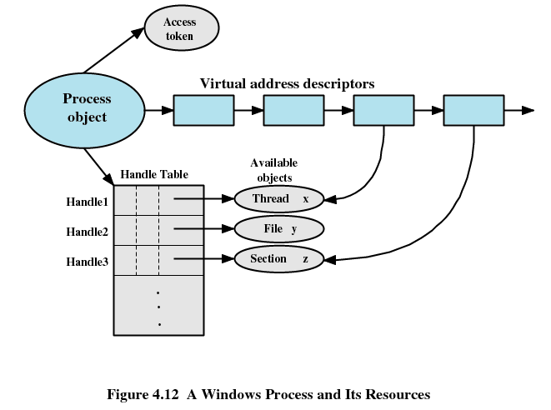

Slide 41
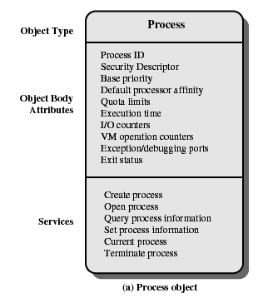
Windows Process Object

Slide 42
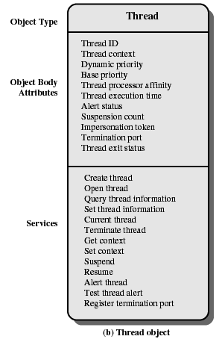
Windows Thread Object

Slide 43
Windows 2000
Thread States
Ready
Standby
Running
Waiting
Transition
Terminated

Slide 44
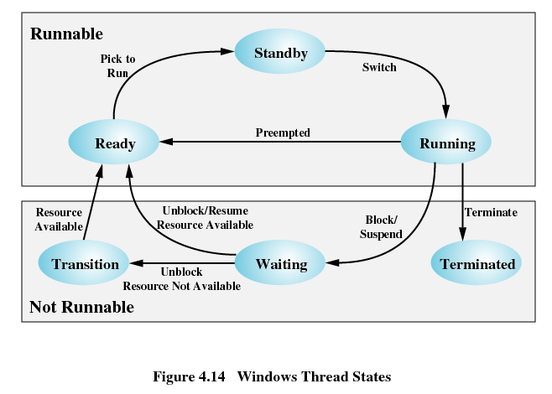

Slide 45
Solaris
Process includes the user’s address space, stack, and process control block
User-level threads
Lightweight processes (LWP)
Kernel threads

Slide 46
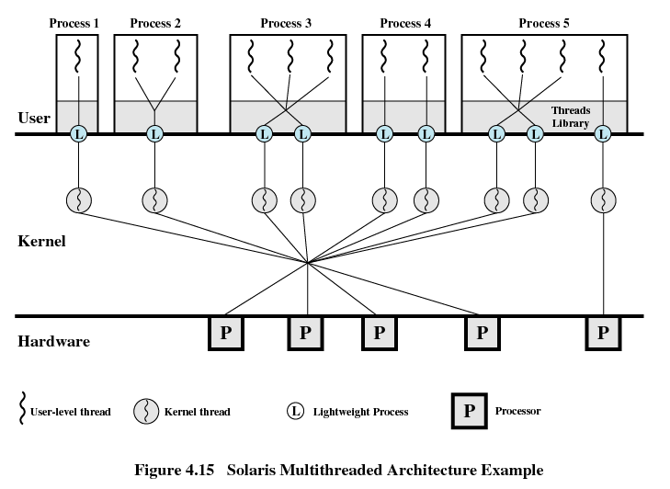

Slide 47
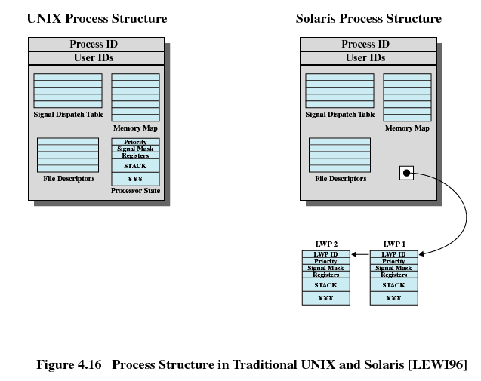

Slide 48
Solaris Lightweight Data Structure
Identifier
Priority
Signal mask
Saved values of user-level registers
Kernel stack
Resource usage and profiling data
Pointer to the corresponding kernel thread
Pointer to the process structure

Slide 49
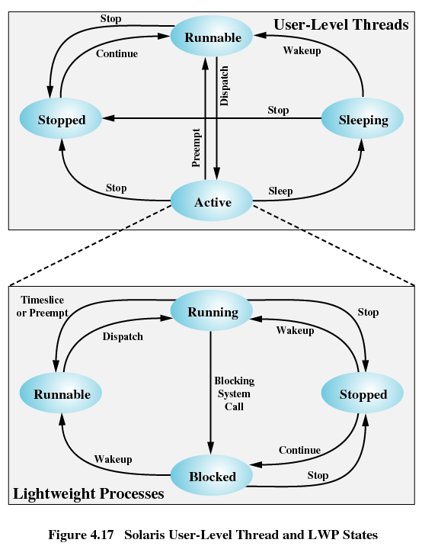

Slide 50
Linux Task Data Structure
State
Scheduling information
Identifiers
Interprocess communication
Links
Times and timers
File system
Address space
Processor-specific context

Slide 51
Linux States of a Process
Running
Interruptable
Uninterruptable
Stopped
Zombie

Slide 52
