Slide 1
Concurrency: Mutual Exclusion and Synchronization
Chapter 5

Slide 2
Concurrency
Multiple applications
Structured applications
Operating system structure

Slide 3
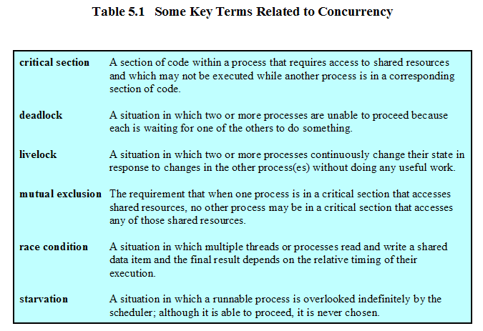
Concurrency

Slide 4
Difficulties of Concurrency
Sharing of global resources
Operating system managing the allocation of resources optimally
Difficult to locate programming errors

Slide 5
Currency
Communication among processes
Sharing resources
Synchronization of multiple processes
Allocation of processor time

Slide 6
Concurrency
Multiple applications
  Multiprogramming
Structured application
  Application can be a set of concurrent processes
Operating-system structure
  Operating system is a set of processes or threads

Slide 7
A Simple Example
void echo()
{
chin = getchar();
chout = chin;
putchar(chout);
}

Slide 8
A Simple Example
Process P1 Process P2
. .
chin = getchar(); .
. chin = getchar();
chout = chin; chout = chin;
putchar(chout); .
. putchar(chout);
. .

Slide 9
Operating System Concerns
Keep track of various processes
Allocate and deallocate resources
  Processor time
  Memory
  Files
  I/O devices
Protect data and resources
Output of process must be independent of the speed of execution of other concurrent processes

Slide 10
Process Interaction
Processes unaware of each other
Processes indirectly aware of each other
Process directly aware of each other

Slide 11
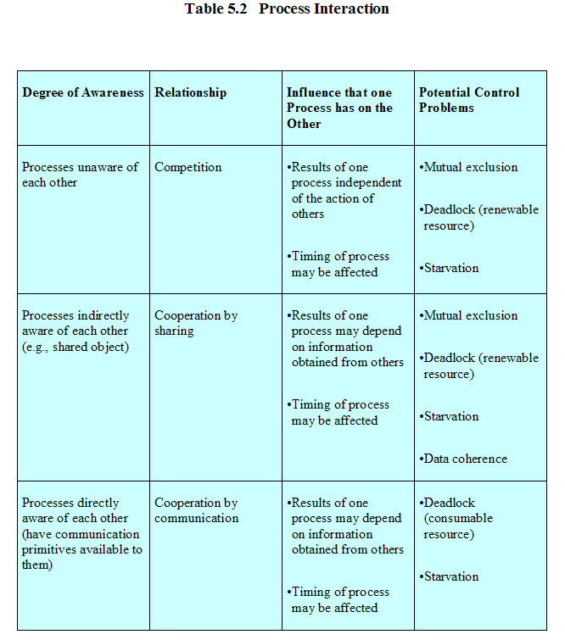

Slide 12
Competition Among Processes for Resources
Mutual Exclusion
  Critical sections
    Only one program at a time is allowed in its critical section
    Example only one process at a time is allowed to send command to the printer
Deadlock
Starvation

Slide 13
Requirements for Mutual Exclusion
Only one process at a time is allowed in the critical section for a resource
A process that halts in its noncritical section must do so without interfering with other processes
No deadlock or starvation

Slide 14
Requirements for Mutual Exclusion
A process must not be delayed access to a critical section when there is no other process using it
No assumptions are made about relative process speeds or number of processes
A process remains inside its critical section for a finite time only

Slide 15
Mutual Exclusion:
Hardware Support
Interrupt Disabling
  A process runs until it invokes an operating system service or until it is interrupted
  Disabling interrupts guarantees mutual exclusion
  Processor is limited in its ability to interleave programs
  Multiprocessing
    disabling interrupts on one processor will not guarantee mutual exclusion

Slide 16
Mutual Exclusion:
Hardware Support
Special Machine Instructions
  Performed in a single instruction cycle
  Access to the memory location is blocked for any other instructions

Slide 17
Mutual Exclusion:
Hardware Support
Test and Set Instruction
boolean testset (int i) {
if (i == 0) {
i = 1;
return true;
}
else {
return false;
}
}

Slide 18
Mutual Exclusion:
Hardware Support
Exchange Instruction
void exchange(int register, int memory) {
int temp;
temp = memory;
memory = register;
register = temp;
}

Slide 19
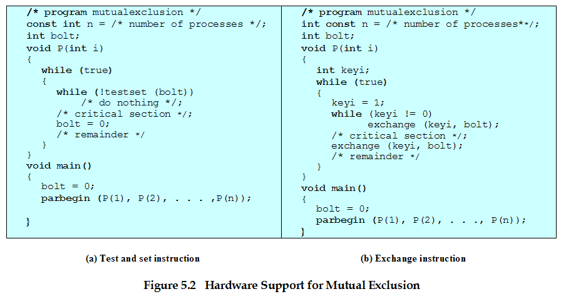
Mutual Exclusion

Slide 20
Mutual Exclusion Machine Instructions
Advantages
  Applicable to any number of processes on either a single processor or multiple processors sharing main memory
  It is simple and therefore easy to verify
  It can be used to support multiple critical sections

Slide 21
Mutual Exclusion Machine Instructions
Disadvantages
  Busy-waiting consumes processor time
  Starvation is possible when a process leaves a critical section and more than one process is waiting.
  Deadlock
    If a low priority process has the critical region and a higher priority process needs, the higher priority process will obtain the processor to wait for the critical region

Slide 22
Semaphores
Special variable called a semaphore is used for signaling
If a process is waiting for a signal, it is suspended until that signal is sent

Slide 23
Semaphores
Semaphore is a variable that has an integer value
  May be initialized to a nonnegative number
  Wait operation decrements the semaphore value
  Signal operation increments semaphore value

Slide 24
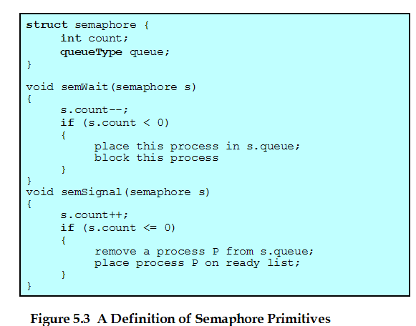
Semaphore Primitives

Slide 25
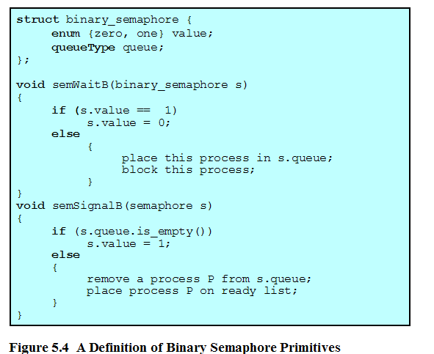
Binary Semaphore Primitives

Slide 26
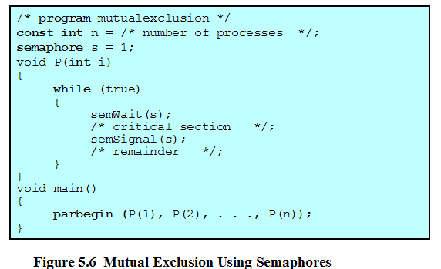
Mutual Exclusion Using Semaphores

Slide 27
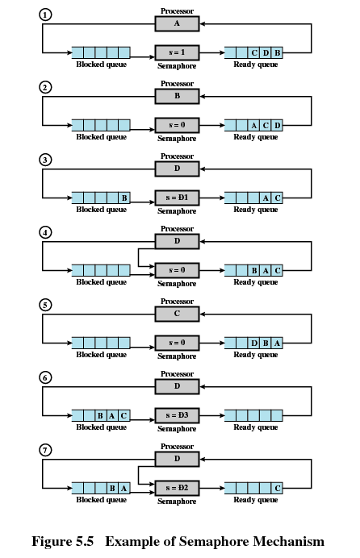

Slide 28
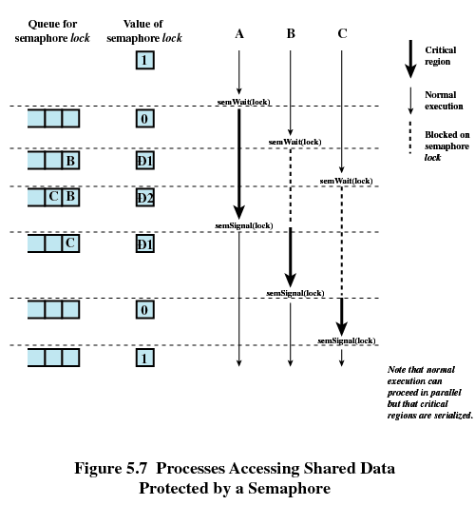

Slide 29
Producer/Consumer Problem
One or more producers are generating data and placing these in a buffer
A single consumer is taking items out of the buffer one at time
Only one producer or consumer may access the buffer at any one time

Slide 30
Producer
producer:
while (true) {
/* produce item v */
b[in] = v;
in++;
}

Slide 31
Consumer
consumer:
while (true) {
while (in <= out)
/*do nothing */;
w = b[out];
out++;
/* consume item w */
}

Slide 32
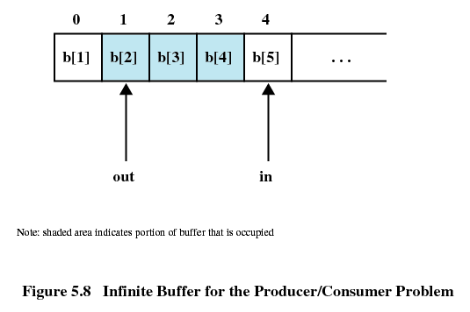
Producer/Consumer Problem

Slide 33
Producer with Circular Buffer
producer:
while (true) {
/* produce item v */
while ((in + 1) % n == out) /* do nothing */;
b[in] = v;
in = (in + 1) % n
}

Slide 34
Consumer with Circular Buffer
consumer:
while (true) {
while (in == out)
/* do nothing */;
w = b[out];
out = (out + 1) % n;
/* consume item w */
}

Slide 35
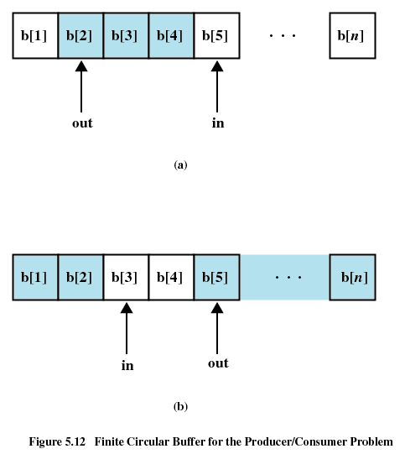

Slide 36
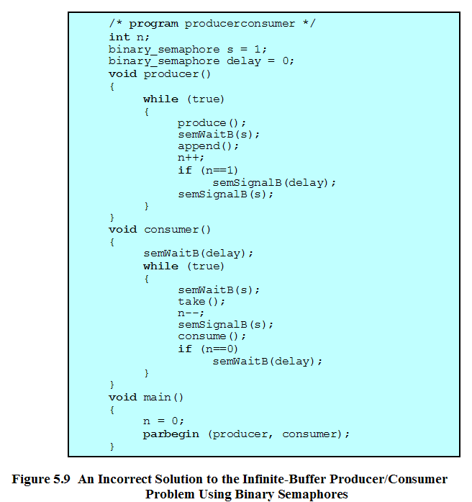

Slide 37
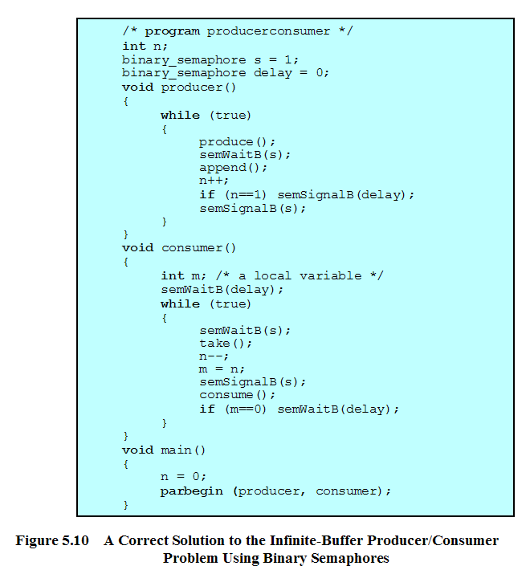

Slide 38
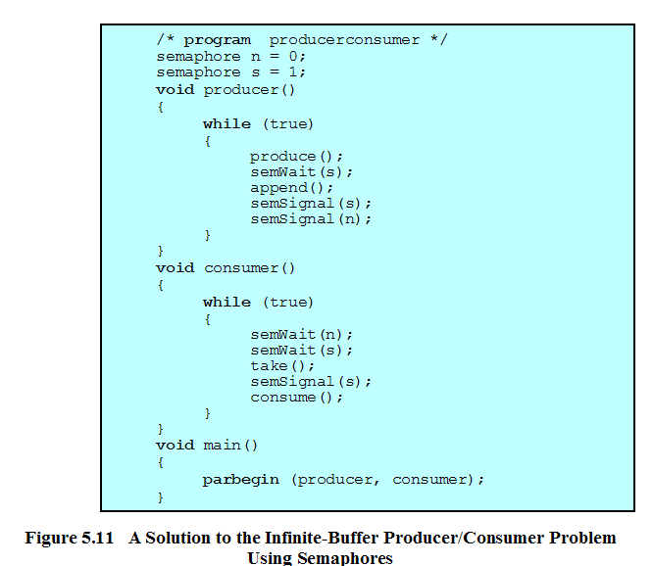

Slide 39
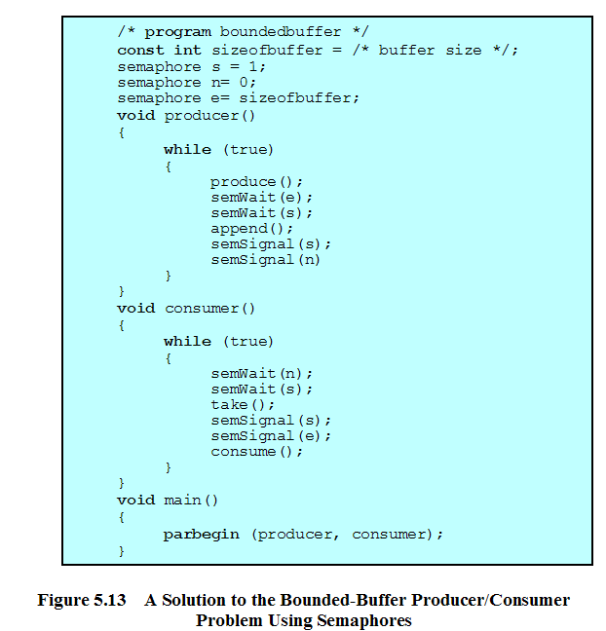

Slide 40
Monitors
Monitor is a software module
Chief characteristics
  Local data variables are accessible only by the monitor
  Process enters monitor by invoking one of its procedures
  Only one process may be executing in the monitor at a time

Slide 41
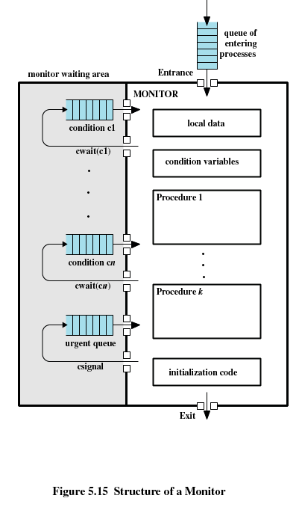

Slide 42
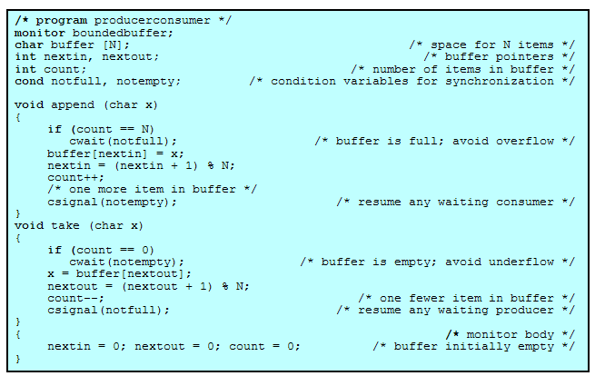

Slide 43
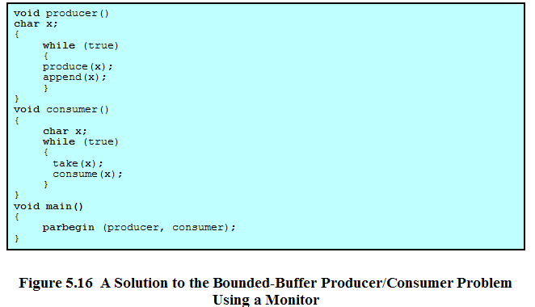

Slide 44
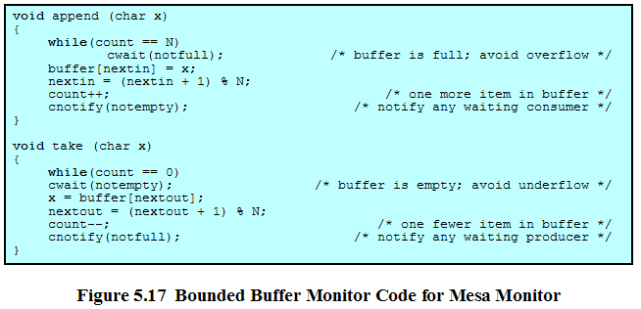

Slide 45
Message Passing
Enforce mutual exclusion
Exchange information
send (destination, message)
receive (source, message)

Slide 46
Synchronization
Sender and receiver may or may not be blocking (waiting for message)
Blocking send, blocking receive
  Both sender and receiver are blocked until message is delivered
  Called a rendezvous

Slide 47
Synchronization
Nonblocking send, blocking receive
  Sender continues on
  Receiver is blocked until the requested message arrives
Nonblocking send, nonblocking receive
  Neither party is required to wait

Slide 48
Addressing
Direct addressing
  Send primitive includes a specific identifier of the destination process
  Receive primitive could know ahead of time which process a message is expected
  Receive primitive could use source parameter to return a value when the receive operation has been performed

Slide 49
Addressing
Indirect addressing
  Messages are sent to a shared data structure consisting of queues
  Queues are called mailboxes
  One process sends a message to the mailbox and the other process picks up the message from the mailbox

Slide 50
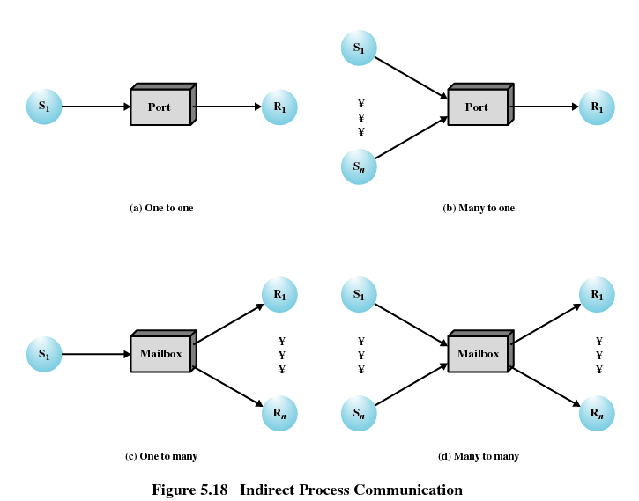

Slide 51
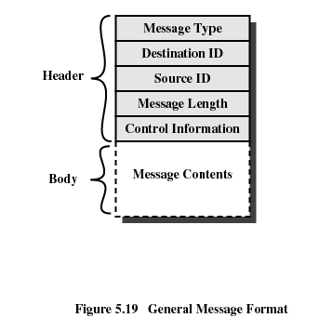
Message Format

Slide 52
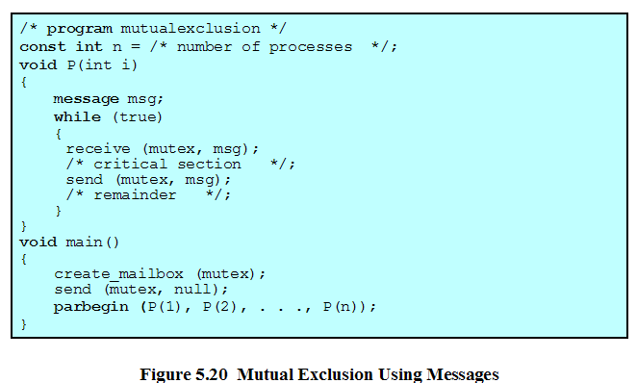

Slide 53
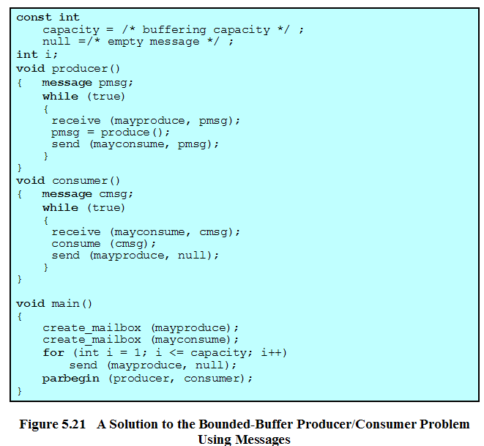

Slide 54
Readers/Writers Problem
Any number of readers may simultaneously read the file
Only one writer at a time may write to the file
If a writer is writing to the file, no reader may read it

Slide 55
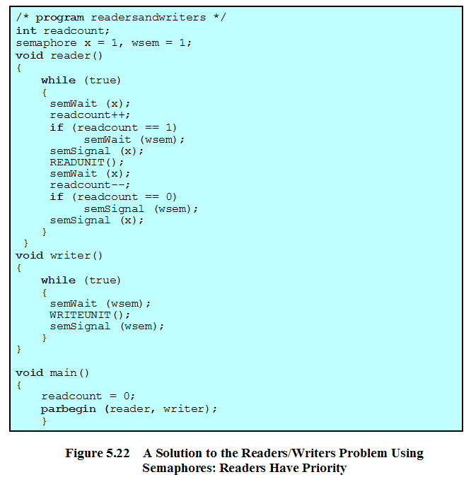

Slide 56
