Slide 1
Concurrency: Deadlock and Starvation
Chapter 6

Slide 2
Deadlock
Permanent blocking of a set of processes that either compete for system resources or communicate with each other
No efficient solution
Involve conflicting needs for resources by two or more processes

Slide 3
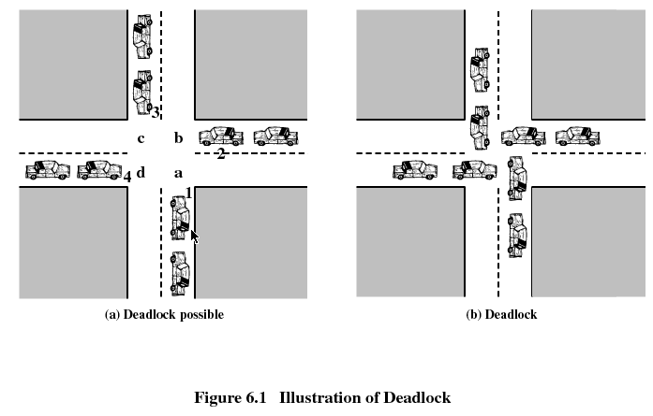

Slide 4
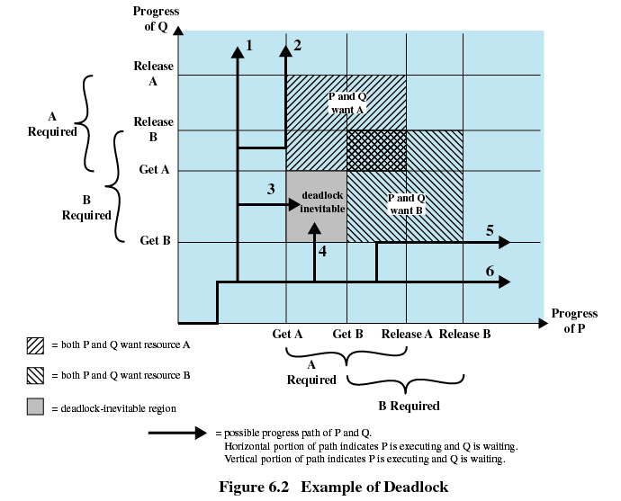

Slide 5
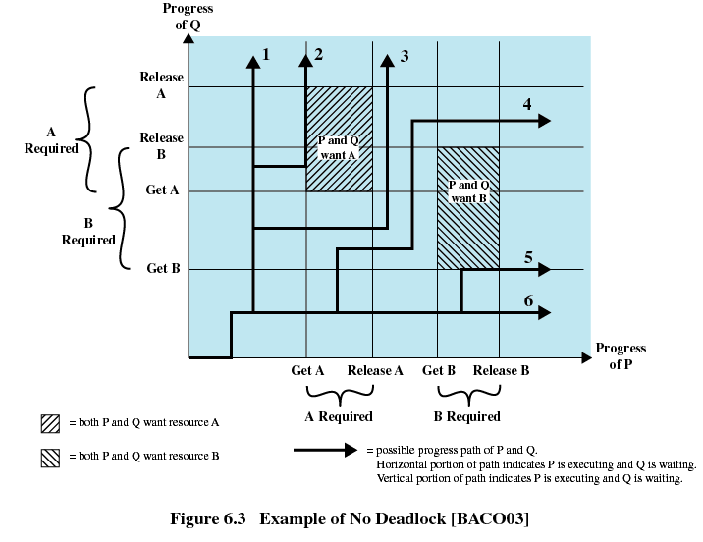

Slide 6
Reusable Resources
Used by only one process at a time and not depleted by that use
Processes obtain resources that they later release for reuse by other processes
Processors, I/O channels, main and secondary memory, devices, and data structures such as files, databases, and semaphores
Deadlock occurs if each process holds one resource and requests the other

Slide 7
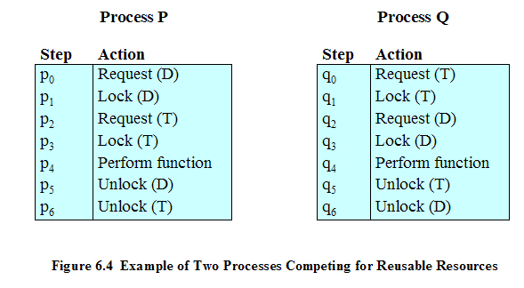
Example of Deadlock

Slide 8
Another Example of Deadlock
Space is available for allocation of 200Kbytes, and the following sequence of events occur
Deadlock occurs if both processes progress to their second request
P1
P2
. . .
. . .
Request 80 Kbytes;
Request 70 Kbytes;
. . .
. . .
Request 60 Kbytes;
Request 80 Kbytes;

Slide 9
Consumable Resources
Created (produced) and destroyed (consumed)
Interrupts, signals, messages, and information in I/O buffers
Deadlock may occur if a Receive message is blocking
May take a rare combination of events to cause deadlock

Slide 10
Example of Deadlock
Deadlock occurs if receive is blocking
P1
P2
. . .
. . .
Receive(P2);
Receive(P1);
. . .
. . .
Send(P2, M1);
Send(P1, M2);

Slide 11
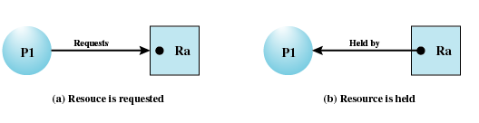
Resource Allocation Graphs
Directed graph that depicts a state of the system of resources and processes

Slide 12
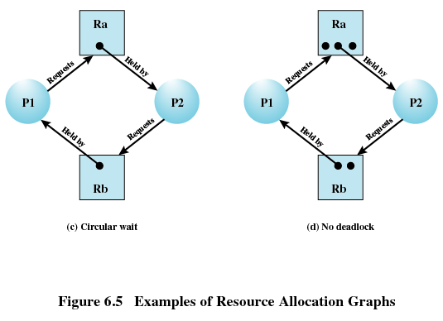
Resource Allocation Graphs

Slide 13
Conditions for Deadlock
Mutual exclusion
  Only one process may use a resource at a time
Hold-and-wait
  A process may hold allocated resources while awaiting assignment of others
No preemption
  No resource can be forcibly removed form a process holding it

Slide 14
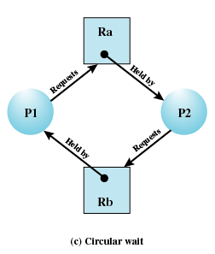
Conditions for Deadlock
Circular wait
  A closed chain of processes exists, such that each process holds at least one resource needed by the next process in the chain

Slide 15
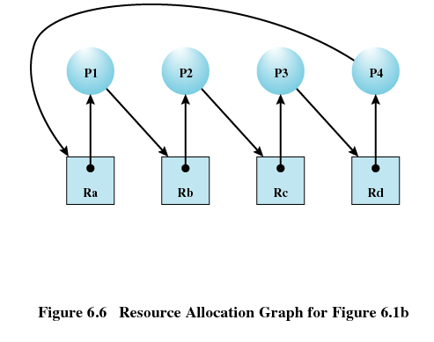

Slide 16
Possibility of Deadlock
Mutual Exclusion
No preemption
Hold and wait

Slide 17
Existence of Deadlock
Mutual Exclusion
No preemption
Hold and wait
Circular wait

Slide 18
Deadlock Prevention
Mutual Exclusion
  Must be supported by the operating system
Hold and Wait
  Require a process request all of its required resources at one time

Slide 19
Deadlock Prevention
No Preemption
  Process must release resource and request again
  Operating system may preempt a process to require it releases its resources
Circular Wait
  Define a linear ordering of resource types

Slide 20
Deadlock Avoidance
A decision is made dynamically whether the current resource allocation request will, if granted, potentially lead to a deadlock
Requires knowledge of future process request

Slide 21
Two Approaches to
Deadlock Avoidance
Do not start a process if its demands might lead to deadlock
Do not grant an incremental resource request to a process if this allocation might lead to deadlock

Slide 22
Resource Allocation Denial
Referred to as the banker’s algorithm
State of the system is the current allocation of resources to process
Safe state is where there is at least one sequence that does not result in deadlock
Unsafe state is a state that is not safe

Slide 23
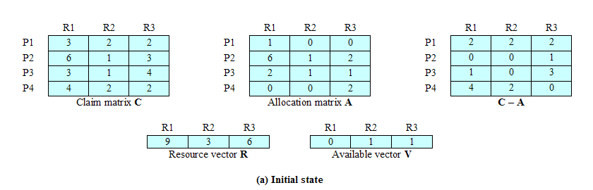
Determination of a Safe State
Initial State

Slide 24
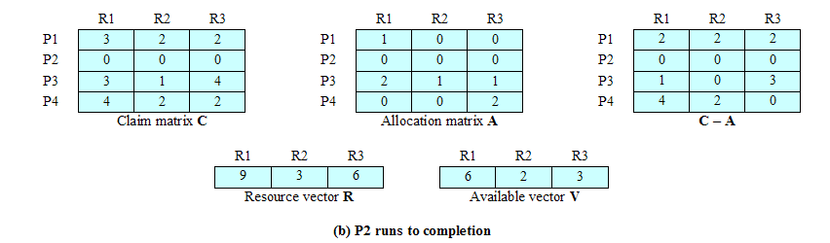
Determination of a Safe State
P2 Runs to Completion

Slide 25
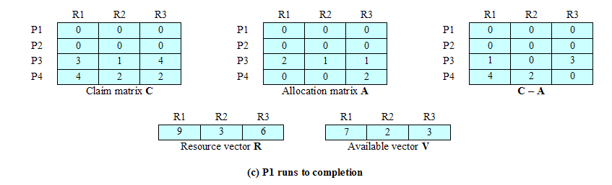
Determination of a Safe State
P1 Runs to Completion

Slide 26
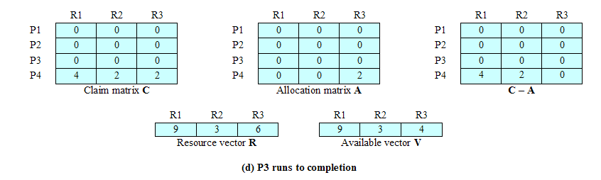
Determination of a Safe State
P3 Runs to Completion

Slide 27
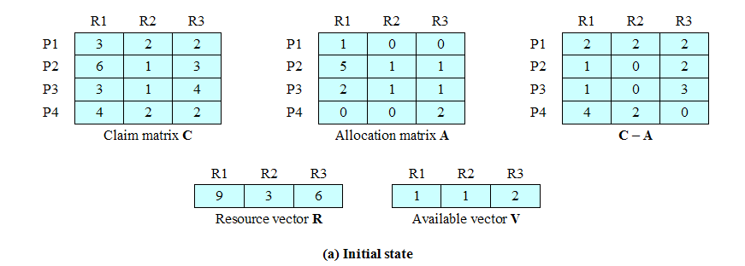
Determination of an
Unsafe State

Slide 28
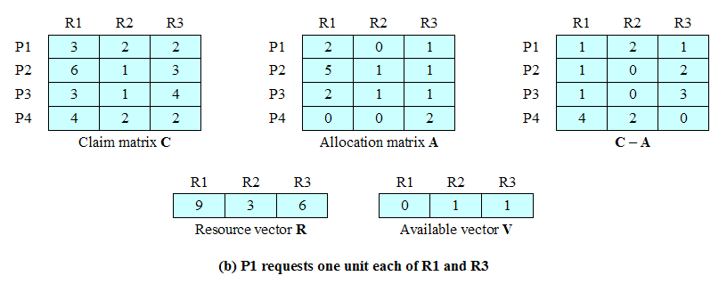
Determination of an
Unsafe State

Slide 29
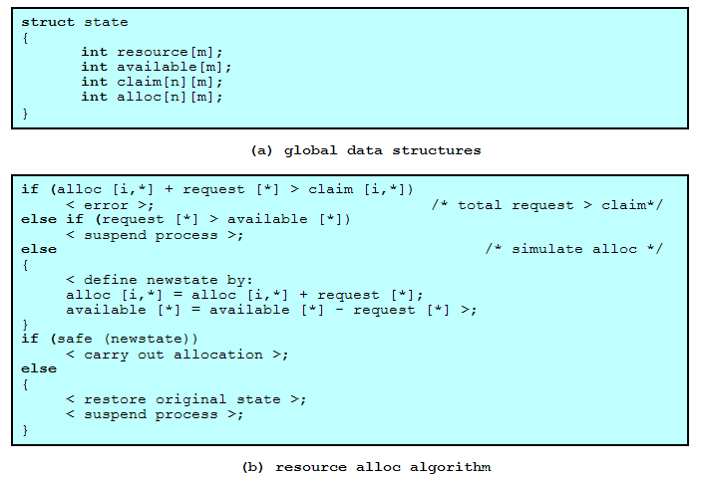
Deadlock Avoidance Logic

Slide 30
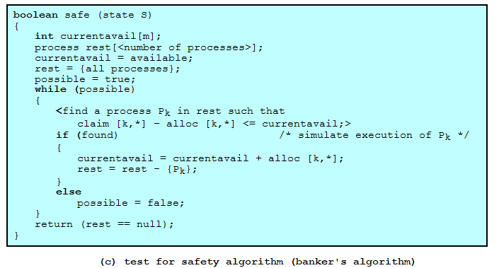
Deadlock Avoidance Logic

Slide 31
Deadlock Avoidance
Maximum resource requirement must be stated in advance
Processes under consideration must be independent; no synchronization requirements
There must be a fixed number of resources to allocate
No process may exit while holding resources

Slide 32
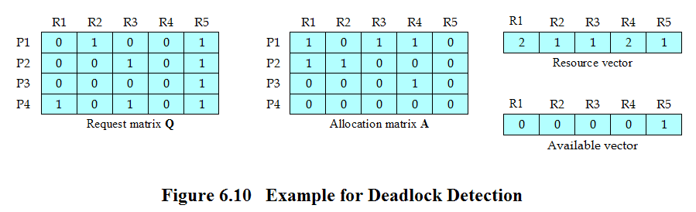
Deadlock Detection

Slide 33
Strategies once Deadlock Detected
Abort all deadlocked processes
Back up each deadlocked process to some previously defined checkpoint, and restart all process
  Original deadlock may occur
Successively abort deadlocked processes until deadlock no longer exists
Successively preempt resources until deadlock no longer exists

Slide 34
Selection Criteria Deadlocked Processes
Least amount of processor time consumed so far
Least number of lines of output produced so far
Most estimated time remaining
Least total resources allocated so far
Lowest priority

Slide 35
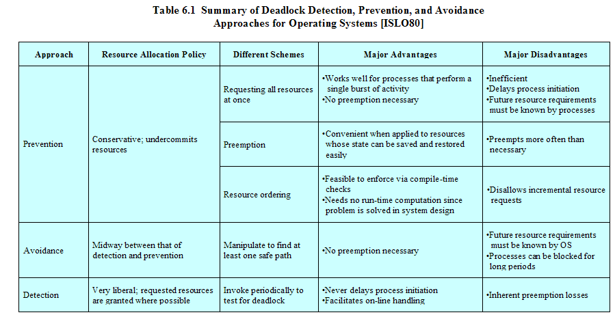
Strengths and Weaknesses of the Strategies

Slide 36
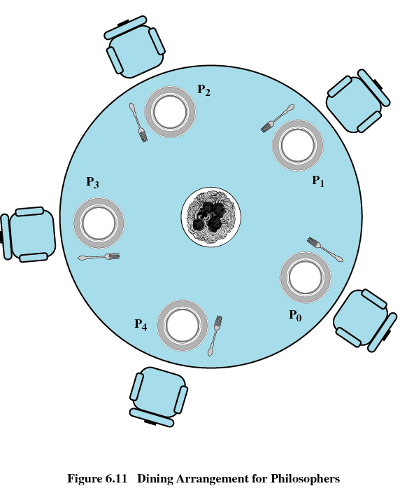
Dining Philosophers Problem

Slide 37
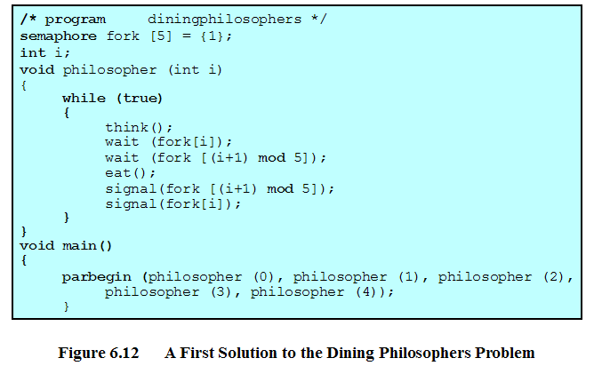
Dining Philosophers Problem

Slide 38
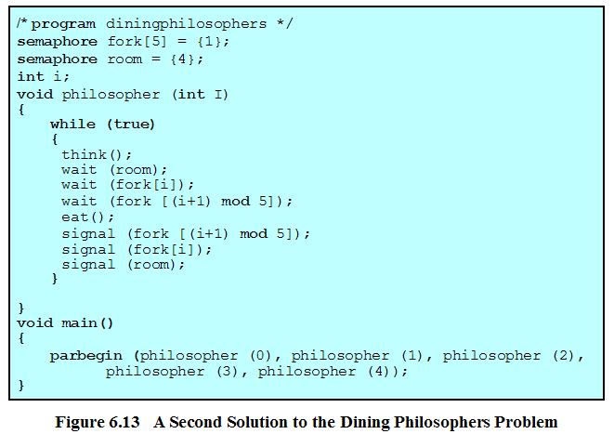
Dining Philosophers Problem

Slide 39
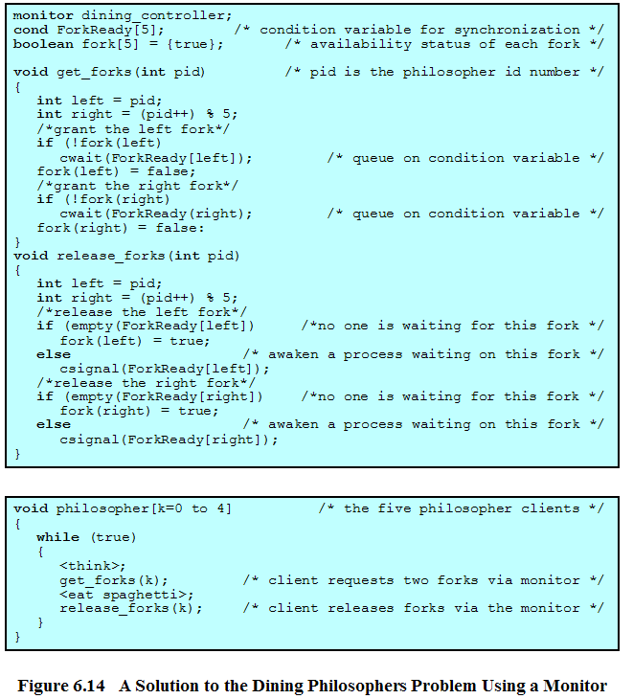
Dining Philosophers Problem

Slide 40
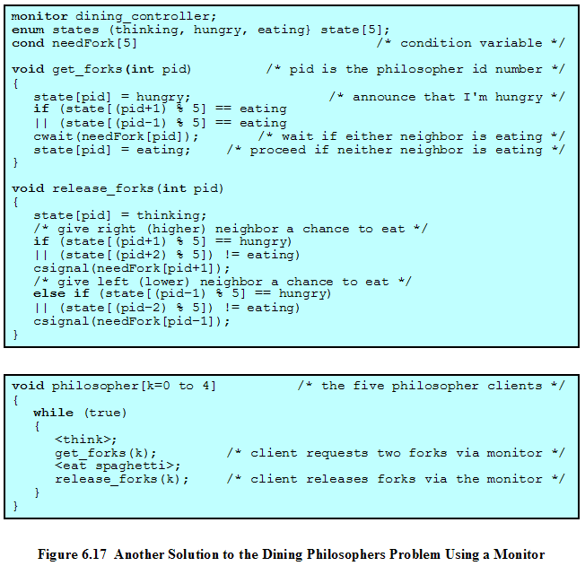
Dining Philosophers Problem

Slide 41
UNIX Concurrency Mechanisms
Pipes
Messages
Shared memory
Semaphores
Signals

Slide 42
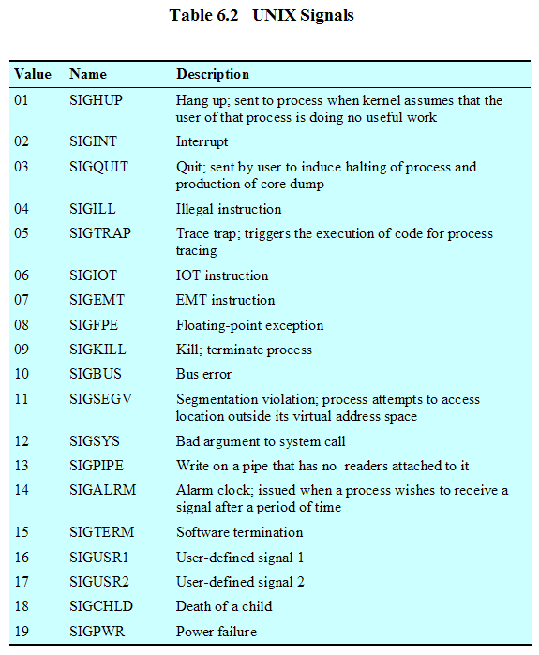

Slide 43
Linux Kernel Concurrency Mechanisms
Includes all the mechanisms found in UNIX
Atomic operations execute without interruption and without interference

Slide 44
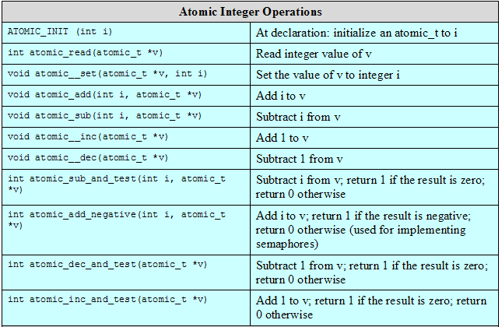
Linux Atomic Operations

Slide 45
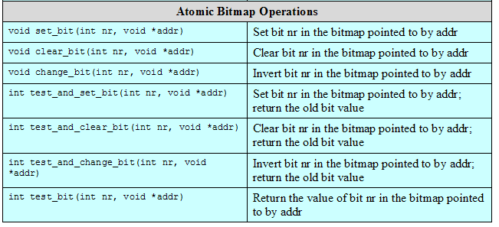
Linux Atomic Operations

Slide 46
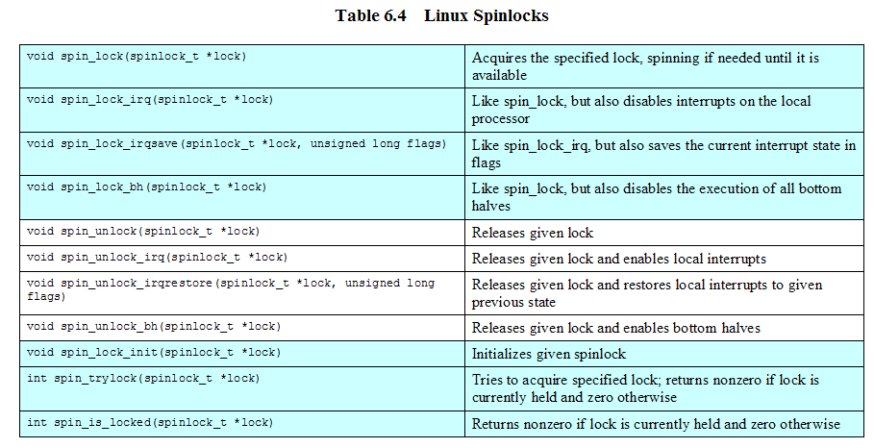
Linux Kernel Concurrency Mechanisms
Spinlocks
  Used for protecting a critical section

Slide 47
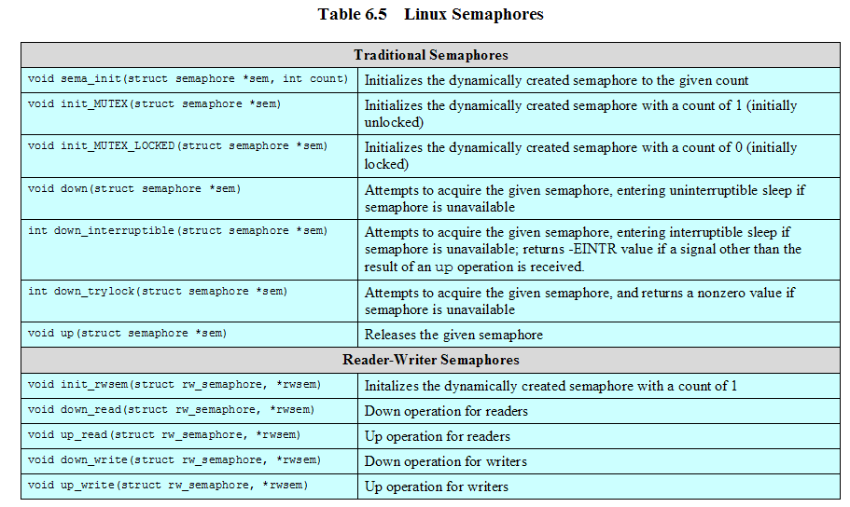

Slide 48
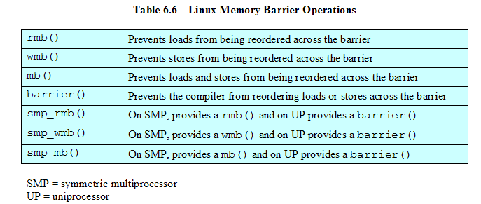
Linux Kernel Concurrency Mechanisms

Slide 49
Solaris Thread Synchronization Primitives
Mutual exclusion (mutex) locks
Semaphores
Multiple readers, single writer (readers/writer) locks
Condition variables

Slide 50
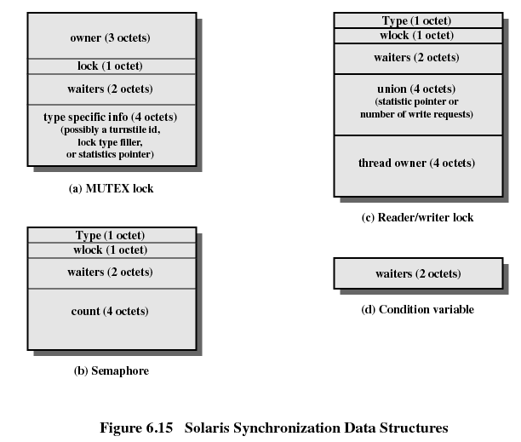

Slide 51
