Slide 1
Multiprocessor and Real-Time Scheduling
Chapter 10

Slide 2
Classifications of Multiprocessor Systems
Loosely coupled or distributed multiprocessor, or cluster
  Each processor has its own memory and I/O channels
Functionally specialized processors
  Such as I/O processor
  Controlled by a master processor
Tightly coupled multiprocessing
  Processors share main memory
  Controlled by operating system

Slide 3
Independent Parallelism
Separate application or job
No synchronization among processes
Example is time-sharing system

Slide 4
Coarse and Very Coarse-Grained Parallelism
Synchronization among processes at a very gross level
Good for concurrent processes running on a multiprogrammed uniprocessor
  Can by supported on a multiprocessor with little change

Slide 5
Medium-Grained Parallelism
Single application is a collection of threads
Threads usually interact frequently

Slide 6
Fine-Grained Parallelism
Highly parallel applications
Specialized and fragmented area

Slide 7
Scheduling
Assignment of processes to processors
Use of multiprogramming on individual processors
Actual dispatching of a process

Slide 8
Assignment of Processes to Processors
Treat processors as a pooled resource and assign process to processors on demand
Permanently assign process to a processor
  Known as group or gang scheduling
  Dedicate short-term queue for each processor
  Less overhead
  Processor could be idle while another processor has a backlog

Slide 9
Assignment of Processes to Processors
Global queue
  Schedule to any available processor
Master/slave architecture
  Key kernel functions always run on a particular processor
  Master is responsible for scheduling
  Slave sends service request to the master
  Disadvantages
    Failure of master brings down whole system
    Master can become a performance bottleneck

Slide 10
Assignment of Processes to Processors
Peer architecture
  Operating system can execute on any processor
  Each processor does self-scheduling
  Complicates the operating system
    Make sure two processors do not choose the same process

Slide 11
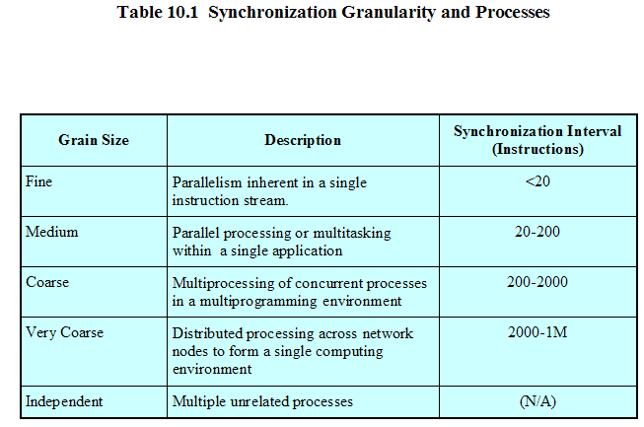

Slide 12
Process Scheduling
Single queue for all processes
Multiple queues are used for priorities
All queues feed to the common pool of processors

Slide 13
Thread Scheduling
Executes separate from the rest of the process
An application can be a set of threads that cooperate and execute concurrently in the same address space
Threads running on separate processors yields a dramatic gain in performance

Slide 14
Multiprocessor Thread Scheduling
Load sharing
  Processes are not assigned to a particular processor
Gang scheduling
  A set of related threads is scheduled to run on a set of processors at the same time

Slide 15
Multiprocessor Thread Scheduling
Dedicated processor assignment
  Threads are assigned to a specific processor
Dynamic scheduling
  Number of threads can be altered during course of execution

Slide 16
Load Sharing
Load is distributed evenly across the processors
No centralized scheduler required
Use global queues

Slide 17
Disadvantages of Load Sharing
Central queue needs mutual exclusion
  May be a bottleneck when more than one processor looks for work at the same time
Preemptive threads are unlikely resume execution on the same processor
  Cache use is less efficient
If all threads are in the global queue, all threads of a program will not gain access to the processors at the same time

Slide 18
Gang Scheduling
Simultaneous scheduling of threads that make up a single process
Useful for applications where performance severely degrades when any part of the application is not running
Threads often need to synchronize with each other

Slide 19
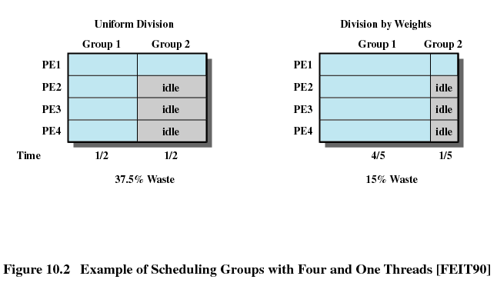
Scheduling Groups

Slide 20
Dedicated Processor Assignment
When application is scheduled, its threads are assigned to a processor
Some processors may be idle
No multiprogramming of processors

Slide 21
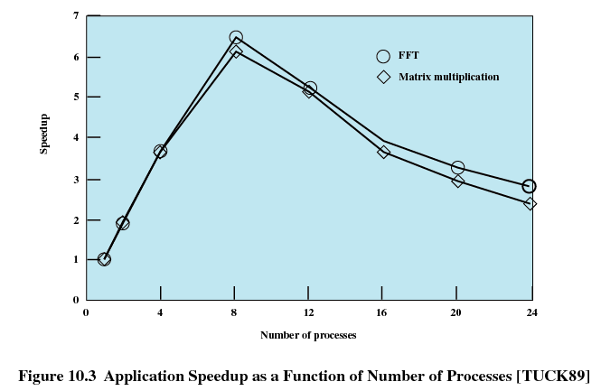

Slide 22
Dynamic Scheduling
Number of threads in a process are altered dynamically by the application
Operating system adjust the load to improve utilization
  Assign idle processors
  New arrivals may be assigned to a processor that is used by a job currently using more than one processor
  Hold request until processor is available
  Assign processor a jog in the list that currently has no processors (i.e., to all waiting new arrivals)

Slide 23
Real-Time Systems
Correctness of the system depends not only on the logical result of the computation but also on the time at which the results are produced
Tasks or processes attempt to control or react to events that take place in the outside world
These events occur in “real time” and tasks must be able to keep up with them

Slide 24
Real-Time Systems
Control of laboratory experiments
Process control in industrial plants
Robotics
Air traffic control
Telecommunications
Military command and control systems

Slide 25
Characteristics of Real-Time Operating Systems
Deterministic
  Operations are performed at fixed, predetermined times or within predetermined time intervals
  Concerned with how long the operating system delays before acknowledging an interrupt and there is sufficient capacity to handle all the requests within the required time

Slide 26
Characteristics of Real-Time Operating Systems
Responsiveness
  How long, after acknowledgment, it takes the operating system to service the interrupt
  Includes amount of time to begin execution of the interrupt
  Includes the amount of time to perform the interrupt
  Effect of interrupt nesting

Slide 27
Characteristics of Real-Time Operating Systems
User control
  User specifies priority
  Specify paging
  What processes must always reside in main memory
  Disks algorithms to use
  Rights of processes

Slide 28
Characteristics of Real-Time Operating Systems
Reliability
  Degradation of performance may have catastrophic consequences
Fail-soft operation
  Ability of a system to fail in such a way as to preserve as much capability and data as possible
  Stability

Slide 29
Features of Real-Time Operating Systems
Fast process or thread switch
Small size
Ability to respond to external interrupts quickly
Multitasking with interprocess communication tools such as semaphores, signals, and events

Slide 30
Features of Real-Time Operating Systems
Use of special sequential files that can accumulate data at a fast rate
Preemptive scheduling base on priority
Minimization of intervals during which interrupts are disabled
Delay tasks for fixed amount of time
Special alarms and timeouts

Slide 31
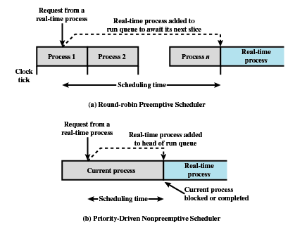
Scheduling of a
Real-Time Process

Slide 32
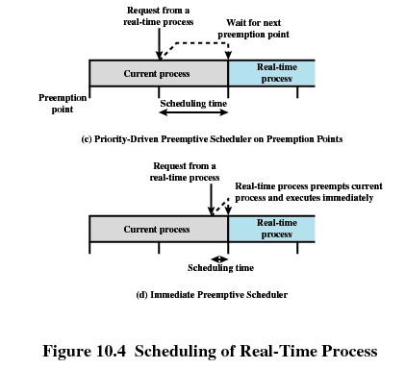
Scheduling of a
Real-Time Process

Slide 33
Real-Time Scheduling
Static table-driven
  Determines at run time when a task begins execution
Static priority-driven preemptive
  Traditional priority-driven scheduler is used
Dynamic planning-based
  Feasibility determined at run time
Dynamic best effort
  No feasibility analysis is performed

Slide 34
Deadline Scheduling
Real-time applications are not concerned with speed but with completing tasks

Slide 35
Deadline Scheduling
Information used
  Ready time
  Starting deadline
  Completion deadline
  Processing time
  Resource requirements
  Priority
  Subtask scheduler

Slide 36
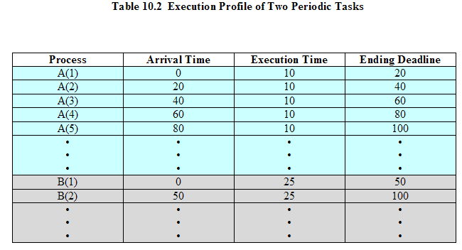
Two Tasks

Slide 37
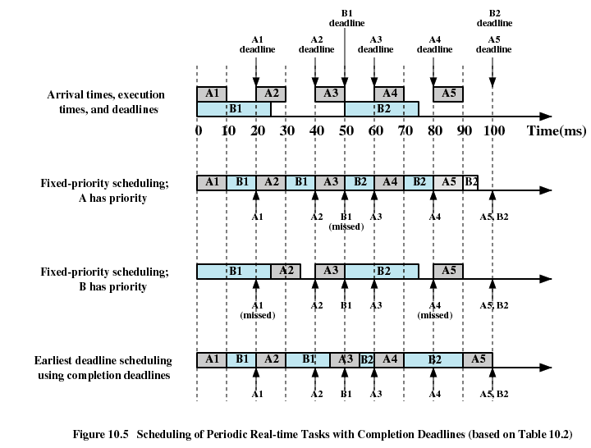

Slide 38
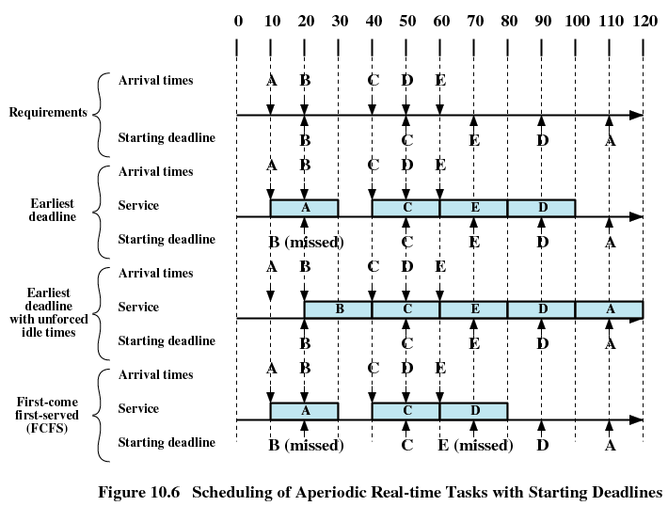

Slide 39
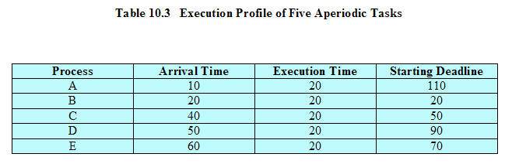

Slide 40
Rate Monotonic Scheduling
Assigns priorities to tasks on the basis of their periods
Highest-priority task is the one with the shortest period

Slide 41
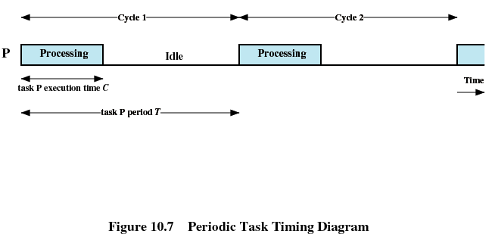
Periodic Task Timing Diagram

Slide 42
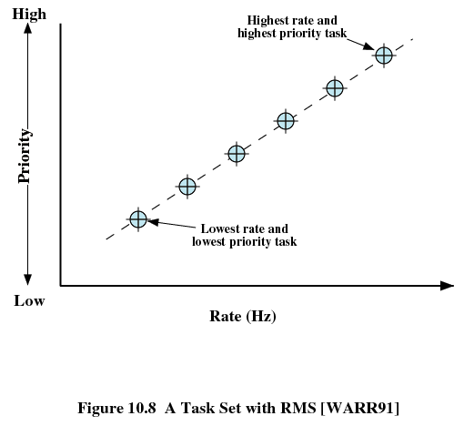

Slide 43
Priority Inversion
Can occur in any priority-based preemptive scheduling scheme
Occurs when circumstances within the system force a higher priority task to wait for a lower priority task

Slide 44
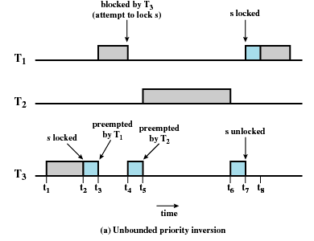
Unbounded Priority Inversion
Duration of a priority inversion depends on unpredictable actions of other unrelated tasks

Slide 45
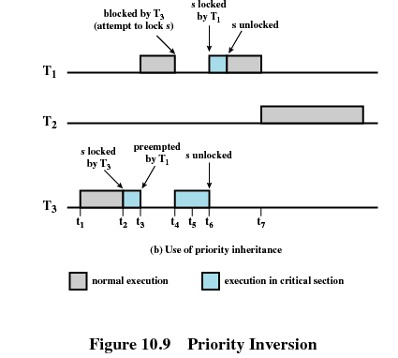
Priority Inheritance
Lower-priority task inherits the priority of any higher priority task pending on a resource they share

Slide 46
Linux Scheduling
Scheduling classes
  SCHED_FIFO: First-in-first-out real-time threads
  SCHED_RR: Round-robin real-time threads
  SCHED_OTHER: Other, non-real-time threads
Within each class multiple priorities may be used

Slide 47
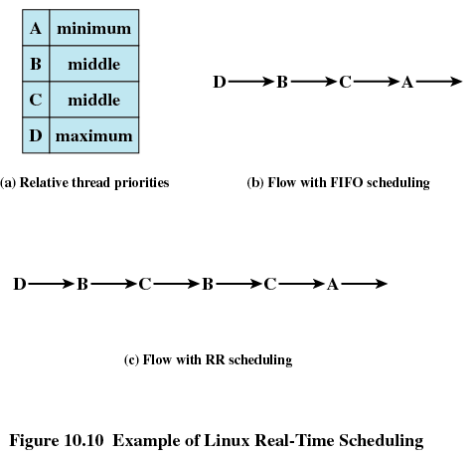

Slide 48
Non-Real-Time Scheduling
Linux 2.6 uses a new scheduler the O(1) scheduler
Time to select the appropriate process and assign it to a processor is constant
  Regardless of the load on the system or number of processors

Slide 49
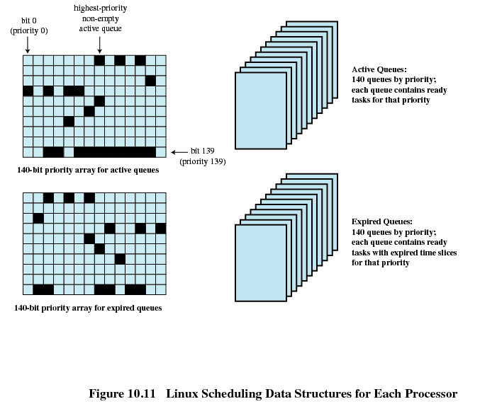

Slide 50
UNIX SVR4 Scheduling
Highest preference to real-time processes
Next-highest to kernel-mode processes
Lowest preference to other user-mode processes

Slide 51
UNIX SVR4 Scheduling
Preemptable static priority scheduler
Introduction of a set of 160 priority levels divided into three priority classes
Insertion of preemption points

Slide 52
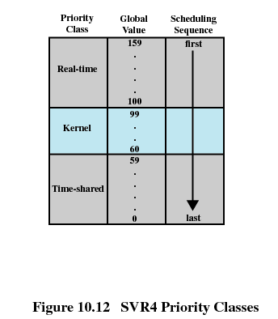
SVR4 Priority Classes

Slide 53
SVR4 Priority Classes
Real time (159 – 100)
  Guaranteed to be selected to run before any kernel or time-sharing process
  Can preempt kernel and user processes
Kernel (99 – 60)
  Guaranteed to be selected to run before any time-sharing process
Time-shared (59-0)
  Lowest-priority

Slide 54
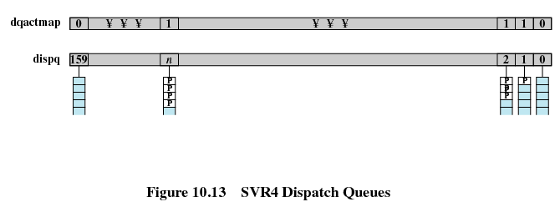
SVR4 Dispatch Queues

Slide 55
Windows Scheduling
Priorities organized into two bands or classes
  Real time
  Variable
Priority-driven preemptive scheduler

Slide 56
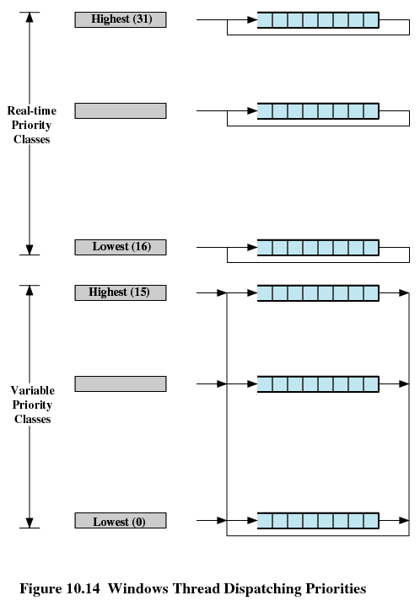

Slide 57
