Slide 1
Distributed Processing, Client/Server, and Clusters
Chapter 13

Slide 2
Client/Server Computing
Client machines are generally single-user PCs or workstations that provide a highly user-friendly interface to the end user
Each server provides a set of shared services to the clients
The server enables many clients to share access to the same database and enables the use of a high-performance computer system to manage the database

Slide 3
Client/Server Terminology
Applications Programming Interface (API)
  A set of function and call programs that allow clients and servers to intercommunicate
Client
  A networked information requester, usually a PC or workstation, that can query database and/or other information from a server
Middleware
  A set of drivers, APIs, or other software that improves connectivity between a client application and a server
Relational Database
  A database in which information access is limited to the selection of rows that satisfy all search criteria
Server
  A computer, usually a high-powered workstation, a minicomputer, or a mainframe, that houses information for manipulation by networked clients
Structured Query Language (SQL)
  A language developed by IBM and standardized by ANSI for addressing, creating, updating, or querying relational databases

Slide 4
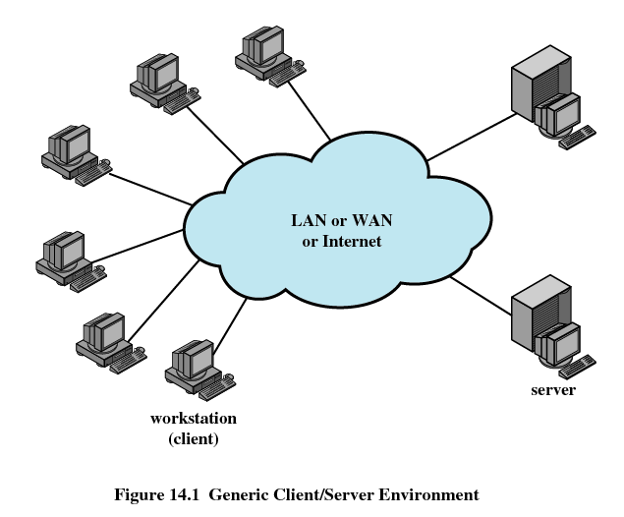

Slide 5
Client/Server Applications
Basic software is an operating system running on the hardware platform
Platforms and the operating systems of client and server may differ
These lower-level differences are irrelevant as long as a client and server share the same communications protocols and support the same applications

Slide 6
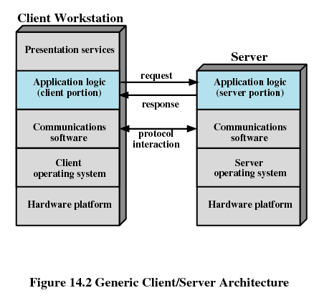

Slide 7
Client/Server Applications
Bulk of applications software executes on the server
Application logic is located at the client
Presentation services in the client

Slide 8
Database Applications
The server is a database server
Interaction between client and server is in the form of transactions
  the client makes a database request and receives a database response
Server is responsible for maintaining the database

Slide 9
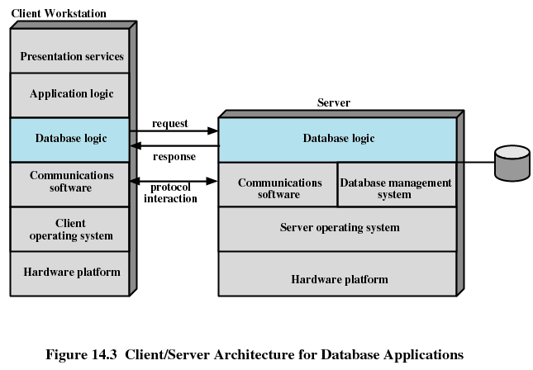

Slide 10
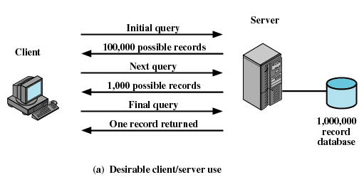
Client/Server Database Usage

Slide 11
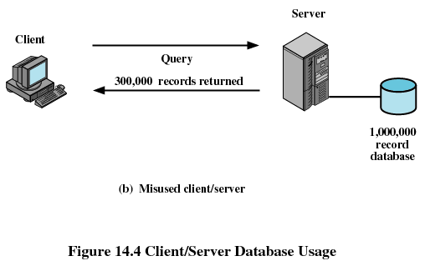
Client/Server Database Usage

Slide 12
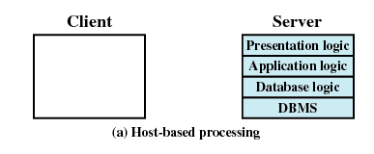
Classes of Client/Server Applications
Host-based processing
  Not true client/server computing
  Traditional mainframe environment

Slide 13
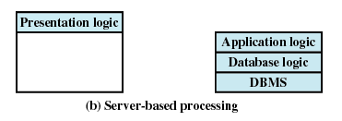
Classes of Client/Server Applications
Server-based processing
  Server does all the processing
  Client provides a graphical user interface

Slide 14
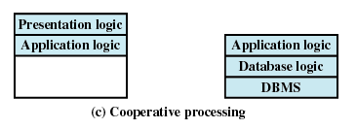
Classes of Client/Server Applications
Client-based processing
  All application processing done at the client
  Data validation routines and other database logic functions are done at the server

Slide 15
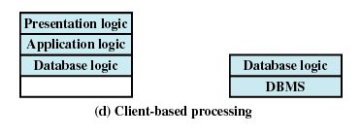
Classes of Client/Server Applications
Cooperative processing
  Application processing is performed in an optimized fashion
  Complex to set up and maintain

Slide 16
Three-Tier Client/Server Architecture
Application software distributed among three types of machines
  User machine
    Thin client
  Middle-tier server
    Gateway
    Convert protocols
    Merge/integrate results from different data sources
  Backend server

Slide 17
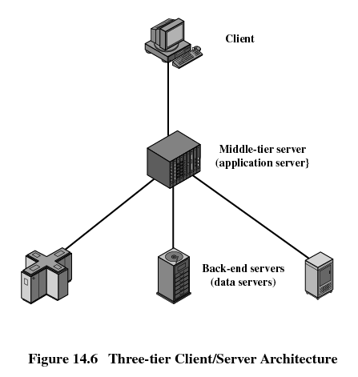

Slide 18
File Cache Consistency
File caches hold recently accessed file records
Caches are consistent when they contain exact copies for remote data
File-locking prevents simultaneous access to a file

Slide 19
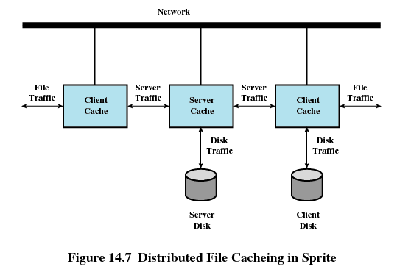

Slide 20
Middleware
Set of tools that provide a uniform means and style of access to system resources across all platforms
Enable programmers to build applications that look and feel the same
Enable programmers to use the same method to access data

Slide 21
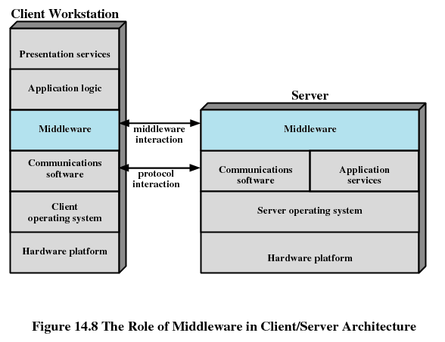

Slide 22
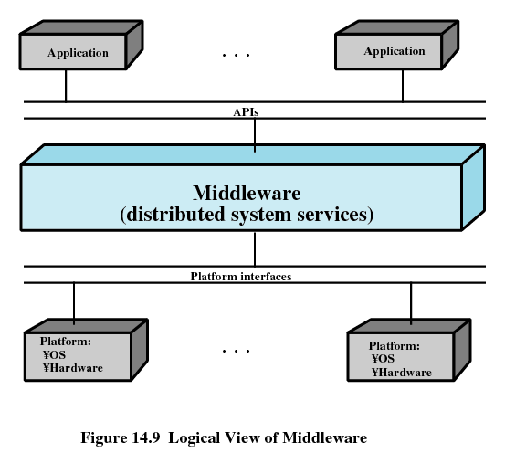

Slide 23
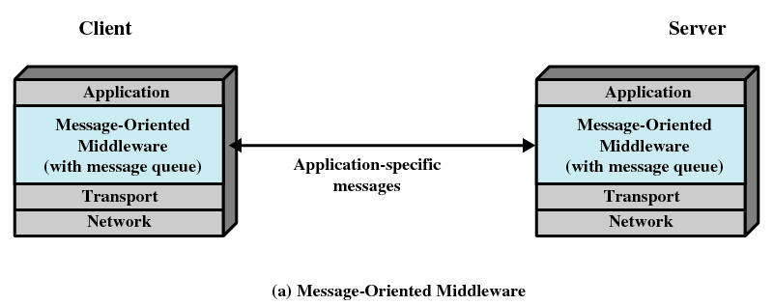
Middleware Mechanisms

Slide 24
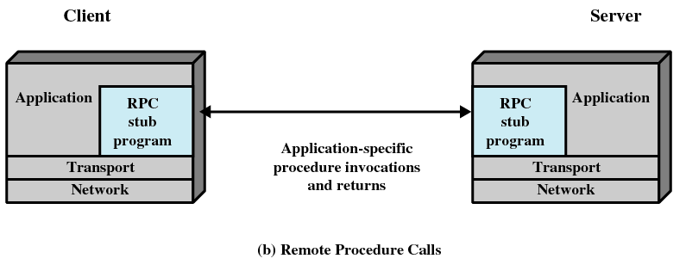
Middleware Mechanisms

Slide 25
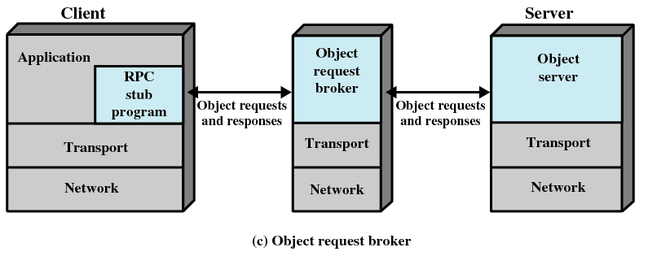
Middleware Mechanisms

Slide 26
Distributed Message Passing
Message passed used to communicate among processes
Send and receive messages as used in a single system OR
Remote procedure calls

Slide 27
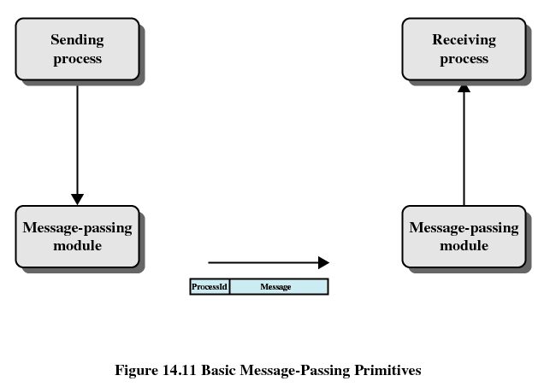
Basic Message-Passing Primitives

Slide 28
Reliability Versus Unreliability
Reliable message-passing guarantees delivery if possible
  Not necessary to let the sending process know that the message was delivered
Send the message out into the communication network without reporting success or failure
  Reduces complexity and overhead

Slide 29
Blocking Versus Nonblocking
Nonblocking
  Process is not suspended as a result of issuing a Send or Receive
  Efficient and flexible
  Difficult to debug
Blocking
  Send does not return control to the sending process until the message has been transmitted
  OR does not return control until an acknowledgment is received
  Receive does not return until a message has been placed in the allocated buffer

Slide 30
Remote Procedure Calls
Allow programs on different machines to interact using simple procedure call/return semantics
Widely accepted
Standardized
  Client and server modules can be moved among computers and operating systems easily

Slide 31
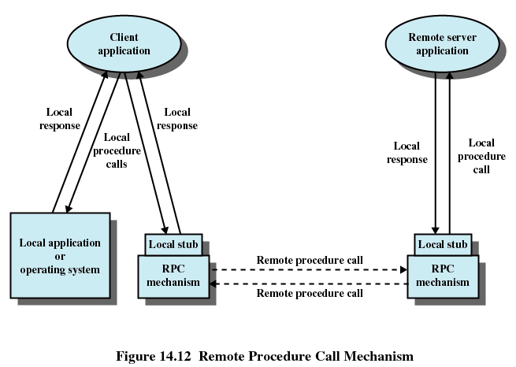

Slide 32
Client/Server Binding
Binding specifies the relationship between remote procedure and calling program
Nonpersistent binding
  Logical connection established during remote procedure call
Persistent binding
  Connection is sustained after the procedure returns

Slide 33
Synchronous versus Asynchronous
Synchronous RPC
  Behaves much like a subroutine call
Asynchronous RPC
  Does not block the caller
  Enable a client execution to proceed locally in parallel with server invocation

Slide 34
Object-Oriented Mechanisms
Clients and servers ship messages back and forth between objects
A client sends a request to an object broker
The broker calls the appropriate object and passes along any relevant data
Microsoft’s Component Object Model (COM)
Common Object Request Broker Architecture (CORBA)

Slide 35
Clusters
Alternative to symmetric multiprocessing (SMP)
Group of interconnected, whole computers working together as a unified computing resource
  Illusion is one machine
  System can run on its own

Slide 36
Clustering Method | Description | Benefits | Limitations
Passive Standby | A secondary server takes over in case of primary server failure. | Easy to implement. | High cost because the secondary server is unavailable for other processing tasks.
Active Secondary | The secondary server is also used for processing tasks. | Reduced cost because secondary servers can be used for processing. | Increased complexity.
Separate Servers | Separate servers have their own disks. Data is continuously copied from primary to secondary server. | High availability. | High network and server overhead due to copying operations.
Servers Connected to Disks | Servers are cabled to the same disks, but each server owns its disks. If one server fails, its disks are taken over by the other server. | Reduced network and server overhead due to elimination of copying operations. | Usually requires disk mirroring or RAID technology to compensate for risk of disk failure.
Servers Share Disks | Multiple servers simultaneously share access to disks. | Low network and server overhead. Reduced risk of downtime caused by disk failure. | Requires lock manager software. Usually used with disk mirroring or RAID technology.

Slide 37
Clusters
Separate server
  Each computer is a separate server
  No shared disks
  Need management or scheduling software
  Data must be constantly copied among systems so each is current

Slide 38
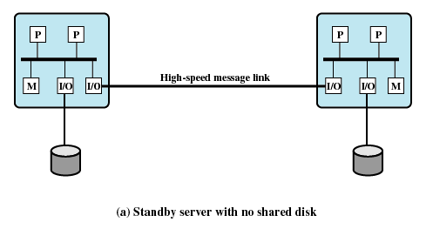
Cluster Configurations

Slide 39
Clusters
Shared nothing
  Reduces communication overhead
  Disks partitioned into volumes
  Each volume owned by a computer
  If computer fails another computer gets ownership of the volume

Slide 40
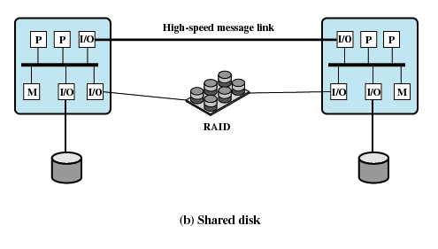
Cluster Configurations

Slide 41
Clusters
Shared disk
  Multiple computers share the same disks at the same time
  Each computer has access to all of the volumes on all of the disks

Slide 42
Operating System Design Issues
Failure management
  Highly available cluster offers a high probability that al resources will be in service
    No guarantee about the state of partially executed transactions if failure occurs
  Fault-tolerant cluster ensures that all resources are always available

Slide 43
Operating System Design Issues
Load balancing
  When new computer added to the cluster, the load-balancing facility should automatically include this computer in scheduling applications
Parallelizing Computation
  Parallelizing compiler
  Parallelized application
  Parametric computing

Slide 44
Cluster Computer Architecture
Cluster middleware services and functions
  Single entry point
  Single file hierarchy
  Single control point
  Single virtual networking
  Single memory space
  Single job-management system

Slide 45
Cluster Computer Architecture
Cluster middleware services and functions
  Single user interface
  Single I/O space
  Single process space
  Checkpointing
  Process migration

Slide 46
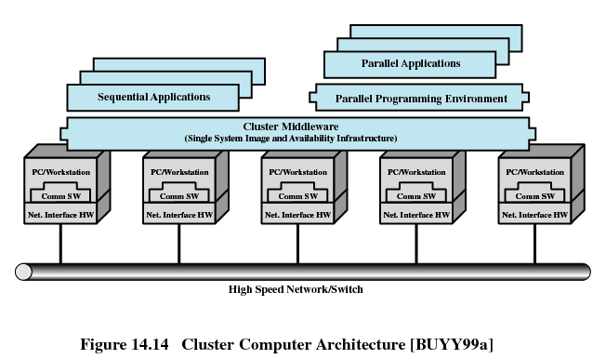
Cluster Computer Architecture

Slide 47
Clusters Compared to SMP
SMP is easier to manage and configure
SMP takes up less space and draws less power
SMP products are well established and stable
Clusters are better for incremental and absolute scalability
Clusters are superior in terms of availability

Slide 48
Windows Cluster Service
Cluster Service
  Collection of software on each node that manages all cluster-specific activity
Resource
  Item managed by the cluster service
Online
  Online at node when it is providing service on that specific node
Group
  Collection of resources managed as a single unit

Slide 49
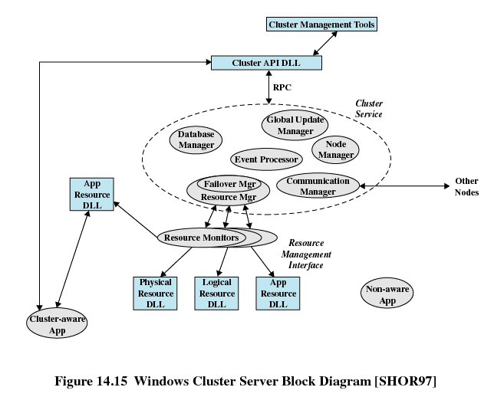

Slide 50
Sun Cluster
Major components
  Object and communication support
  Process management
  Networking
  Global distributed file system

Slide 51
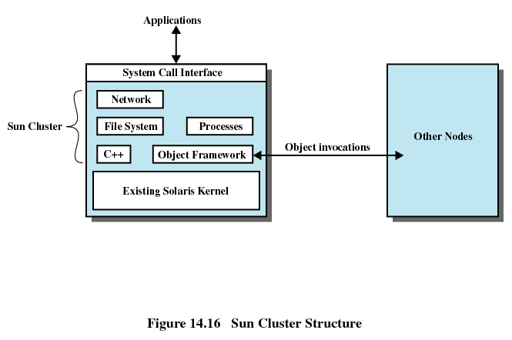

Slide 52
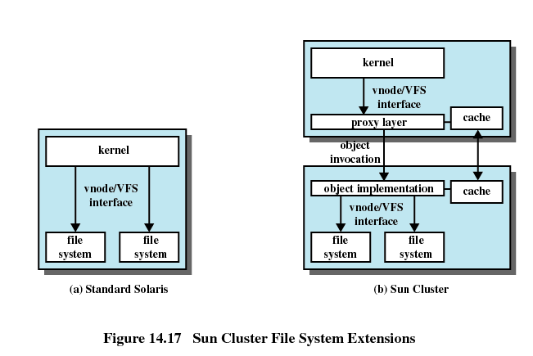

Slide 53
Beowulf and Linux Clusters
Key features
  Mass market commodity components
  Dedicated processors (rather than scavenging cycles from idle workstations)
  A dedicated, private network (LAN or WAN or internetted combination)
  No custom components
  Easy replication from multiple vendors

Slide 54
Beowulf and Linux Clusters
Key features
  Scalable I/O
  A freely available software base
  Use freely available distribution computing tools with minimal changes
  Return the design and improvements to the community

Slide 55
