Slide 1
Distributed Process Management
Chapter 15

Slide 2
Process Migration
Transfer of sufficient amount of the state of a process from one computer to another
The process executes on the target machine

Slide 3
Motivation
Load sharing
  Move processes from heavily loaded to lightly load systems
Communications performance
  Processes that interact intensively can be moved to the same node to reduce communications cost
  May be better to move process to where the data reside when the data is large

Slide 4
Motivation
Availability
  Long-running process may need to move because the machine it is running on will be down
Utilizing special capabilities
  Process can take advantage of unique hardware or software capabilities

Slide 5
Initiation of Migration
Operating system
  When goal is load balancing
Process
  When goal is to reach a particular resource

Slide 6
What is Migrated?
Must destroy the process on the source system and create it on the target system
Process image and process control block and any links must be moved

Slide 7
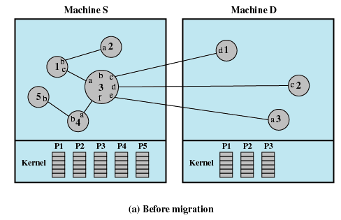
Example of Process Migration

Slide 8
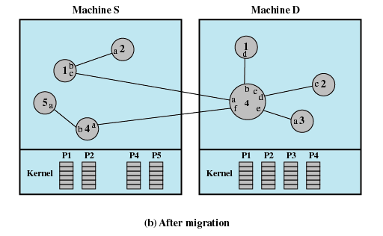
Example of Process Migration

Slide 9
What is Migrated?
Eager (all):Transfer entire address space
  No trace of process is left behind
  If address space is large and if the process does not need most of it, then this approach my be unnecessarily expensive

Slide 10
What is Migrated?
Precopy: Process continues to execute on the source node while the address space is copied
  Pages modified on the source during precopy operation have to be copied a second time
  Reduces the time that a process is frozen and cannot execute during migration

Slide 11
What is Migrated?
Eager (dirty): Transfer only that portion of the address space that is in main memory and have been modified
  Any additional blocks of the virtual address space are transferred on demand
  The source machine is involved throughout the life of the process

Slide 12
What is Migrated?
Copy-on-reference: Pages are only brought over when referenced
  Has lowest initial cost of process migration
Flushing: Pages are cleared from main memory by flushing dirty pages to disk
  Relieves the source of holding any pages of the migrated process in main memory

Slide 13
Negotiation of Migration
Migration policy is responsibility of Starter utility
Starter utility is also responsible for long-term scheduling and memory allocation
Decision to migrate must be reached jointly by two Starter processes (one on the source and one on the destination)

Slide 14
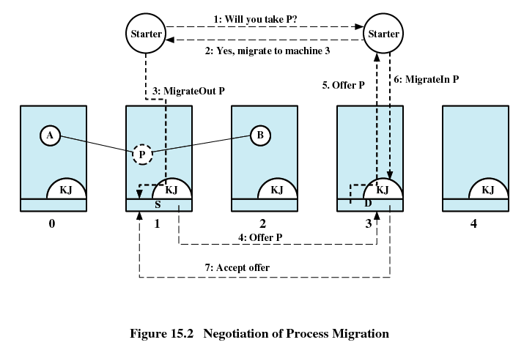

Slide 15
Eviction
Destination system may refuse to accept the migration of a process to itself
If a workstation is idle, process may have been migrated to it
  Once the workstation is active, it may be necessary to evict the migrated processes to provide adequate response time

Slide 16
Distributed Global States
Operating system cannot know the current state of all process in the distributed system
A process can only know the current state of all processes on the local system
Remote processes only know state information that is received by messages
  These messages represent the state in the past

Slide 17
Example
Bank account is distributed over two branches
The total amount in the account is the sum at each branch
At 3 PM the account balance is determined
Messages are sent to request the information

Slide 18
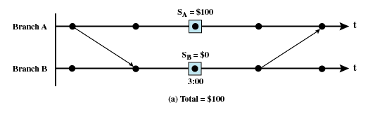
Example

Slide 19
Example
If at the time of balance determination, the balance from branch A is in transit to branch B
The result is a false reading

Slide 20
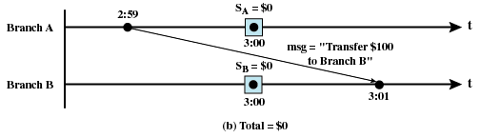
Example

Slide 21
Example
All messages in transit must be examined at time of observation
Total consists of balance at both branches and amount in message

Slide 22
Example
If clocks at the two branches are not perfectly synchronized
Transfer amount at 3:01 from branch A
Amount arrives at branch B at 2:59
At 3:00 the amount is counted twice

Slide 23
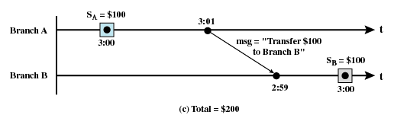
Example

Slide 24
Some Terms
Channel
  Exists between two processes if they exchange messages
State
  Sequence of messages that have been sent and received along channels incident with the process

Slide 25
Some Terms
Snapshot
  Records the state of a process
Global state
  The combined state of all processes
Distributed Snapshot
  A collection of snapshots, one for each process

Slide 26
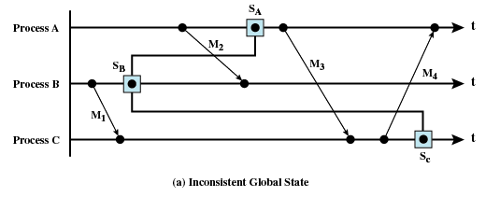
Inconsistent Global State

Slide 27
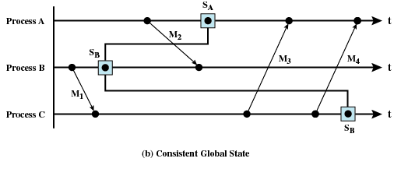
Consistent Global State

Slide 28
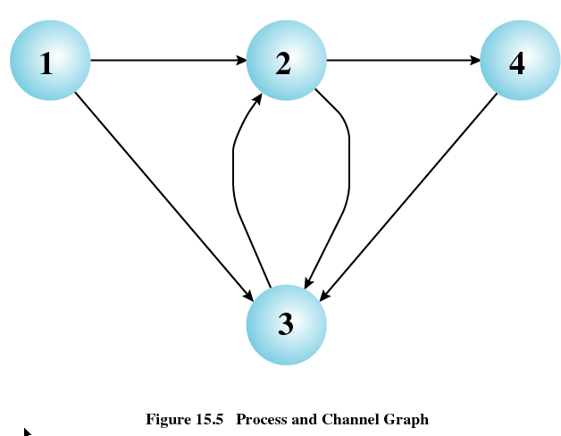
Distributed Snapshot Algorithm

Slide 29
Distributed Snapshot Algorithm
Process 1 Outgoing channels 2 sent 1, 2, 3, 4, 5, 6 3 sent 1, 2, 3, 4, 5, 6 Incoming channels | Process 3 Outgoing channels 2 sent 1, 2, 3, 4, 5, 6, 7, 8 Incoming channels 1 received 1, 2, 3 stored 4, 5, 6 2 received 1, 2, 3 stored 4 4 received 1, 2, 3
Process 2 Outgoing channels 3 sent 1, 2, 3, 4 4 sent 1, 2, 3, 4 Incoming channels 1 received 1, 2, 3, 4 stored 5, 6 3 received 1, 2, 3, 4, 5, 6, 7, 8 | Process 4 Outgoing channels 3 sent 1, 2, 3 Incoming channels 2 received 1, 2 stored 3, 4

Slide 30
Distributed Mutual Exclusion Concepts
Mutual exclusion must be enforced: only one process at a time is allowed in its critical section
A process that halts in its noncritical section must do so without interfering with other processes
It must not be possible for a process requiring access to a critical section to be delayed indefinitely: no deadlock or starvation

Slide 31
Distributed Mutual Exclusion Concepts
When no process is in a critical section, any process that requests entry to its critical section must be permitted to enter without delay
No assumptions are made about relative process speeds or number of processors
A process remains inside its critical section for a finite time only

Slide 32
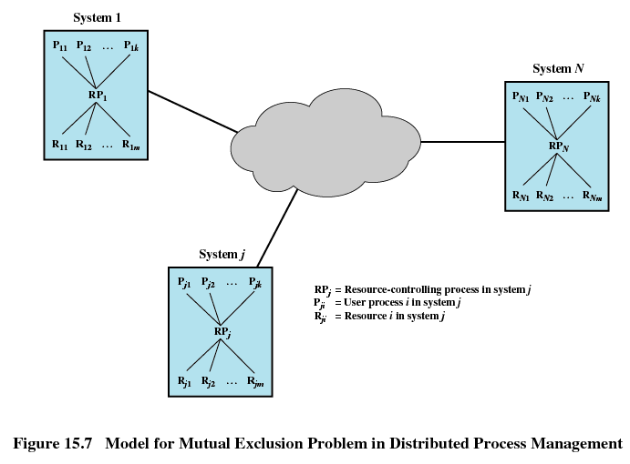

Slide 33
Centralized Algorithm for Mutual Exclusion
One node is designated as the control node
This node control access to all shared objects
Only the control node makes resource-allocation decision
All necessary information is concentrated in the control node
If control node fails, mutual exclusion breaks down

Slide 34
Distributed Algorithm
All nodes have equal amount of information, on average
Each node has only a partial picture of the total system and must make decisions based on this information
All nodes bear equal responsibility for the final decision

Slide 35
Distributed Algorithm
All nodes expend equal effort, on average, in effecting a final decision
Failure of a node, in general, does not result in a total system collapse
There exits no systemwide common clock with which to regulate the time of events

Slide 36
Ordering of Events
Events must be order to ensure mutual exclusion and avoid deadlock
Clocks are not synchronized
Communication delays

Slide 37
Ordering of Events
Need to consistently say that one event occurs before another event
Messages are sent when want to enter critical section and when leaving critical section
Time-stamping
  Orders events on a distributed system
  System clock is not used

Slide 38
Time-Stamping
Each system on the network maintains a counter which functions as a clock
Each site has a numerical identifier
When a message is received, the receiving system sets is counter to one more than the maximum of its current value and the incoming time-stamp (counter)

Slide 39
Time-Stamping
If two messages have the same time-stamp, they are ordered by the number of their sites
For this method to work, each message is sent from one process to all other processes
  Ensures all sites have same ordering of messages
  For mutual exclusion and deadlock all processes must be aware of the situation

Slide 40
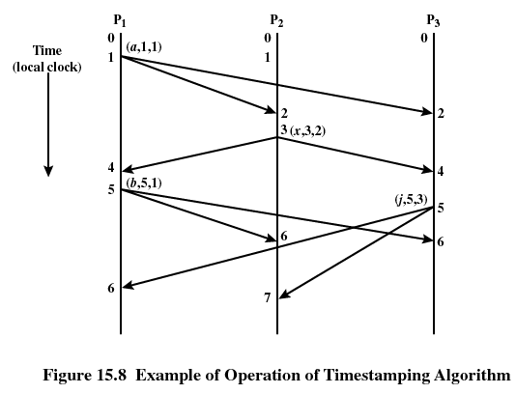

Slide 41
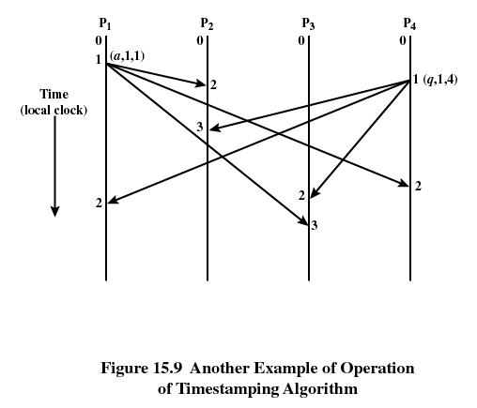

Slide 42
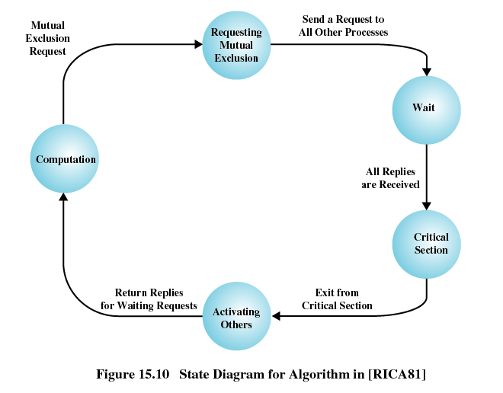

Slide 43
Token-Passing Approach
Pass a token among the participating processes
The token is an entity that at any time is held by one process
The process holding the token may enter its critical section without asking permission
When a process leaves its critical section, it passes the token to another process

Slide 44
Deadlock in Resource Allocation
Mutual exclusion
Hold and wait
No preemption
Circular wait

Slide 45
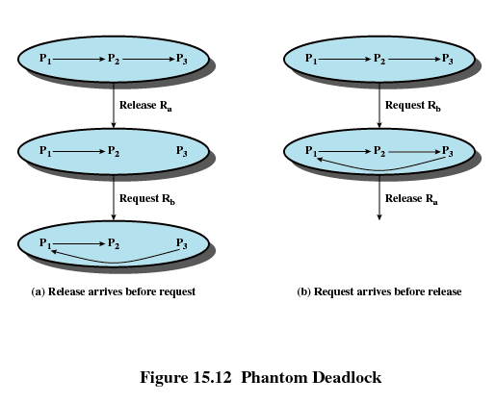
Phantom Deadlock

Slide 46
Deadlock Prevention
Circular-wait condition can be prevented by defining a linear ordering of resource types
Hold-and-wait condition can be prevented by requiring that a process request all of its required resource at one time, and blocking the process until all requests can be granted simultaneously

Slide 47
Deadlock Avoidance
Distributed deadlock avoidance is impractical
  Every node must keep track of the global state of the system
  The process of checking for a safe global state must be mutually exclusive
  Checking for safe states involves considerable processing overhead for a distributed system with a large number of processes and resources

Slide 48
Distributed Deadlock Detection
Each site only knows about its own resources
  Deadlock may involve distributed resources
Centralized control – one site is responsible for deadlock detection
Hierarchical control – lowest node above the nodes involved in deadlock
Distributed control – all processes cooperate in the deadlock detection function

Slide 49
Deadlock in Message Communication
Mutual Waiting
  Deadlock occurs in message communication when each of a group of processes is waiting for a message from another member of the group and there are no messages in transit

Slide 50
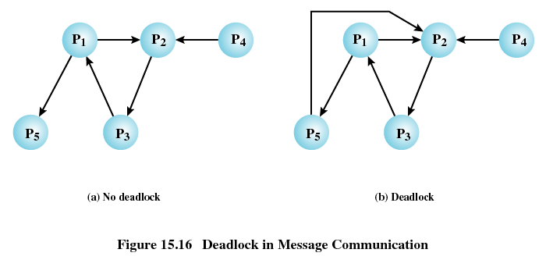

Slide 51
Deadlock in Message Communication
Unavailability of Message Buffers
  Well known in packet-switching data networks
  Example: buffer space for A is filled with packets destined for B. The reverse is true at B.

Slide 52
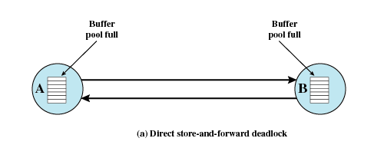
Direct Store-and-Forward Deadlock

Slide 53
Deadlock in Message Communication
Unavailability of Message Buffers
  For each node, the queue to the adjacent node in one direction is full with packets destined for the next node beyond

Slide 54
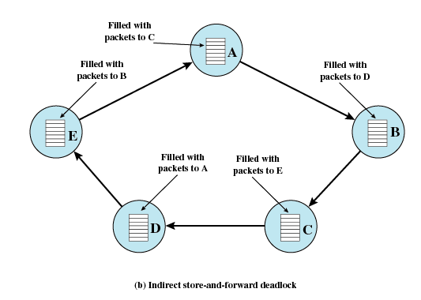

Slide 55
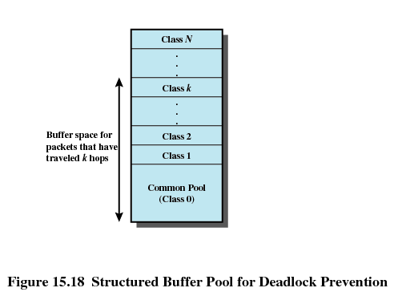
Structured Buffer Pool

Slide 56
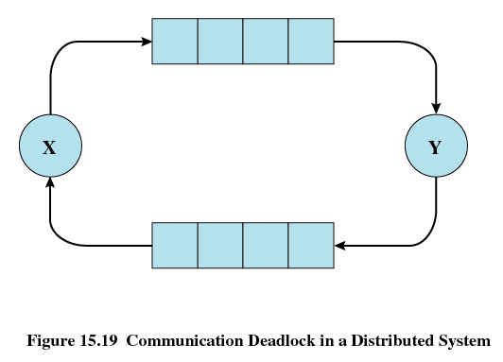
Finite Channels Lead to Deadlock

