Slide 1
Security
Chapter 16

Slide 2
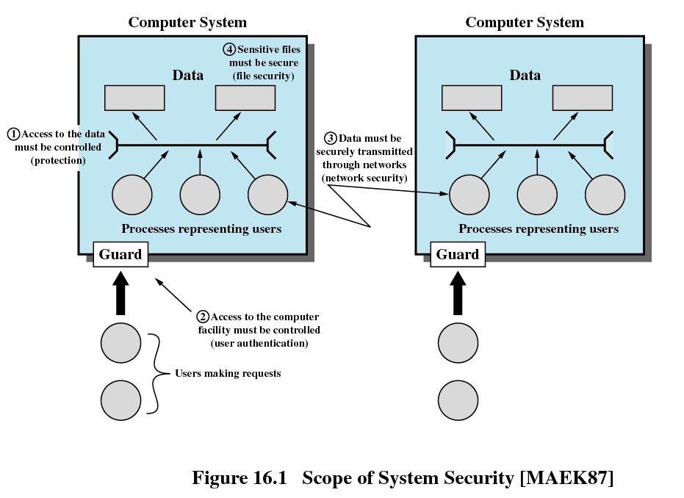

Slide 3
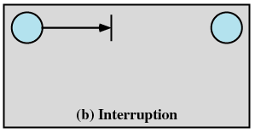
Types of Threats
Interruption
  An asset of the system is destroyed of becomes unavailable or unusable
  Attack on availability
  Destruction of hardware
  Cutting of a communication line
  Disabling the file management system

Slide 4
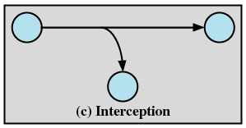
Types of Threats
Interception
  An unauthorized party gains access to an asset
  Attack on confidentiality
  Wiretapping to capture data in a network
  Illicit copying of files or programs

Slide 5
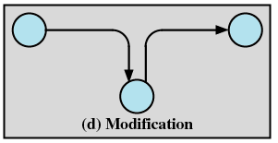
Types of Threats
Modification
  An unauthorized party not only gains access but tampers with an asset
  Attack on integrity
  Changing values in a data file
  Altering a program so that it performs differently
  Modifying the content of messages being transmitted in a network

Slide 6
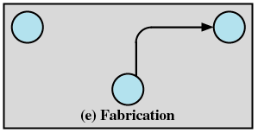
Types of Threats
Fabrication
  An unauthorized party inserts counterfeit objects into the system
  Attack on authenticity
  Insertion of spurious messages in a network
  Addition of records to a file

Slide 7
Computer System Assets
Hardware
  Threats include accidental and deliberate damage
Software
  Threats include deletion, alteration, damage
  Backups of the most recent versions can maintain high availability

Slide 8
Computer System Assets
Data
  Involves files
  Security concerns fro availability, secrecy, and integrity
  Statistical analysis can lead to determination of individual information which threatens privacy

Slide 9
Computer System Assets
Communication Lines and Networks – Passive Attacks
  Learn or make use of information from the system but does not affect system resources
  Traffic analysis
    Encryption masks the contents of what is transferred so even if obtained by someone, they would be unable to extract information

Slide 10
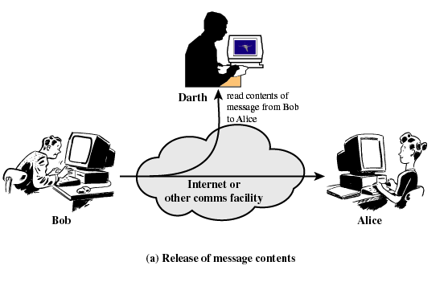
Computer System Assets
Communication Lines and Networks – Passive Attacks
  Release of message contents for a telephone conversion, an electronic mail message, and a transferred file are subject to these threats

Slide 11
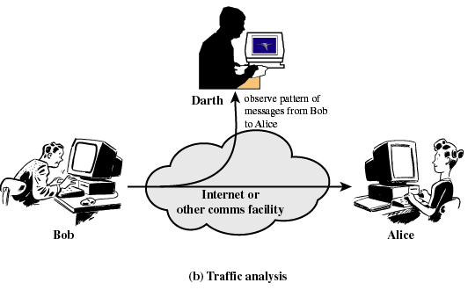
Computer System Assets
Communication Lines and Networks – Passive Attacks
  Traffic analysis
    Encryption masks the contents of what is transferred so even if obtained by someone, they would be unable to extract information

Slide 12
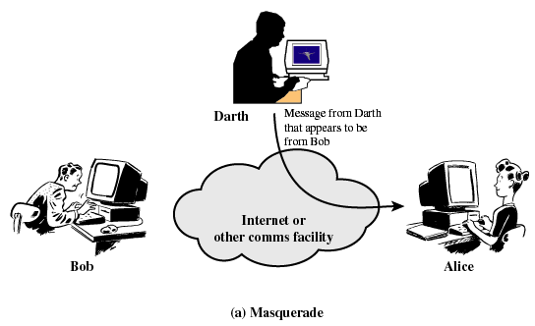
Computer System Assets
Communication Lines and Networks – Active Attacks
  Masquerade takes place when one entity pretends to be a different entity

Slide 13
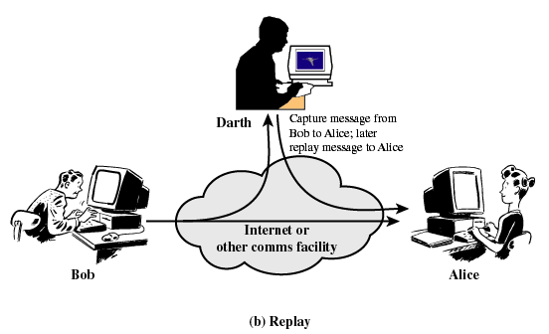
Computer System Assets
Communication Lines and Networks – Active Attacks
  Replay involves the passive capture of a data unit and its subsequent retransmission to produce an unauthorized effect

Slide 14
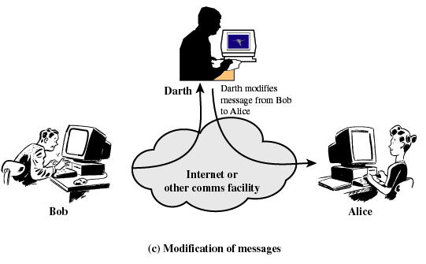
Computer System Assets
Communication Lines and Networks – Active Attack
  Modification of messages means that some portion of a legitimate message is altered, or that messages are delayed or reordered, to produce an unauthorized effect

Slide 15
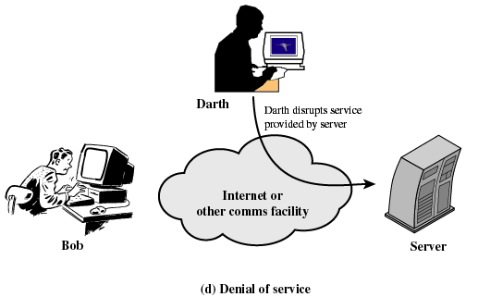
Computer System Assets
Communication Lines and Networks – Active Attacks
  Denial of service prevents or inhibits the normal use or management of communications facilities
    Disable network or overload it with messages

Slide 16
Protection
No protection
  Sensitive procedures are run at separate times
Isolation
  Each process operates separately from other processes with no sharing or communication

Slide 17
Protection
Share all or share nothing
  Owner of an object declares it public or private
Share via access limitation
  Operating system checks the permissibility of each access by a specific user to a specific object
  Operating system acts as the guard

Slide 18
Protection
Share via dynamic capabilities
  Dynamic creation of sharing rights for objects
Limit use of an object
  Limit not just access to an object but also the use to which that object may be put
  Example: a user may be able to derive statistical summaries but not to determine specific data values

Slide 19
Protection of Memory
Security
Correct functioning of the various processes that are active

Slide 20
User-Oriented Access Control
Referred as authentication
Log on
  Requires both a user identifier (ID) and a password
  System only allows users to log on if the ID is known to the system and password associated with the ID is correct
  Users can reveal their password to others either intentionally or accidentally
  Hackers are skillful at guessing passwords
  ID/password file can be obtained

Slide 21
Data-Oriented Access Control
Associated with each user, there can be a profile that specifies permissible operations and file accesses
Operating system enforces these rules
Database management system controls access to specific records or portions of records

Slide 22
Access Matrix
Subject
  An entity capable of accessing objects
Object
  Anything to which access is controlled
Access rights
  The way in which an object is accessed by a subject

Slide 23
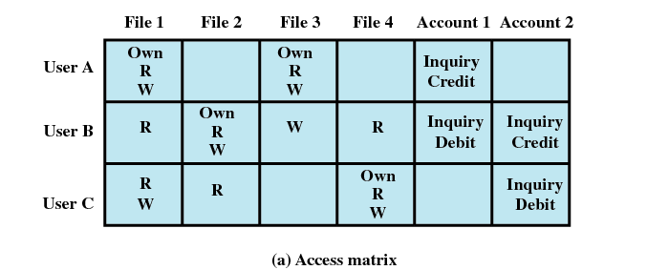
Access Matrix

Slide 24
Access Control List
Matrix decomposed by columns
For each object, an access control list gives users and their permitted access rights

Slide 25
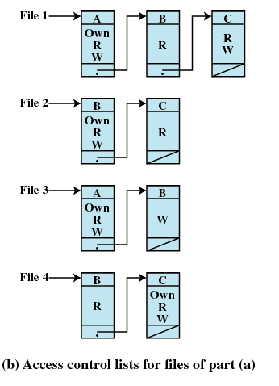
Access Control List

Slide 26
Capability Tickets
Decomposition of access matrix by rows
Specifies authorized objects and operations for a user

Slide 27
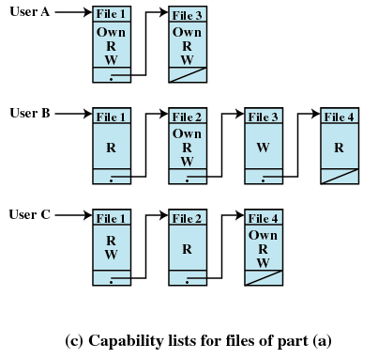
Capability Tickets

Slide 28
Intrusion Techniques
Objective of intruder is the gain access to the system or to increase the range of privileges accessible on a system
Protected information that an intruder acquires is a password

Slide 29
Techniques for Learning Passwords
Try default password used with standard accounts shipped with system
Exhaustively try all short passwords
Try words in dictionary or a list of likely passwords
Collect information about users and use these items as passwords

Slide 30
Techniques for Learning Passwords
Try users’ phone numbers, social security numbers, and room numbers
Try all legitimate license plate numbers for this state
Use a Trojan horse to bypass restrictions on access
Tap the line between a remote user and the host system

Slide 31
ID Provides Security
Determines whether the user is authorized to gain access to a system
Determines the privileges accorded to the user
  Superuser enables file access protected by the operating system
  Guest or anonymous accounts have more limited privileges than others
ID is used for discretionary access control
  A user may grant permission to files to others by ID

Slide 32
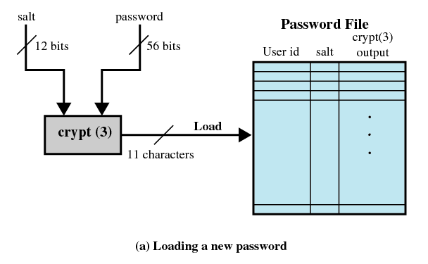
UNIX Password Scheme

Slide 33
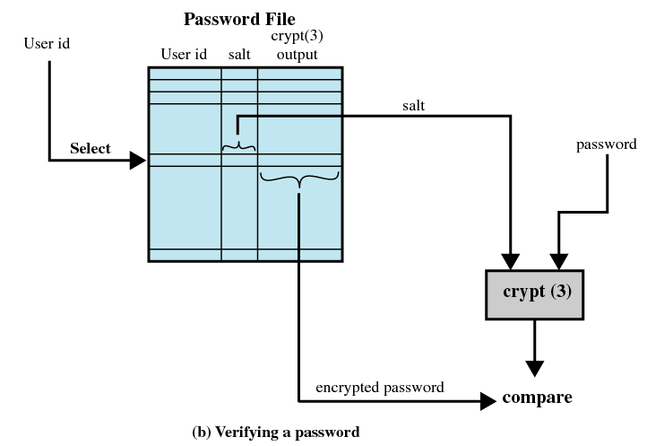
UNIX Password Scheme

Slide 34
Password Selection Strategies
Computer generated passwords
  Users have difficulty remembering them
  Need to write it down
  Have history of poor acceptance

Slide 35
Password Selection Strategies
Reactive password checking strategy
  System periodically runs its own password cracker to find guessable passwords
  System cancels passwords that are guessed and notifies user
  Consumes resources to do this
  Hacker can use this on their own machine with a copy of the password file

Slide 36
Password Selection Strategies
Proactive password checker
  The system checks at the time of selection if the password is allowable
  With guidance from the system users can select memorable passwords that are difficult to guess

Slide 37
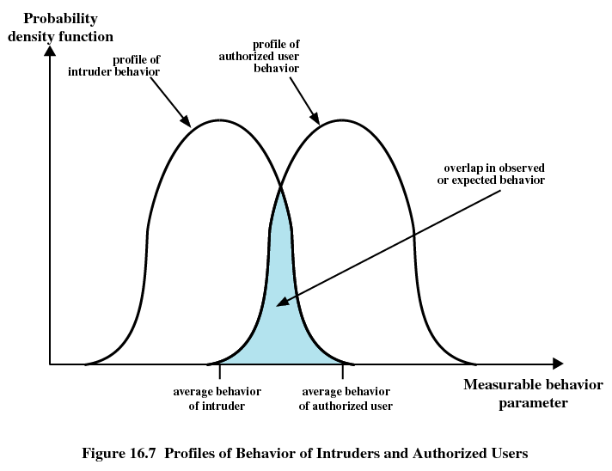

Slide 38
Intrusion Detection
Assume the behavior of the intruder differs from the legitimate user
Statistical anomaly detection
  Collect data related to the behavior of legitimate users over a period of time
  Statistical tests are used to determine if the behavior is not legitimate behavior

Slide 39
Intrusion Detection
Rule-based detection
  Rules are developed to detect deviation from previous usage pattern
  Expert system searches for suspicious behavior

Slide 40
Intrusion Detection
Audit record
  Native audit records
    All operating systems include accounting software that collects information on user activity
  Detection-specific audit records
    Collection facility can be implemented that generates audit records containing only that information required by the intrusion detection system

Slide 41
Malicious Programs
Those that need a host program
  Fragments of programs that cannot exist independently of some application program, utility, or system program
Independent
  Self-contained programs that can be scheduled and run by the operating system

Slide 42
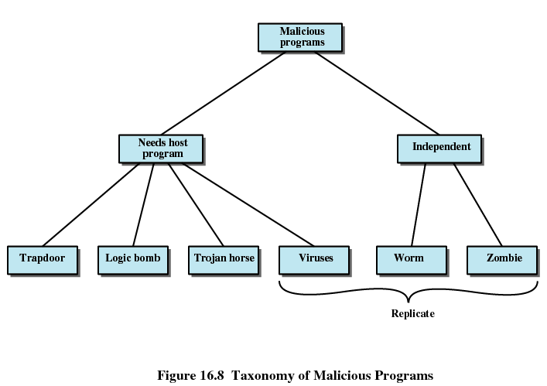

Slide 43
Trapdoor
Entry point into a program that allows someone who is aware of trapdoor to gain access
Used by programmers to debug and test programs
  Avoids necessary setup and authentication
  Method to activate program if something wrong with authentication procedure

Slide 44
Logic Bomb
Code embedded in a legitimate program that is set to “explode” when certain conditions are met
  Presence or absence of certain files
  Particular day of the week
  Particular user running application

Slide 45
Trojan Horse
Useful program that contains hidden code that when invoked performs some unwanted or harmful function
Can be used to accomplish functions indirectly that an unauthorized user could not accomplish directly
  User may set file permission so everyone has access

Slide 46
Virus
Program that can “infect” other programs by modifying them
  Modification includes copy of virus program
  The infected program can infect other programs

Slide 47
Worms
Use network connections to spread form system to system
Electronic mail facility
  A worm mails a copy of itself to other systems
Remote execution capability
  A worm executes a copy of itself on another system
Remote log-in capability
  A worm logs on to a remote system as a user and then uses commands to copy itself from one system to the other

Slide 48
Zombie
Program that secretly takes over another Internet-attached computer
It uses that computer to launch attacks that are difficult to trace to the zombie’s creator

Slide 49
Virus Stages
Dormant phase
  Virus is idle
Propagation phase
  Virus places an identical copy of itself into other programs or into certain system areas on the disk

Slide 50
Virus Stages
Triggering phase
  Virus is activated to perform the function for which it was intended
  Caused by a variety of system events
Execution phase
  Function is performed

Slide 51
Types of Viruses
Parasitic
  Attaches itself to executable files and replicates
  When the infected program is executed, it looks for other executables to infect
Memory-resident
  Lodges in main memory as part of a resident system program
  Once in memory, it infects every program that executes

Slide 52
Types of Viruses
Boot sector
  Infects boot record
  Spreads when system is booted from the disk containing the virus
Stealth
  Designed to hide itself form detection by antivirus software

Slide 53
Types of Viruses
Polymorphic
  Mutates with every infection, making detection by the “signature” of the virus impossible
  Mutation engine creates a random encryption key to encrypt the remainder of the virus
    The key is stored with the virus

Slide 54
Macro Viruses
Platform independent
  Most infect Microsoft Word documents
Infect documents, not executable portions of code
Easily spread

Slide 55
Macro Viruses
A macro is an executable program embedded in a word processing document or other type of file
Autoexecuting macros in Word
  Autoexecute
    Executes when Word is started
  Automacro
    Executes when defined event occurs such as opening or closing a document
  Command macro
    Executed when user invokes a command (e.g., File Save)

Slide 56
Antivirus Approaches
Detection
Identification
Removal

Slide 57
Generic Decryption
CPU emulator
  Instructions in an executable file are interpreted by the emulator rather than the processor
Virus signature scanner
  Scan target code looking for known virus signatures
Emulation control module
  Controls the execution of the target code

Slide 58
Digital Immune System
Developed by IBM
Motivation has been the rising threat of Internet-based virus propagation
  Integrated mail systems
  Mobile-program system

Slide 59
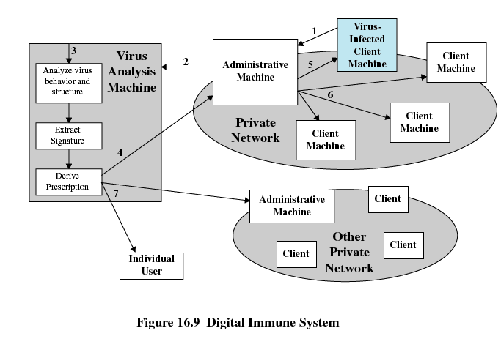

Slide 60
E-mail Virus
Activated when recipient opens the e-mail attachment
Activated by opening an e-mail that contains the virus
Uses Visual Basic scripting language
Propagates itself to all of the e-mail addresses known to the infected host

Slide 61
Trusted Systems
Multilevel security
  Information organized into levels
  No read up
    Only read objects of a less or equal security level
  No write down
    Only write objects of greater or equal security level

Slide 62
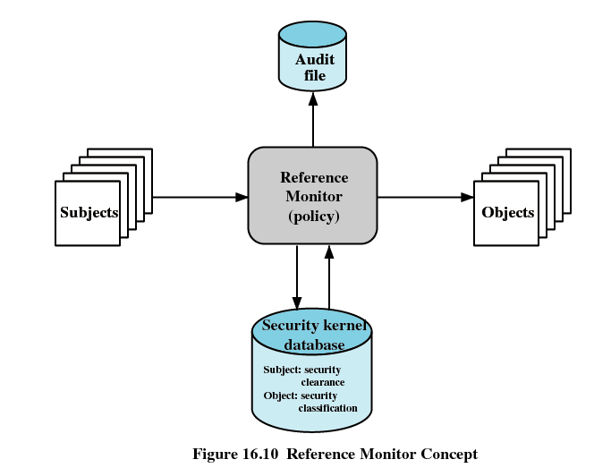

Slide 63
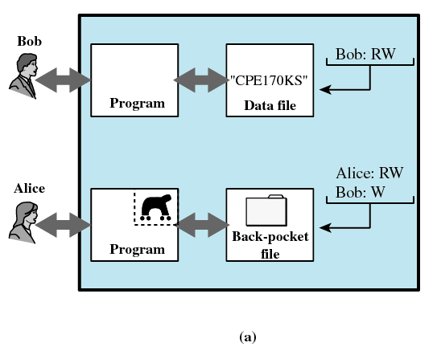
Trojan Horse Defense

Slide 64
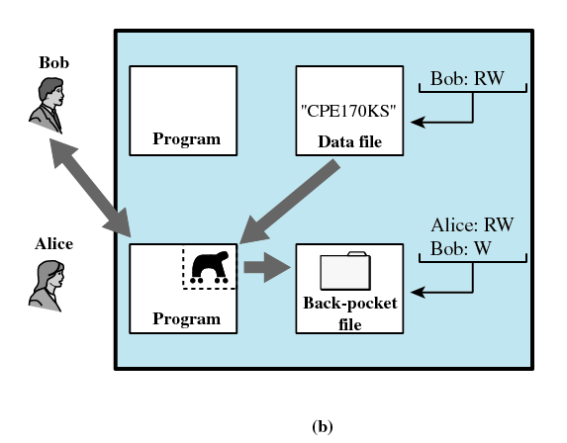
Trojan Horse Defense

Slide 65
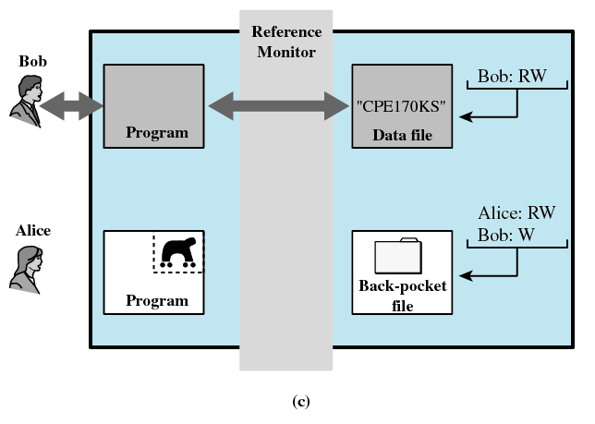
Trojan Horse Defense

Slide 66
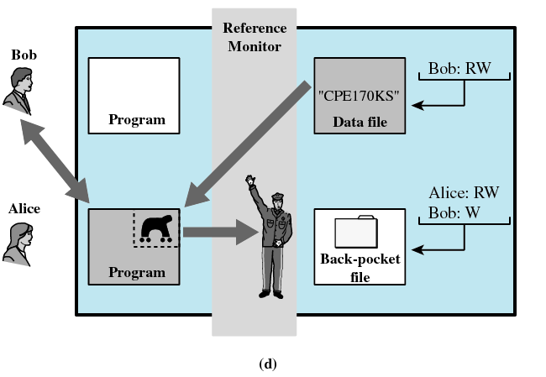
Trojan Horse Defense

Slide 67
Windows 2000 Security
Access Control Scheme
  Name/password
  Access token associated with each process object indicating privileges associated with a user

Slide 68
Access Token
Security ID
  Identifies a user uniquely across all the machines on the network (logon name)
Group SIDs
  List of the groups to which this user belongs
Privileges
  List of security-sensitive system services that this user may call

Slide 69
Access token
Default owner
  If this process creates another object, this field specifies who is the owner
Default ACL
  Initial list of protections applied to the objects that the user creates

Slide 70
Security Descriptor
Flags
  Defines type and contents of a security descriptor
Owner
  Owner of the object can generally perform any action on the security descriptor
System Access Control List (SACL)
  Specifies what kinds of operations on the object should generate audit messages
Discretionary Access Control List (DACL)
  Determines which users and groups can access this object for which operations

Slide 71
