Slide 1
Chapter 20 - Standard Template Library (STL)
Outline
20.1 Introduction to the Standard Template Library (STL)
20.1.1 Introduction to Containers
20.1.2 Introduction to Iterators
20.1.3 Introduction to Algorithms
20.2 Sequence Containers
20.2.1 vector Sequence Container
20.2.2 list Sequence Container
20.2.3 deque Sequence Container
20.3 Associative Containers
20.3.1 multiset Associative Container
20.3.2 set Associative Container
20.3.3 multimap Associative Container
20.3.4 map Associative Container
20.4 Container Adapters
20.4.1 stack Adapter
20.4.2 queue Adapter
20.4.3 priority_queue Adapter
20.5 Algorithms
20.5.1 fill, fill_n, generate and generate_n
20.5.2 equal, mismatch and lexicographical_compare
20.5.3 remove, remove_if, remove_copy and remove_copy_if
20.5.4 replace, replace_if, replace_copy and replace_copy_if
20.5.5 Mathematical Algorithms
20.5.6 Basic Searching and Sorting Algorithms
20.5.7 swap, iter_swap and swap_ranges
20.5.8 copy_backward, merge, unique and reverse
20.5.9 inplace_merge, unique_copy and reverse_copy
20.5.10 Set Operations
20.5.11 lower_bound, upper_bound and equal_range
20.5.12 Heapsort
20.5.13 min and max
20.5.14 Algorithms Not Covered in This Chapter
20.6 Class bitset
20.7 Function Objects

Slide 2
20.1 Introduction to the Standard Template Library (STL)
object oriented programming - reuse, reuse, reuse
  STL has many reusable components
  Divided into
    containers
    iterators
    algorithms
This is only an introduction to STL, a huge class library

Slide 3
20.1.1 Introduction to Containers
Three types of containers
  sequence containers
  associative containers
  container adapters
Near-containers - similar to containers, without all the capabilities
  C-like arrays (Chapter 4)
  string (Chapter 19)
  bitset for maintaining sets of 1/0 flag values
  valarray - high-speed mathematical vector operations
The containers have similar functions
First class containers

Slide 4
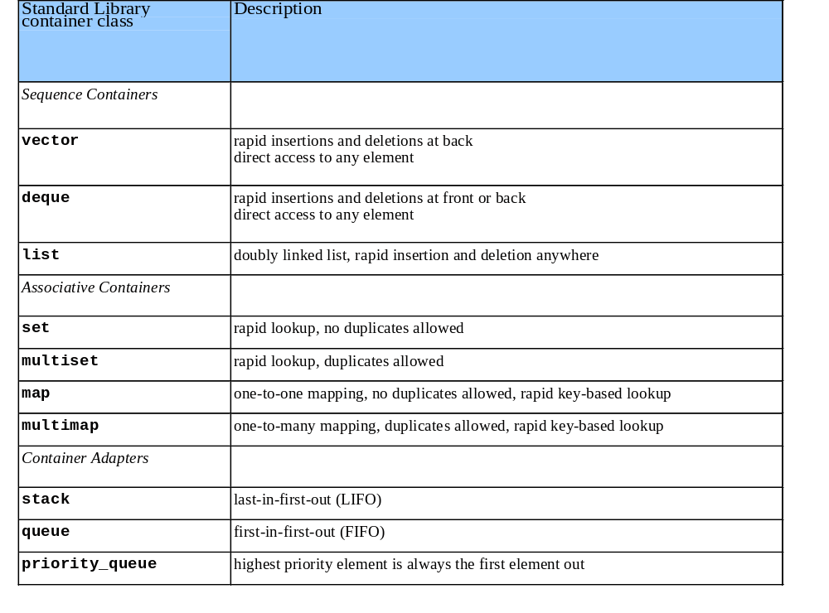
20.1.1 Introduction to Containers (II)

Slide 5
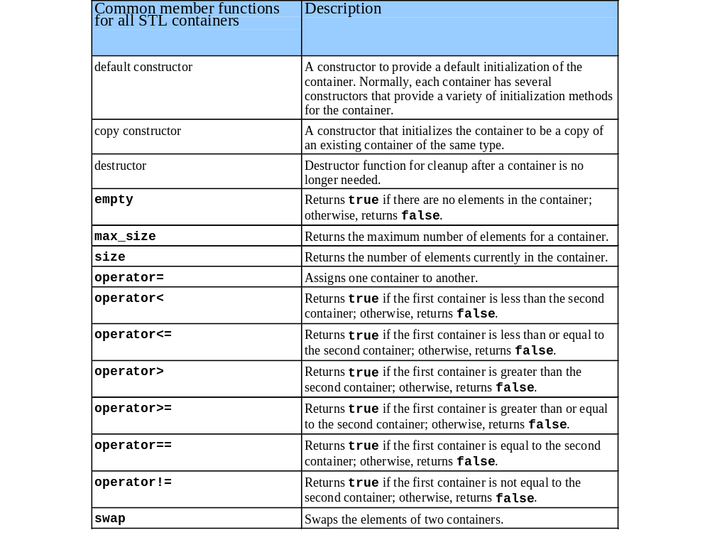
20.1.1 Introduction to Containers (III)

Slide 6
20.1.2 Introduction to Iterators
Iterators are similar to pointers
  point to first element in a container
  iterator operators uniform for all containers
    * dereferences, ++ points to next element
    begin() returns iterator pointing to first element
    end() returns iterator pointing to last element
  use iterators with sequences (ranges)
    containers
    input sequences - istream_iterator
    output sequences - ostream_iterator

Slide 7
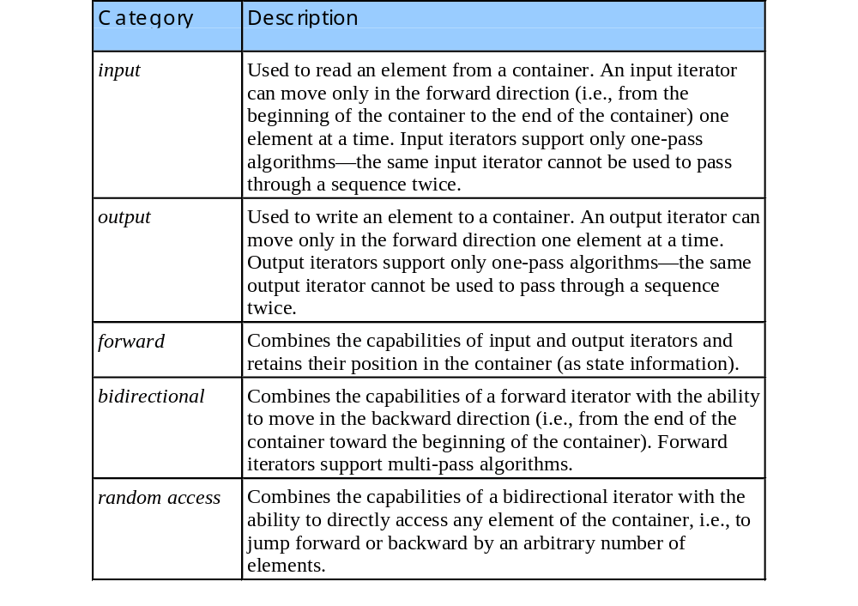
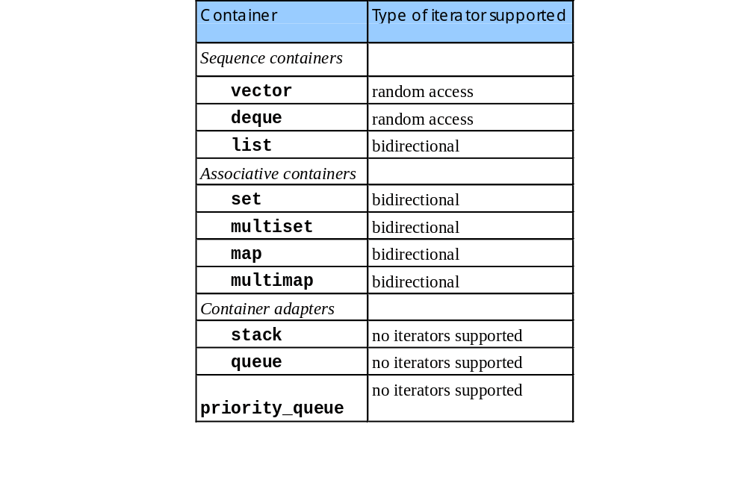
20.1.2 Introduction to Iterators (II)

Slide 8
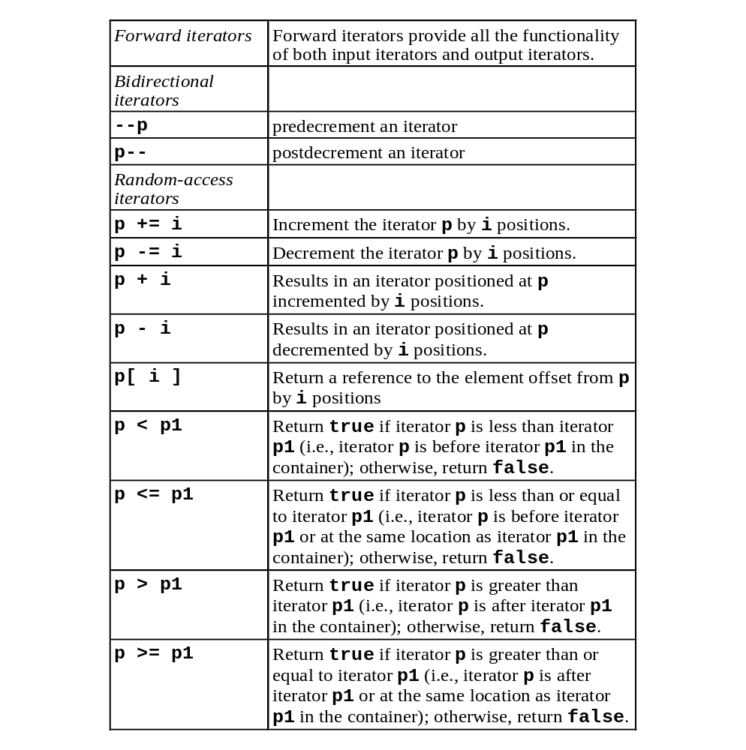
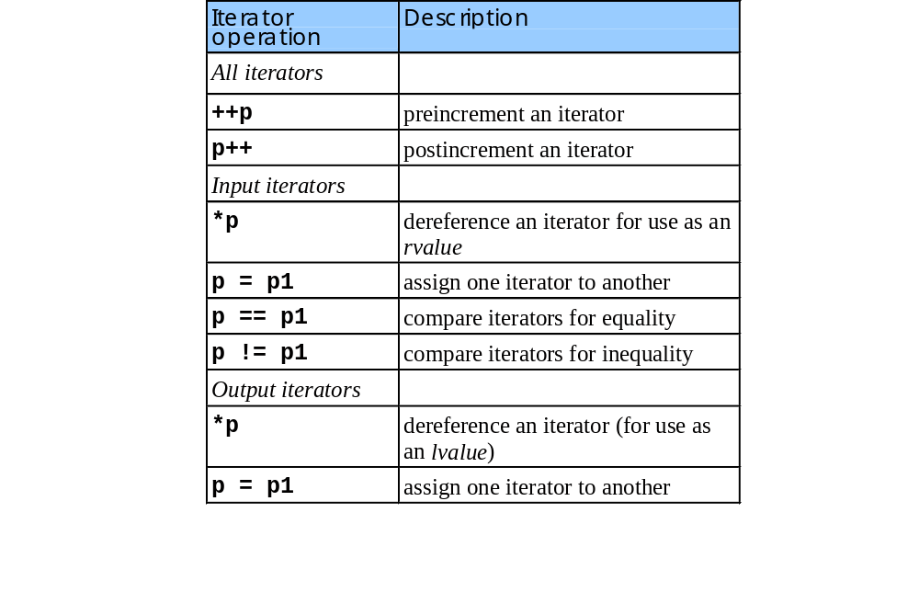
20.1.2 Introduction to Iterators (III)

Slide 9
1 // Fig. 20.5: fig20_05.cpp
2 // Demonstrating input and output with iterators.
3 #include <iostream>
4
1.1 Initialize iterators
2. Sum numbers
3. Output results
Program Output
5 using std::cout;
6 using std::cin;
7 using std::endl;
8
9 #include <iterator>
10
11 int main()
12 {
13 cout << "Enter two integers: ";
14
15 std::istream_iterator< int > inputInt( cin );
16 int number1, number2;
17
18 number1 = *inputInt; // read first int from standard input
19 ++inputInt; // move iterator to next input value
20 number2 = *inputInt; // read next int from standard input
21
22 cout << "The sum is: ";
23
24 std::ostream_iterator< int > outputInt( cout );
25
26 *outputInt = number1 + number2; // output result to cout
27 cout << endl;
28 return 0;
29 }
Enter two integers: 12 25
The sum is: 37

Slide 10
20.1.3 Introduction to Algorithms
STL provides algorithms used generically across containers
  operate on elements indirectly through iterators
  often operate on sequences of elements defined by pairs of iterators
  algorithms often return iterators, such as find()
  premade algorithms save programmers time and effort

Slide 11
20.2 Sequence Containers
Three sequence containers
  vector - based on arrays
  deque - based on arrays
  list - robust linked list

Slide 12
20.2.1 vector Sequence Container
vector
  data structure with contiguous memory locations
  use the subscript operator []
  used when data must be sorted and easily accessible
  when memory exhausted
    allocates a larger, contiguous area of memory
    copies itself there
    deallocates the old memory
  has a random access iterators
Declarations
  vectors: vector <type> v;
    type - int, float, etc.
  iterators: vector<type>::const_iterator iterVar;

Slide 13
20.2.1 vector Sequence Container (II)
vector functions, for vector object v
  v.push_back(value) - add element to end (found in all sequence containers).
  v.size() - current size of vector.
  v.capacity() - how much vector can hold before reallocating memory. Reallocation doubles each time.
  vector<type> v(a, a + SIZE) - creates vector v with elements from array a up to (not including) a + SIZE
  v.insert( pointer, value ) - inserts value before location of pointer.
  v.insert( pointer, array , array + SIZE) - inserts array elements (up to, but not including array + SIZE) into vector.

Slide 14
20.2.1 vector Sequence Container (III)
vector functions and operations
  v.erase( pointer )
    remove element from container
  v.erase( pointer1, pointer2 )
    remove elements starting from pointer1 and up to (not including) pointer2.
  v.clear()
    erases entire container.
  v.[elementNumber] = value;
    assign value to an element
  v.at[elementNumber] = value;
    as above, with range checking
    throws out_of_bounds exception

Slide 15
20.2.1 vector Sequence Container (IV)
ostream_iterator
  std::ostream_iterator<type> Name( outputStream, separator );
  type - only outputs values of a certain type
  outputStream - where the iterator outputs to
  separator - character separating outputs
  Example:
  std::ostream_iterator< int > output( cout, " " );
  std::copy( iterator1, iterator2, output );
  copies elements from iterator1 up to (not including) iterator2 to output, an ostream_iterator object.

Slide 16
1 // Fig. 20.15: fig20_15.cpp
2 // Testing Standard Library vector class template
3 // element-manipulation functions
4 #include <iostream>
5
1. Initialize variables
1.1 Copy array to vector
1.2 Copy vector to output
2. Set and insert vector elements
2.1 Copy vector to output
2.2 Access out of range element
2.3 Erase and copy elements
6 using std::cout;
7 using std::endl;
8
9 #include <vector>
10 #include <algorithm>
Notice how the ostream_iterator object is used.
11
12 int main()
13 {
14 const int SIZE = 6;
15 int a[ SIZE ] = { 1, 2, 3, 4, 5, 6 };
16 std::vector< int > v( a, a + SIZE );
17 std::ostream_iterator< int > output( cout, " " );
Vector v contains: 1 2 3 4 5 6
18 cout << "Vector v contains: ";
19 std::copy( v.begin(), v.end(), output );
20
First element of v: 1
Last element of v: 6
21 cout << "\nFirst element of v: " << v.front()
22 << "\nLast element of v: " << v.back();
23
24 v[ 0 ] = 7; // set first element to 7
25 v.at( 2 ) = 10; // set element at position 2 to 10
Contents of vector v after changes: 7 22 2 10 4 5 6
26 v.insert( v.begin() + 1, 22 ); // insert 22 as 2nd element
27 cout << "\nContents of vector v after changes: ";
at throws an exception if an element is out of range.
28 std::copy( v.begin(), v.end(), output );
29
30 try {
31 v.at( 100 ) = 777; // access element out of range
32 }
33 catch ( std::out_of_range e ) {

Slide 17
34 cout << "\nException: " << e.what();
35 }
Exception: invalid vector<T> subscript
36
37 v.erase( v.begin() );
2.4 erase
2.5 clear
Program Output
38 cout << "\nContents of vector v after erase: ";
39 std::copy( v.begin(), v.end(), output );
Contents of vector v after erase: 22 2 10 4 5 6
40 v.erase( v.begin(), v.end() );
41 cout << "\nAfter erase, vector v "
42 << ( v.empty() ? "is" : "is not" ) << " empty";
After erase, vector v is empty
43
44 v.insert( v.begin(), a, a + SIZE );
45 cout << "\nContents of vector v before clear: ";
Contents of vector v before clear: 1 2 3 4 5 6
46 std::copy( v.begin(), v.end(), output );
47 v.clear(); // clear calls erase to empty a collection
48 cout << "\nAfter clear, vector v "
49 << ( v.empty() ? "is" : "is not" ) << " empty";
After clear, vector v is empty
50
51 cout << endl;
52 return 0;
53 }
Vector v contains: 1 2 3 4 5 6
First element of v: 1
Last element of v: 6
Contents of vector v after changes: 7 22 2 10 4 5 6
Exception: invalid vector<T> subscript
Contents of vector v after erase: 22 2 10 4 5 6
After erase, vector v is empty
Contents of vector v before clear: 1 2 3 4 5 6
After clear, vector v is empty

Slide 18
20.2.2 list Sequence Container
list container
  header <list>
  efficient insertion/deletion anywhere in container
  doubly-linked list (two pointers per node)
  bidirectional iterators

Slide 19
20.2.2 list Sequence Container (II)
list functions for listObject and otherObject
  listObject.sort()
    sorts in ascending order
  listObject.splice(iterator, otherObject);
    inserts values from otherObject before location of iterator
  listObject.merge(otherObject)
    removesotherObject and inserts it into listObject, sorted
  listObject.unique()
    removes duplicate elements
  listObject.swap(otherObject);
    exchange contents
  listObject.assign(iterator1, iterator2)
    replaces contents with elements in range of iterators
  listObject.remove(value)
    erases all instances of value

Slide 20
1 // Fig. 20.17: fig20_17.cpp
2 // Testing Standard Library class list
3 #include <iostream>
4
5 using std::cout;
1. Function prototype
1.1 Define and initialize variables
2. Function calls
2.1 sort
6 using std::endl;
7
8 #include <list>
9 #include <algorithm>
10
11 template < class T >
12 void printList( const std::list< T > &listRef );
13
14 int main()
15 {
16 const int SIZE = 4;
17 int a[ SIZE ] = { 2, 6, 4, 8 };
18 std::list< int > values, otherValues;
19
20 values.push_front( 1 );
21 values.push_front( 2 );
22 values.push_back( 4 );
23 values.push_back( 3 );
24
values contains: 2 1 4 3
25 cout << "values contains: ";
26 printList( values );
27 values.sort();
values after sorting contains: 1 2 3 4
28 cout << "\nvalues after sorting contains: ";
29 printList( values );
30
31 otherValues.insert( otherValues.begin(), a, a + SIZE );
32 cout << "\notherValues contains: ";
otherValues contains: 2 6 4 8
33 printList( otherValues );

Slide 21
34 values.splice( values.end(), otherValues );
35 cout << "\nAfter splice values contains: ";
36 printList( values );
After splice values contains: 1 2 3 4 2 6 4 8
37
38 values.sort();
2.2 splice
2.3 merge
2.4 pop
2.5 unique
2.6 swap
39 cout << "\nvalues contains: ";
40 printList( values );
41 otherValues.insert( otherValues.begin(), a, a + SIZE );
42 otherValues.sort();
values contains: 1 2 2 3 4 4 6 8
otherValues contains: 2 4 6 8
43 cout << "\notherValues contains: ";
44 printList( otherValues );
45 values.merge( otherValues );
46 cout << "\nAfter merge:\n values contains: ";
47 printList( values );
After merge:
values contains: 1 2 2 2 3 4 4 4 6 6 8 8
otherValues contains: List is empty
48 cout << "\n otherValues contains: ";
49 printList( otherValues );
50
51 values.pop_front();
52 values.pop_back(); // all sequence containers
53 cout << "\nAfter pop_front and pop_back values contains:\n";
54 printList( values );
After pop_front and pop_back values contains:
2 2 2 3 4 4 4 6 6 8
55
56 values.unique();
57 cout << "\nAfter unique values contains: ";
58 printList( values );
After unique values contains: 2 3 4 6 8
59
60 // method swap is available in all containers
61 values.swap( otherValues );
After swap:
values contains: List is empty
otherValues contains: 2 3 4 6 8
62 cout << "\nAfter swap:\n values contains: ";
63 printList( values );
64 cout << "\n otherValues contains: ";
65 printList( otherValues );
66

Slide 22
67 values.assign( otherValues.begin(), otherValues.end() );
68 cout << "\nAfter assign values contains: ";
After assign values contains: 2 3 4 6 8
69 printList( values );
70
2.7 assign
2.8 remove
3. Function definition
71 values.merge( otherValues );
72 cout << "\nvalues contains: ";
73 printList( values );
values contains: 2 2 3 3 4 4 6 6 8 8
74 values.remove( 4 );
75 cout << "\nAfter remove( 4 ) values contains: ";
76 printList( values );
After remove( 4 ) values contains: 2 2 3 3 6 6 8 8
77 cout << endl;
78 return 0;
79 }
80
81 template < class T >
82 void printList( const std::list< T > &listRef )
83 {
84 if ( listRef.empty() )
85 cout << "List is empty";
86 else {
87 std::ostream_iterator< T > output( cout, " " );
88 std::copy( listRef.begin(), listRef.end(), output );
89 }
90 }

Slide 23
values contains: 2 1 4 3
values after sorting contains: 1 2 3 4
otherValues contains: 2 6 4 8
After splice values contains: 1 2 3 4 2 6 4 8
values contains: 1 2 2 3 4 4 6 8
otherValues contains: 2 4 6 8
After merge:
values contains: 1 2 2 2 3 4 4 4 6 6 8 8
otherValues contains: List is empty
After pop_front and pop_back values contains:
2 2 2 3 4 4 4 6 6 8
After unique values contains: 2 3 4 6 8
After swap:
values contains: List is empty
otherValues contains: 2 3 4 6 8
After assign values contains: 2 3 4 6 8
values contains: 2 2 3 3 4 4 6 6 8 8
After remove( 4 ) values contains: 2 2 3 3 6 6 8 8
Program Output

Slide 24
20.2.3 deque Sequence Container
deque ("deek") - double-ended queue
  load <deque>
  indexed access using []
  efficient insertion/deletion in front and back
  non-contiguous memory: "smarter" pointers
same basic operations as vector
  adds push_front / pop_front - insertion/deletion at beginning of deque

Slide 25
20.3 Associative Containers
Associative containers
  provide direct access to store and retrieve elements via keys (search keys)
4 types: multiset, set, multimap and map
  keys in sorted order
  multiset and multimap allow duplicate keys
  multimap and map allow keys and associate values (mapped values)

Slide 26
20.3.1 multiset Associative Container
multiset - fast storage, retrieval of keys
  allows duplicates
Ordering by comparator function object
  less<type> - sorts keys in ascending order
  multiset< int, less<int> > myObject;
Functions for multiset object msObject
  msObject.insert(value) - inserts value into iterator
  msObject.find(value) - returns iterator to first instance of value
  msObject.lower_bound(value)- returns iterator to first location of value

Slide 27
20.3.1 multiset Associative Container (II)
Functions for multiset object msObject
  msObject.upper_bound(value)- returns iterator to location after last occurrence of value
  class pair
    used to manipulate pairs of values
    objects contain first and second, which are const_iterators
  for a pair object q
    q = msObject.equal_range(value)
    sets first and second to lower_bound and upper_bound for a given value

Slide 28
20.3.2 set Associative Container
set
  implementation identical to multiset
  unique keys - duplicates ignored and not inserted
  supports bidirectional iterators (but not random access)
  use header file <set>

Slide 29
1 // Fig. 20.20: fig20_20.cpp
2 // Testing Standard Library class set
3 #include <iostream>
4
1. Load <set> header
1.1 Initialize variables
2. Function calls
3. Output results
5 using std::cout;
6 using std::endl;
7
8 #include <set>
9 #include <algorithm>
10
11 int main()
12 {
13 typedef std::set< double, std::less< double > > double_set;
14 const int SIZE = 5;
15 double a[ SIZE ] = { 2.1, 4.2, 9.5, 2.1, 3.7 };
16 double_set doubleSet( a, a + SIZE );;
17 std::ostream_iterator< double > output( cout, " " );
18
doubleSet contains: 2.1 3.7 4.2 9.5
19 cout << "doubleSet contains: ";
20 std::copy( doubleSet.begin(), doubleSet.end(), output );
21
22 std::pair< double_set::const_iterator, bool > p;
23
24 p = doubleSet.insert( 13.8 ); // value not in set
13.8 was inserted
25 cout << '\n' << *( p.first )
26 << ( p.second ? " was" : " was not" ) << " inserted";
Notice the attempt to add a duplicate value.
doubleSet contains: 2.1 3.7 4.2 9.5 13.8
27 cout << "\ndoubleSet contains: ";
28 std::copy( doubleSet.begin(), doubleSet.end(), output );
29
30 p = doubleSet.insert( 9.5 ); // value already in set

Slide 30
31 cout << '\n' << *( p.first )
32 << ( p.second ? " was" : " was not" ) << " inserted";
9.5 was not inserted
33 cout << "\ndoubleSet contains: ";
34 std::copy( doubleSet.begin(), doubleSet.end(), output );
3. Output results
Program Output
35
doubleSet contains: 2.1 3.7 4.2 9.5 13.8
36 cout << endl;
37 return 0;
38 }
doubleSet contains: 2.1 3.7 4.2 9.5
13.8 was inserted
doubleSet contains: 2.1 3.7 4.2 9.5 13.8
9.5 was not inserted
doubleSet contains: 2.1 3.7 4.2 9.5 13.8

Slide 31
20.3.3 multimap Associative Container
multimap
  fast storage and retrieval of keys and associated values (key/value pairs)
  header file <map>
  duplicate keys allowed (multiple values for a single key)
    one-to-many relationship. I.e., one student can take many courses.
  insert pair objects (with a key and value)
  bidirectional iterators

Slide 32
20.3.3 multimap Associative Container (II)
Example:
  std::multimap< int, double, std::less< int > > mmapObject;
  key type int, value type double, sorted in ascending order.
  use typedef to simplify code
  typedef std::multimap<int, double, std::less<int>> multi;
  multi mmapObject;
  mmapObject.insert( multi::value_type( 1, 3.4 ) );
  inserts key 1 with value 3.4

Slide 33
1 // Fig. 20.21: fig20_21.cpp
2 // Testing Standard Library class multimap
3 #include <iostream>
4
1. Load <map> header
1.1 Initialize variables
5 using std::cout;
6 using std::endl;
7
8 #include <map>
9
10 int main()
11 {
12 typedef std::multimap< int, double, std::less< int > > mmid;
13 mmid pairs;
There are currently 0 pairs with key 15 in the multimap
14
15 cout << "There are currently " << pairs.count( 15 )
16 << " pairs with key 15 in the multimap\n";
Notice how key/value pairs are inserted into the multimap
17 pairs.insert( mmid::value_type( 15, 2.7 ) );
18 pairs.insert( mmid::value_type( 15, 99.3 ) );
19 cout << "After inserts, there are "
After inserts, there are 2 pairs with key 15
20 << pairs.count( 15 )
21 << " pairs with key 15\n";p
22 pairs.insert( mmid::value_type( 30, 111.11 ) );
23 pairs.insert( mmid::value_type( 10, 22.22 ) );
24 pairs.insert( mmid::value_type( 25, 33.333 ) );
25 pairs.insert( mmid::value_type( 20, 9.345 ) );
26 pairs.insert( mmid::value_type( 5, 77.54 ) );
27 cout << "Multimap pairs contains:\nKey\tValue\n";
28
29 for ( mmid::const_iterator iter = pairs.begin();
30 iter != pairs.end(); ++iter )

Slide 34
31 cout << iter->first << '\t'
32 << iter->second << '\n';
33
Program Output
34 cout << endl;
35 return 0;
36 }
There are currently 0 pairs with key 15 in the multimap
After inserts, there are 2 pairs with key 15
Multimap pairs contains:
Key Value
5 77.54
10 22.22
15 2.7
15 99.3
20 9.345
25 33.333
30 111.11

Slide 35
20.3.4 map Associative Container
map
  fast storage/retrieval of unique key/value pairs
  header file <map>
  one-to-one mapping (duplicates ignored)
  use [] to access values
    for map object mapObject
    mapObject[30] = 4000.21;
    sets the value of key 30 to 4000.21
  if subscript not in map, creates new key/value pair

Slide 36
20.4 Container Adapters
container adapters—stack, queue and priority_queue
  not first class containers
  do not support iterators
  do not provide actual data structure
  programmer can select implementation of the container adapters
  have member functions push and pop

Slide 37
20.4.1 stack Adapter
stack
  insertions and deletions at one end
  last-in-first-out data structure
  implemented with vector, list, and deque (default)
  header <stack>
Declarations
  stack<type, vector<type> > myStack;
  stack<type, list<type> > myOtherStack;
  stack<type> anotherStack;
  type - float, int, etc.
  vector, list - implementation of stack (default queue)

Slide 38
20.4.2 queue Adapter
queue - insertions at back, deletions at front
  first-in-first-out data structure
  implemented with list or deque
  header <queue>
Functions
  push(element) - (push_back) add to end
  pop(element) - (pop_front) remove from front
  empty() - test for emptiness
  size() - returns number of elements
Example:
  queue <double> values; //create queue
  values.push(1.2); // values: 1.2
  values.push(3.4); // values: 1.2 3.4
  values.pop(); // values: 1.2

Slide 39
20.4.3 priority_queue Adapter
insertions in sorted order, deletions from front
  implemented with vector or deque
  highest priority element always removed first
    heapsort puts largest elements at front
    less<T> by default, programmer can specify another
Functions
  push - (push_back then reorder elements)
  pop - (pop_back to remove highest priority element)
  size
  empty

Slide 40
1 // Fig. 20.25: fig20_25.cpp
2 // Testing Standard Library class priority_queue
3 #include <iostream>
4
1. Load <queue> header
1.1 Initialize priority queue
2 Push elements
2.1 Pop elements
3. Print data
5 using std::cout;
6 using std::endl;
7
8 #include <queue>
9
10 int main()
11 {
12 std::priority_queue< double > priorities;
13
14 priorities.push( 3.2 );
15 priorities.push( 9.8 );
16 priorities.push( 5.4 );
17
18 cout << "Popping from priorities: ";
19
20 while ( !priorities.empty() ) {
21 cout << priorities.top() << ' ';
22 priorities.pop();
The highest priority (largest) elements are popped off first
23 }
24
25 cout << endl;
26 return 0;
27 }
Popping from priorities: 9.8 5.4 3.2

Slide 41
20.5 Algorithms
Before STL
  class libraries were incompatible among vendors
  algorithms built into container classes
STL separates containers and algorithms
  easier to add new algorithms
  more efficient, avoids virtual function calls

Slide 42
20.5.1 fill, fill_n, generate and generate_n
STL functions, change containers. For a char vector myVector
fill - changes a range of elements (from iterator1 to iterator2) to value
  fill(iterator1, iterator2, value);
fill_n - changes specified number of elements, starting at iterator1
  fill_n(iterator1, quantity, value);
generate - like fill, but calls a function for value
  generate(iterator1, iterator2, function);
generate_n - like fill_n, but calls function for value
  generate(iterator1, quantity, value)

Slide 43
20.5.2 equal, mismatch and lexicographical_compare
equal, mismatch and lexicographical_compare
  functions to compare sequences of values
equal
  returns true if sequences are equal (uses ==)
  returns false if of unequal length
  equal(iterator1, iterator2, iterator3);
  compares sequence from iterator1 up to iterator2 with the sequence beginning at iterator3

Slide 44
20.5.2 equal, mismatch and lexicographical_compare (II)
mismatch
  returns a pair object with iterators pointing to where mismatch occurred
pair <iterator1, iterator2> myPairObject;
myPairObject = mismatch( iterator1, iterator2 ,
iterator3);
lexicographical_compare
  compare contents of two character arrays
  returns true if element in first sequence smaller than corresponding element in second
bool result = lexicographical_compare( iterator1, iterator2, iterator3);

Slide 45
1 // Fig. 20.27: fig20_27.cpp
2 // Demonstrates standard library functions equal,
3 // mismatch, lexicographical_compare.
4 #include <iostream>
5
1. Load headers
1.1 Initialize variables
2. Function calls
3. Output results
6 using std::cout;
7 using std::endl;
8
9 #include <algorithm>
10 #include <vector>
11
12 int main()
13 {
14 const int SIZE = 10;
15 int a1[ SIZE ] = { 1, 2, 3, 4, 5, 6, 7, 8, 9, 10 };
16 int a2[ SIZE ] = { 1, 2, 3, 4, 1000, 6, 7, 8, 9, 10 };
17 std::vector< int > v1( a1, a1 + SIZE ),
18 v2( a1, a1 + SIZE ),
Vector v1 contains: 1 2 3 4 5 6 7 8 9 10
Vector v2 contains: 1 2 3 4 5 6 7 8 9 10
Vector v3 contains: 1 2 3 4 1000 6 7 8 9 10
19 v3( a2, a2 + SIZE );
20 std::ostream_iterator< int > output( cout, " " );
21
22 cout << "Vector v1 contains: ";
23 std::copy( v1.begin(), v1.end(), output );
24 cout << "\nVector v2 contains: ";
25 std::copy( v2.begin(), v2.end(), output );
26 cout << "\nVector v3 contains: ";
27 std::copy( v3.begin(), v3.end(), output );
28
Vector v1 is equal to vector v2.
29 bool result =
30 std::equal( v1.begin(), v1.end(), v2.begin() );
31 cout << "\n\nVector v1 " << ( result ? "is" : "is not" )
32 << " equal to vector v2.\n";
33

Slide 46
34 result = std::equal( v1.begin(), v1.end(), v3.begin() );
35 cout << "Vector v1 " << ( result ? "is" : "is not" )
36 << " equal to vector v3.\n";
Vector v1 is not equal to vector v3.
37
38 std::pair< std::vector< int >::iterator,
3. Output results
Program Output
39 std::vector< int >::iterator > location;
40 location =
41 std::mismatch( v1.begin(), v1.end(), v3.begin() );
42 cout << "\nThere is a mismatch between v1 and v3 at "
43 << "location " << ( location.first - v1.begin() )
44 << "\nwhere v1 contains " << *location.first
45 << " and v3 contains " << *location.second
46 << "\n\n";
There is a mismatch between v1 and v3 at location 4
where v1 contains 5 and v3 contains 1000
47
48 char c1[ SIZE ] = "HELLO", c2[ SIZE ] = "BYE BYE";
49
50 result = std::lexicographical_compare(
51 c1, c1 + SIZE, c2, c2 + SIZE );
52 cout << c1
HELLO is greater than or equal to BYE BYE
53 << ( result ? " is less than " :
54 " is greater than or equal to " )
55 << c2 << endl;
56
57 return 0;
58 }
Vector v1 contains: 1 2 3 4 5 6 7 8 9 10
Vector v2 contains: 1 2 3 4 5 6 7 8 9 10
Vector v3 contains: 1 2 3 4 1000 6 7 8 9 10
Vector v1 is equal to vector v2.
Vector v1 is not equal to vector v3.
There is a mismatch between v1 and v3 at location 4
where v1 contains 5 and v3 contains 1000
HELLO is greater than or equal to BYE BYE

Slide 47
20.5.3 remove, remove_if, remove_copy and remove_copy_if
remove - removes all instances of value in a range
  moves instances of value toward end. Does not change size of container or delete elements.
  returns iterator to "new" end of container.
  elements after new iterator are undefined (0)
  remove(iterator1,iterator2, value);
  old container: 2 3 6 5 8
  after removing 6
  new container: 2 3 5 8
  remove returns an end iterator
remove_copy - copies elements not equal to value into iterator3 (output iterator)
remove_copy(iterator1, iterator2, iterator3, value);

Slide 48
20.5.3 remove, remove_if, remove_copy and remove_copy_if (II)
remove_if -
  like remove, but only removes elements that return true for specified function
  newLastElement = remove_if(iterator1,iterator2, function);
  the elements are passed to function, which returns a bool
remove_copy_if
  like remove_copy and remove_if. Deletion if function returns true
  remove_copy_if(iterator1, iterator2, iterator3, function);

Slide 49
20.5.4 replace, replace_if, replace_copy and replace_copy_if
replace( iterator1, iterator2, value, newvalue );
  like remove, except replaces value with newvalue
replace_if( iterator1, iterator2, function, newvalue );
  replaces value if function returns true
replace_copy( iterator1, iterator2, iterator3, value, newvalue );
  replaces and copies elements to where iterator3 points
  does not effect originals
replace_copy_if( iterator1, iterator2, iterator3, function, newvalue );
  replaces and copies elements where iterator3 points if function returns true

Slide 50
20.5.5 Mathematical Algorithms
random_shuffle(iterator1, iterator2) - randomly mixes elements in range.
count(iterator1, iterator2, value) - returns number of instances of value in range.
count_if(iterator1, iterator2, function) - counts number of instances that return true.
min_element(iterator1, iterator2) - returns iterator to smallest element
max_element(iterator1, iterator2) - returns iterator to largest element
accumulate(iterator1, iterator2) - returns the sum of the elements in range
for_each(iterator1, iterator2, function) - calls function on every element in range. Does not modify element.
transform(iterator1, iterator2, iterator3, function)- calls function for all elements in range of iterator1 and iterator2, and copies result to iterator3

Slide 51
20.5.6 Basic Searching and Sorting Algorithms
find(iterator1, iterator2, value) - returns iterator pointing to first instance of value
find_if(iterator1, iterator2, function)- like find, but returns an iterator when function returns true.
sort(iterator1, iterator2) - sorts elements in ascending order
binary_search(iterator1, iterator2, value)- searches an ascending sorted list for value using a binary search

Slide 52
20.5.7 swap, iter_swap and swap_ranges
swap(element1, element2) - exchanges two values
  swap( a[ 0 ], a[ 1 ] );
iter_swap(iterator1, iterator2) - exchanges the values to which the iterators refer
swap_ranges(iterator1, iterator2, iterator3) - swap the elements from iterator1 to iterator2 with the elements beginning at iterator3

Slide 53
20.5.8 copy_backward, merge, unique and reverse
copy_backward(iterator1, iterator2, iterator3)
  copy the range of elements from iterator1 to iterator2 into iterator3, but in reverse order.
merge(iter1, iter2, iter3, iter4, iter5)
  ranges iter1-iter2 and iter3-iter4 must be sorted in ascending order.
  merge copies both lists into iter5, in ascending order.
unique(iter1, iter2) - removes duplicate elements from a sorted list, returns iterator to new end of sequence.
reverse(iter1, iter2)- reverses elements in the range of iter1 to iter2.

Slide 54
20.5.9 inplace_merge, unique_copy and reverse_copy
inplace_merge(iter1, iter2, iter3) - merges two sorted sequences (iter1-iter2, iter2-iter3) inside the same container.
unique_copy(iter1, iter2, iter3) - copies all the unique elements in a sorted array from the range iter1-iter2 into the location of iter3.
reverse_copy(iter1, iter2, iter3) - reverses elements in iter1-iter2 and copies it into the location of iter3.

Slide 55
20.5.10 Set Operations
includes(iter1, iter2, iter3, iter4) - returns true if iter1-iter2 contains iter3-iter4 (both must be sorted).
  a1: 1 2 3 4 a2: 1 3
  a1 includes a3
set_difference(iter1, iter2, iter3, iter4, iter5)
  copies elements in first set (1-2) not in second set (3-4) into iter5.
set_intersection(iter1, iter2, iter3, iter4, iter5)
  copies common elements from the two sets into iter5.

Slide 56
20.5.10 Set Operations (II)
set_symmetric_difference(iter1, iter2, iter3, iter4, iter5)
  copies elements in set1 (1-2) not in set2 (3-4), and vice versa, into iter5. set1 and set2 must be sorted.
set_union(iter1, iter2, iter3, iter4, iter5)
  copies elements in either or both sets to iter5. Both sets must be sorted.

Slide 57
20.5.11 lower_bound, upper_bound and equal_range
lower_bound(iter1, iter2, value) - for sorted elements, returns iterator to the first location where value could be inserted and elements remain sorted
upper_bound(iter1, iter2, value) - same as lower_bound, but returns iterator to last element where value could be inserted.
equal_range(iter1, iter2, value) - returns a two iterators, a lower_bound and an upper_bound.
    assign them to a pair object

Slide 58
20.5.12 Heapsort
Heapsort - sorting algorithm
  Heap binary tree
  largest element at top of heap
  children are always less than parent node
make_heap(iter1, iter2) - creates a heap in the range of the iterators.
  Must be random access iterators (arrays, vectors, deques)
sort_heap(iter1, iter2) - sorts a heap sequence from iter1 to iter2.

Slide 59
20.5.12 Heapsort (II)
push_heap(iter1, iter2) - adds the last element to the heap. The iterators must specify a heap.
pop_heap(iter1, iter2) - removes the top element of a heap and puts it at the end of the container.
  function checks that all other elements still in a heap
  range of the iterators must be a heap.
  if all the elements popped, sorted list

Slide 60
1 // Fig. 20.37: fig20_37.cpp
2 // Demonstrating push_heap, pop_heap, make_heap and sort_heap.
3 #include <iostream>
4
5 using std::cout;
1. Initialize variables
1.1 Create heap
2. Sort heap
6 using std::endl;
7
8 #include <algorithm>
9 #include <vector>
10
11 int main()
12 {
13 const int SIZE = 10;
14 int a[ SIZE ] = { 3, 100, 52, 77, 22, 31, 1, 98, 13, 40 };
15 int i;
16 std::vector< int > v( a, a + SIZE ), v2;
17 std::ostream_iterator< int > output( cout, " " );
Vector v before make_heap:
3 100 52 77 22 31 1 98 13 40
18
19 cout << "Vector v before make_heap:\n";
20 std::copy( v.begin(), v.end(), output );
21 std::make_heap( v.begin(), v.end() );
Vector v after make_heap:
100 98 52 77 40 31 1 3 13 22
22 cout << "\nVector v after make_heap:\n";
23 std::copy( v.begin(), v.end(), output );
24 std::sort_heap( v.begin(), v.end() );
Vector v after sort_heap:
1 3 13 22 31 40 52 77 98 100
25 cout << "\nVector v after sort_heap:\n";
26 std::copy( v.begin(), v.end(), output );
27
28 // perform the heapsort with push_heap and pop_heap
29 cout << "\n\nArray a contains: ";
Array a contains: 3 100 52 77 22 31 1 98 13 40
30 std::copy( a, a + SIZE, output );
31
32 for ( i = 0; i < SIZE; ++i ) {
33 v2.push_back( a[ i ] );

Slide 61
34 std::push_heap( v2.begin(), v2.end() );
35 cout << "\nv2 after push_heap(a[" << i << "]): ";
2.3 Pop heap
3. Output
36 std::copy( v2.begin(), v2.end(), output );
v2 after 100 popped from heap
98 77 52 22 40 31 1 3 13 100
v2 after 98 popped from heap
77 40 52 22 13 31 1 3 98 100
v2 after 77 popped from heap
52 40 31 22 13 3 1 77 98 100
v2 after 52 popped from heap
40 22 31 1 13 3 52 77 98 100
v2 after 40 popped from heap
31 22 3 1 13 40 52 77 98 100
v2 after 31 popped from heap
22 13 3 1 31 40 52 77 98 100
v2 after 22 popped from heap
13 1 3 22 31 40 52 77 98 100
v2 after 13 popped from heap
3 1 13 22 31 40 52 77 98 100
v2 after 3 popped from heap
1 3 13 22 31 40 52 77 98 100
v2 after 1 popped from heap
1 3 13 22 31 40 52 77 98 100
v2 after push_heap(a[0]): 3
v2 after push_heap(a[1]): 100 3
v2 after push_heap(a[2]): 100 3 52
v2 after push_heap(a[3]): 100 77 52 3
v2 after push_heap(a[4]): 100 77 52 3 22
v2 after push_heap(a[5]): 100 77 52 3 22 31
v2 after push_heap(a[6]): 100 77 52 3 22 31 1
v2 after push_heap(a[7]): 100 98 52 77 22 31 1 3
v2 after push_heap(a[8]): 100 98 52 77 22 31 1 3 13
v2 after push_heap(a[9]): 100 98 52 77 40 31 1 3 13 22
37 }
38
39 for ( i = 0; i < v2.size(); ++i ) {
40 cout << "\nv2 after " << v2[ 0 ] << " popped from heap\n";
41 std::pop_heap( v2.begin(), v2.end() - i );
42 std::copy( v2.begin(), v2.end(), output );
43 }
44
45 cout << endl;
46 return 0;
47 }

Slide 62
Vector v before make_heap:
3 100 52 77 22 31 1 98 13 40
Vector v after make_heap:
100 98 52 77 40 31 1 3 13 22
Vector v after sort_heap:
1 3 13 22 31 40 52 77 98 100
Array a contains: 3 100 52 77 22 31 1 98 13 40
v2 after push_heap(a[0]): 3
v2 after push_heap(a[1]): 100 3
v2 after push_heap(a[2]): 100 3 52
v2 after push_heap(a[3]): 100 77 52 3
v2 after push_heap(a[4]): 100 77 52 3 22
v2 after push_heap(a[5]): 100 77 52 3 22 31
v2 after push_heap(a[6]): 100 77 52 3 22 31 1
v2 after push_heap(a[7]): 100 98 52 77 22 31 1 3
v2 after push_heap(a[8]): 100 98 52 77 22 31 1 3 13
v2 after push_heap(a[9]): 100 98 52 77 40 31 1 3 13 22
v2 after 100 popped from heap
98 77 52 22 40 31 1 3 13 100
v2 after 98 popped from heap
77 40 52 22 13 31 1 3 98 100
v2 after 77 popped from heap
52 40 31 22 13 3 1 77 98 100
v2 after 52 popped from heap
40 22 31 1 13 3 52 77 98 100
v2 after 40 popped from heap
31 22 3 1 13 40 52 77 98 100
v2 after 31 popped from heap
Program Output

Slide 63
22 13 3 1 31 40 52 77 98 100
v2 after 22 popped from heap
13 1 3 22 31 40 52 77 98 100
v2 after 13 popped from heap
3 1 13 22 31 40 52 77 98 100
v2 after 3 popped from heap
1 3 13 22 31 40 52 77 98 100
v2 after 1 popped from heap
1 3 13 22 31 40 52 77 98 100
Program Output

Slide 64
20.5.13 min and max
min(value1, value2) - returns smaller element
max(value1, value2) - returns larger element

Slide 65
20.5.14 Algorithms Not Covered in This Chapter
adjacent_difference
inner_product
partial_sum
nth_element
partition
stable_partition
next_permutation
prev_permutation
rotate
rotate_copy
adjacent_find
partial_sort
partial_sort_copy
stable_sort

Slide 66
20.6 Class bitset
class bitsets
  we can manipulate bit sets
  represent a set of bit flags
operations
  bitset <size> b; create bitset
  b.set( bitNumber) set bit bitNumber to on
  b.set() all bits on
  b.reset(bitNumber) set bit bitNumber to off
  b.reset() all bits off
  b.flip(bitNumber) flip bit (on to off, off to on)
  b.flip() flip all bits
  b[bitNumber] returns reference to bit
  b.at(bitNumber) range checking, returns reference

Slide 67
20.6 Class bitset (II)
b.test(bitNumber) - has range checking. If on, true.
b.size() - size of bitset
b.count() - number of bits set to on
b.any() - true if any bits are on
b.none() - true if no bits are on
can use &=, |=, !=, <<=, >>=
b &= b1 //logical AND between b and b1, result in b
b.to_string() - convert to string
b.to_ulong() - convert to long

Slide 68
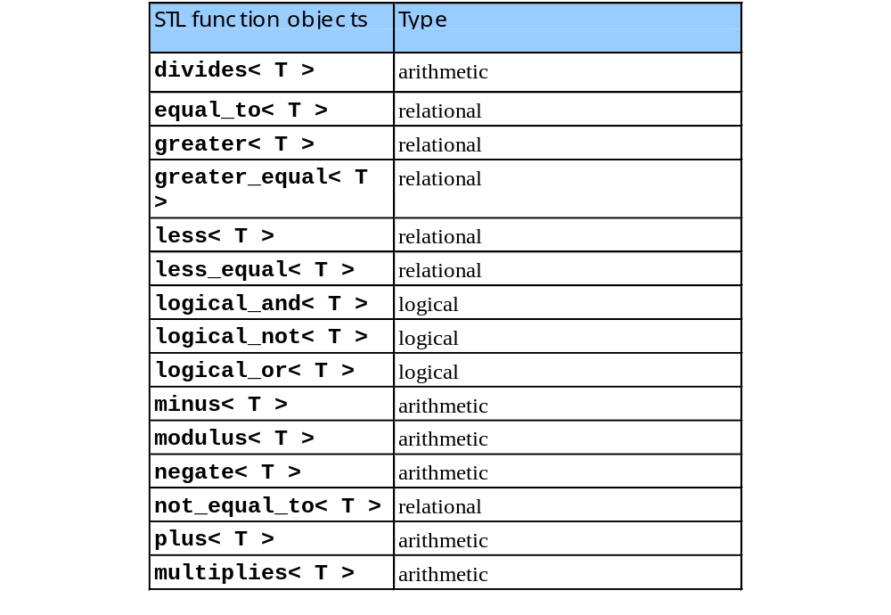
20.7 Function Objects
function objects- contain functions invoked off the object using operator()
  header <functional>

