Slide 1
Threads, SMP, and Microkernels
Chapter 4

Slide 2
Process
Resource ownership - process is allocated a virtual address space to hold the process image
Scheduling/execution- follows an execution path that may be interleaved with other processes
These two characteristics are treated independently by the operating system

Slide 3
Process
Dispatching is referred to as a thread
Resource of ownership is referred to as a process or task

Slide 4
Multithreading
Operating system supports multiple threads of execution within a single process
MS-DOS supports a single thread
UNIX supports multiple user processes but only supports one thread per process
Windows 2000, Solaris, Linux, Mach, and OS/2 support multiple threads

Slide 5
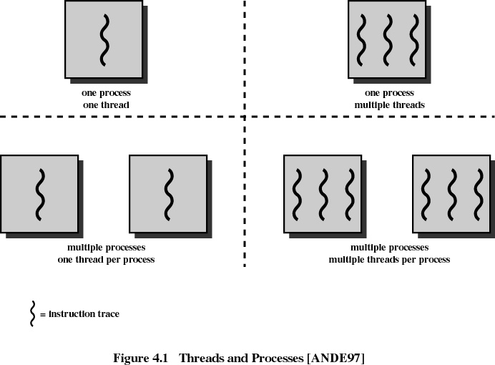

Slide 6
Process
Have a virtual address space which holds the process image
Protected access to processors, other processes, files, and I/O resources

Slide 7
Thread
An execution state (running, ready, etc.)
Saved thread context when not running
Has an execution stack
Some per-thread static storage for local variables
Access to the memory and resources of its process
  all threads of a process share this

Slide 8
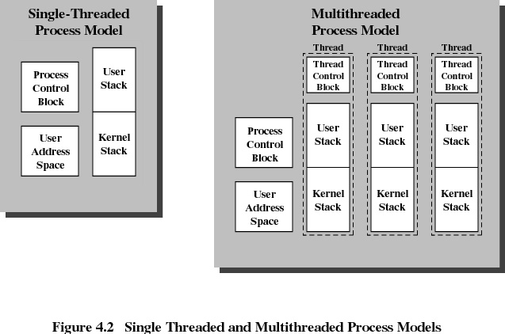

Slide 9
Benefits of Threads
Takes less time to create a new thread than a process
Less time to terminate a thread than a process
Less time to switch between two threads within the same process
Since threads within the same process share memory and files, they can communicate with each other without invoking the kernel

Slide 10
Uses of Threads in a Single-User Multiprocessing System
Foreground to background work
Asynchronous processing
Speed execution
Modular program structure

Slide 11
Threads
Suspending a process involves suspending all threads of the process since all threads share the same address space
Termination of a process, terminates all threads within the process

Slide 12
Thread States
States associated with a change in thread state
  Spawn
    Spawn another thread
  Block
  Unblock
  Finish
    Deallocate register context and stacks

Slide 13
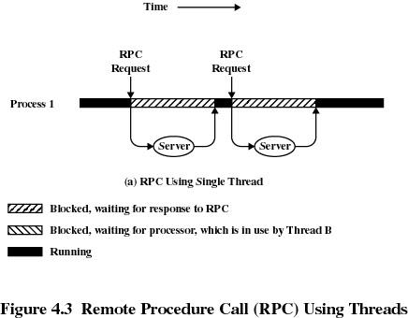
Remote Procedure Call Using Threads

Slide 14
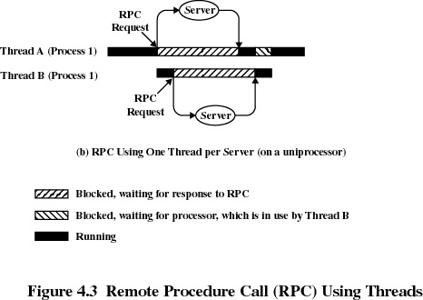
Remote Procedure Call Using Threads

Slide 15
User-Level Threads
All thread management is done by the application
The kernel is not aware of the existence of threads

Slide 16
Kernel-Level Threads
W2K, Linux, and OS/2 are examples of this approach
Kernel maintains context information for the process and the threads
Scheduling is done on a thread basis

Slide 17
Combined Approaches
Example is Solaris
Thread creation done in the user space
Bulk of scheduling and synchronization of threads done in the user space

Slide 18
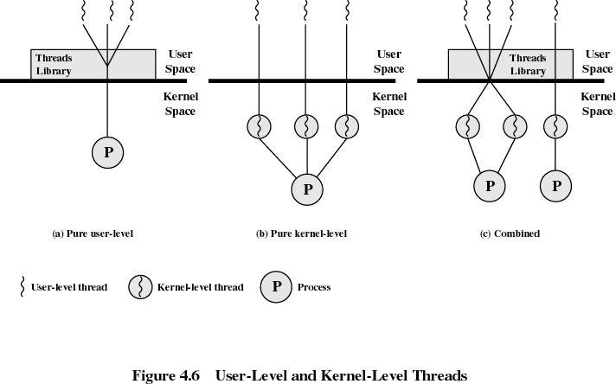

Slide 19
Relationship Between Threads and Processes
Threads:Process
Description
Example Systems
1:1
Each thread of execution is a
unique process with its own
address space and resources.
Traditional UNIX implementations
M:1
A process defines an address
space and dynamic resource
ownership. Multiple threads
may be created and executed
within that process.
Windows NT, Solaris, OS/2,
OS/390, MACH

Slide 20
Relationship Between Threads and Processes
Threads:Process
Description
Example Systems
1:M
A thread may migrate from one
process environment to
another. This allows a thread
to be easily moved among
distinct systems.
Ra (Clouds), Emerald
M:M
Combines attributes of M:1
and 1:M cases
TRIX

Slide 21
Categories of Computer Systems
Single Instruction Single Data (SISD)
  single processor executes a single instruction stream to operate on data stored in a single memory
Single Instruction Multiple Data (SIMD)
  each instruction is executed on a different set of data by the different processors

Slide 22
Categories of Computer Systems
Multiple Instruction Single Data (MISD)
  a sequence of data is transmitted to a set of processors, each of which executes a different instruction sequence. Never implemented
Multiple Instruction Multiple Data (MIMD)
  a set of processors simultaneously execute different instruction sequences on different data sets

Slide 23
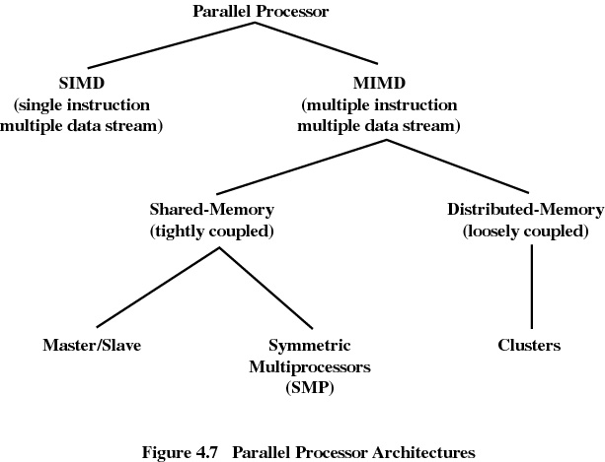

Slide 24
Symmetric Multiprocessing
Kernel can execute on any processor
Typically each processor does self-scheduling form the pool of available process or threads

Slide 25
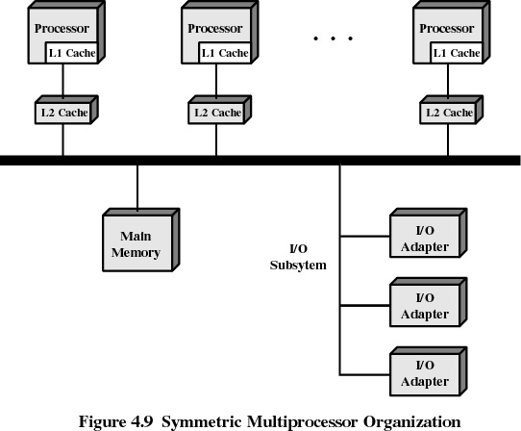

Slide 26
Multiprocessor Operating System Design Considerations
Simultaneous concurrent processes or threads
Scheduling
Synchronization
Memory Management
Reliability and Fault Tolerance

Slide 27
Microkernels
Small operating system core
Contains only essential operating systems functions
Many services traditionally included in the operating system are now external subsystems
  device drivers
  file systems
  virtual memory manager
  windowing system
  security services

Slide 28
Benefits of a Microkernel Organization
Uniform interface on request made by a process
  All services are provided by means of message passing
Extensibility
  Allows the addition of new services
Flexibility
  New features added
  Existing features can be subtracted

Slide 29
Benefits of a Microkernel Organization
Portability
  Changes needed to port the system to a new processor is changed in the microkernel - not in the other services
Reliability
  Modular design
  Small microkernel can be rigorously tested

Slide 30
Benefits of Microkernel Organization
Distributed system support
  Message are sent without knowing what the target machine is
Object-oriented operating system
  Components are objects with clearly defined interfaces that can be interconnected to form software

Slide 31
Microkernel Design
Low-level memory management
  mapping each virtual page to a physical page frame
Inter-process communication
I/O and interrupt management

Slide 32
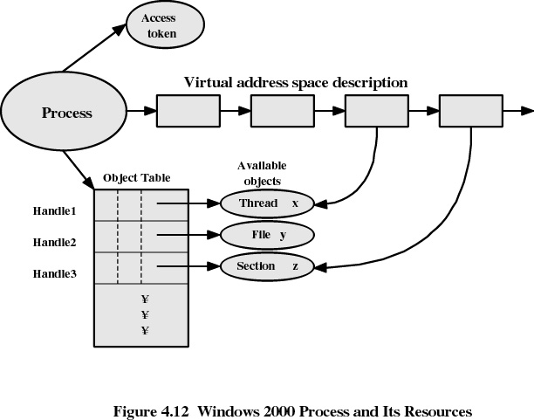

Slide 33
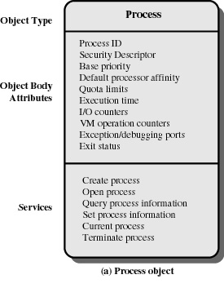
Windows 2000
Process Object

Slide 34
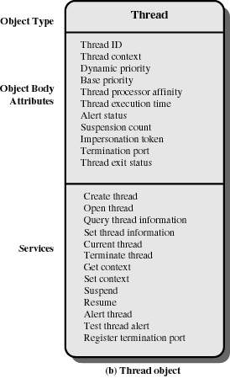
Windows 2000
Thread Object

Slide 35
Windows 2000
Thread States
Ready
Standby
Running
Waiting
Transition
Terminated

Slide 36
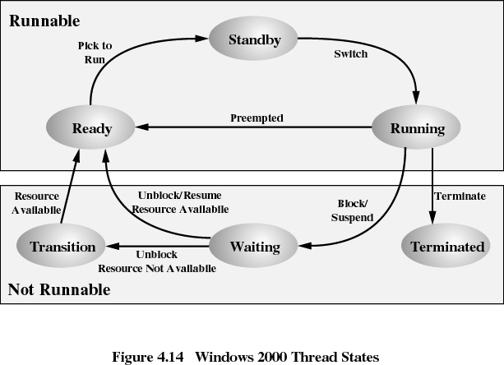

Slide 37
Solaris
Process includes the user’s address space, stack, and process control block
User-level threads
Lightweight processes
Kernel threads

Slide 38
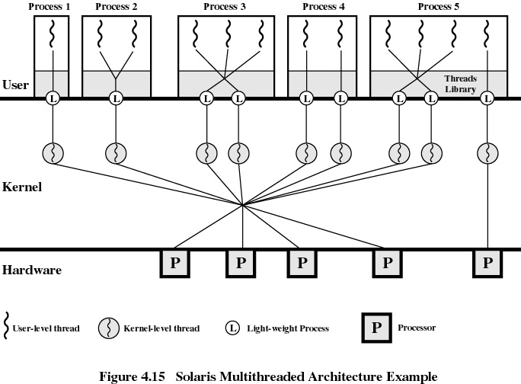

Slide 39
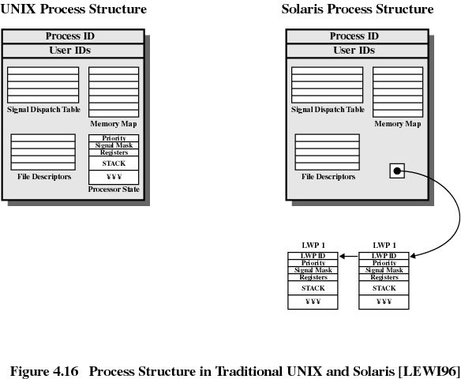

Slide 40
Solaris Thread Execution
Synchronization
Suspension
Preemption
Yielding

Slide 41
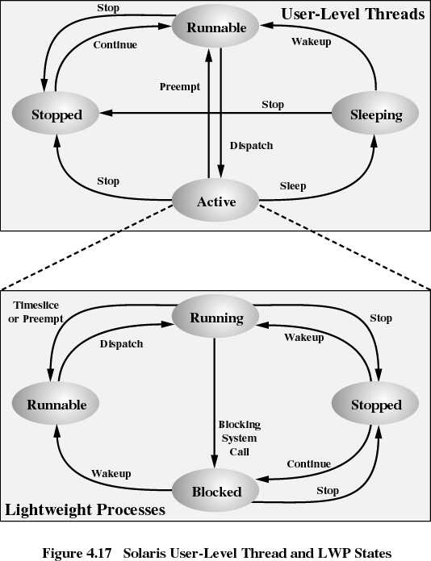

Slide 42
Linux Process
State
Scheduling information
Identifiers
Interprocess communication
Links
Times and timers
File system
Virtual memory
Processor-specific context

Slide 43
Linux States of a Process
Running
Interruptable
Uninterruptable
Stopped
Zombie

Slide 44
