Slide 1
Concurrency: Mutual Exclusion and Synchronization
Chapter 5

Slide 2
Currency
Communication among processes
Sharing resources
Synchronization of multiple processes
Allocation of processor time

Slide 3
Concurrency
Multiple applications
  Multiprogramming
Structured application
  Application can be a set of concurrent processes
Operating-system structure
  Operating system is a set of processes or threads

Slide 4
Difficulties with Concurrency
Sharing global resources
Management of allocation of resources
Programming errors difficult to locate

Slide 5
A Simple Example
void echo()
{
chin = getchar();
chout = chin;
putchar(chout);
}

Slide 6
A Simple Example
Process P1 Process P2
. .
in = getchar(); .
. in = getchar();
chout = chin; chout = chin;
putchar(chout); .
. putchar(chout);
. .

Slide 7
Operating System Concerns
Keep track of active processes
Allocate and deallocate resources
  Processor time
  Memory
  Files
  I/O devices
Protect data and resources
Result of process must be independent of the speed of execution of other concurrent processes

Slide 8
Process Interaction
Processes unaware of each other
Processes indirectly aware of each other
Process directly aware of each other

Slide 9
Competition Among Processes for Resources
Mutual Exclusion
  Critical sections
    Only one program at a time is allowed in its critical section
    Example only one process at a time is allowed to send command to the printer
Deadlock
Starvation

Slide 10
Cooperation Among Processes by Sharing
Writing must be mutually exclusive
Critical sections are used to provide data integrity

Slide 11
Cooperation Among Processes by Communication
Messages are passes
  Mutual exclusion is not a control requirement
Possible to have deadlock
  Each process waiting for a message from the other process
Possible to have starvation
  Two processes sending message to each other while another process waits for a message

Slide 12
Requirements for Mutual Exclusion
Only one process at a time is allowed in the critical section for a resource
A process that halts in its non-critical section must do so without interfering with other processes
No deadlock or starvation

Slide 13
Requirements for Mutual Exclusion
A process must not be delayed access to a critical section when there is no other process using it
No assumptions are made about relative process speeds or number of processes
A process remains inside its critical section for a finite time only

Slide 14
First Attempt
Busy Waiting
  Process is always checking to see if it can enter the critical section
  Process can do nothing productive until it gets permission to enter its critical section

Slide 15
Coroutine
Designed to be able to pass execution control back and forth between themselves
Inadequate to support concurrent processing

Slide 16
Second Attempt
Each process can examine the other’s status but cannot alter it
When a process wants to enter the critical section is checks the other processes first
If no other process is in the critical section, it sets its status for the critical section
This method does not guarantee mutual exclusion
Each process can check the flags and then proceed to enter the critical section at the same time

Slide 17
Third Attempt
Set flag to enter critical section before check other processes
If another process is in the critical section when the flag is set, the process is blocked until the other process releases the critical section
Deadlock is possible when two process set their flags to enter the critical section. Now each process must wait for the other process to release the critical section

Slide 18
Fourth Attempt
A process sets its flag to indicate its desire to enter its critical section but is prepared to reset the flag
Other processes are checked. If they are in the critical region, the flag is reset and later set to indicate desire to enter the critical region. This is repeated until the process can enter the critical region.

Slide 19
Fourth Attempt
It is possible for each process to set their flag, check other processes, and reset their flags. This scenario will not last very long so it is not deadlock. It is undesirable

Slide 20
Correct Solution
Each process gets a turn at the critical section
If a process wants the critical section, it sets its flag and may have to wait for its turn

Slide 21
Mutual Exclusion:
Hardware Support
Interrupt Disabling
  A process runs until it invokes an operating-system service or until it is interrupted
  Disabling interrupts guarantees mutual exclusion
  Processor is limited in its ability to interleave programs
  Multiprocessing
    disabling interrupts on one processor will not guarantee mutual exclusion

Slide 22
Mutual Exclusion:
Hardware Support
Special Machine Instructions
  Performed in a single instruction cycle
  Not subject to interference from other instructions
  Reading and writing
  Reading and testing

Slide 23
Mutual Exclusion:
Hardware Support
Test and Set Instruction
boolean testset (int i) {
if (i == 0) {
i = 1;
return true;
}
else {
return false;
}
}

Slide 24
Mutual Exclusion:
Hardware Support
Exchange Instruction
void exchange(int register, int memory) {
int temp;
temp = memory;
memory = register;
register = temp;
}

Slide 25
Mutual Exclusion Machine Instructions
Advantages
  Applicable to any number of processes on either a single processor or multiple processors sharing main memory
  It is simple and therefore easy to verify
  It can be used to support multiple critical sections

Slide 26
Mutual Exclusion Machine Instructions
Disadvantages
  Busy-waiting consumes processor time
  Starvation is possible when a process leaves a critical section and more than one process is waiting.
  Deadlock
    If a low priority process has the critical region and a higher priority process needs, the higher priority process will obtain the processor to wait for the critical region

Slide 27
Semaphores
Special variable called a semaphore is used for signaling
If a process is waiting for a signal, it is suspended until that signal is sent
Wait and signal operations cannot be interrupted
Queue is used to hold processes waiting on the semaphore

Slide 28
Semaphores
Semaphore is a variable that has an integer value
  May be initialized to a nonnegative number
  Wait operation decrements the semaphore value
  Signal operation increments semaphore value

Slide 29
Producer/Consumer Problem
One or more producers are generating data and placing these in a buffer
A single consumer is taking items out of the buffer one at time
Only one producer or consumer may access the buffer at any one time

Slide 30
Producer
producer:
while (true) {
/* produce item v */
b[in] = v;
in++;
}

Slide 31
Consumer
consumer:
while (true) {
while (in <= out)
/*do nothing */;
w = b[out];
out++;
/* consume item w */
}

Slide 32
Producer with Circular Buffer
producer:
while (true) {
/* produce item v */
while ((in + 1) % n == out) /* do nothing */;
b[in] = v;
in = (in + 1) % n
}

Slide 33
Consumer with Circular Buffer
consumer:
while (true) {
while (in == out)
/* do nothing */;
w = b[out];
out = (out + 1) % n;
/* consume item w */
}

Slide 34
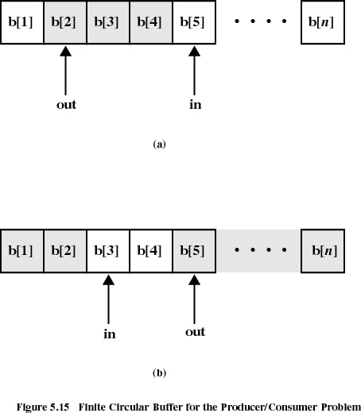

Slide 35
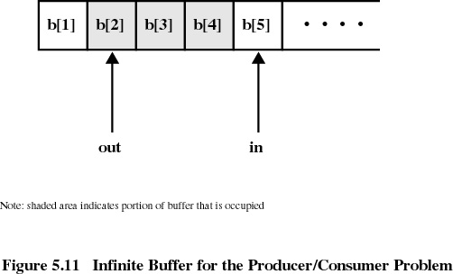
Infinite Buffer

Slide 36
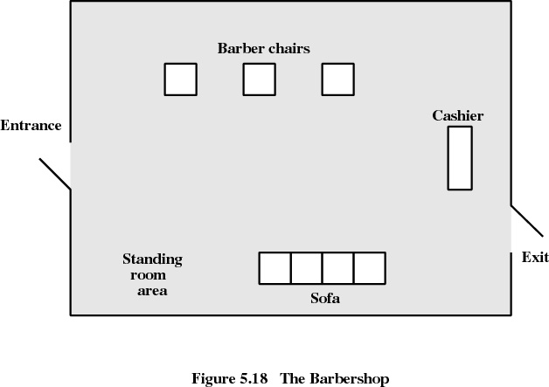
Barbershop Problem

Slide 37
Monitors
Monitor is a software module
Chief characteristics
  Local data variables are accessible only by the monitor
  Process enters monitor by invoking one of its procedures
  Only one process may be executing in the monitor at a time

Slide 38
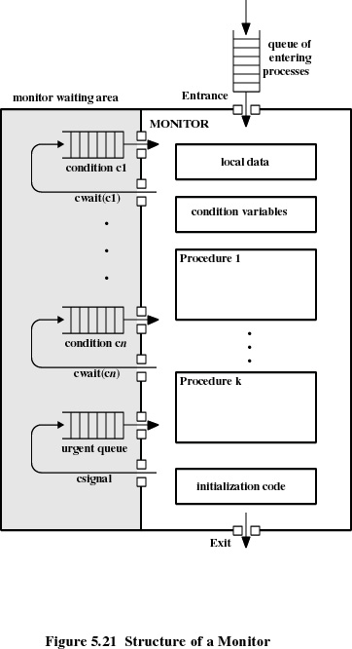

Slide 39
Message Passing
Enforce mutual exclusion
Exchange information
send (destination, message)
receive (source, message)

Slide 40
Synchronization
Sender and receiver may or may not be blocking (waiting for message)
Blocking send, blocking receive
  Both sender and receiver are blocked until message is delivered
  Called a rendezvous

Slide 41
Synchronization
Nonblocking send, blocking receive
  Sender continues processing such as sending messages as quickly as possible
  Receiver is blocked until the requested message arrives
Nonblocking send, nonblocking receive
  Neither party is required to wait

Slide 42
Addressing
Direct addressing
  send primitive includes a specific identifier of the destination process
  receive primitive could know ahead of time which process a message is expected
  receive primitive could use source parameter to return a value when the receive operation has been performed

Slide 43
Addressing
Indirect addressing
  messages are sent to a shared data structure consisting of queues
  queues are called mailboxes
  one process sends a message to the mailbox and the other process picks up the message from the mailbox

Slide 44
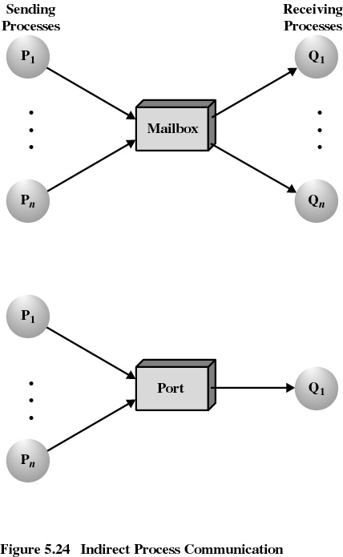

Slide 45
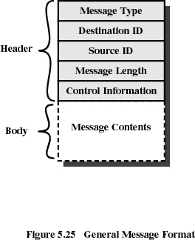
Message Format

Slide 46
Readers/Writers Problem
Any number of readers may simultaneously read the file
Only one writer at a time may write to the file
If a writer is writing to the file, no reader may read it

